Slide 2
An absorbent material is…
a material which can soak up liquid.

Slide 3
Waterproof
What does waterproof mean?
If a material is waterproof it keeps water out.
Why do we need waterproof materials?
To keep us dry! Our raincoats are waterproof to stop the rain from making our clothes wet. Boots are waterproof so that we can walk through puddles without our socks getting wet.
What materials are waterproof?
Let’s investigate and find out.

Slide 4
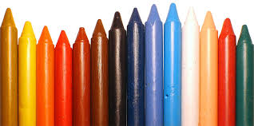
Our Experiment
Choose a material.
Drop water onto it using a pipette. Keep the droplets on one side of the material.
Watch the droplets. Do they get absorbed in the material or do the droplets sit on top?
Rub wax (a wax crayon) on to the dry side of the fabric.
Drop water onto the waxy side.
Watch the droplets carefully. What do they do? Is it different to the side with no wax?

