Slide 2
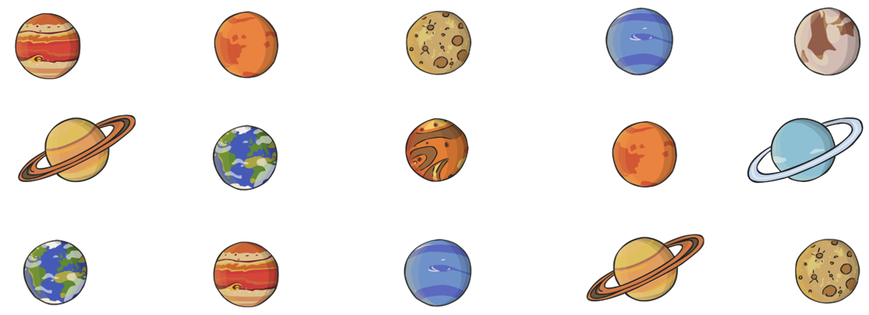
What Is an Array?
When pictures or objects are put into columns and rows, it is called an array. They can help us to count objects more efficiently.
3 × 5 = 15
?

Slide 3
How Many Stars Are There?
Remember: You don’t need to count every star.
For this one you could count in 5s!
5 × 5 = 25
?

Slide 4
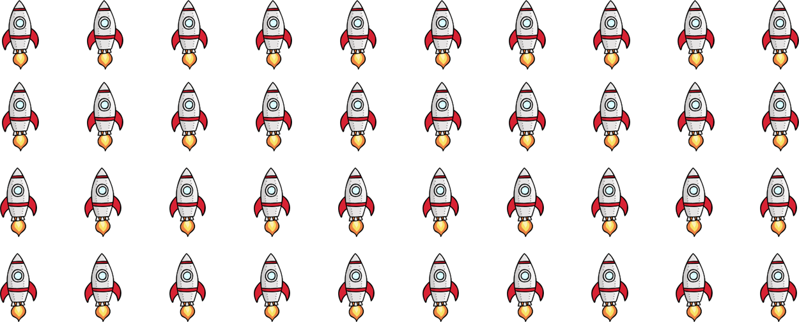
How Many Rockets Are There?
Remember: You don’t need to count every rocket.
For this one you could count in 10s!
4 × 10 = 40
?

Slide 5
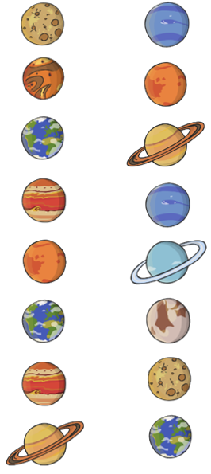
How Many Planets Are There?
How many columns are there?
How many planets in each column?
2
8
2 × 8 = 16
?

Slide 6
Can You Use an Array to Answer This Question?
There are 5 astronauts in the spaceship. They each had 4 books.
How many books were on board the spaceship altogether?
It doesn’t matter which way around you make the array –
the answer is the same!

Slide 7
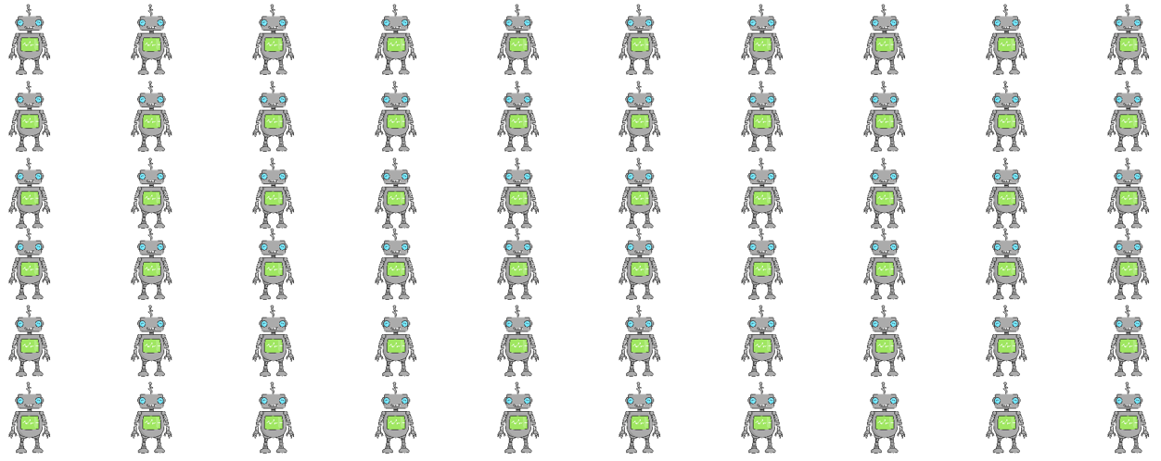
Can You Use an Array to Answer This Question?
There are 10 aliens on Planet Zarg. Each alien has 6 robots.
How many robots are there altogether?
6 × 10 = 60
or
10 × 6 = 60
?
?

Slide 8
Can You Use an Array to Answer This Question?
There are 2 astronauts on board the International Space Station (ISS) every month. How many astronauts will have been on the ISS after 6 months?
6 × 2 = 12
or
2 × 6 = 12
?
?

