Slide 1


Slide 3


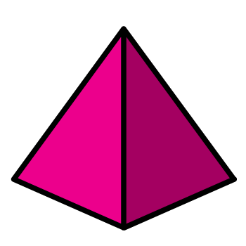
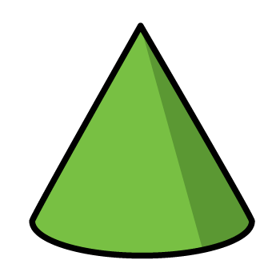
Which one of these is the odd one out?
Notes:
Only one than can roll in any direction
Only one which if cut part way up the faces would remain the same size
Only one that doesn’t roll
Only shape to have one circular face

Slide 4
Which one of these is the odd one out?
Notes:
Only one than can roll in any direction
Only one which if cut part way up the faces would remain the same size
Only one that doesn’t roll
Only shape to have one circular face

Slide 6


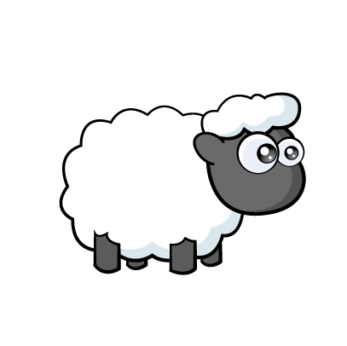

Who is correct?
This shape has 3 vertices
No, this shape has 3 sides
Have a think

Slide 7
My shape has 5 vertices
And 5 sides
Have a think

Slide 8
My shape has 4 vertices
And 5 sides
Notes:
Of course you could buy any item on their own

Slide 9
My shape has 5 vertices
And 5 sides
Notes:
Of course you could buy any item on their own

Slide 10
When working with 2D shapes are the number of sides and vertices always equal?
I’m not sure.
Have a think

Slide 11
A triangle has 3 sides and 3 vertices.
A square has 4 sides and 4 vertices.
A rectangle has 4 sides and 4 vertices.
A pentagon has 5 sides and 5 vertices.
A hexagon has 6 sides and 6 vertices.
Have a think

Slide 12
My shape has 5 vertices
But it has 10 sides
Have a think

Slide 13
My shape has 10 vertices
And it has 10 sides

Slide 14
Have a go at the questions on the worksheet

