Slide 3
What does the number line with orange blocks show?
What is the same about the two number lines?
What is different about the two number lines?
0
1
2
0
3
1
4
2
5
3
6
4
7
5
8
6
9
7
10
8
9
10
0
1
2
3
4
5
6
7
8
9
10

Slide 4
What does the number line with orange blocks show?
What is the same about the two number lines?
What is different about the two number lines?
4
Both ascend in 1s
Both show 4
The colour of the cubes
One is vertical and one is horizontal
0
1
2
0
3
1
4
2
5
3
6
4
7
5
8
6
9
7
10
8
9
10
0
1
2
3
4
5
6
7
8
9
10

Slide 6
Key $=$ 1 cube
Colour | Cubes
Green
Yellow
Red
Let’s make real towers using cubes

Slide 7
Key $=$ 1 cube

Slide 8
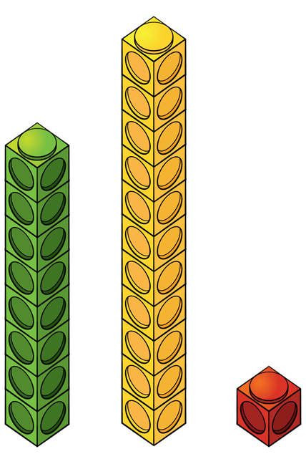
11
10
9
8
7
6
5
4
3
2
1
Green
Red
Yellow
Notes:
Instead of a key we have a scale

Slide 9
Have a go at questions 1 and 2 on the worksheet

Slide 11
Rosie and Teddy
Colour | Balloons
Red
Green
Key $=$ 10 balloons
20
15
10
5
0
Red
Green

Slide 12
Rosie and Teddy
Colour | Balloons
Red
Green
Key $=$ 10 balloons
Have a think
20
15
10
5
0
Red
Green

Slide 13
Have a go at question 3 on the worksheet

