Slide 3
Week 1
Annie
Eva
Ron
Mo
Week 2
Annie
Eva
Ron
Mo
Key $=$ 1 piece of fruit
Who ate the most pieces of fruit in week 1?
Who ate the least fruit overall?
What was the difference in amount of fruit between week 1 and week 2 for Ron?
Did Ron have the biggest difference?

Slide 4
Week 1
Annie
Eva
Ron
Mo
Week 2
Annie
Eva
Ron
Mo
Key $=$ 1 piece of fruit
Who ate the most pieces of fruit in week 1?
Who ate the least fruit overall?
What was the difference in amount of fruit between week 1 and week 2 for Ron?
Did Ron have the biggest difference?
Mo
Ron
0
No, Annie had a difference of 5

Slide 6
Have a go at question 1 on the worksheet

Slide 7
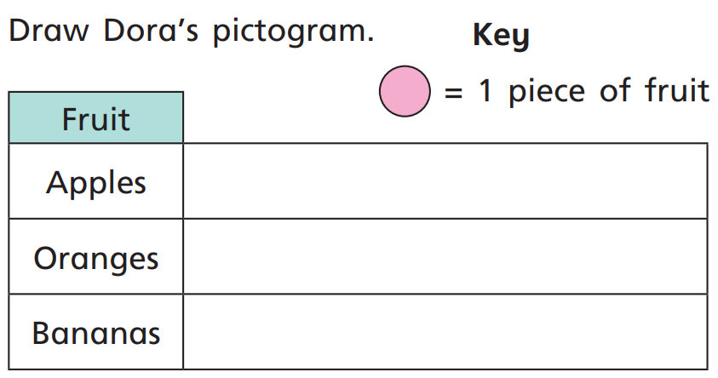
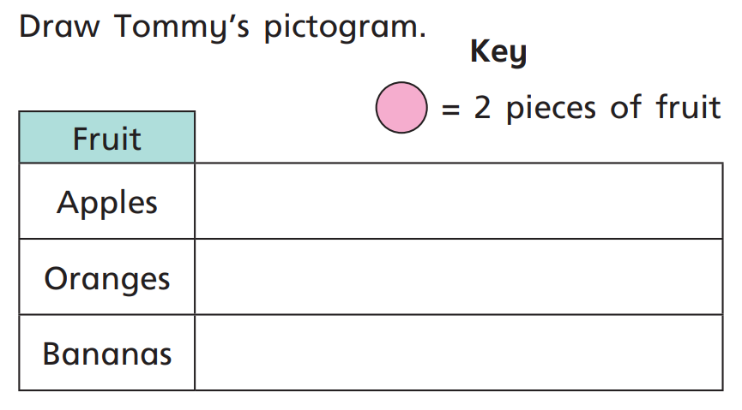

Slide 8
?
10
Key $=$ __ relatives called
Relatives
Grandmas
Uncles
Cousins
And twice as many uncles as grandmas!
We’ve called 20 grandmas!
The whole class have been video calling our relatives
But five fewer cousins than uncles

Slide 9
10
Key $=$ __ relatives called
Relatives
Grandmas
Uncles
Cousins
Have a think
10
5
Key $=$__ relatives called
Relatives
Grandmas
Uncles
Cousins
Notes:
What do you notice about the two pictographs?

Slide 10
Have a go at question 2 on the worksheet

Slide 11
Day | Minutes spent reading
Monday | 20
Tuesday | 25
Wednesday | 10
Thursday | 15
Friday | 30
Saturday | 55
Sunday | 45
10
Have a
think
Key = ________ minutes
5
Key = ________ minutes

Slide 12
Key $=$ 10 minutes
Monday
Tuesday
Wednesday
Thursday
Friday
Saturday
Sunday
Have a think
On which day did Alex read the most and by how much?
Saturday, by 10 minutes

Slide 13
Have a go at question 3 on the worksheet

