Slide 3
If asked to ‘find the difference’, which representation would help you?
a) b)
If asked, ‘how many more…’, which representation would help you?
a) b)

Slide 4
If asked to ‘find the difference’, which representation would help you?
a) b)
If asked, ‘how many more…’, which representation would help you?
a) b)

Slide 6
Day | Dogs seen
Monday
Tuesday
Wednesday
Thursday
Friday
Key $=$ 1 dog
How many dogs were seen on Wednesday?
_____ dogs
3
How many dogs were seen on Thursday?
_____ dogs
2
Have a think

Slide 7
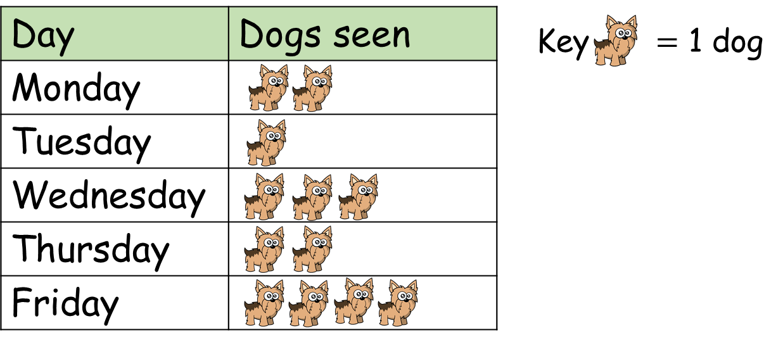
On which day were the fewest dogs seen?
Tuesday, only 1 dog.

Slide 8
How many more dogs were seen on Wednesday
than Tuesday?
I know an easier way to compare.
I will subtract to find the difference.

Slide 9
How many more dogs were seen on Wednesday
than Tuesday?
Tuesday
Wednesday
Key $=$ 1 dog
3 dogs were seen on Wednesday.
1 dog was seen on Tuesday.
3 $−$ 1 $=$ 2
2 more dogs were seen on Wednesday than Tuesday.
I can use the pictogram to compare.
I can see there are 2 more dogs on Wednesday.

Slide 10
Player | Goals scored
Alex
Jack
Mo
Rosie
Whitney
Key $=$ 1 goal
I scored 6. That’s the most goals!
Jack scored 1 goal.
What do you notice?
19 goals were scored altogether.
Mo scored 2 more goals than Whitney.
Have a think

Slide 11
Game 1
Key $=$ 1 point
Game 2
Player | Points scored
Ron
Amir
Player | Points scored
Ron
Amir
How many points did Ron score overall?
Who scored the most points overall?
In which game were most points scored?
6 points
Amir
Game 1
Have a think

Slide 12
Have a go at the questions on the worksheet

