Slide 3
How many does each tally represent?
a) b)
Draw tallies to show
a) 7 b) 11
3) Complete the tally chart.
Button Colour | Tally | Total
pink
blue
green

Slide 4
How many does each tally represent?
a) b)
Draw tallies to show
a) 7 b) 11
3) Complete the tally chart.
9
22
Button Colour | Tally | Total
pink
blue
green
3
6
4

Slide 6
Key $=$ 1 shape
Shape
Square
Triangle
Decagon
Trapezium

Slide 7
Have a go at questions 1 and 2 on the worksheet

Slide 8
Day | Minutes spent reading
Monday | 3
Tuesday | 10
Wednesday | 8
Key $=$ 1 minute reading
Day
Monday
Tuesday
Wednesday
Have a think

Slide 9
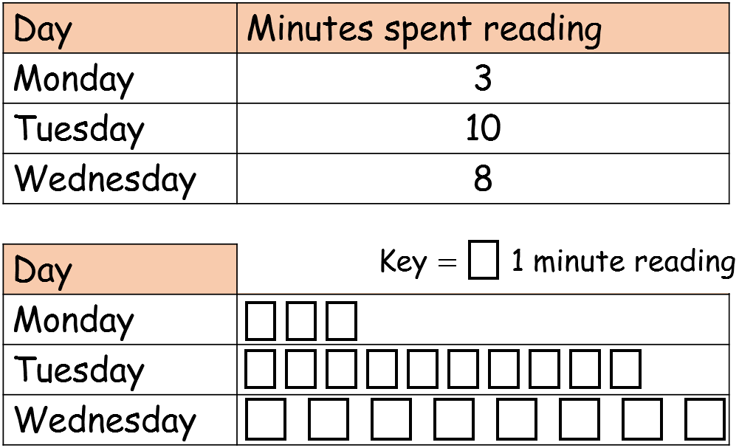
Key $=$ 1 minute reading
Day
Monday
Tuesday
Wednesday

Slide 10
Have a go at question 3 on the worksheet

Slide 11
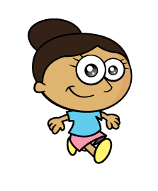
Key $=$ 1 relative called
Relatives
Grandmas
Uncles
Cousins
And twice as many uncles as grandmas!
We’ve called 5 grandmas!
We’ve been video calling our relatives
But one less cousin than uncles

Slide 12
Have a go at question 4 on the worksheet

