Slide 1


Slide 3

How many is represented here?
1)
2)
3)

Slide 4
How many is represented here?
1)
2)
3)
20
20
7

Slide 5
Have a go at questions
1, 2 and 3 on the worksheet

Slide 7
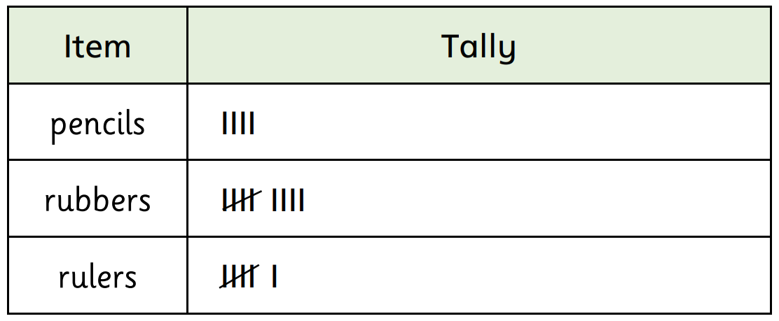



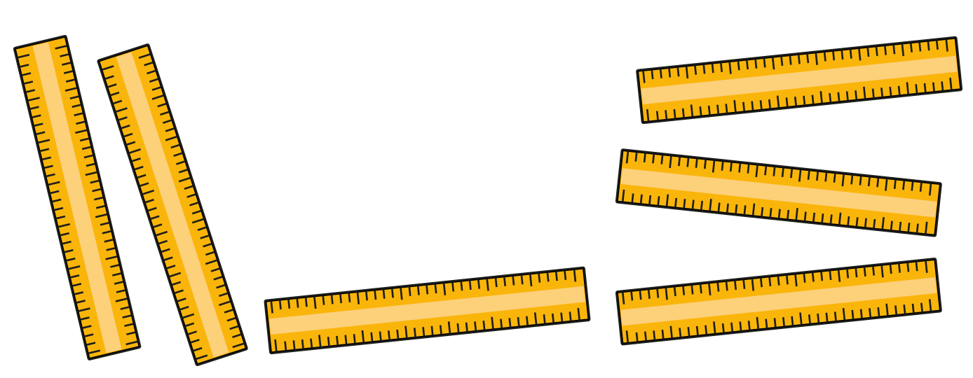
Have a
think

Slide 8
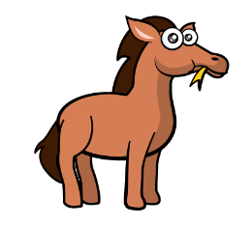
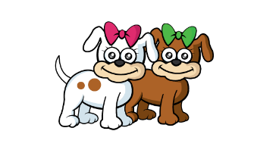
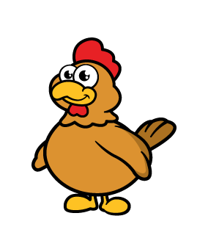

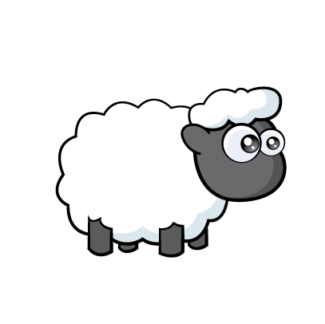
Animals | Tally | Total
Horses
Dogs
Chickens
Frogs
Sheep
1
2
7
4
9

Slide 9
Have a go at question
4 on the worksheet

Slide 10
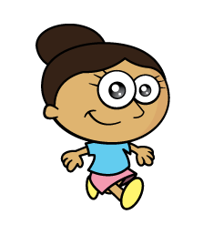



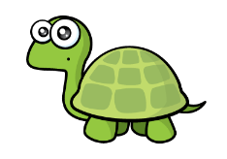
Have a think

Slide 11
Have a go at questions
5 and 6 on the worksheet

