Slide 1


Slide 3

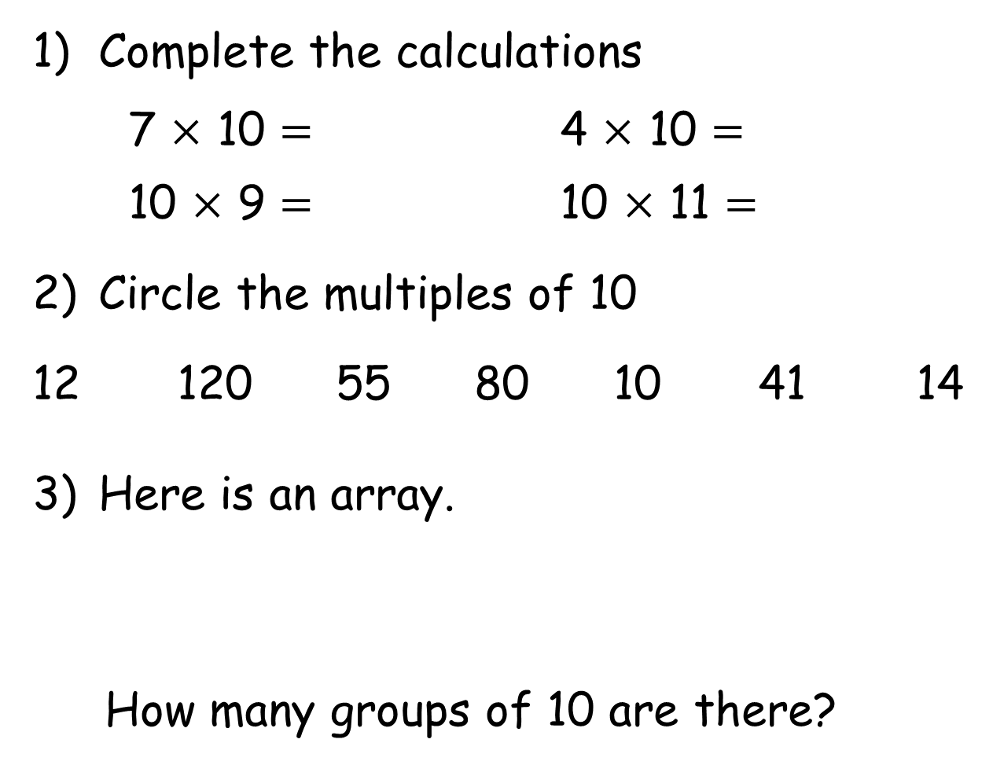
Complete the calculations
7 $×$ 10 $=$ 4 $×$ 10 $=$
10 $×$ 9 $=$ 10 $×$ 11 $=$
Circle the multiples of 10
12 120 55 80 10 41 14
Here is an array.
How many groups of 10 are there?

Slide 4
Complete the calculations
7 $×$ 10 $=$ 4 $×$ 10 $=$
10 $×$ 9 $=$ 10 $×$ 11 $=$
Circle the multiples of 10
12 120 55 80 10 41 14
Here is an array.
How many groups of 10 are there?
70
40
90
110

Slide 6




Here are 20 flowers.
We can share the flowers between 10 pots.
We can group the flowers into pots of 10
Have a
think

Slide 7

Here are 20 flowers.
The flowers are shared equally between 10 pots.
There are 2 flowers in each pot.
20 $÷$ 10 $=$ 2

Slide 8

Here are 20 flowers.
The flowers are grouped into pots of 10
There are 2 pots of 10
20 $÷$ 10 $=$ 2

Slide 9

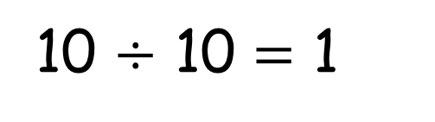
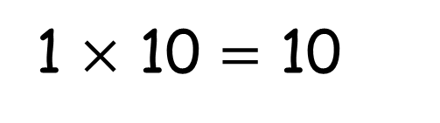
1 $×$ 10 $=$ 10
10 $÷$ 10 $=$ 1

Slide 10
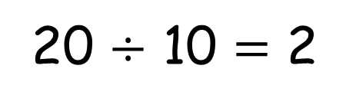
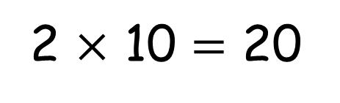
2 $×$ 10 $=$ 20
20 $÷$ 10 $=$ 2

Slide 11
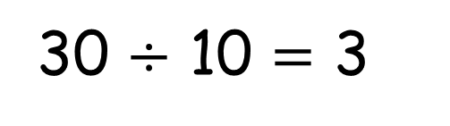
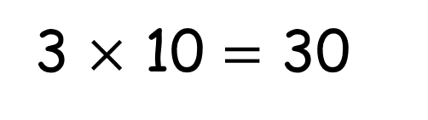
3 $×$ 10 $=$ 30
30 $÷$ 10 $=$ 3

Slide 12
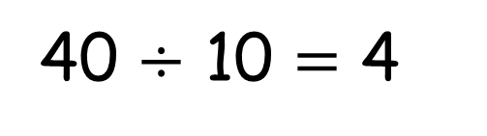
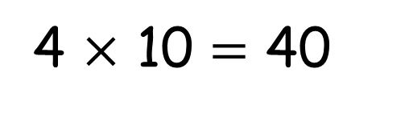
4 $×$ 10 $=$ 40
40 $÷$ 10 $=$ 4

Slide 13
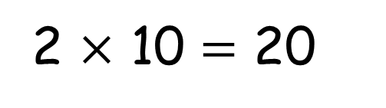
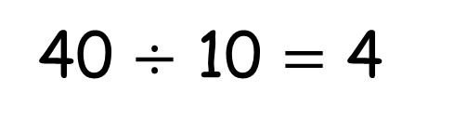
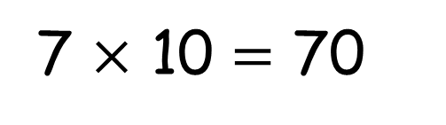
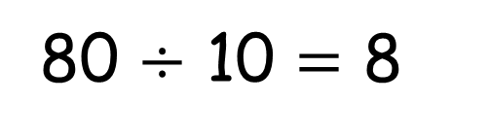
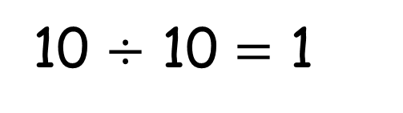
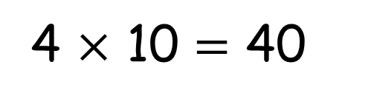
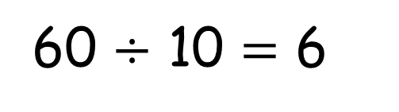
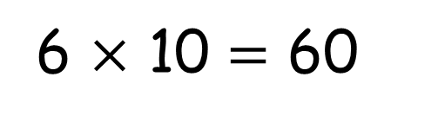
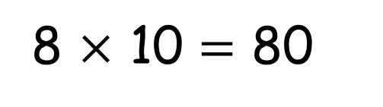
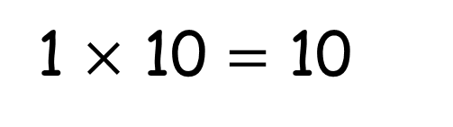
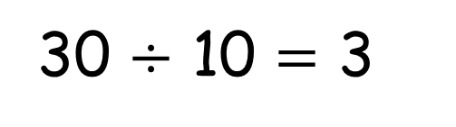
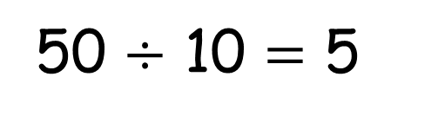
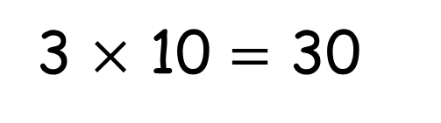
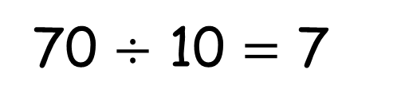
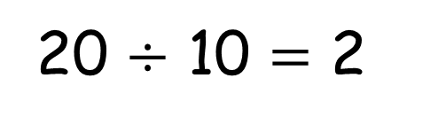
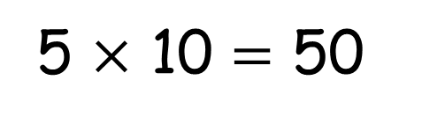
1 $×$ 10 $=$ 10
10 $÷$ 10 $=$ 1
2 $×$ 10 $=$ 20
20 $÷$ 10 $=$ 2
3 $×$ 10 $=$ 30
30 $÷$ 10 $=$ 3
4 $×$ 10 $=$ 40
40 $÷$ 10 $=$ 4
5 $×$ 10 $=$ 50
50 $÷$ 10 $=$ 5
6 $×$ 10 $=$ 60
60 $÷$ 10 $=$ 6
7 $×$ 10 $=$ 70
70 $÷$ 10 $=$ 7
8 $×$ 10 $=$ 80
80 $÷$ 10 $=$ 8
Have a think

Slide 14
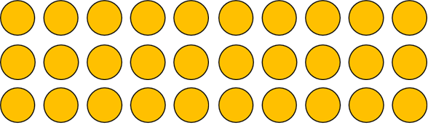


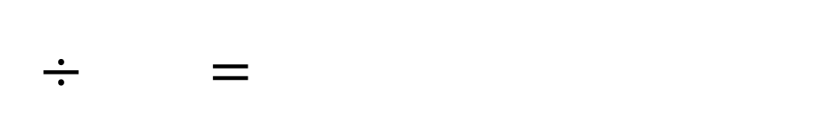
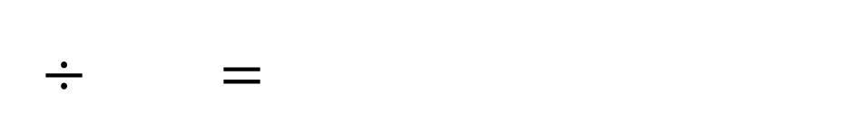
Use the array to complete the calculations
$×$ $=$
$÷$ $=$
3
10
30
30
10
3
$×$ $=$
$÷$ $=$
10
3
30
30
3
10

Slide 15
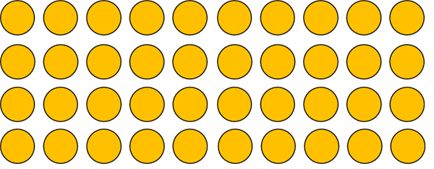
Use the array to complete the calculations
Have a
think
$×$ $=$
$÷$ $=$
4
10
40
40
10
4
$×$ $=$
$÷$ $=$
10
4
40
40
4
10

Slide 16

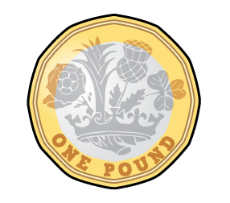



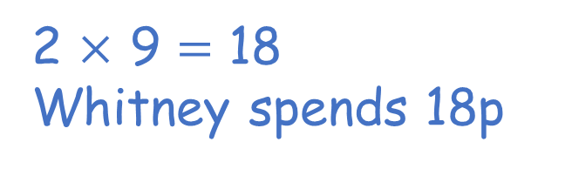
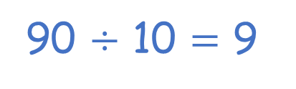
Alex buys 10 rolls.
Have a think
She pays with a £1 coin and gets 10p change.
10 rolls cost 90p
Each roll costs 9p
Whitney buys 2 rolls.
How much does Whitney spend?
90 $÷$ 10 $=$ 9
2 $×$ 9 $=$ 18
Whitney spends 18p

Slide 17
Have a go at the questions on the worksheet

