Slide 1


Slide 3
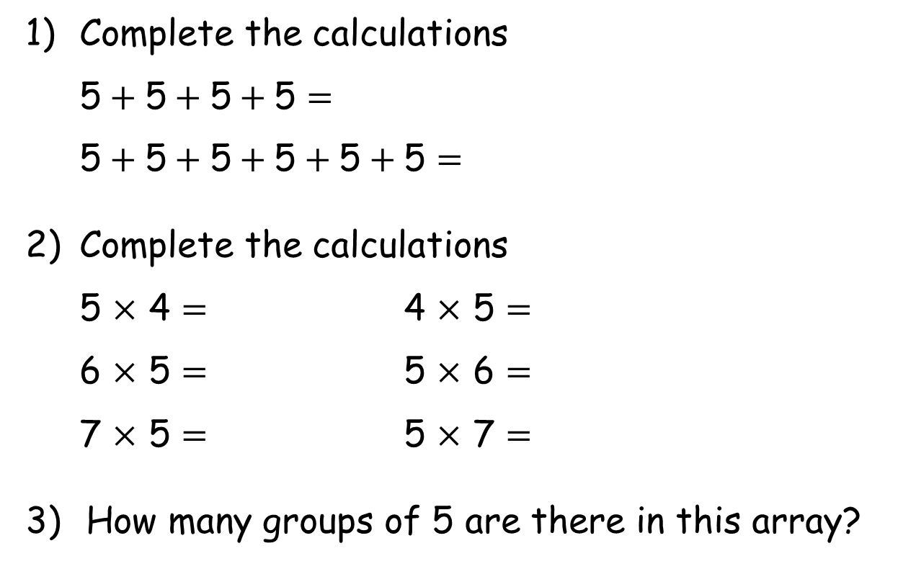
1) Complete the calculations
5$+ \text{5}+\text{5}+\text{5}=$
5$+ \text{5}+\text{5}+\text{5}+\text{5}+\text{5}=$
2) Complete the calculations
5 $×$ 4 $=$ 4 $×$ 5 $=$
6 $×$ 5 $=$ 5 $×$ 6 $=$
7 $×$ 5 $=$ 5 $×$ 7 $=$
How many groups of 5 are there in this array?

Slide 4
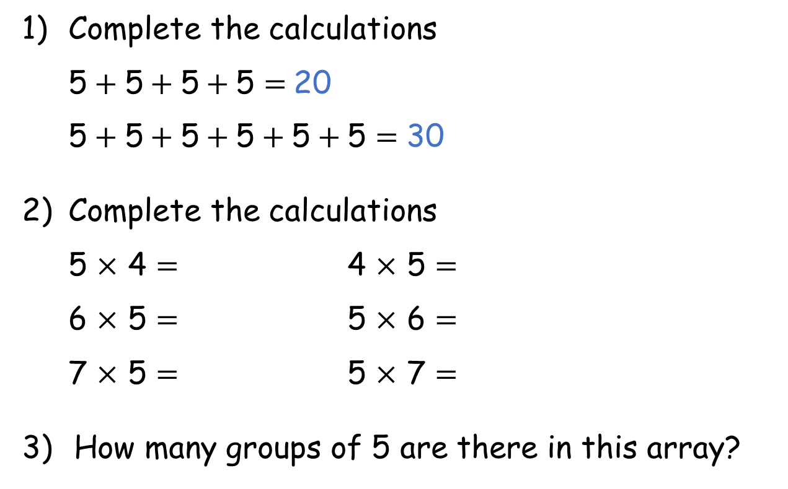
1) Complete the calculations
5$+ \text{5}+\text{5}+\text{5}=$20
5$+ \text{5}+\text{5}+\text{5}+\text{5}+\text{5}=$ 30
2) Complete the calculations
5 $×$ 4 $=$ 4 $×$ 5 $=$
6 $×$ 5 $=$ 5 $×$ 6 $=$
7 $×$ 5 $=$ 5 $×$ 7 $=$
How many groups of 5 are there in this array?
20 20
30 30
35 35
2

Slide 6

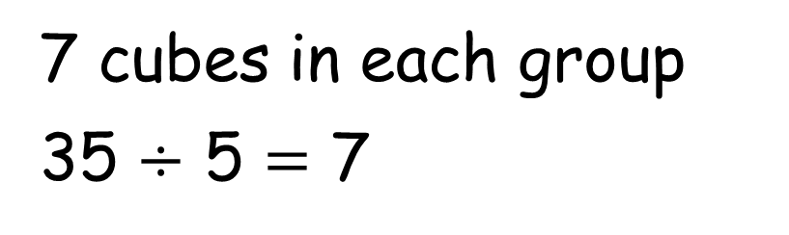
Whitney has 35 cubes.
She shares the cubes into 5 equal groups.
How many will be in each group?
7 cubes in each group
35 $÷$ 5 $=$ 7

Slide 7
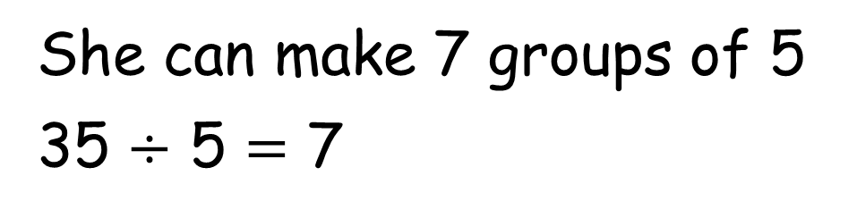
Whitney has 35 cubes.
She groups the cubes into 5s.
How many groups can she make?
She can make 7 groups of 5
35 $÷$ 5 $=$ 7

Slide 8
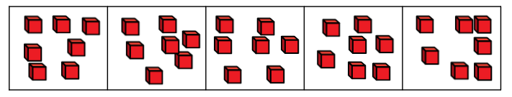
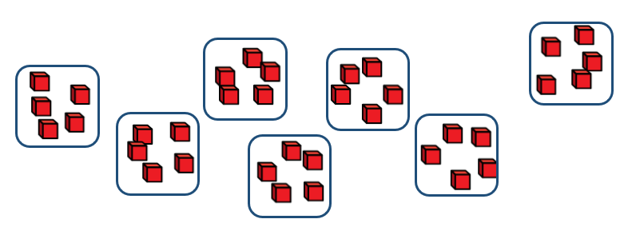
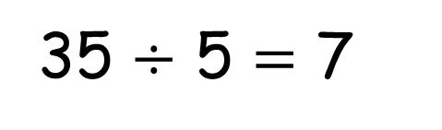
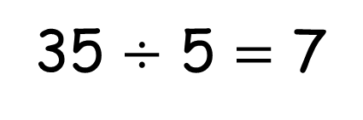
Sharing
There are 7 cubes in each group.
35 $÷$ 5 $=$ 7
Grouping
There are 7 groups of 5
35 $÷$ 5 $=$ 7

Slide 9


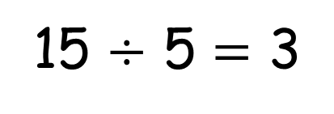
Here are 15 conkers.
The conkers are shared into 5 equal groups.
The conkers are grouped into 5s.
Have a think
15 $÷$ 5 $=$ 3

Slide 10
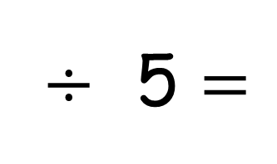
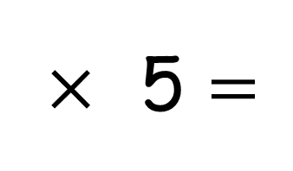
Use the array to complete the calculations
$×$ 5 $=$
6
30
$÷$ 5 $=$
30
6

Slide 11
Have a go at questions
1 - 4 on the worksheet

Slide 12



The farmer has picked 25 apples.
He puts them into bags of 5
How many bags of 5 can he make?
5
10
15
20
25
0
5
10
15
20
25
Have a think

Slide 13
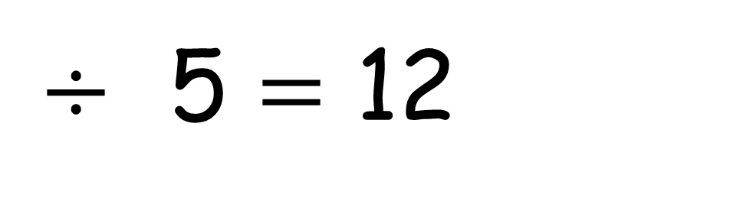
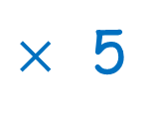
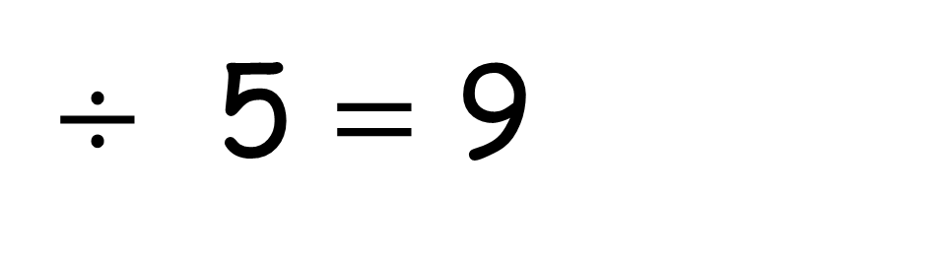
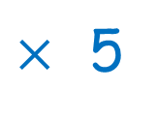
45
$÷$ 5 $=$ 9
$×$ 5
60
$÷$ 5 $=$ 12
$×$ 5
Have a think

Slide 14
Have a go at the rest of the questions on the worksheet

