Slide 1


Slide 3
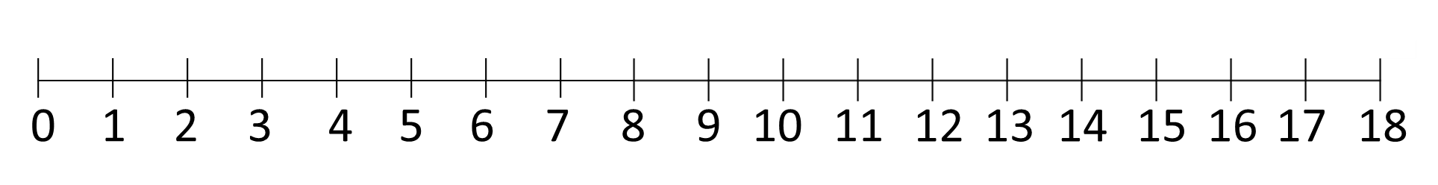
1) Follow the jumps and count along the number line.
2) What do you notice?
3) Follow the jumps and count along the number line.
4) What do you notice this time?

Slide 4
1) Follow the jumps and count along the number line.
2) What do you notice?
3) Follow the jumps and count along the number line.
4) What do you notice this time?

Slide 6










Dora and Teddy are hiding number shapes around the garden.
1 2
3 4
5

Slide 7






Slide 8








The children are playing a game.
They need to get into pairs.
Do we have an odd amount of children or an even amount of children?

Slide 9
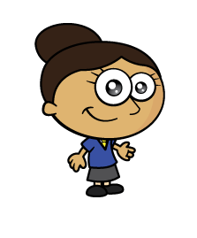
Jack has to go.
The children continue playing.
They need to get into pairs.
Do we have an odd amount of children or an even amount of children?

Slide 10




Here are 5 flowers.
Can the flowers be shared
equally between 2 pots.
Have a think

Slide 11
Here are 5 flowers.
The flowers cannot be shared equally between 2 pots.
5 is an odd number.

Slide 12

Here are 12 flowers.
There are 6 pots of 2
12 $÷$ 2 $=$ 6
The flowers can be shared equally between 2 pots.
12 is an even number.

Slide 13
odd
What if we had 13 flowers?
What if we had 14 flowers?
What if we had 15 flowers?
What if we had 16 flowers?
Have a think
even
odd
even

Slide 14
Have a go at questions
1 - 4 on the worksheet

Slide 15



I know 6 is an even number because I can split 6 cubes into 2 equal groups
I know 10 is an even number but I can’t split this 10 into 2 equal pieces, it’s too tough!

Slide 16
If I add any of these pieces, is my number still even?
So….if 10 is even, then 20 must be even too, and 30 and 40?

Slide 17

Whitney is making a number pattern.
Which numbers greater than 40
could be in the pattern?
Have a think
2, 4, 6, 8, 10, 12, 14, 16, 18,
42, 44, 46, 48, 50...

Slide 18
Have a go at the rest of the questions on the worksheet

