Slide 1


Slide 3
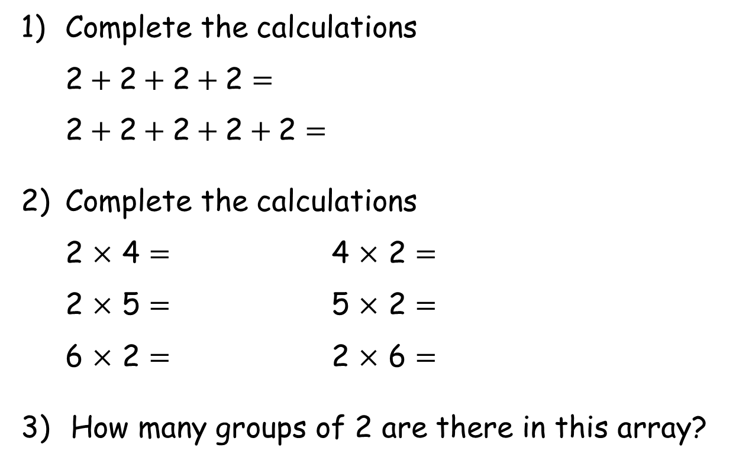
1) Complete the calculations
2$+ \text{2}+\text{2}+\text{2}=$
2$+ \text{2}+\text{2}+\text{2}+\text{2}=$
2) Complete the calculations
2 $×$ 4 $=$ 4 $×$ 2 $=$
2 $×$ 5 $=$ 5 $×$ 2 $=$
6 $×$ 2 $=$ 2 $×$ 6 $=$
How many groups of 2 are there in this array?

Slide 4
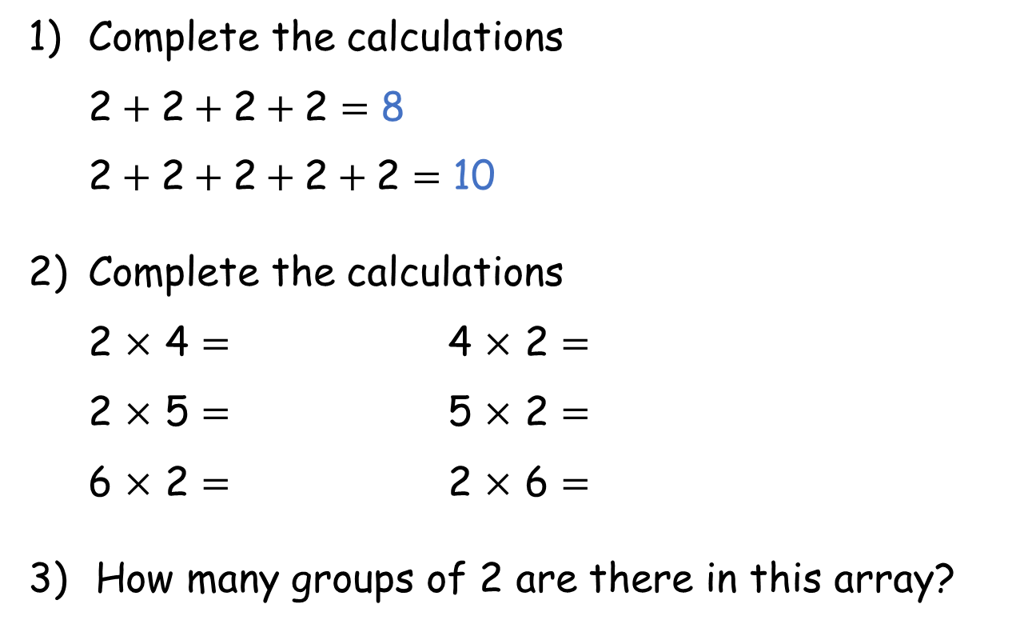
1) Complete the calculations
2$+ \text{2}+\text{2}+\text{2}=$ 8
2$+ \text{2}+\text{2}+\text{2}+\text{2}=$ 10
2) Complete the calculations
2 $×$ 4 $=$ 4 $×$ 2 $=$
2 $×$ 5 $=$ 5 $×$ 2 $=$
6 $×$ 2 $=$ 2 $×$ 6 $=$
How many groups of 2 are there in this array?
8 8
10 10
12 12
5

Slide 6








The children are playing a game.
They need to get into two equal teams.
How many will be in each team?
There will be 4 children in each team.

Slide 7
The children are playing a game.
They need to get into twos.
How many pairs will there be?
There will be 4 pairs of children.

Slide 8
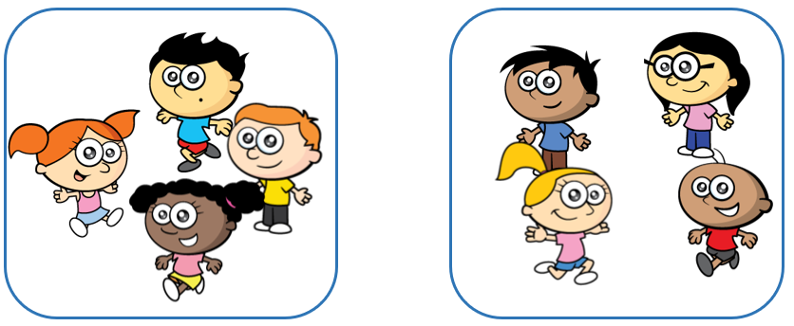
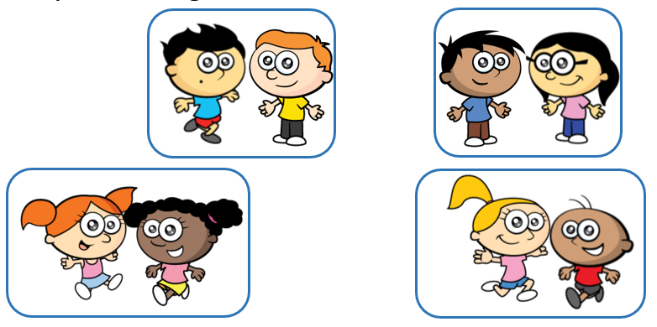
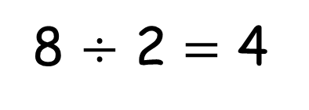
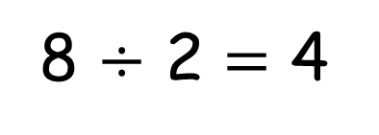
Sharing
There are 4 children in each team.
8 $÷$ 2 $=$ 4
Grouping
There are 4 pairs of children.
8 $÷$ 2 $=$ 4

Slide 9




Here are 12 flowers.
The flowers are shared
equally between 2 pots.
The flowers are grouped
into pots of 2
Have a think

Slide 10

Here are 12 flowers.
There are 6 flowers in each pot.
12 $÷$ 2 $=$ 6
The flowers are shared equally between 2 pots.
How many flowers will be in each pot?

Slide 11

Here are 12 flowers.
There are 6 pots of 2
12 $÷$ 2 $=$ 6
The flowers are grouped into pots of 2
How many pots can we fill?

Slide 12
What if we had 13 flowers?
The flowers are shared
equally between 2 pots.
The flowers are grouped into
pots of 2
Have a think

Slide 13
What if we had 13 flowers?
There are 2 pots of 6 flowers.
There is one flower left over.

Slide 14
What if we had 13 flowers?
There are 6 pots of 2 flowers.
There is one flower left over.

Slide 15
Which groups can be divided by 2 with no flowers left over?
Have a think

Slide 16
Have a go at questions
1 - 3 on the worksheet

Slide 17
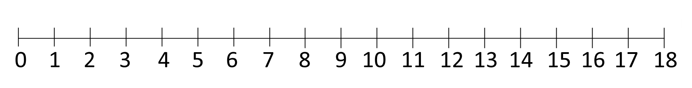
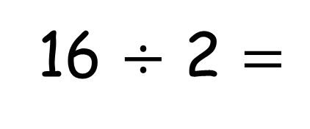
16 $÷$ 2 $=$
8

Slide 18
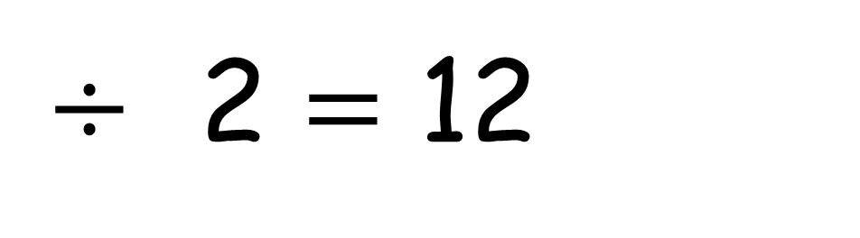
$÷$ 2 $=$ 12

Slide 19
$÷$ 2 $=$ 12

Slide 20
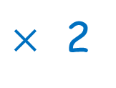
24
$÷$ 2 $=$ 12
$×$ 2

Slide 21
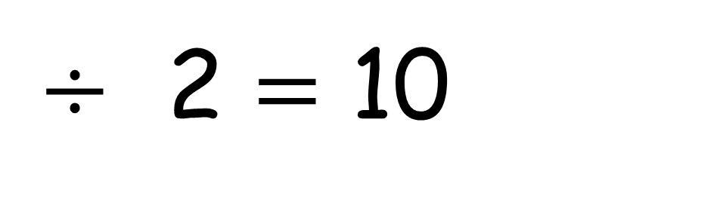
20
$÷$ 2 $=$ 10
$×$ 2

Slide 22
Have a go at the rest of the questions on the worksheet

