Slide 3
If we group 9 apples into groups of 3.
How many groups will we have?
2) If we share 8 flowers between 4 vases.
How many will be in each vase?
Which calculation represents 8 flowers being shared between 4 vases?
8 $÷$ 4 $=$ 2 or 8 $÷$ 2 $=$ 4

Slide 4
If we group 9 apples into groups of 3.
How many groups will we have?
2) If we share 8 flowers between 4 vases.
How many will be in each vase?
Which calculation represents 8 flowers being shared between 4 vases?
8 $÷$ 4 $=$ 2 or 8 $÷$ 2 $=$ 4

Slide 6
10 $÷$ 2
Sharing
10 $÷$ 2 $=$ 5
Grouping
10 $÷$ 2 $=$ 5

Slide 7
6 $÷$ 3
Have a think
Sharing
6 $÷$ 3 $=$ 2
Grouping
6 $÷$ 3 $=$ 2

Slide 8
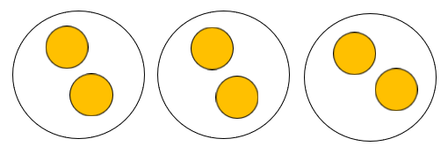
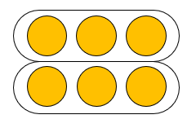
6 $÷$ 3
Sharing
Grouping
6 $÷$ 3 $=$ 2
6 $÷$ 3 $=$ 2
How many groups we are sharing between
How many in each group

Slide 9
6 $÷$ 3
Sharing
Grouping
6 $÷$ 3 $=$ 2
6 $÷$ 3 $=$ 2
How many are in each group
How many groups we can make

Slide 10
How many groups of 10 can you make?
How many groups of 5?
How many groups of 4?
How many groups of 2?
How many groups of 1?
Have a think

Slide 11
2 groups of 10 20 $÷$ 10 $=$ 2

Slide 12
4 groups of 5 20 $÷$ 5 $=$ 4

Slide 13
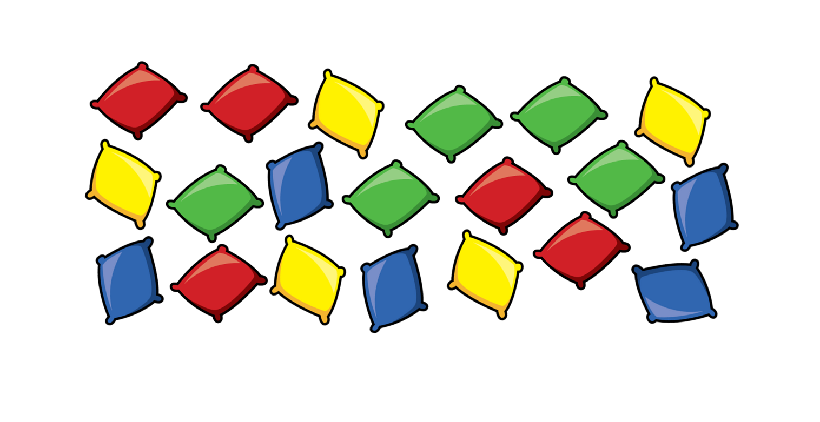
5 groups of 4 20 $÷$ 4 $=$ 5
10 groups of 2 20 $÷$ 2 $=$ 10
20 groups of 1 20 $÷$ 1 $=$ 20

Slide 14
8 $÷$ 2 $=$
4
0 2 4 6 8 10 12 14
4 jumps of 2 are equal to 8

Slide 15
15 $÷$ 5 $=$
3
Have a think
0 5 10 15 20 25 30 35
3 jumps of 5 are equal to 15

Slide 16
60 $÷$ 10 $=$
6
Have a think
0 10 20 30 40 50 60
6 jumps of 10 are equal to 60

Slide 17
18 $÷$ $=$
Have a think
18 jumps of 1 18 $÷$ 1 $=$ 18
9 jumps of 2 18 $÷$ 2 $=$ 9
6 jumps of 3 18 $÷$ 3 $=$ 6
3 jumps of 6 18 $÷$ 6 $=$ 3
2 jumps of 9 18 $÷$ 9 $=$ 2
1 jump of 18 18 $÷$ 18 $=$ 1

Slide 18
30$\text{÷}$1
$=$ 30
30$\text{÷}$5
$=$ 6
30$\text{÷}$2
$=$ 15
30$\text{÷}$6
$=$ 5
30$\text{÷}$3
30$\text{÷}$7
$=$ 10
$=$
30$\text{÷}$4
$=$
Have a think

