Slide 1


Slide 3

1)
2)
3)

Slide 4
1)
2)
3)
5
10
25

Slide 6
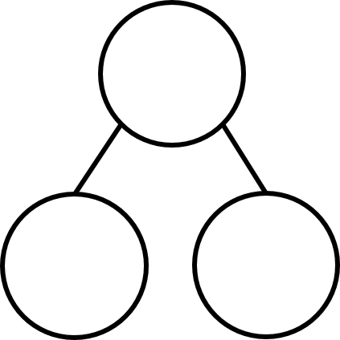



Double is
2
4

Slide 7



6
Double is
3
$+ =$
6
3
3
6
3
3

Slide 8

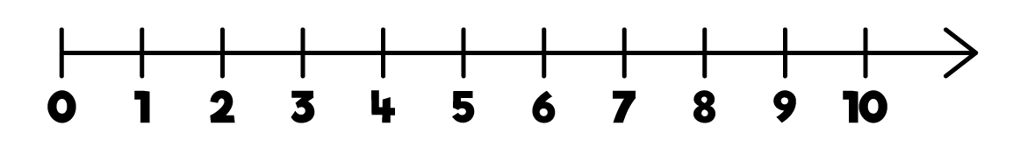

Double is
2
4
$+ =$
2
2
4

Slide 9


Double is
4
8
$+ =$
4
4
8

Slide 10



Have a think
Double is
5
10
$+ =$
10
5
5

Slide 11





Double is
11
22
$+ =$
11
11
22
$$+$$
$$=$$
20
2
22
$+ =$

Slide 12
Have a go at the questions on the worksheet

