Slide 2
Aims
To understand how plastic pollution is affecting our environment.
To know what to do to help.

Slide 3
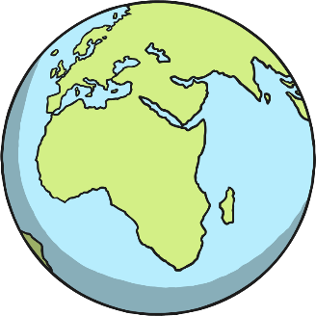
Today We Will Ask..
Why is Plastic Harmful?
What Is Plastic?
What Happens to Plastic Rubbish?
What Can You Do to Help?
What Is Recycling?
What is a Landfill Site?
How Can I Recycle?

Slide 4
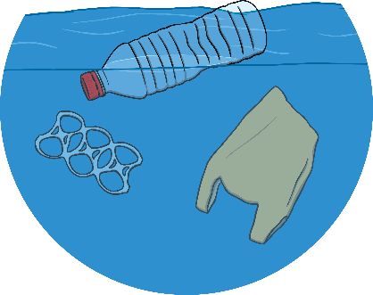
What Is Plastic?
Plastic is a very useful material that we use for many different everyday items because it is cheap to make, strong and doesn’t fall apart easily.
However, these properties also mean it is very harmful to our environment because there is so much of it around, animals get hurt by it and it doesn’t rot down easily in the soil.
Plastic is not natural; it is human-made. It is usually made from fossil fuels, such as crude oil.
Did You Know?
Every second, 160,000
plastic bags are used around the world.

Slide 5
Why is Plastic Harmful?
Worms and tiny creatures in the soil cannot break down plastic like they can natural items such as leaves, banana skins or apple cores.
This means that plastic rubbish stays in the environment for many, many years after it has been used.

Slide 6
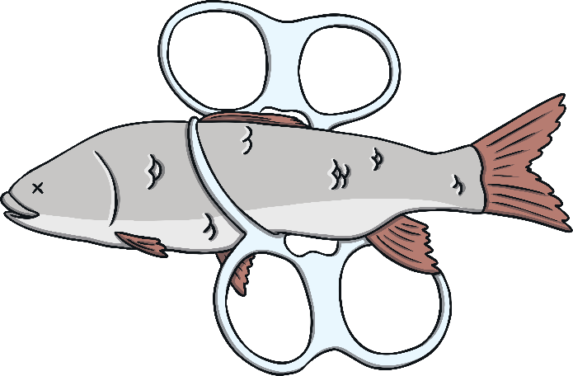
Why is Plastic Harmful?
Plastic is harmful for both humans and wildlife.
Animals get confused and eat plastic because they think it is food.
They get trapped in litter and are hurt or even die.

Slide 7
Why is Plastic Harmful?
Most plastic in the world either ends up buried in the ground or dumped into the sea.
Some plastic floats about on the sea for decades and is eaten by sea creatures such as whales and sea birds.
However, most plastic sinks to the bottom of the sea. It becomes brittle and breaks into small pieces. These get mixed up with plankton which is then eaten by fish and many other sea creatures.
Plastic in our oceans is dangerous to a wide range
of sea life.

Slide 8
What Happens to Plastic Rubbish?
Most plastics are called single-use plastics. This means that they are only used once, for example to package a new toy in a shop or to make a bottle for a fizzy drink.
When the toy has been opened or the drink has been drunk, the plastic becomes rubbish.

Slide 9
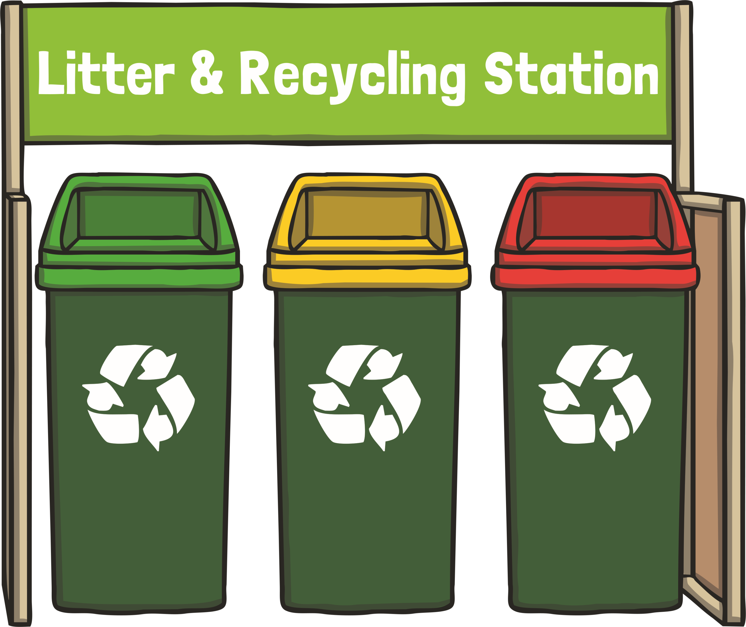
What Is Recycling?
Many types of plastic can be recycled.
When we recycle old plastic rubbish, it gets turned into something new.
Recycling helps the environment because it reduces air, water and land pollution and it saves making new plastic.

Slide 10
How Can I Recycle?
Check what can be recycled with your household bin collection. If it can’t be recycled from home, bring your plastic waste to a recycling centre or even the supermarket (for old, ripped carrier bags).
Plastic bottles
Plastic pots
Carrier bags
Look out for this sign on packaging. It means that that particular plastic may or may not be recycled by your local authority.

Slide 11
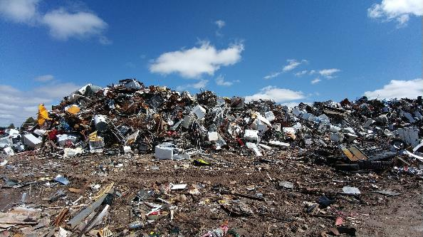
What is a Landfill Site?
Landfill sites are areas where rubbish is taken if it can’t be recycled.
Waste at landfill sites is buried under the ground. It may take hundreds or years to rot away and it produces nasty gases that harm our atmosphere.
Did You Know?
A plastic bag takes about 20 years to rot away.
A nappy or a plastic bottle is estimated to take 450 years!

Slide 12
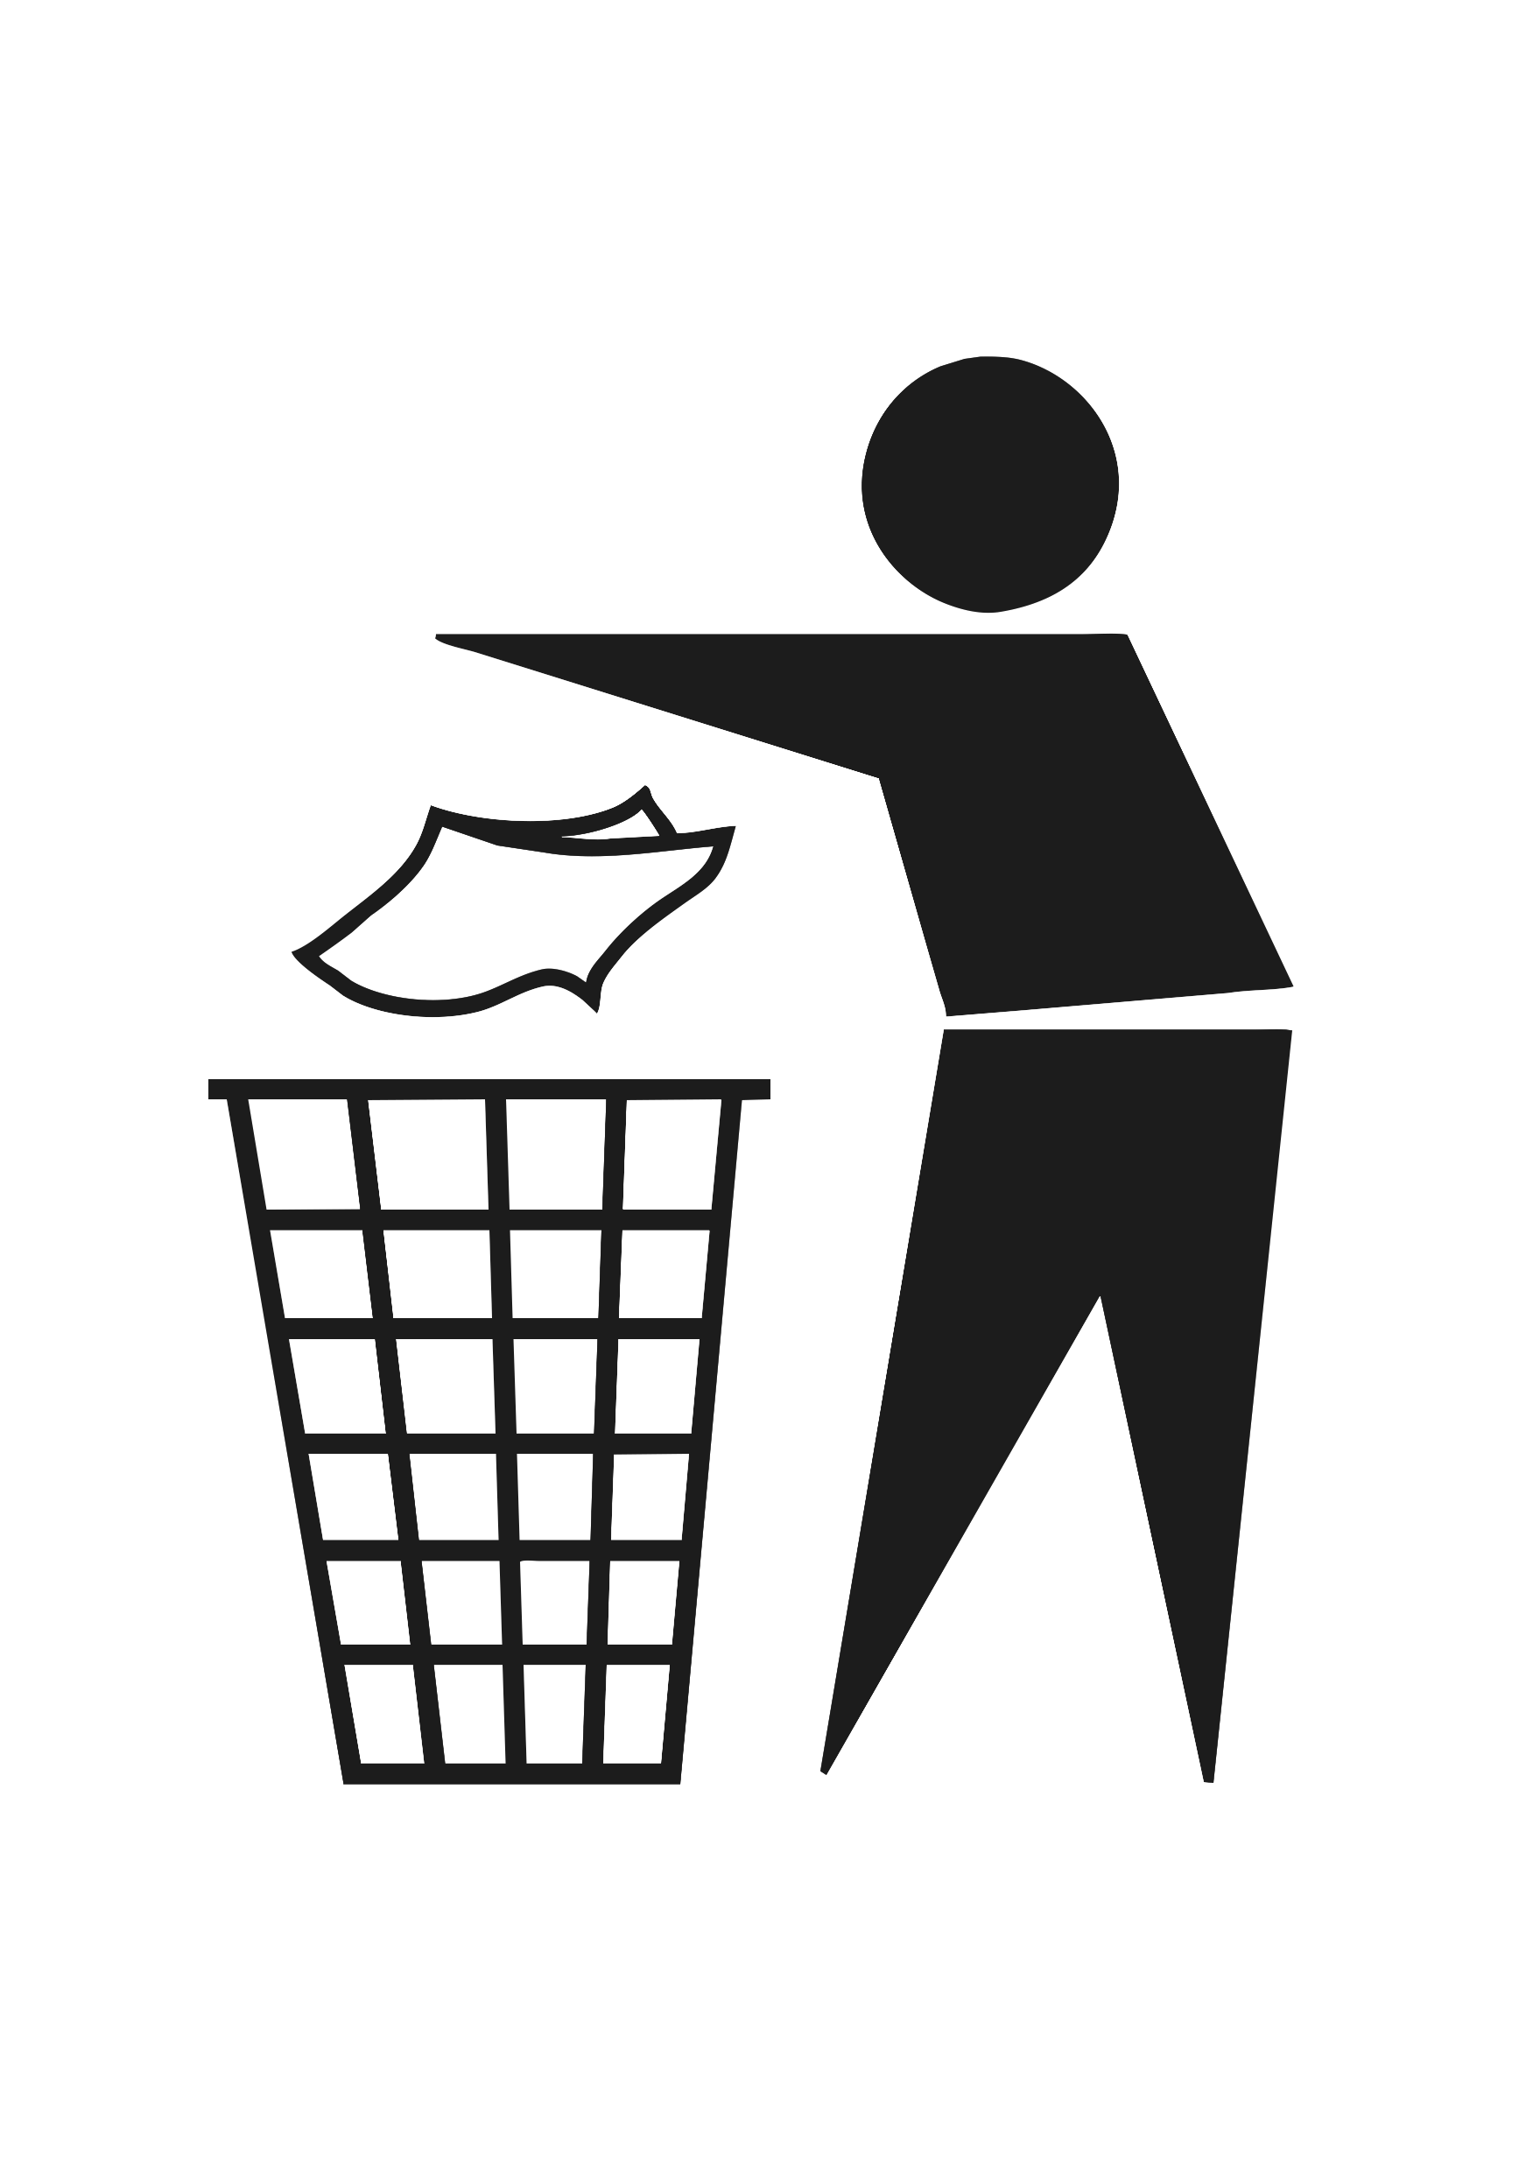
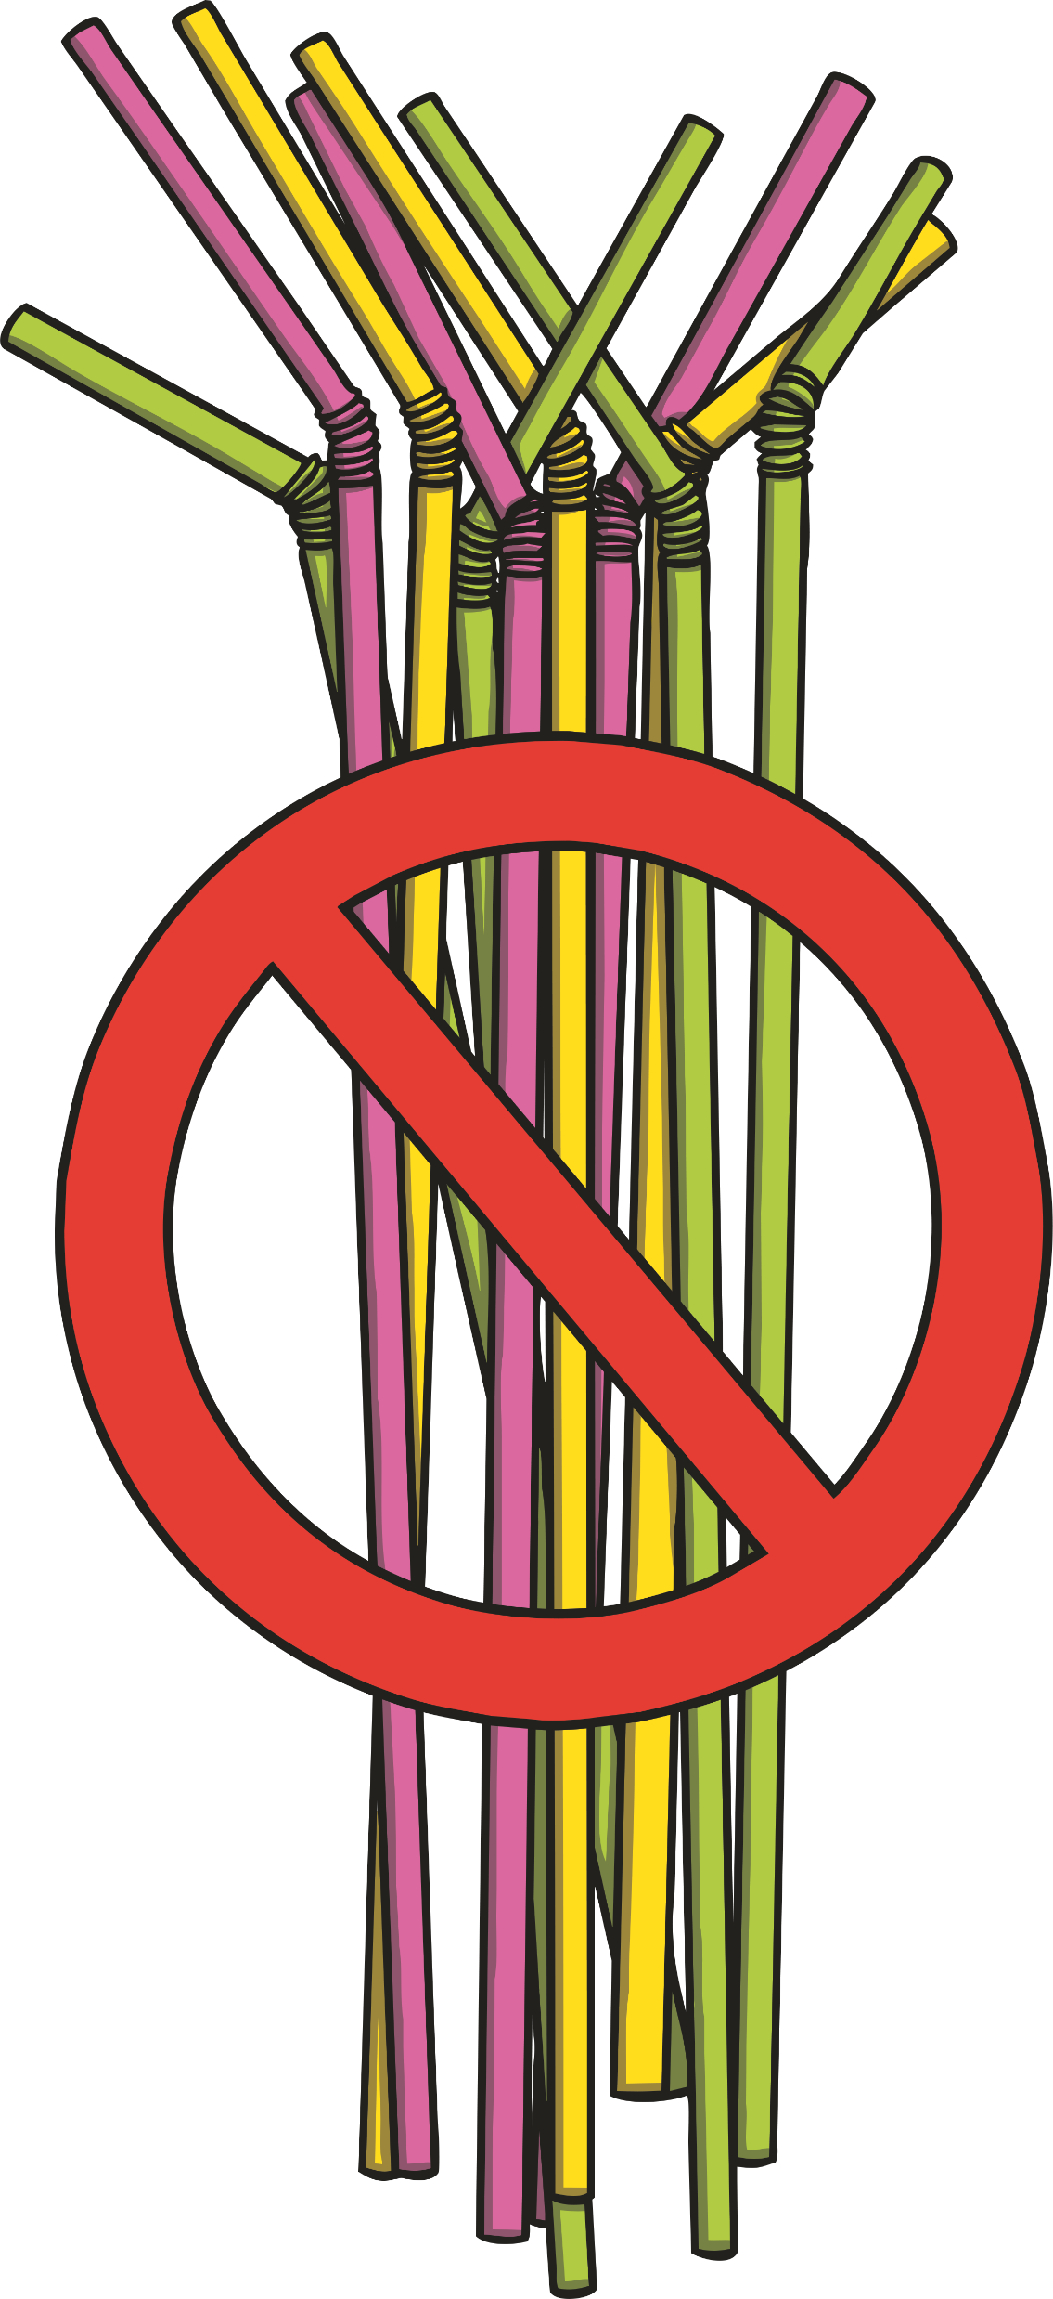
What Can You Do to Help?
Don’t buy bottled water. Single-use plastics are very bad for the environment. Carry a reusable bottle instead and fill it up at the tap.
Always put your rubbish in a bin or take it home with you to recycle. If litter is left on the ground it may hurt wildlife.
Say, “No,” to plastic bags or straws. These are very harmful to sea life and take hundreds of years to rot away. Carry a reusable bag with you and ask for a paper straw.

Slide 13
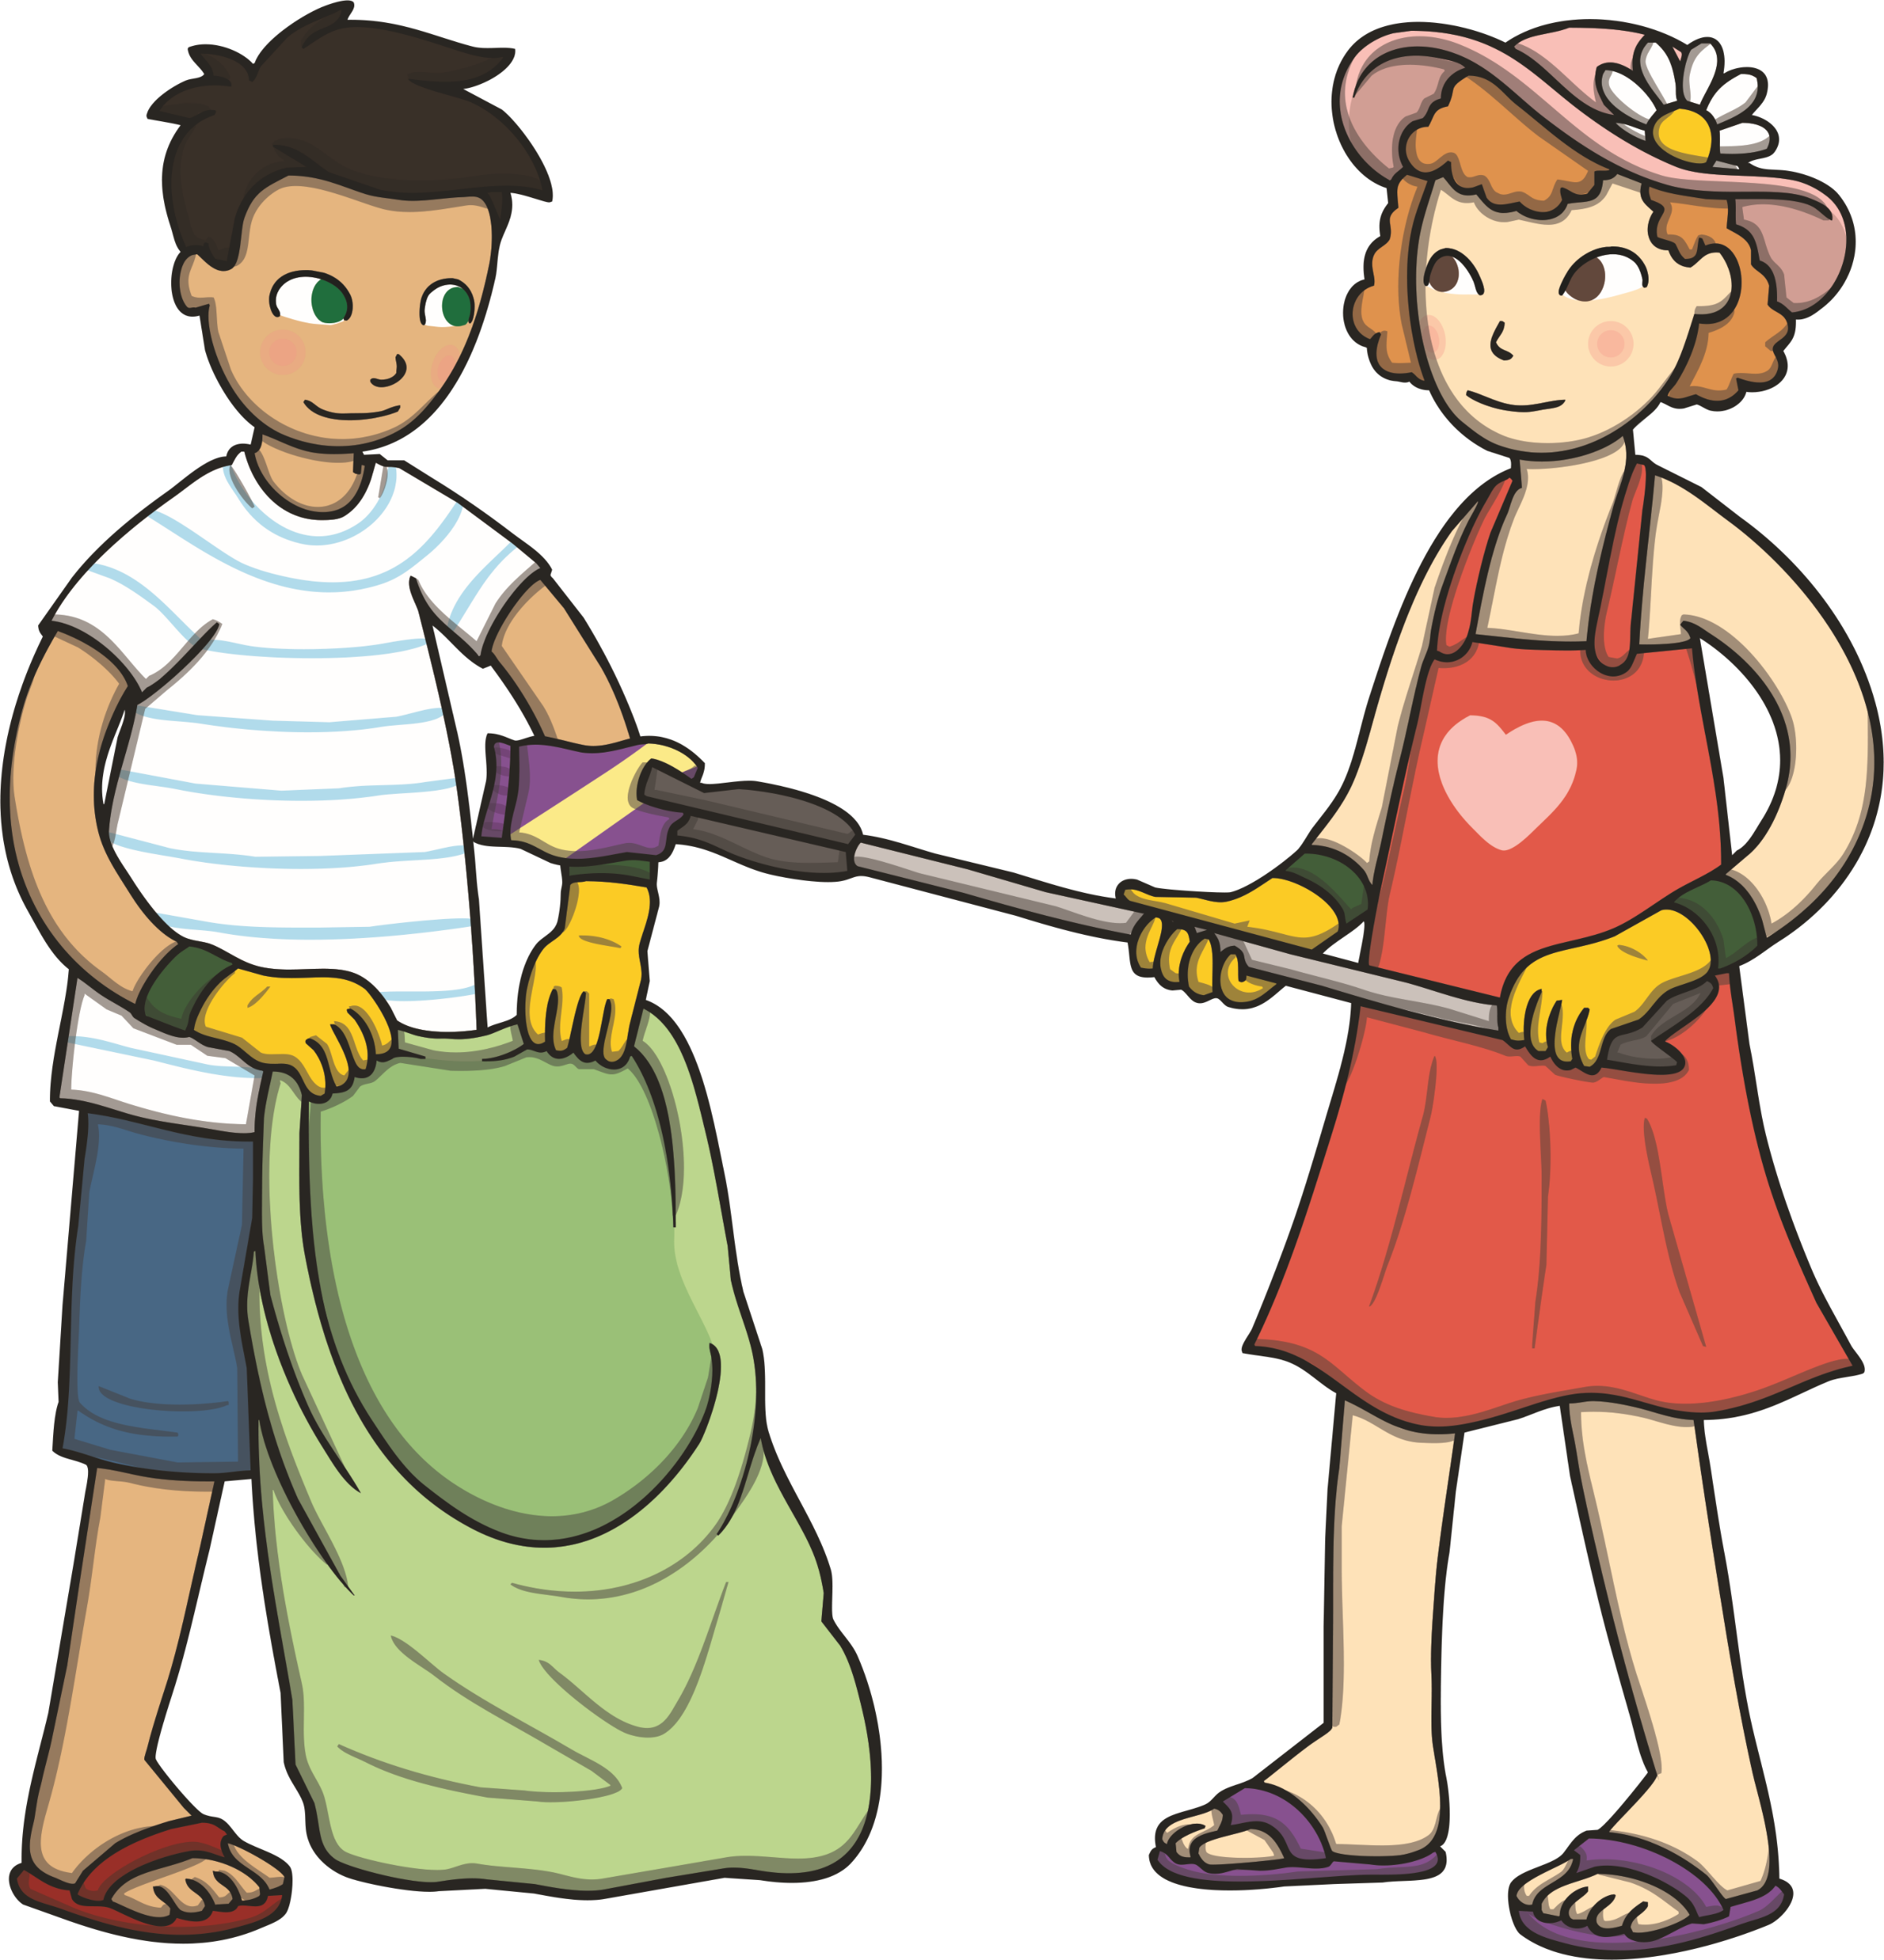
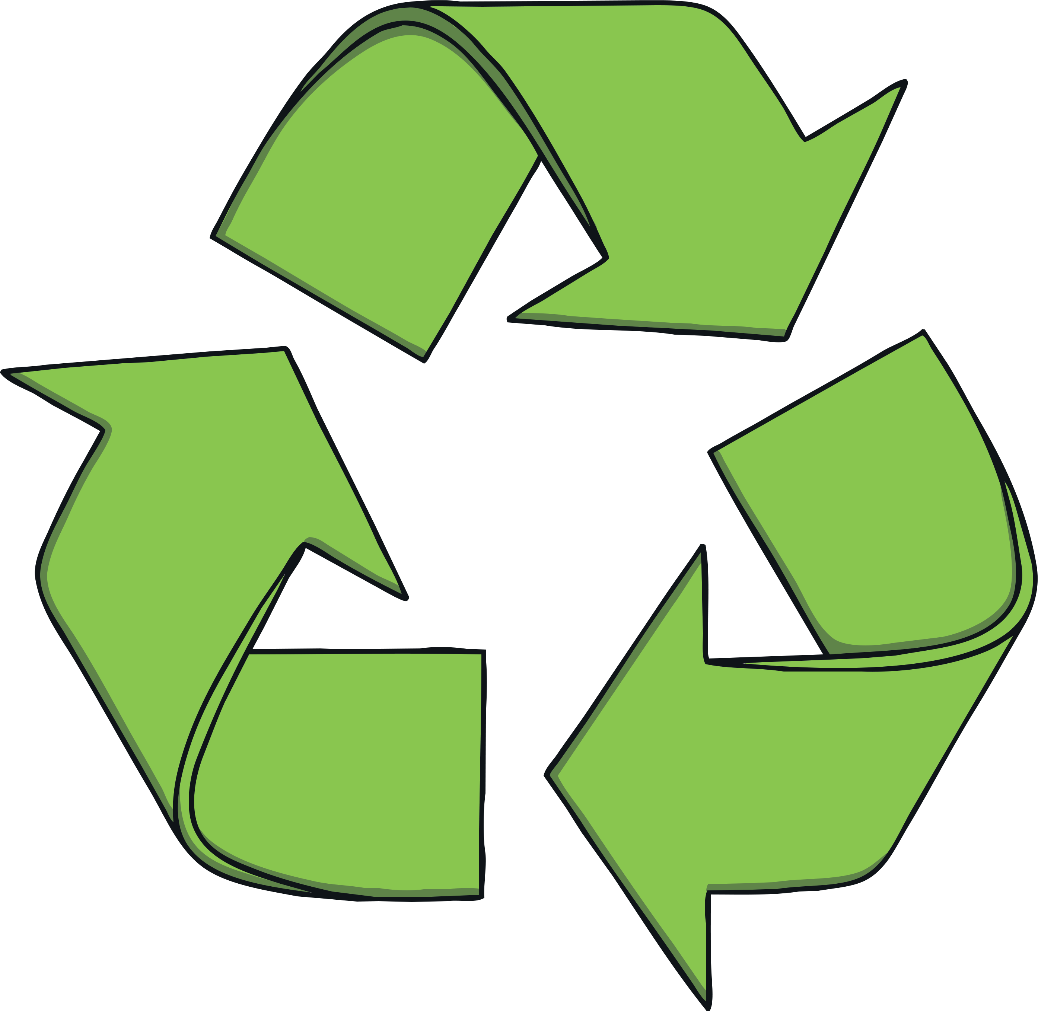
What Can You Do to Help?
Go on a litter-pick with your grown-up. Some councils give out free litter-picking equipment to volunteers and will collect the rubbish that you pick up.
Reject, reduce, reuse and recycle plastics. Think about all the rubbish thrown away in your house. Can you stop buying some plastic items? Can you reuse single-use plastics as something else (a bird feeder or plant pot, for example)? Can you give old plastic toys to a charity shop or a friend?

