Slide 1
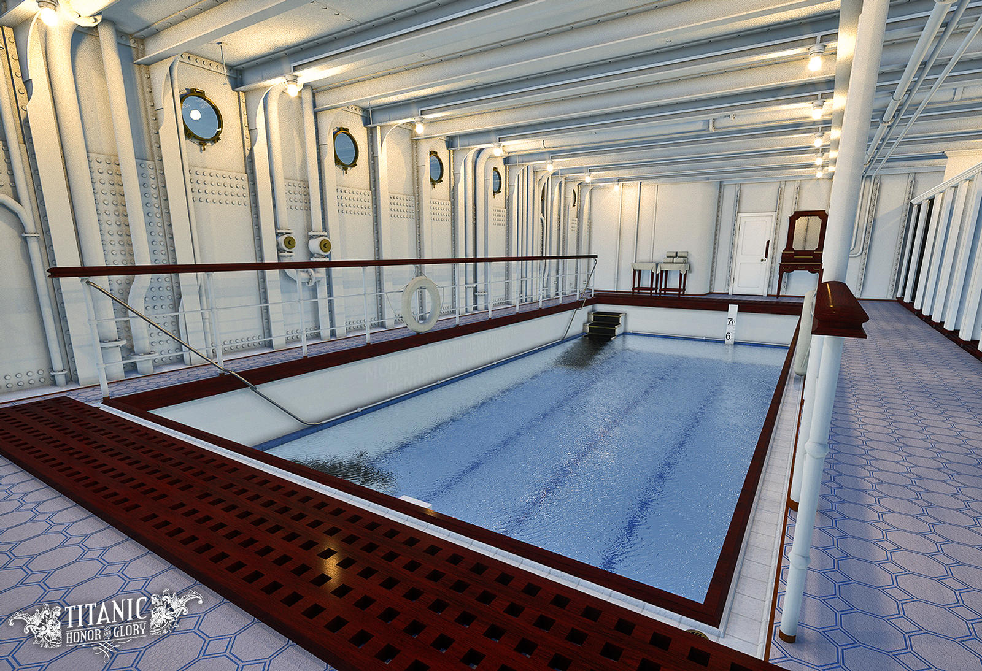
Luxurious, glistening, exquisite swimming pool

Slide 2
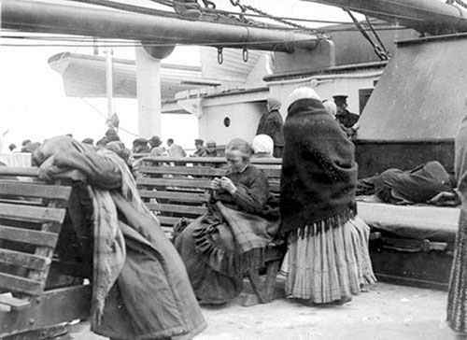
On the deck wooden, hard, uncomfortable benches

Slide 3
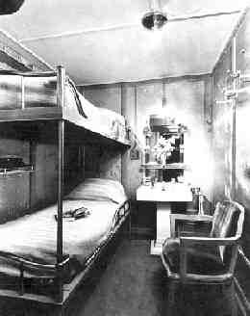
Rickety, high, single bunk beds in third class

Slide 4
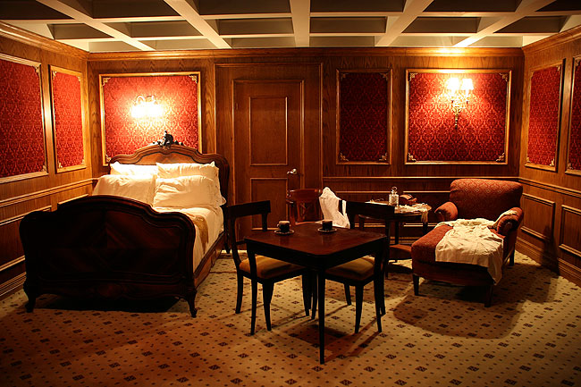
Palatial, sumptuous, elegant first-class suite near the deck

Slide 5
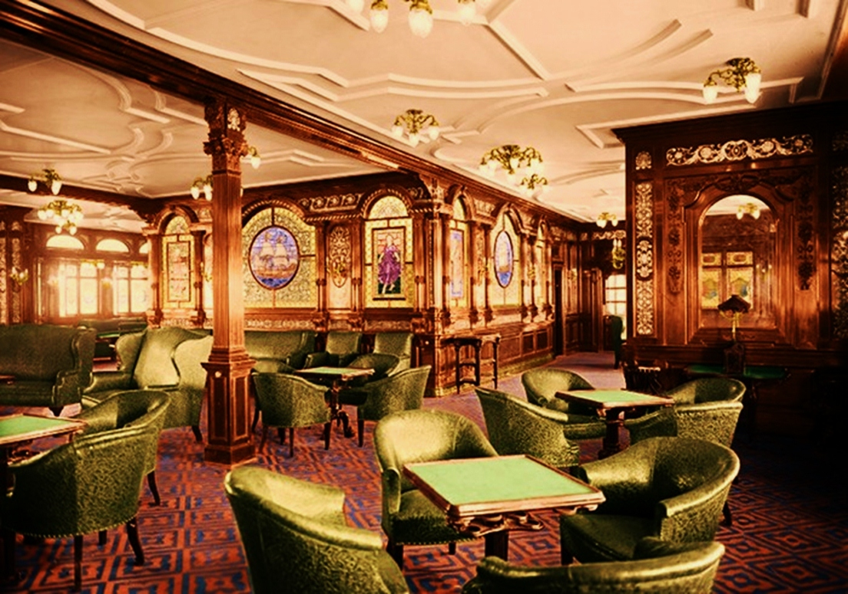
Elegant, beautiful, expensive first-class dining with other aristocrats

Slide 6
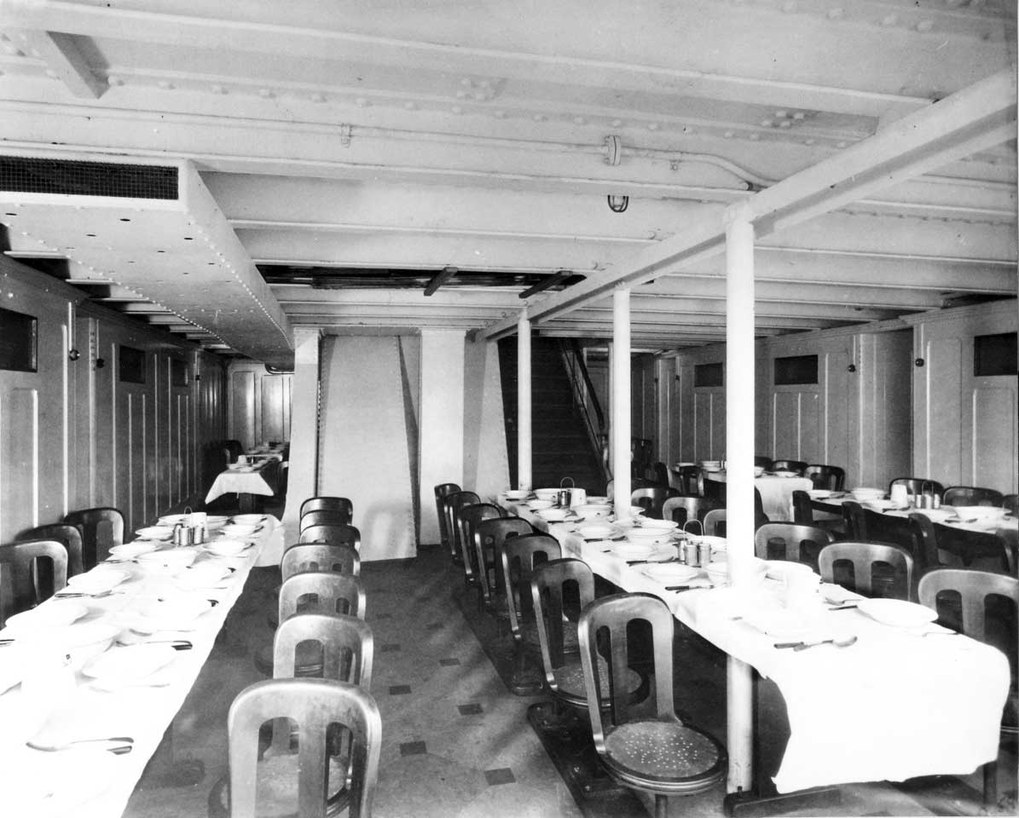
modest, squashed, basic dining tables close to each other

