Slide 1
INSPIRATION

Slide 2
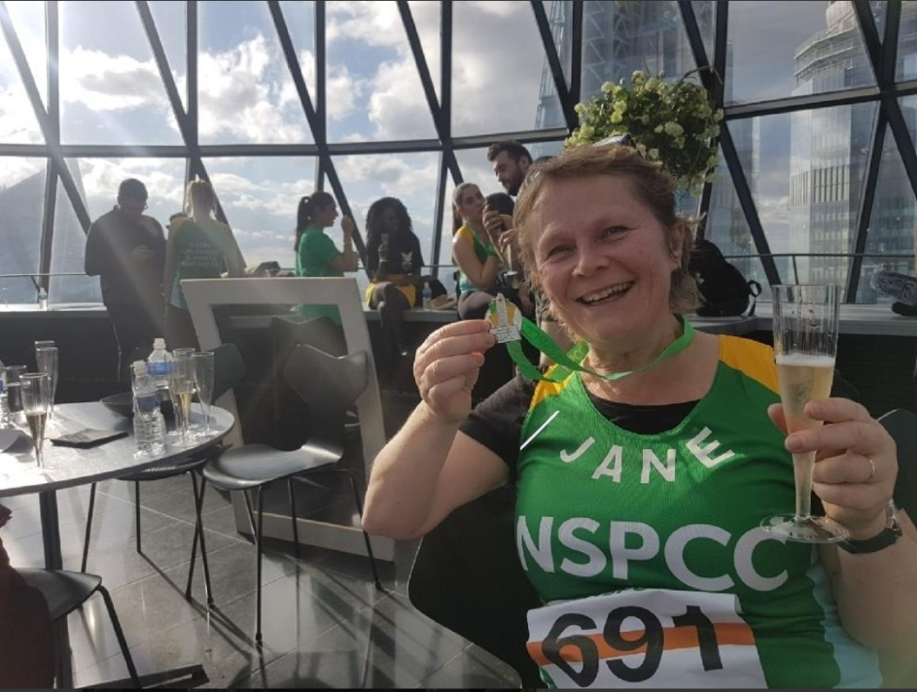
Mrs Crabbe walked up the Gherkin in London and raised £405 for the NSPCC.

Slide 3
Stanley and Nancy
After their 6 month old baby cousin received open heart surgery at Great Ormand Street Hospital, Stanley and Nancy have decided to try and raise some money for the hospital by cycling 200 laps of the bike track at Danes Way park. We wish them luck!

Slide 4
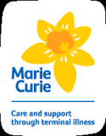
Miss Parkinson raised £770 for Marie Curie Cancer Care by jumping out of an aeroplane. She did have a parachute!

Slide 5
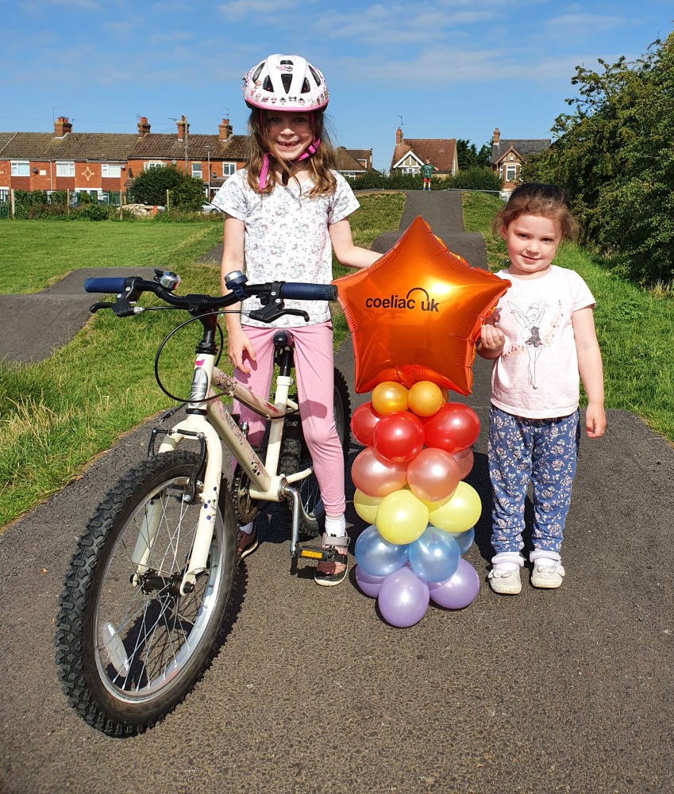
Bethany
In 2019, Bethany’s sister Jessica was very poorly, and after a long stay in hospital she was diagnosed with Coeliac disease at 19 months old. To mark the anniversary of her diagnosis, Bethany cycled 365 laps of the bike track at Vandyke playing field to raise money for Coeliac UK. In total she raised £815!

Slide 6
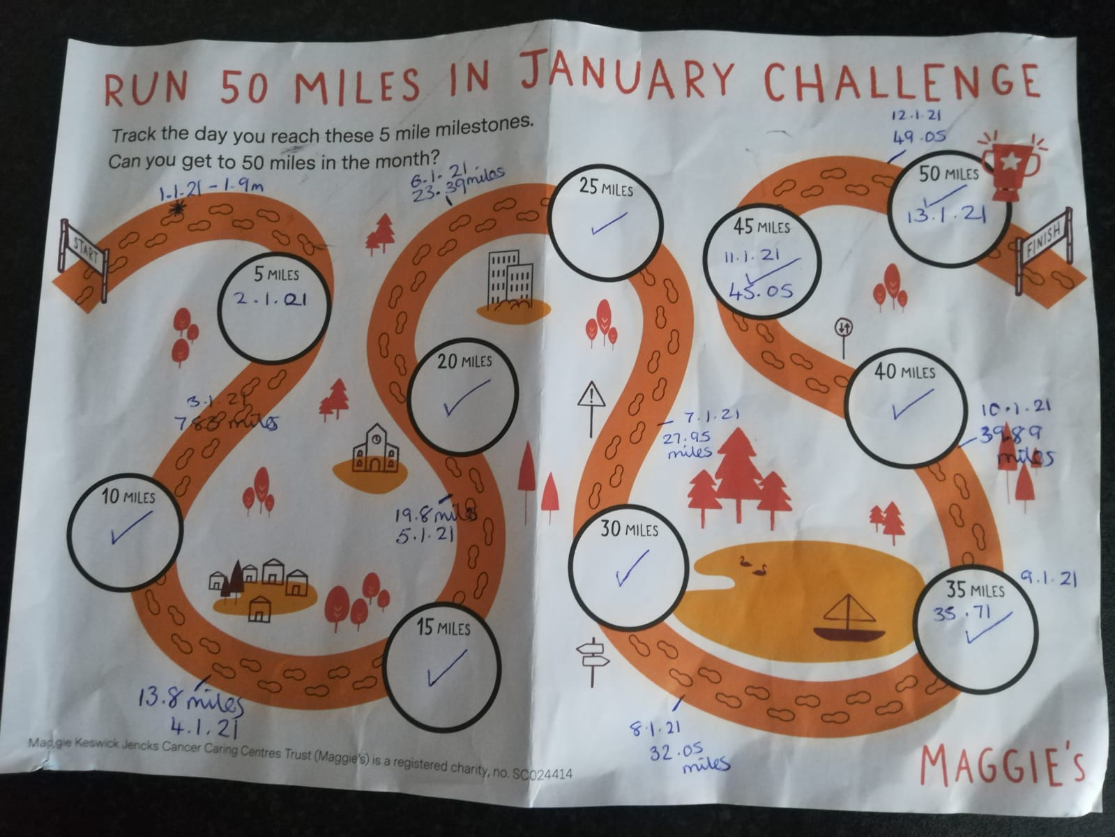
Mrs Arnold ran 50 miles during January and raised £220 for Cancer Research.

Slide 7
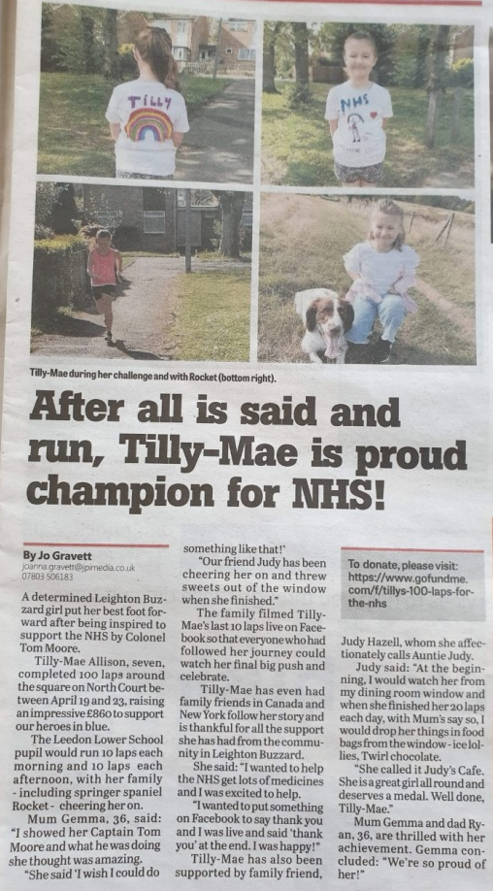
Tilly-Mae
After the first lockdown, Tilly-Mae was inspired by Captain Sir Tom Moore, into doing her own bit to raise some money for the NHS.
She ran 100 laps of the green outside her house and raised a staggering £900!

Slide 8
For the past 11 years, Mr Benson has organised Ampthill’s annual fireworks display. This event has raised over £125,000 for local charities.

Slide 9
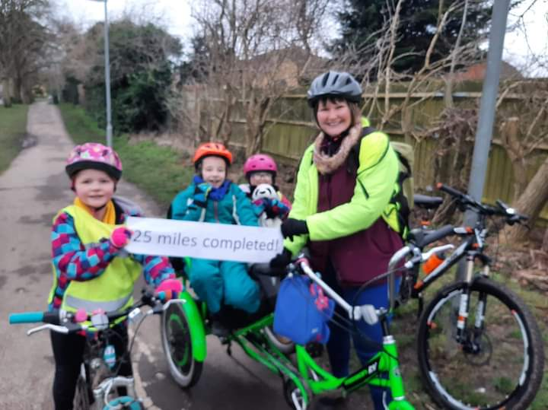
Amber, Emily and Robin
Amber, Emily and Robin, along with their Mum, cycled 25 miles over 5 days to raise money for Spectrum Community Arts. They managed to raise an incredible total of £760!

Slide 10
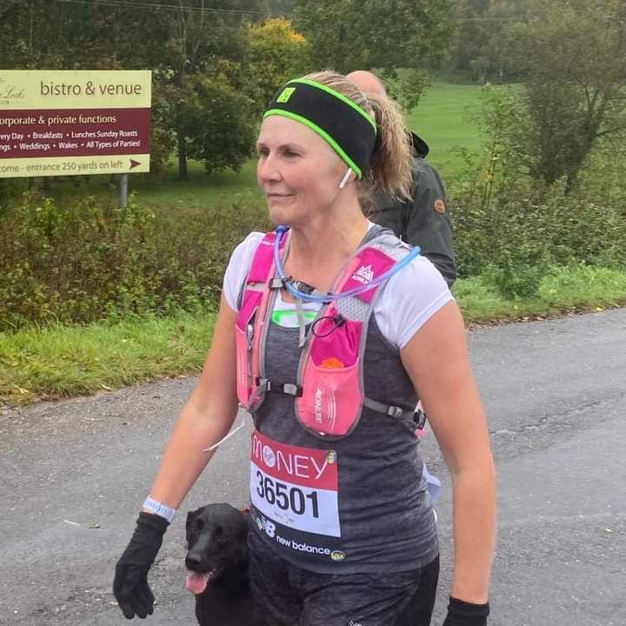
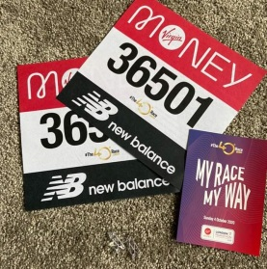
Mrs Cawood has taken part in 2 marathons, raising £6500 for Cancer Treatment and Research Trust at Mount Vernon Hospital.

Slide 11
Beau
After seeing some homeless people sleeping on the streets of Leighton Buzzard, Beau decided she wanted to help by raising some money. She did a sponsored ‘sleep out’ and spent a cold January night sleeping outside with only a sleeping bag. Her efforts raised £340 for charity.

Slide 12
Mrs Walton has raised £1000 for VICTA, a children’s charity, by running the London Marathon.

