Slide 1
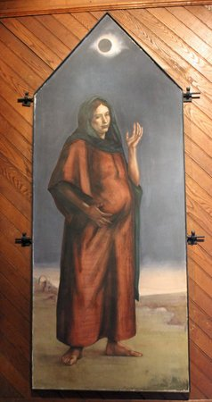
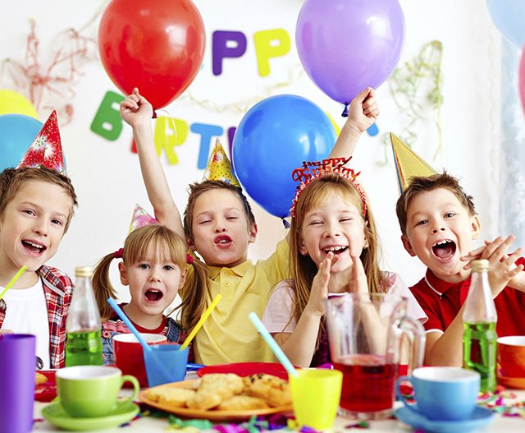
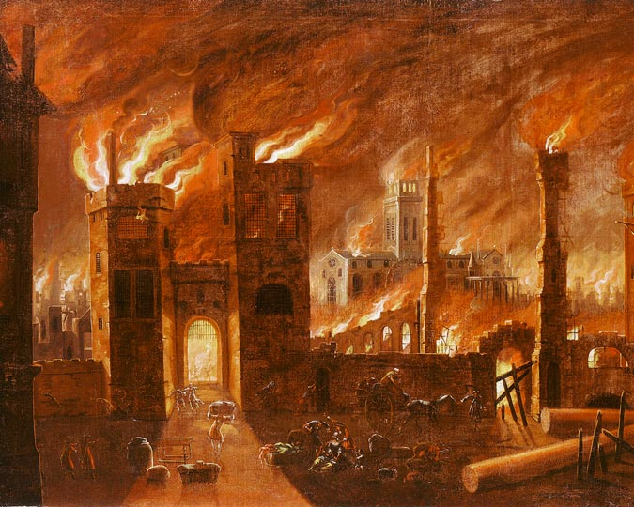
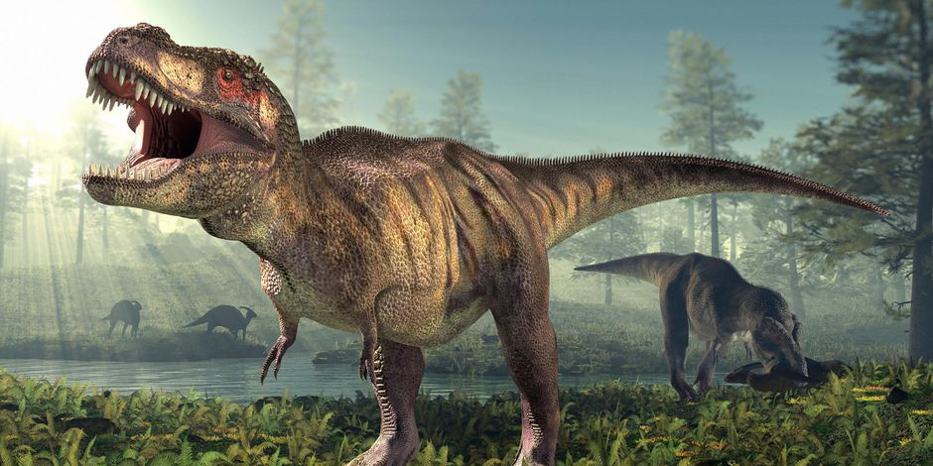
The party was great!
Mary was great with child
The Great Fire of London
GREAT?
The T-Rex had great big teeth!

Slide 2
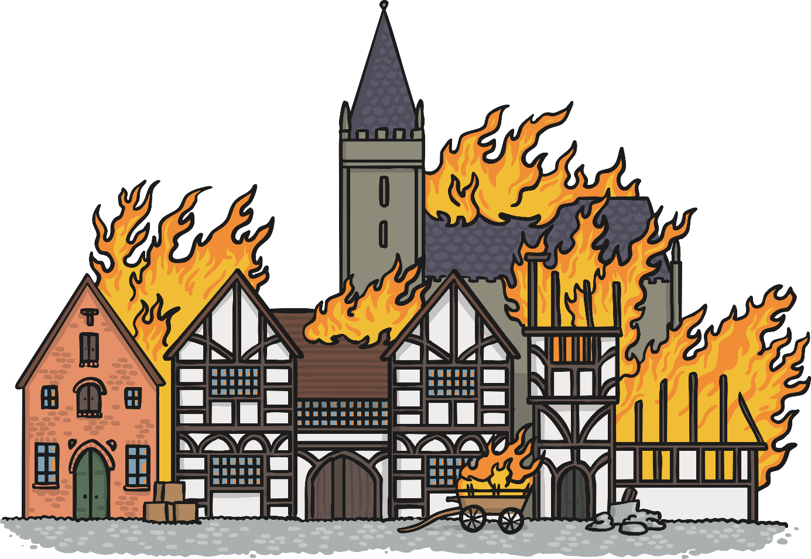

The Great Fire of London

Slide 3
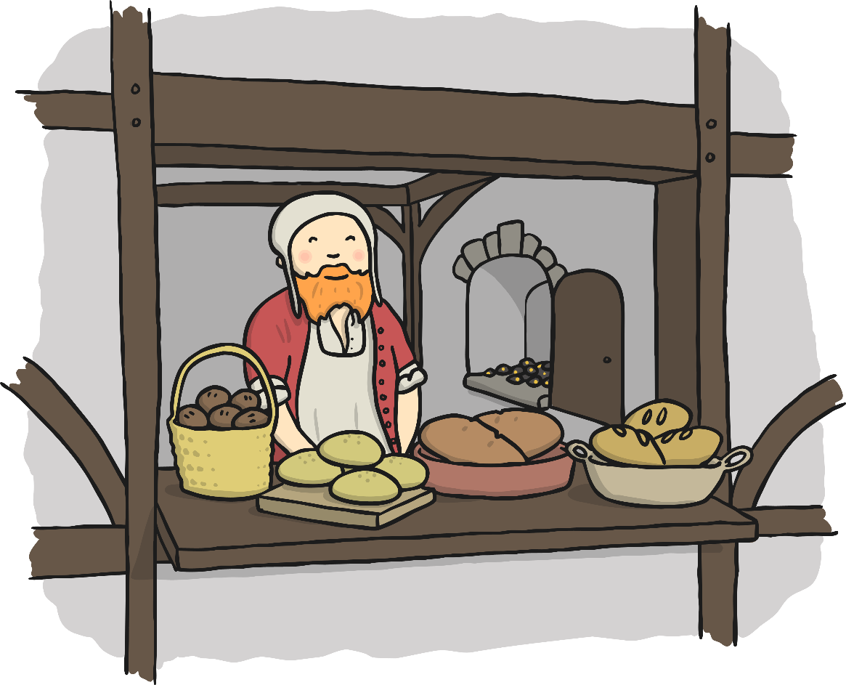
The famous ‘Great Fire of London’ started on Sunday the 2nd of September 1666 in a baker’s shop on Pudding Lane. The baker was called Thomas Farriner.

Slide 4
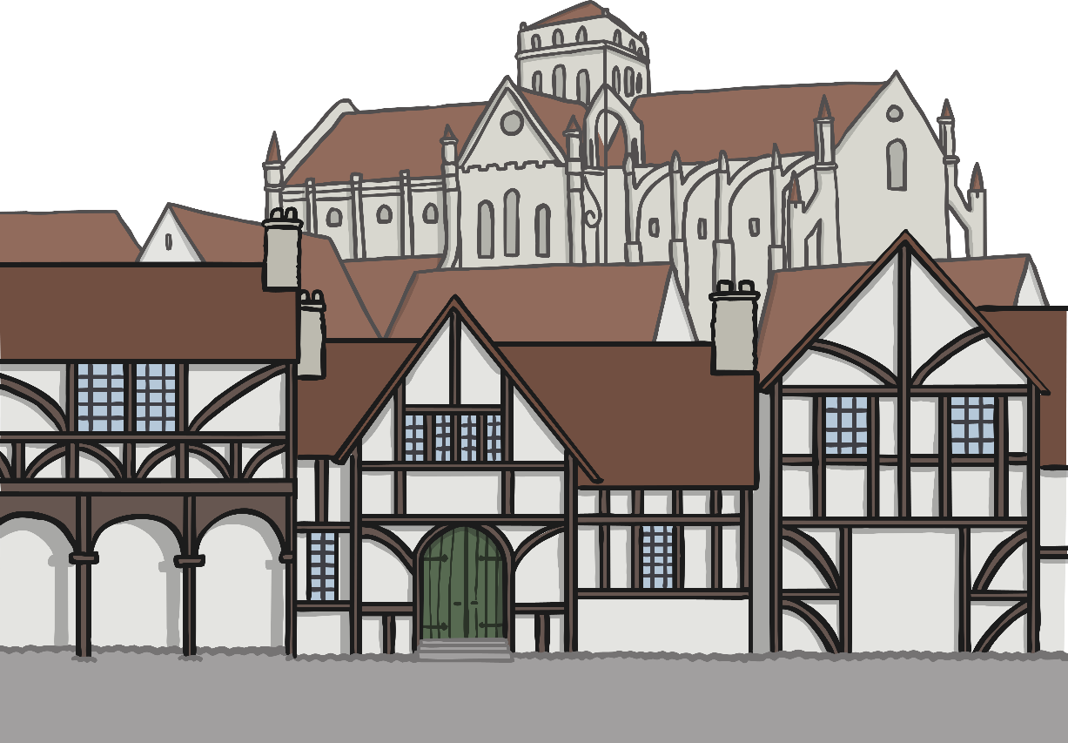
In 1666, most of London’s buildings were made from wood.
They were also packed tightly together in narrow rows.

Slide 5
This meant that they burnt very easily and quickly.
The wind also helped carry the fire!

Slide 6
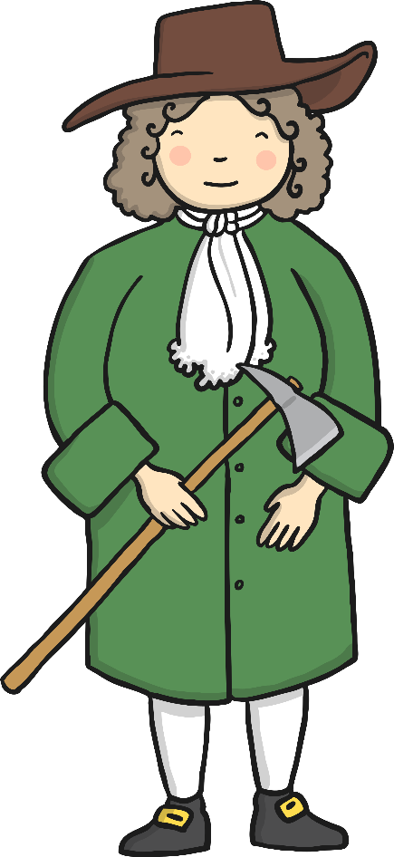

Fire services never used to exist so citizens had to try and put the fire out! They used leather buckets filled with water and axes.
They tried their best but were unable to battle the flames.

Slide 7
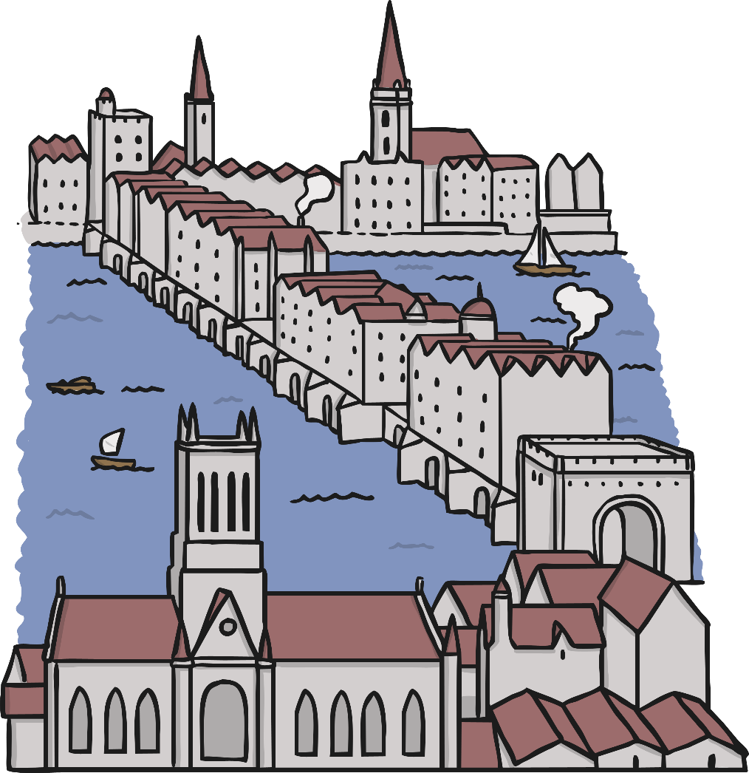
The water used to try and put out the fire was taken from the River Thames.

Slide 8
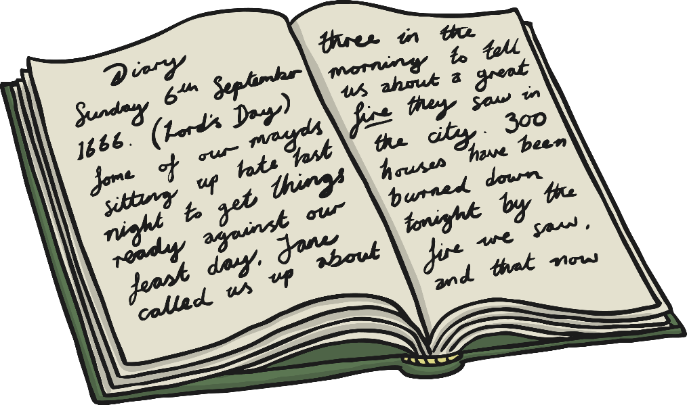
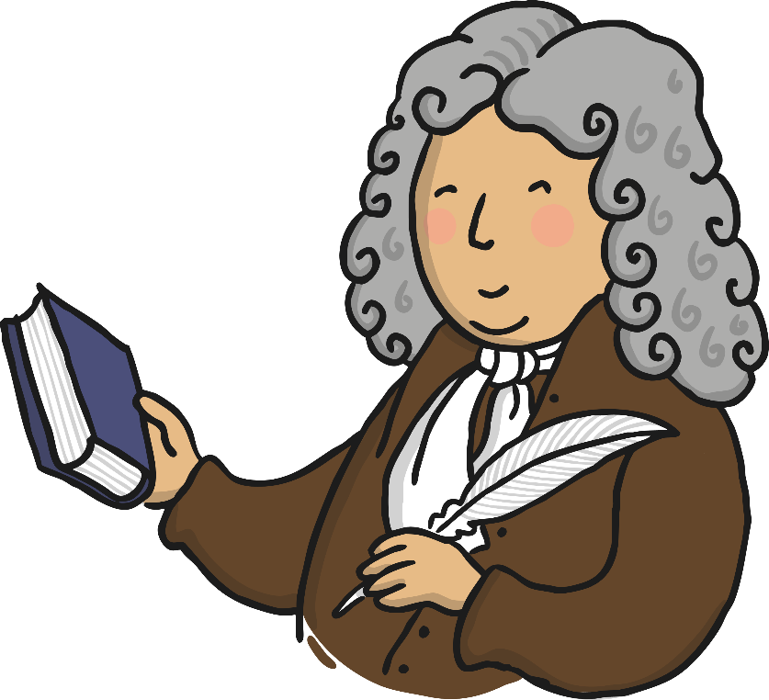
Samuel Pepys kept a diary of The Great Fire, as he watched it from across the River Thames. He saw the fire spread west and went to inform the King and his brother, The Duke of York.

Slide 9
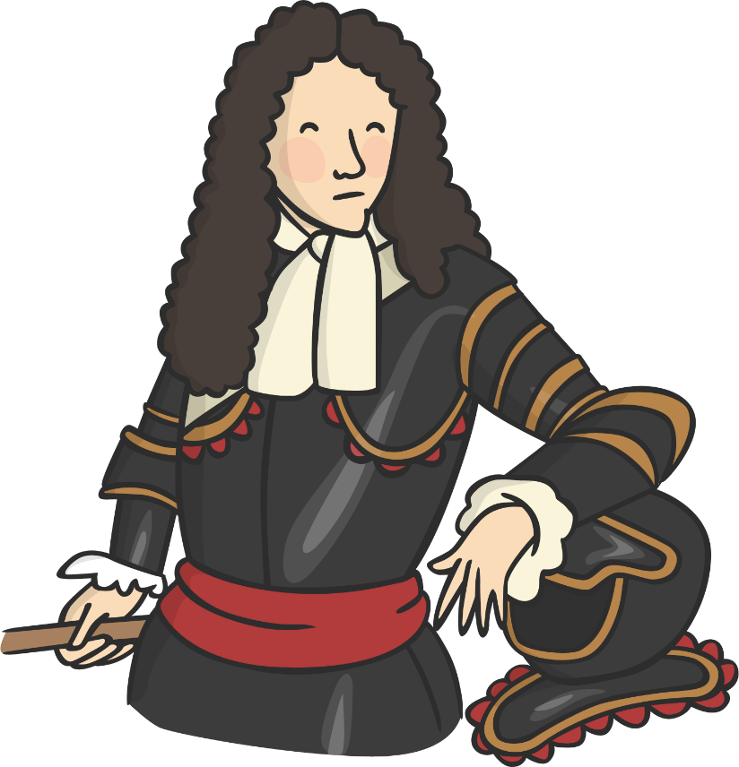
On Wednesday The Duke of York (the future King James II) ordered that houses be destroyed using gunpowder ahead of the fire to stop the fire from spreading even further. This plan succeeded and by Thursday, the fire had been extinguished.

Slide 10
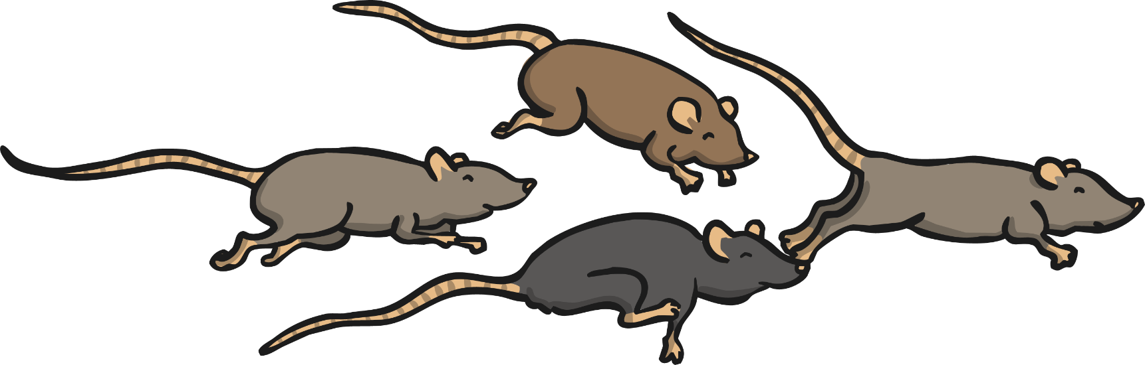
The disaster made London a better and safer city.
Streets were widened and buildings were made stronger, more fireproof and out of brick instead of wood.
A lot of rats carrying the black plague were also killed off.

Slide 11
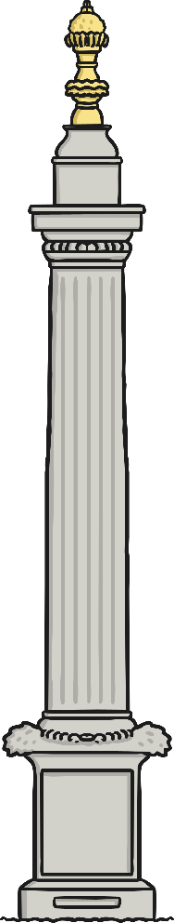
The Monument to the Great Fire of London was erected. The monument still remains in place today so that no one will ever forget what happened.

Slide 12
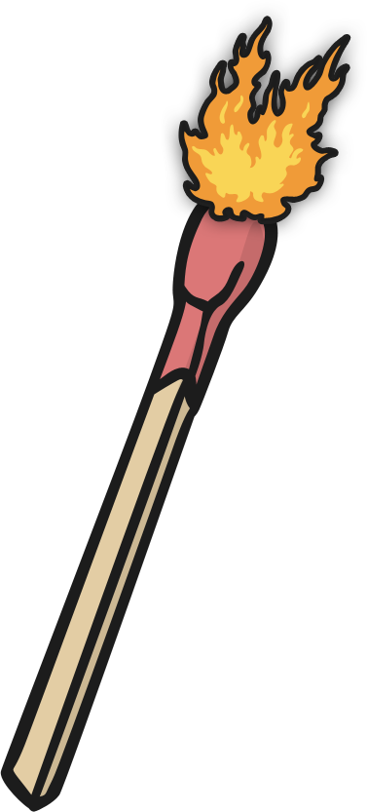
Even the smallest fire can be dangerous within a few minutes. Make sure you always have a fire escape planned. If a fire starts, stay calm and leave immediately.

Slide 13
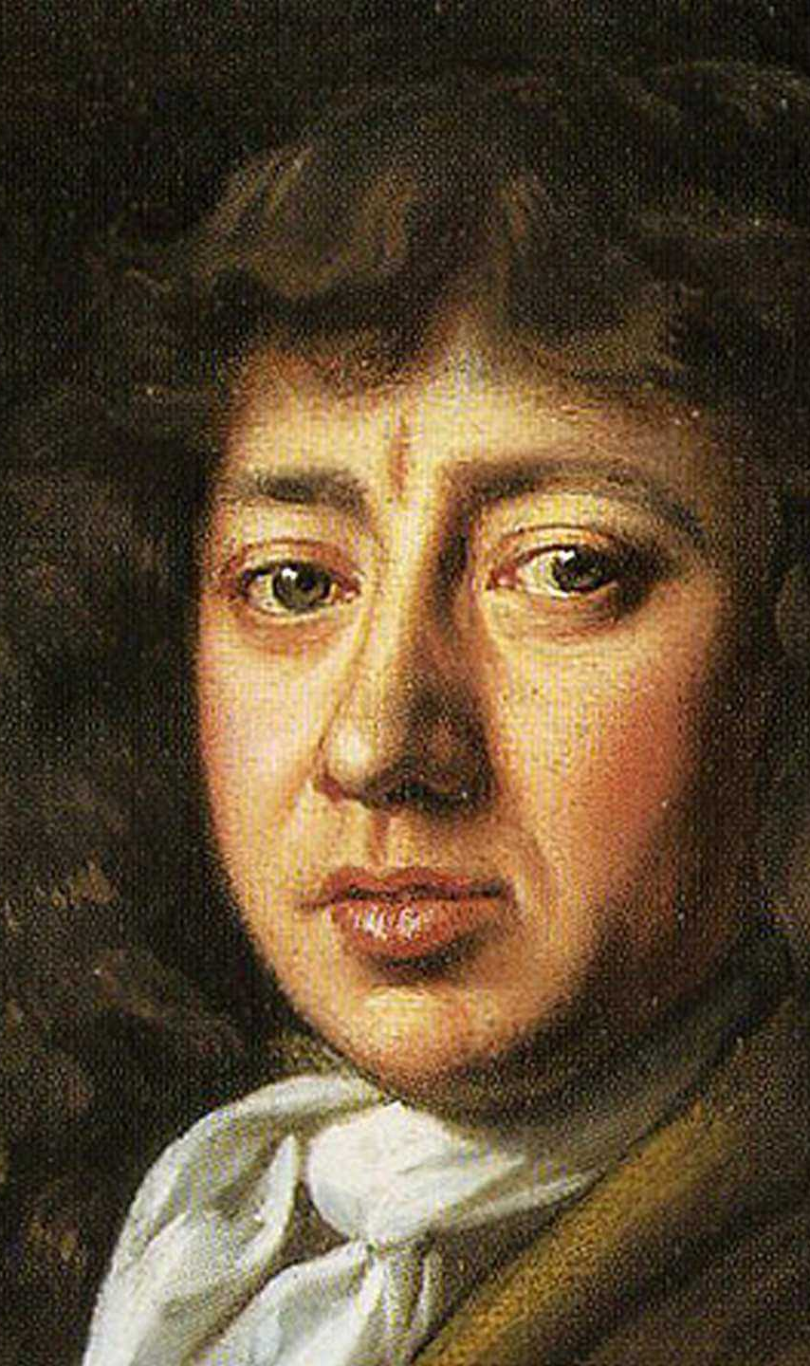
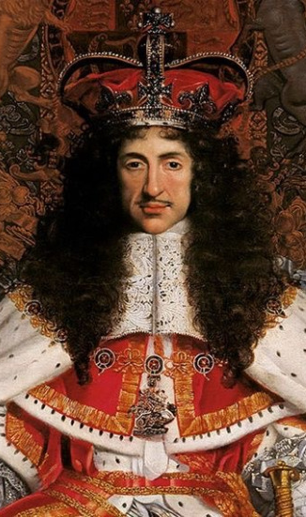
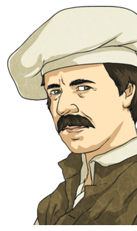

Slide 14
The Diary of Samuel Pepys September 2, 1666 Part One
Oh the miserable and calamitous spectacle!
It was a small mistake, but with great consequences. On September 2, 1666, Thomas Farrinor, baker to King Charles II of England, failed, in effect, to turn off his oven. He thought the fire was out, but apparently the smouldering embers ignited some nearby firewood and by one o'clock in the morning, three hours after Farrinor went to bed, his house in Pudding Lane was in flames. Farrinor, along with his wife and daughter, and one servant, escaped from the burning building through an upstairs window, but the baker's maid was not so fortunate, becoming the Great Fire's first victim. Did these cakes set fire to London?

Slide 15
September 2nd 1666
Part Two
The fire then leapt across Fish Street Hill and engulfed the Star Inn. The London of 1666 was a city of half-timbered, medieval buildings and sheds that ignited at the touch of a spark--and a strong wind on that September morning ensured that sparks flew everywhere. From the Inn, the fire spread into Thames Street, where riverfront warehouses were bursting with oil, tallow, and other combustible goods. By now the fire had grown too fierce to combat with the crude firefighting methods of the day, which consisted of little more than bucket brigades armed with wooden pails of water. The usual solution during a fire of such size was to demolish every building in the path of the flames in order to deprive the fire of fuel, but the city's mayor hesitated, fearing the high cost of rebuilding. Meanwhile, the fire spread out of control, doing far more damage than anyone could possibly have managed.

Slide 16
L.O. Discuss and clarify the meaning of words in Samuel Pepys’s diary. 26.2.20
Never-heard
the-word
grid
Word | Definition | Picto-word | Use it in a sentence

Slide 17
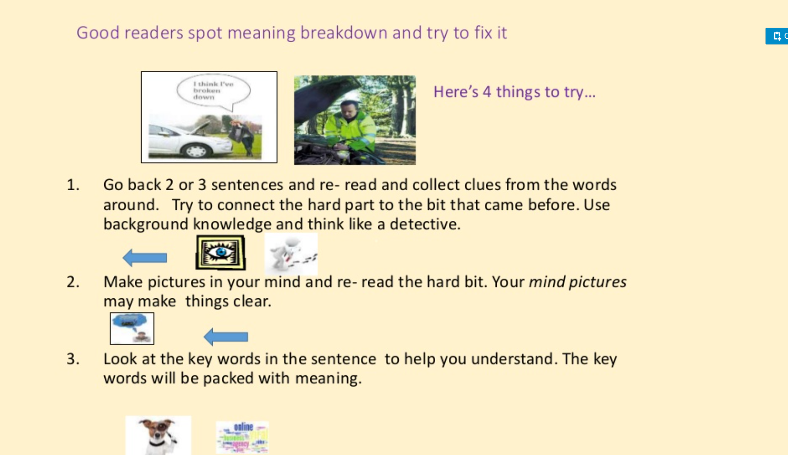

Slide 18
