Slide 1
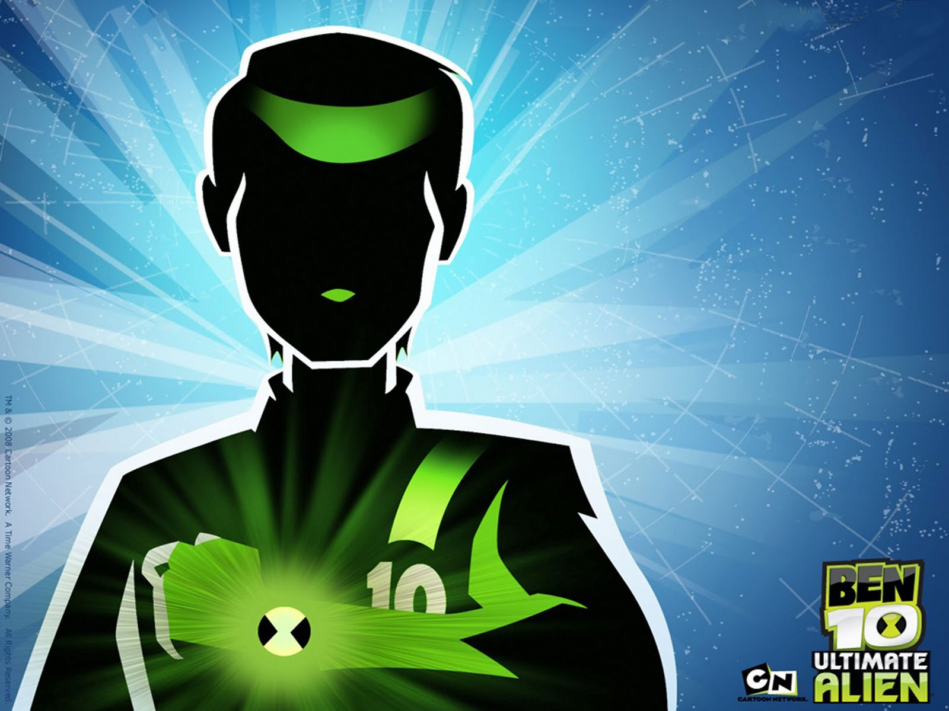
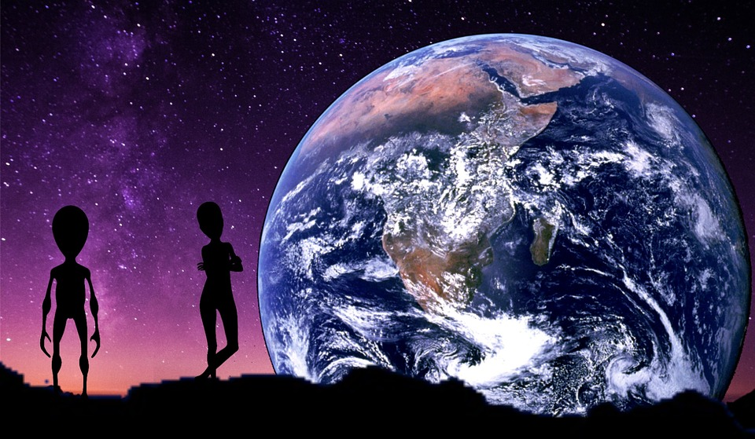
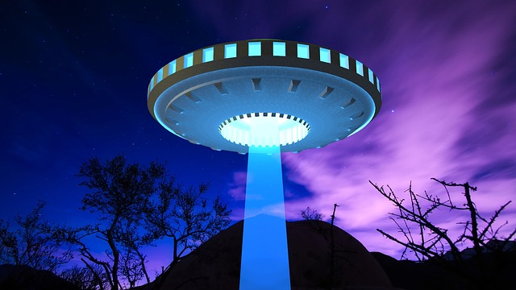
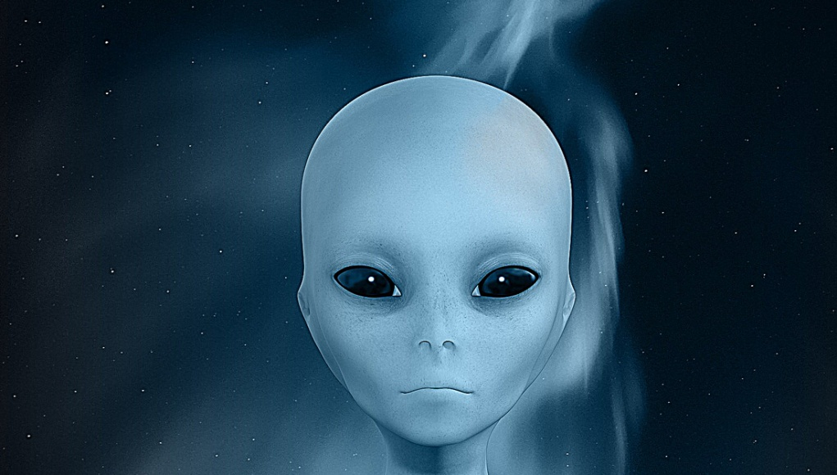
Dr O’Reilly’s Book Of Aliens

Slide 2
The Zerbanda aliens come from the Planet Zerb.
Its rocky landscape
makes it challenging for the Zerbandas to hunt.
This planet has a huge ring of
ice around its Equator.
Surrounding the planet is a thick, green gas, which the aliens must breathe.

Slide 3
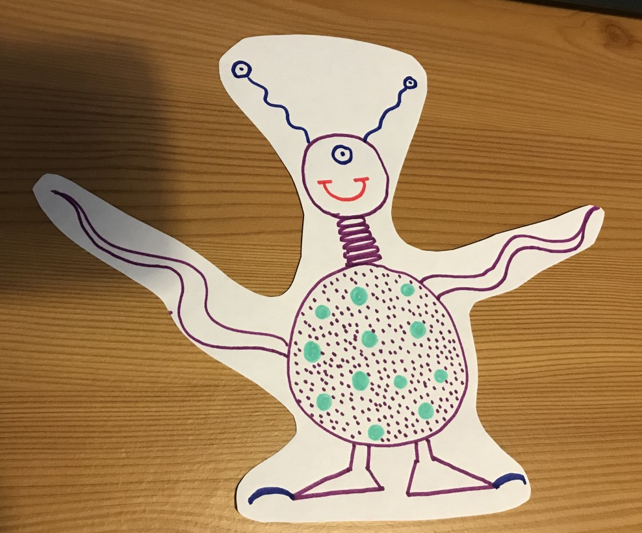
The Zerbandas have rotating eyes on their antennae to see into the rocky distance.
In the centre of their foreheads you will find their third eye, which can read the minds of humans.
So that they can reach their heads up high, the Zerbandas have a spiral neck.
In order to camouflage themselves, they have a speckled body the same colour as the Planet Zerb.

