Slide 1
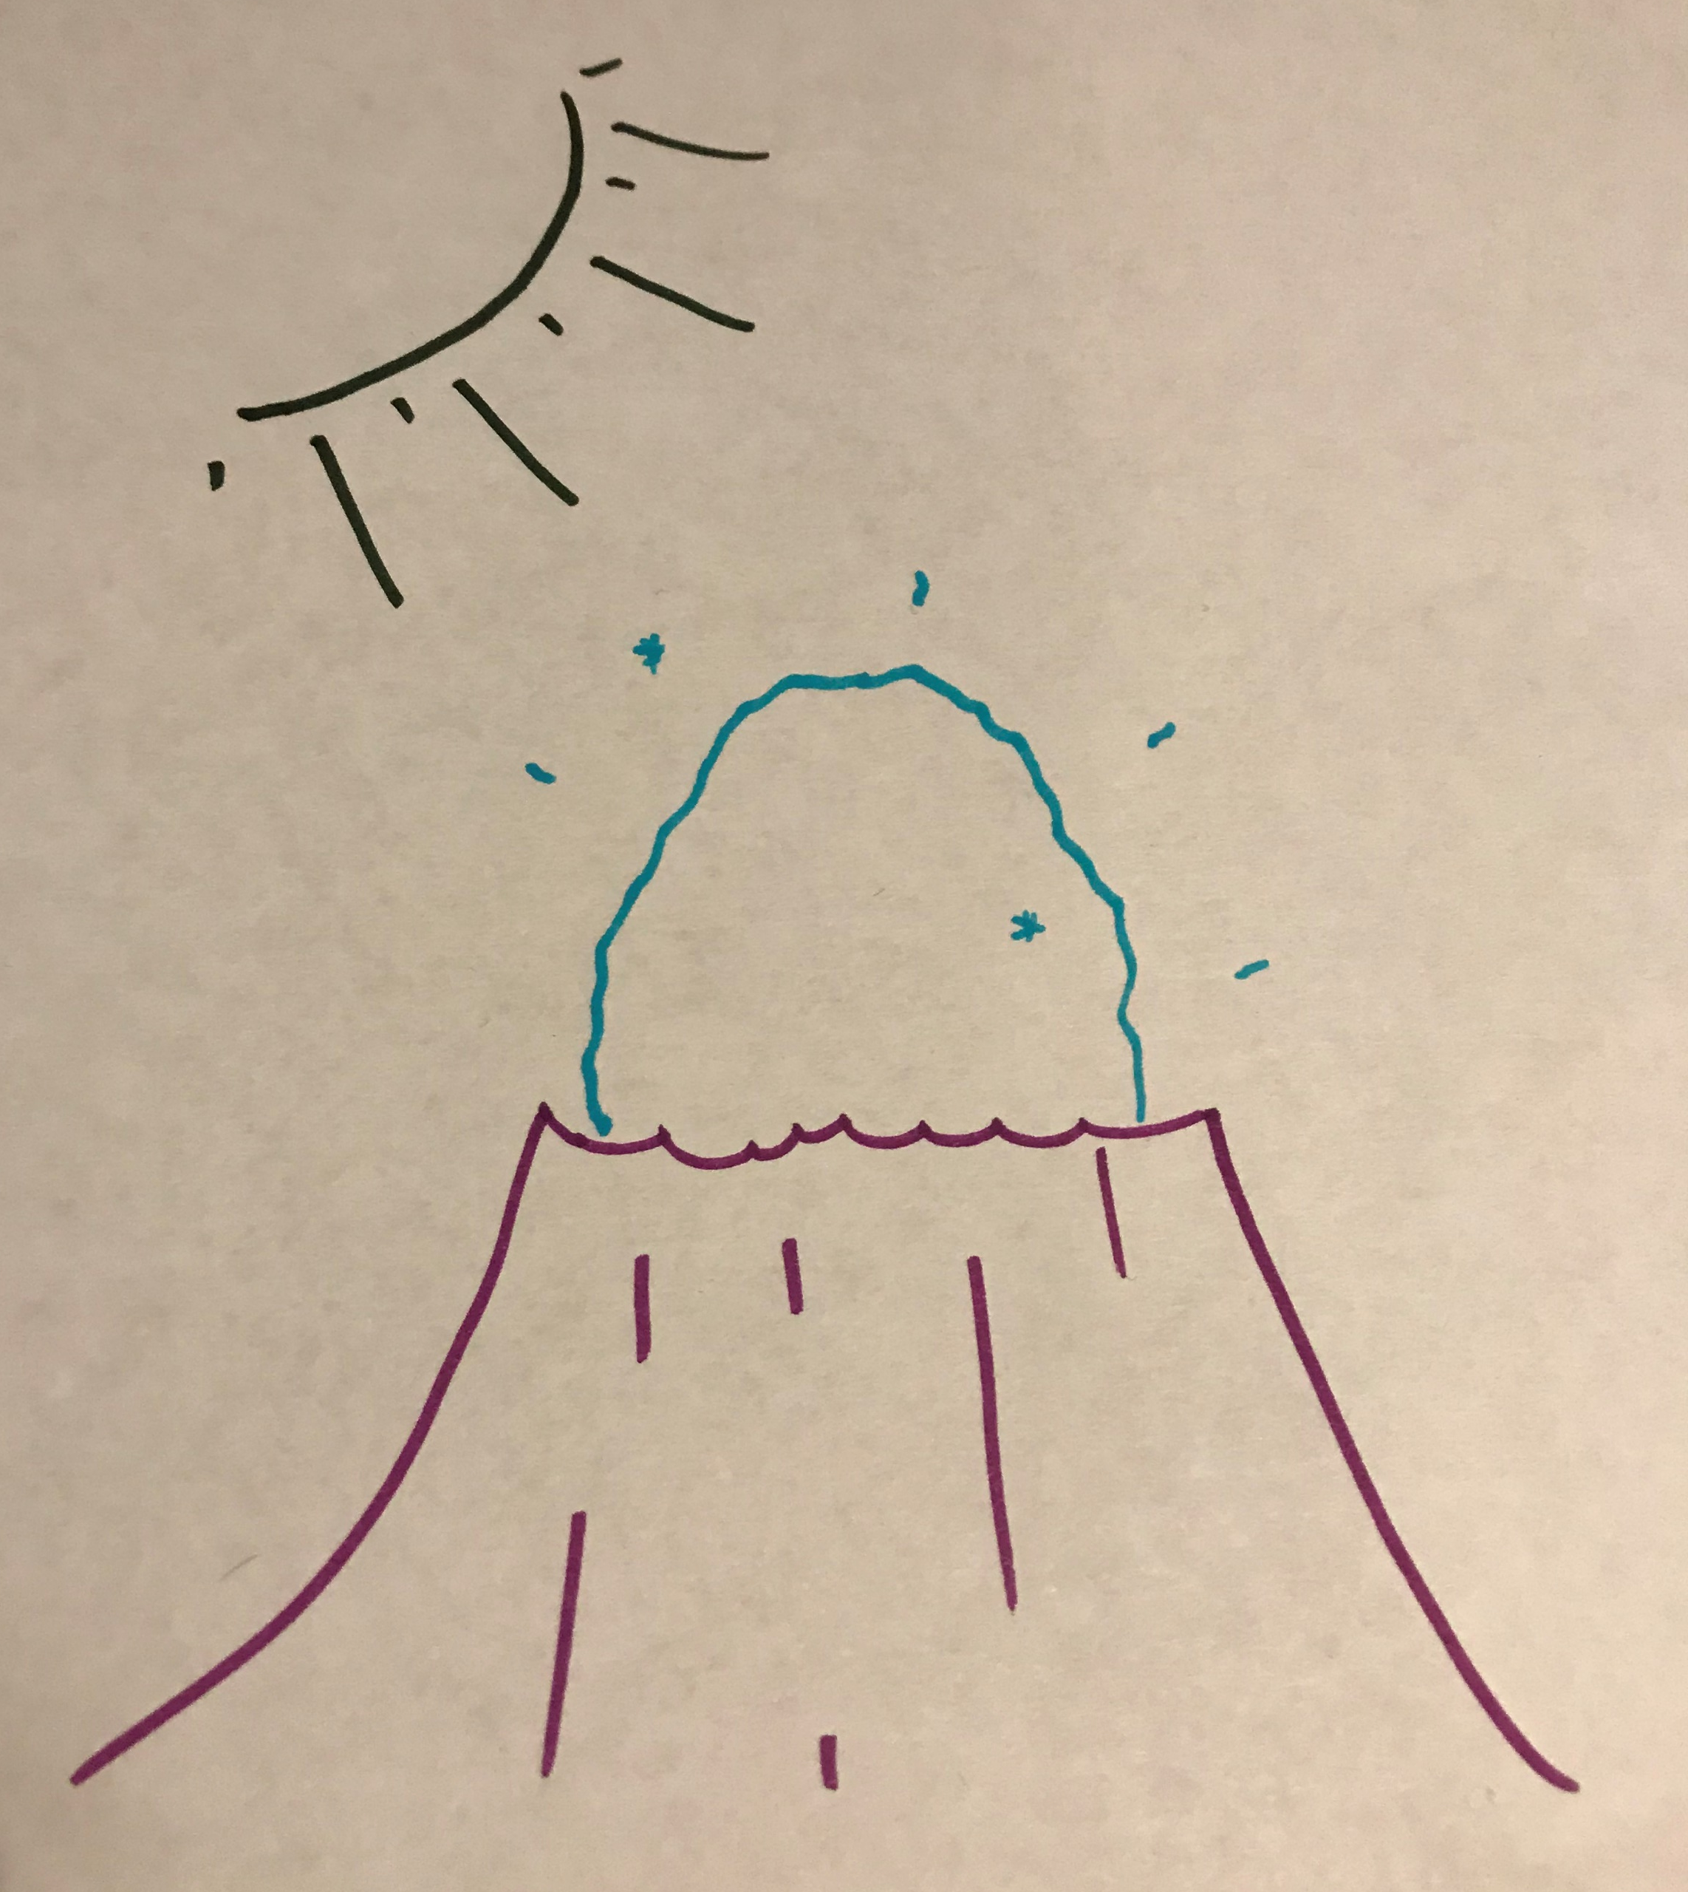
Female Zerbandas lay the eggs containing Zerbandalings in small craters.
High in the sky, the enormous, green Zerbanda sun keeps the egg warm until it is ready to hatch.
Cleverly, the eggs are invisible to hide them from larger aliens who enjoy Zerbandaling eggs for a snack.

Slide 2
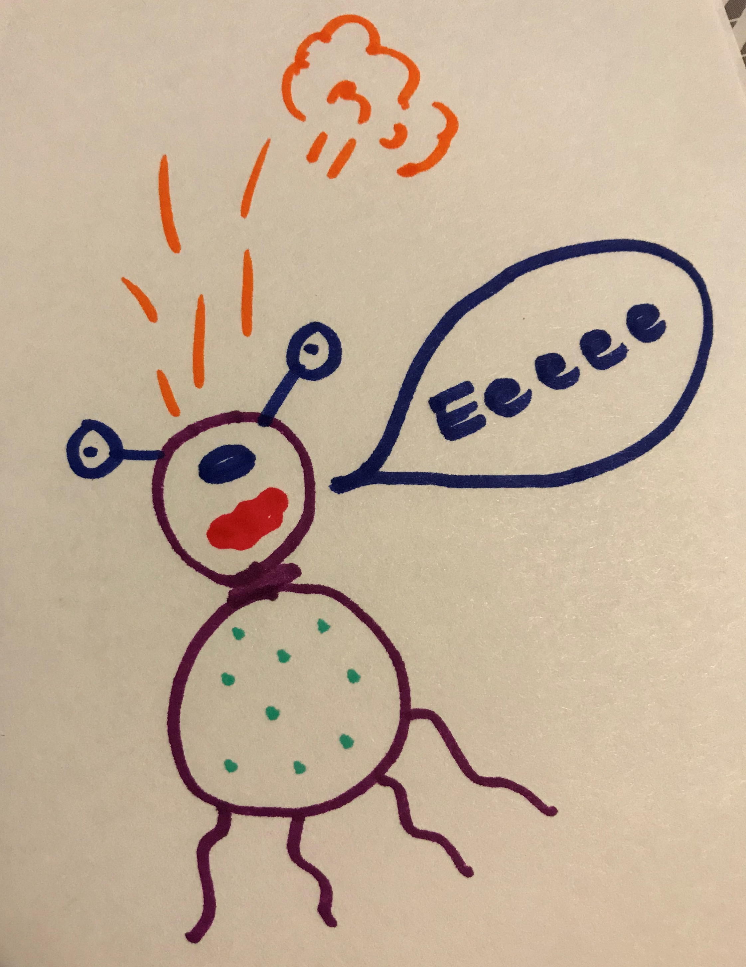
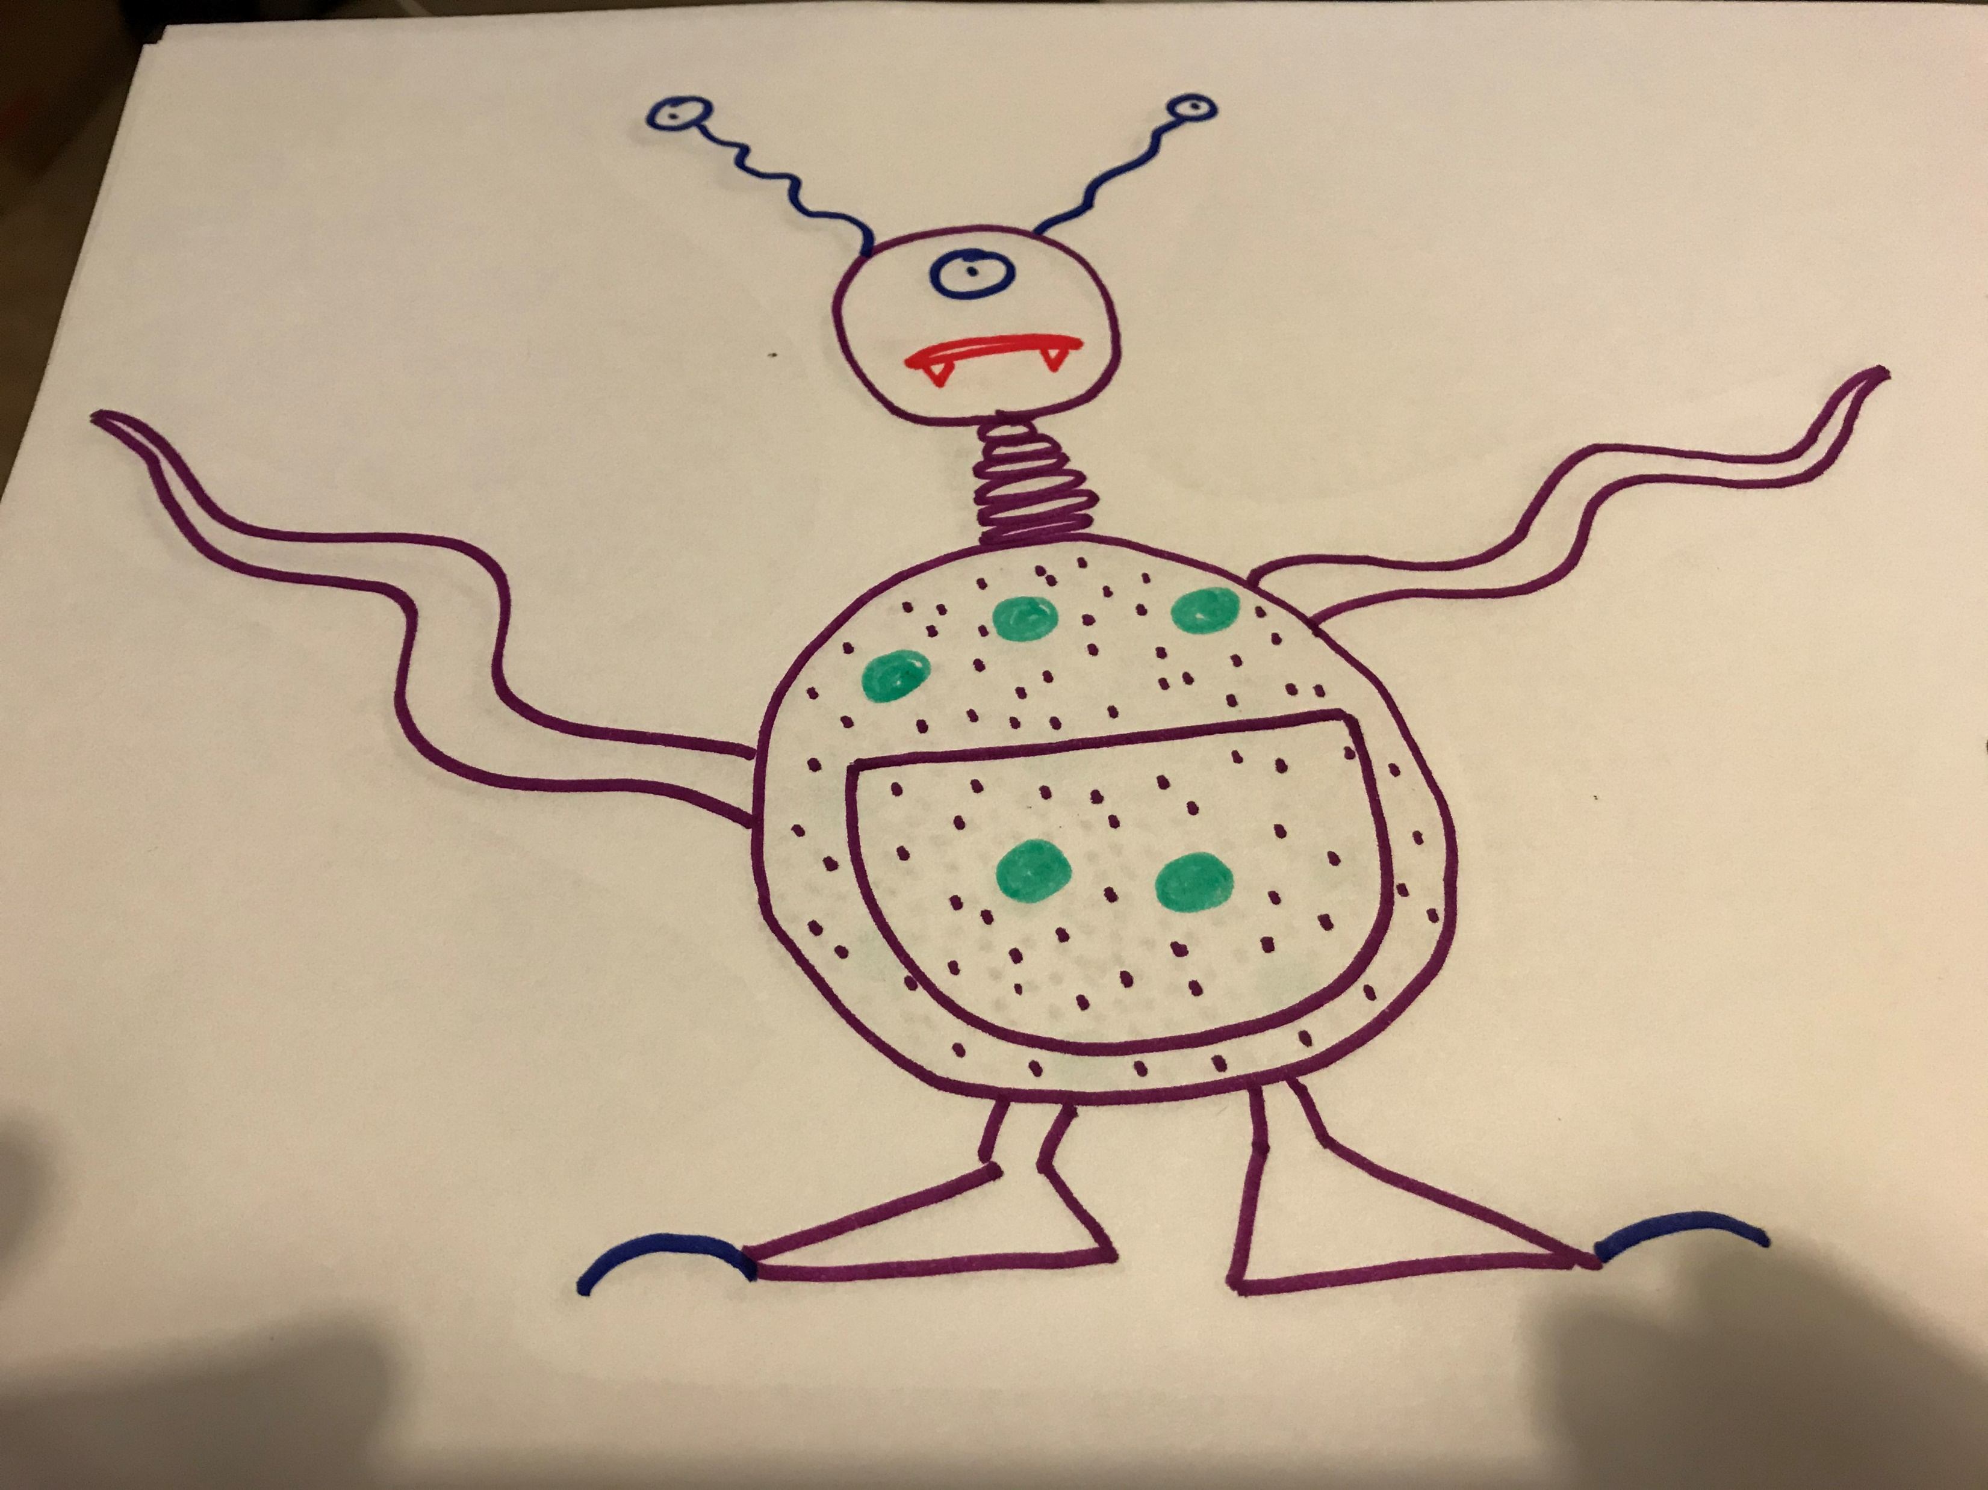
Zerbandalings are deafeningly loud and their screams of ‘Eeeeeeeeeee’ can be heard for miles across the Zerbandan mountains.
In order to protect their tiny hatchling, the mother Zerbanda grows a protective pouch on her abdomen in which to keep her youngster. These pouches are soundproof so no one can hear their screams.
Small Zerbandalings poop from the top of their small heads. Parent Zerbandalings know not to kiss the child on the head!
When they are first hatched, their tentacles are under-developed and they cannot run very fast.
You will notice that the mother alien’s face has also changed as she fiercely defends her child.

