Slide 1


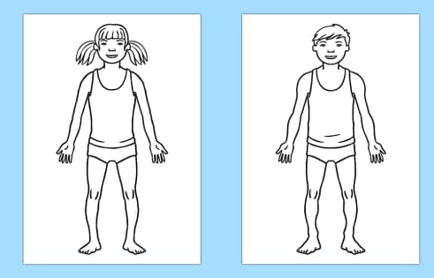

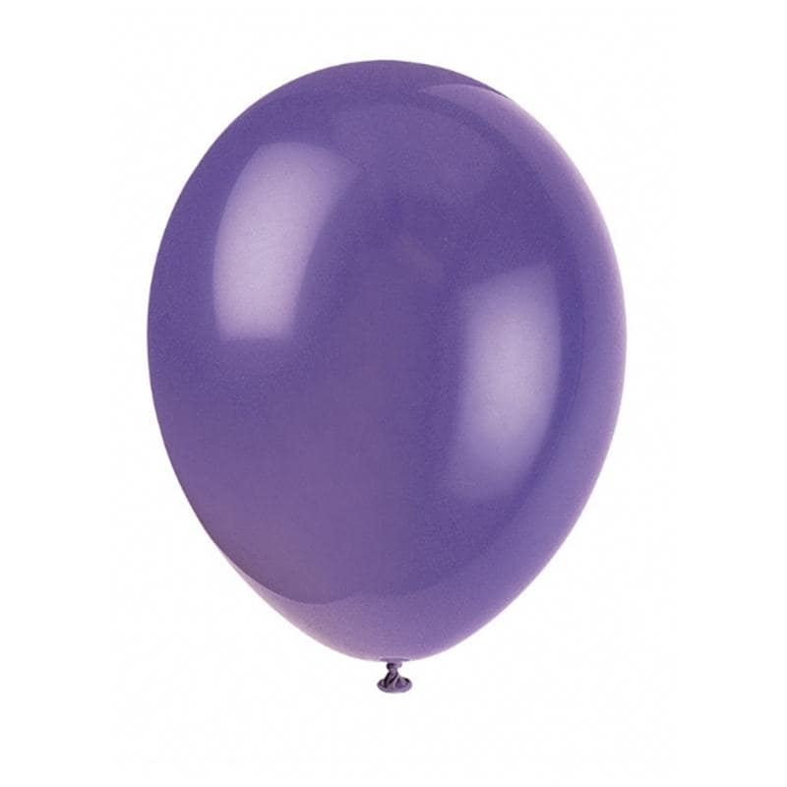
Unravel a metal coat hanger to form the antennae. Spray paint them blue.
If you want to visit Zerb and meet the Zerbandas, you must disguise yourself well.
Use a long, purple slinky attached to the collar of your top to mimic the neck.
Stitch blue spots to a purple onesie and cover your body in it.
Blow up an enormous purple balloon and paint the third eye and sneaky smiling mouth onto the front.

Slide 2

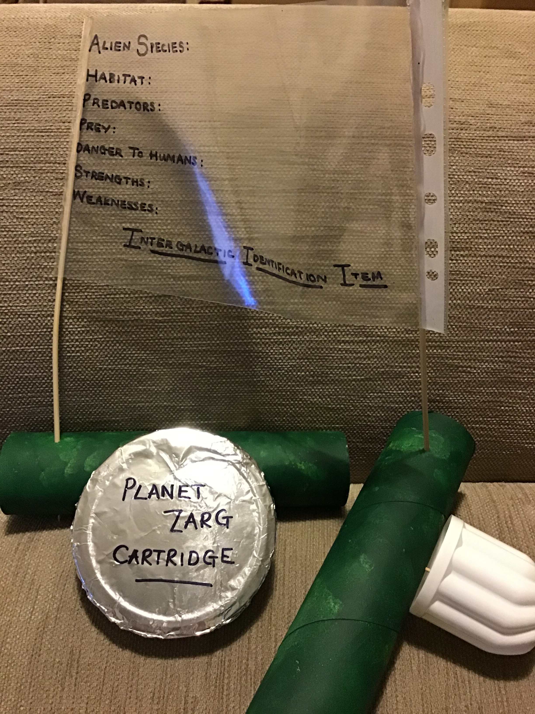

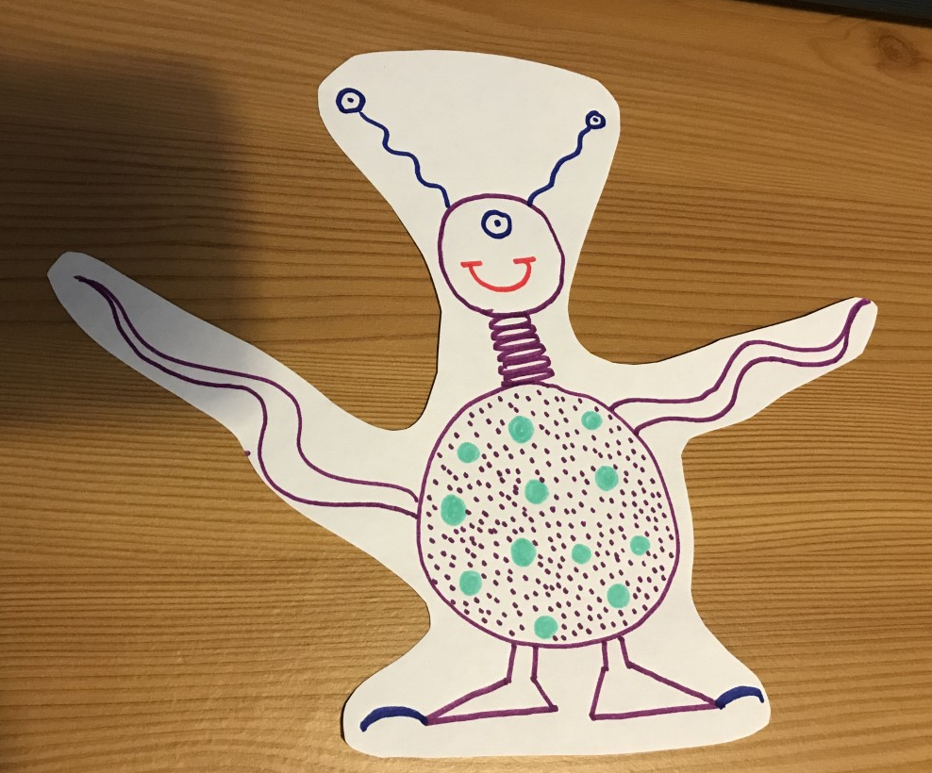
Once you have cunningly disguised yourself as a Zerbanda, climb aboard your space craft, set your co-ordinates for deepest, darkest space and take off!
Good luck – and don’t forget your Intergalactic Identification Item!

