Slide 1
Why jewellery was important in Roman times.
Wednesday topic task
Jewellery tells a story about where the material comes from to make it.
Jewellery is a symbol of power and wealth.
Jewellery is still used on the same parts of the body as it was in Ancient Rome.

Slide 2
Roman Jewellery
Roman women had mirrors made of highly polished metal. Necklaces and bracelets were made out of brightly coloured glass beads and polished stones. Pearls were also used. As well as necklaces and bracelets, Roman women would also wear ear-rings and friendship rings.
Clothes pins were worn and also decorated as items of jewellery. Jewelled and decorated hair-pins were also popular with the Roman ladies. Roman men only wore finger rings and it was expected that they should only wear one.
Even in Roman times though there were people who ignored tradition and some Roman men wore rings on every finger!

Slide 3
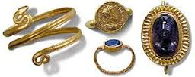
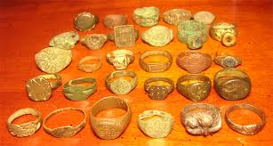
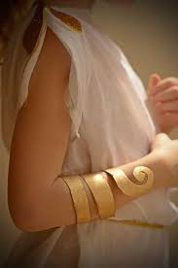
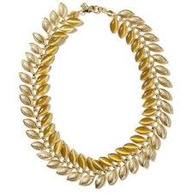
Bracelets, rings, necklaces and more!

Slide 4
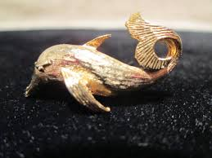
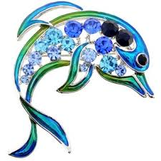
Broaches and beliefs
In Roman times men and women would often fasten their cloaks with brooches. Brooches would come in all different sorts of shapes and sizes.
Often brooches were shaped like animals to bring the wearer luck. Certain animals were symbols of certain gods, for instance the dolphin was often used to celebrate the sea god Neptune.

Slide 5
Fancy Festivals!
Sometimes Romans would have specially designed broaches to celebrate different Roman festivals. They would wear these badges to try and look their best at these festivals.
Romans loved festivals, at one time there were over 159 festivals in one year!

Slide 6
Create your own Roman broach
Now design and create your own Roman broach. Think about all you have learnt about Roman designs. Draw your design and colour it in. Cut it out and attach your broach with tape or a safety pin, with help from your adult.

