Slide 1
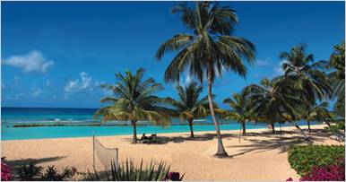
Persuasive Writing
Advertisements
Barbados special offers from £775!

Slide 2
Aim of adverts is to... SELL!
This means it has to make you want to go on holiday here.
It has to sound like the BEST place ever!!

Slide 3
Feel Good Words
What do people want from a holiday?
Number One Holiday!
ATTRACTIVE
friendly
peaceful
picturesque
Calm seas
Special Offer!!
Once in a lifetime experience
Welcoming
people
EXCITING
adventures!

Slide 4
Superlatives!
Simply the best!
The most luxurious hotels!
The tastiest food!
The bluest seas!
The fastest speedboats!
The comfiest beds!
The friendliest people!
The prettiest fish!
The hottest sun!
The cheapest deals!
The best carnivals!
The softest sand!

Slide 5
BOSSY VERBS
(IMPERATIVES)
You MUST....
EXPLORE
our beautiful mountains
VISIT
the ancient castles
EXPERIENCE
swimming with dolphins
STROLL
along the white sand beaches

Slide 6
Use a catchy slogan:
SUPER SOFT SAND!
Swim with
Colourful Caribbean Creatures!!
Beautiful Barbados
Beaches!
BE happiest here in haiti!
Magnificant Mountains!
Remember to use ALLITERATION
Use a slogan that catches the reader’s attention!
Make it big, bold and fun to read!

Slide 7
Rhetorical questions????
These are questions that do not need an answer but are used for effect.
Fancy a great holiday break?
Want to swim with turtles?
Ever experienced Carnival?
Why not visit the Caribbean?

Slide 8

PICTURES
Paint a thousand words

Slide 9
Organise your information
BULLET POINTS
Walking along our spectacular coast
Bird-watching at our beautiful reserve
Dancing in our famous carnival
Sub-headings
Activities
You can go surfing, snorkelling and even swimming with sharks!
Labels
Snorkelling and
Underwater photography
Of the amazing sealife!

Slide 10
Use words that:-
STAND OUT
PERSUAde
COOL!
Describe
Show it’s the best!
Inform
BIG AND BOLD

