Slide 1
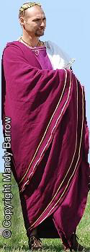
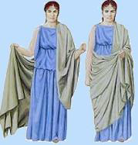
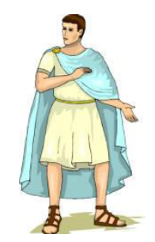
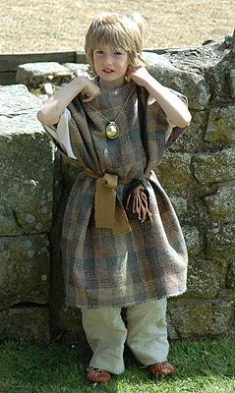
Thursday topic task
Think about all we have learnt about Roman clothes and jewellery. Today’s task is to draw or create a Roman outfit. You could draw your design and label it or it could be made for yourself or a teddy to wear. Maybe you could also wear your piece of jewellery.

