Slide 2
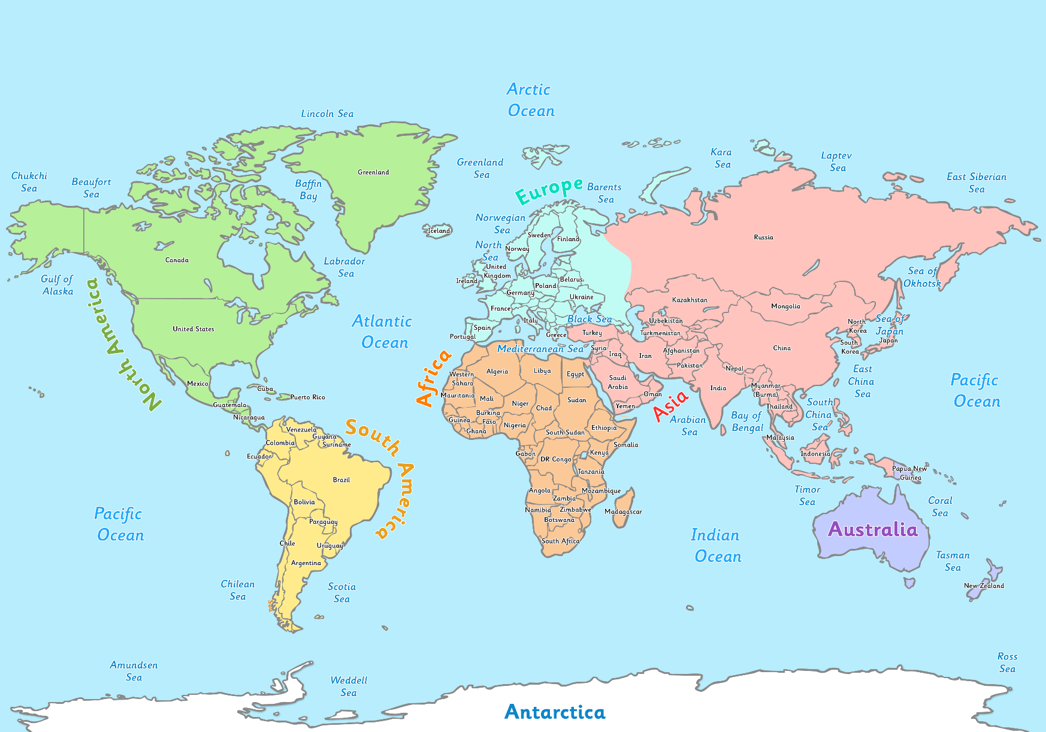
Where in the World?
United Kingdom
The United Kingdom is made up of England, Scotland, Wales and Northern Ireland. It is in the Atlantic Ocean.
Australia
Australia is a country and a continent surrounded by the Indian and Pacific Oceans.

Slide 3
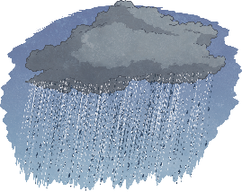
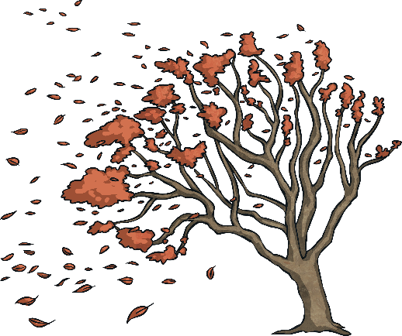
Weather in Australia
The weather in Australia changes over the year. Australia has different seasons of weather.
In Australia, the four seasons are summer, autumn, winter and spring. The seasons are identified by the group of calendar months which they belong to.
In Summer (December, January and February), the weather is hot. Some parts of Australia are humid and other parts are dry.
In Autumn (March, April and May), the weather becomes cooler.
In Winter (June, July and August), the weather is cold and rain and storms are common. Some places in Australia get snow.
In Spring (September, October and November), the weather becomes warmer, however, it is still very mixed. There can be rain, wind and cool days.

Slide 4
Weather in the UK
The weather in the UK also follows a seasonal pattern, and it is similar to the weather pattern in some parts of Australia, but is opposite in the corresponding months.
The Winter (December, January and February) usually sees the coldest weather. It is cold, wet and windy and it sometimes snows. The average winter temperature is around 3 degrees Celsius and the average rainfall is about 5cm.
In Spring (March, April and May), the weather turns milder. It can still be wet and windy, especially in April. The average temperature is 11 degrees Celsius and the average rainfall is 5cm.
In Summer (June, July and August), the weather gets warmer. Average temperatures go up to around 19 degrees Celsius and the average rainfall is around 4.5 cm.
The Autumn (September, October and November) sees the weather turn colder and wetter. The average temperature is 13 degrees Celsius and the average rainfall is about 6cm.

Slide 5
Australian Fruit

Slide 6
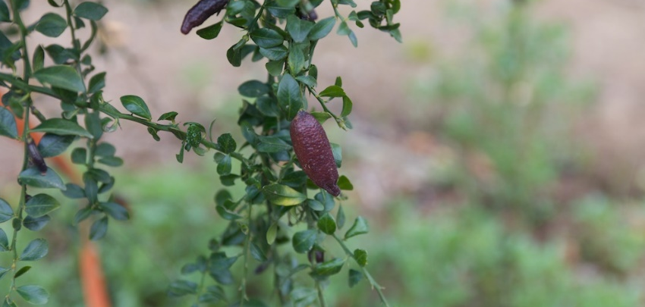
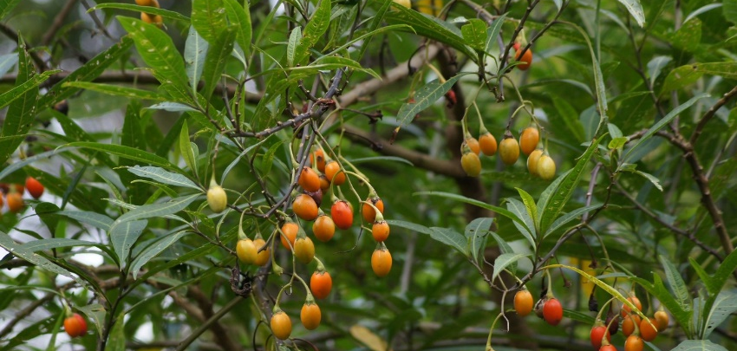
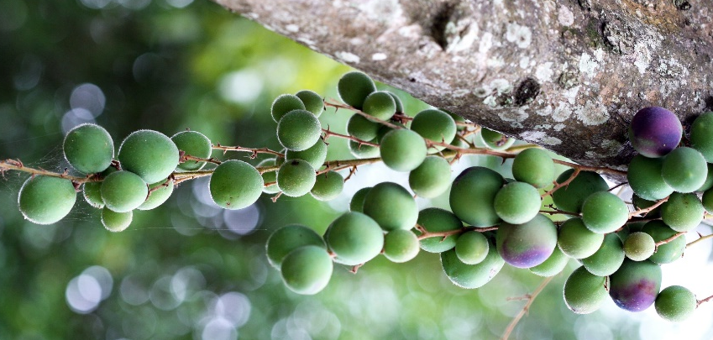
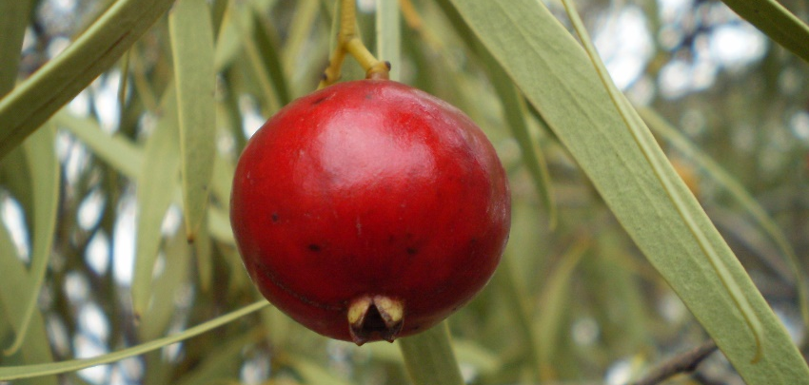
Australia grows many fruits including apples, pears, bananas, citrus fruits, pineapples and mangoes. However, these are not native.
Some native fruits in Australia include:
Finger Lime
Kangaroo Apple
“Finger Lime” by Malcolm Manners is licensed under CC BY 2.0
“Kangaroo apple” by tatters is licensed under CC BY 2.0
Quandong
Davidson Plum
“Davidson Plum” by Brisbane City Council is licensed under CC BY 2.0

Slide 7
UK Fruit

Slide 8
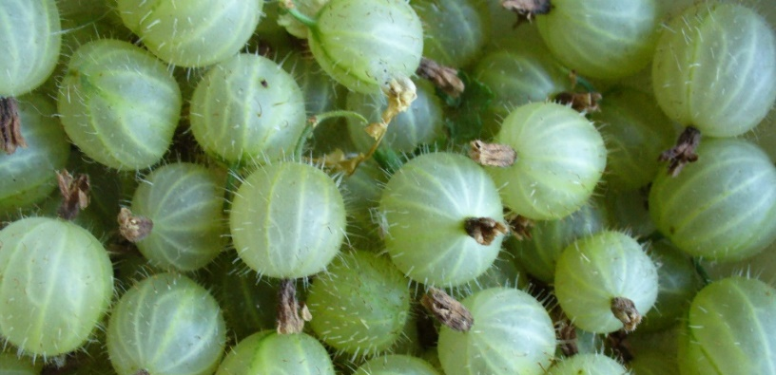
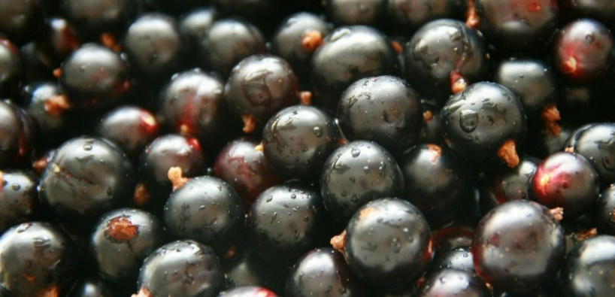
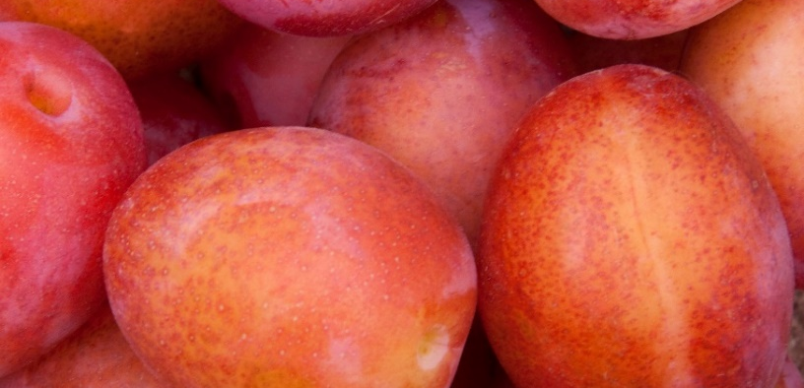
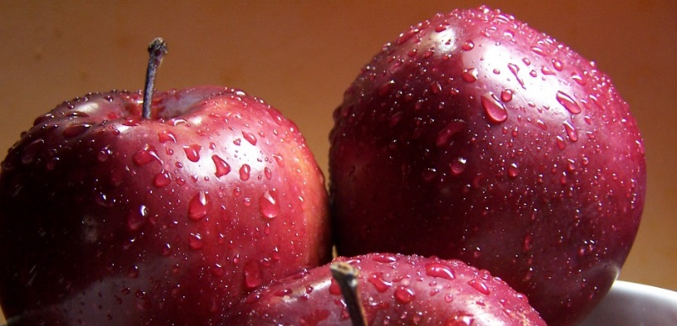
Gooseberry
Blackcurrants
“Gooseberries” by fsse8info is licensed under CC BY 2.0
“blackcurrants” by The Garden Smallholder is licensed under CC BY 2.0
Plums
Apples
“Plums” by katerha is licensed under CC BY 2.0
“apples” by katerha is licensed under CC BY 2.0

Slide 9
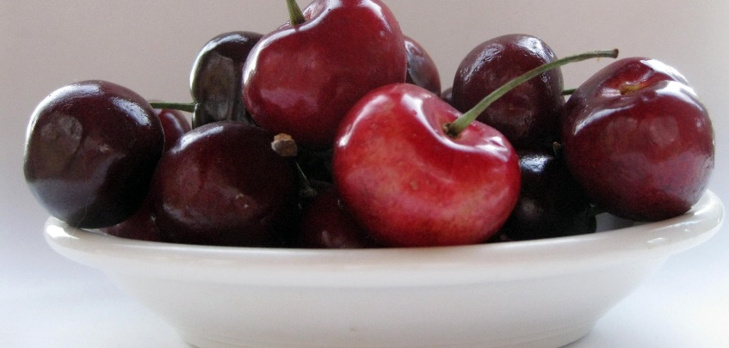
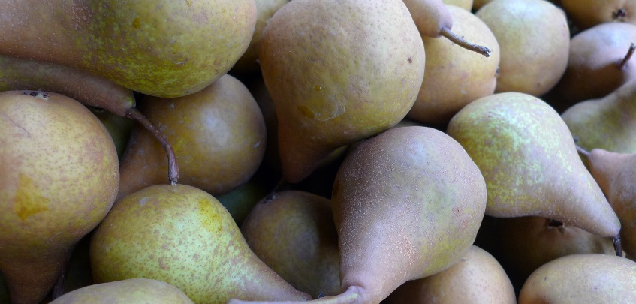
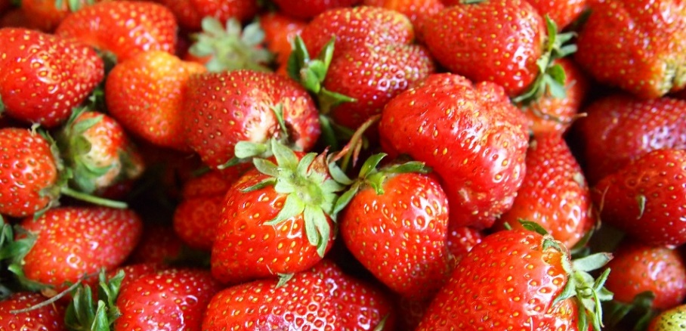
Cherries
“cherries” by ahisgett is licensed under CC BY 2.0
Pears
Strawberries
“Pairs” by cuttlefish is licensed under CC BY 2.0
“Strawberries” by Fried Dough is licensed under CC BY 2.0
“Davidson Plum” by Brisbane City Council is licensed under CC BY 2.0

Slide 10
Australian Houses

Slide 11
“renovation of gyldenrisparken” by seier+seier is licensed under CC BY 2.0
“pool abdrewarchy” by Abdrewarch is licensed under CC BY 2.0

Slide 12
UK Houses

Slide 13
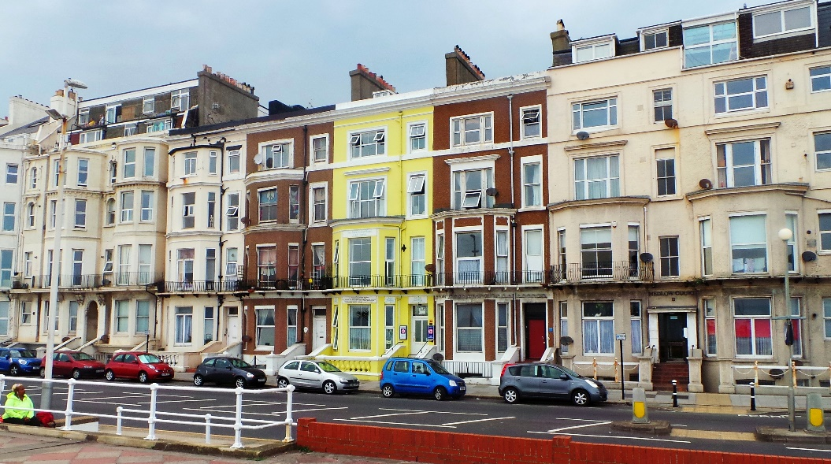
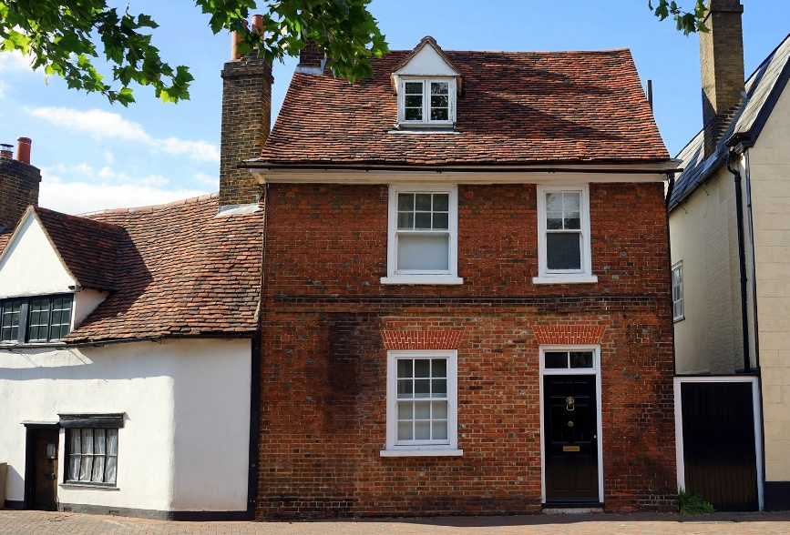
“Hastings Seafront July 2014 – Primrose House” by Gareth Williams is licensed under CC BY 2.0

Slide 14
Australian Beaches

Slide 15
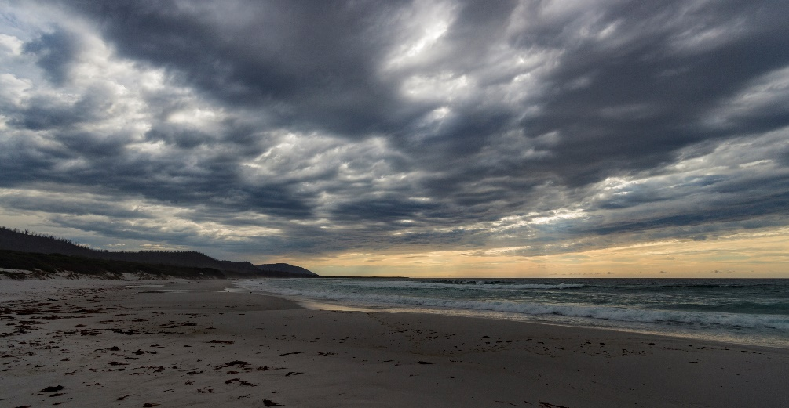
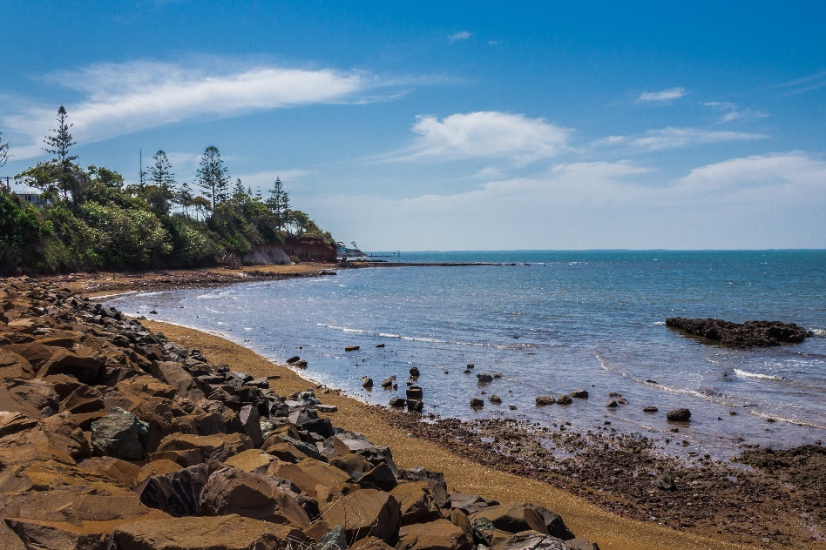
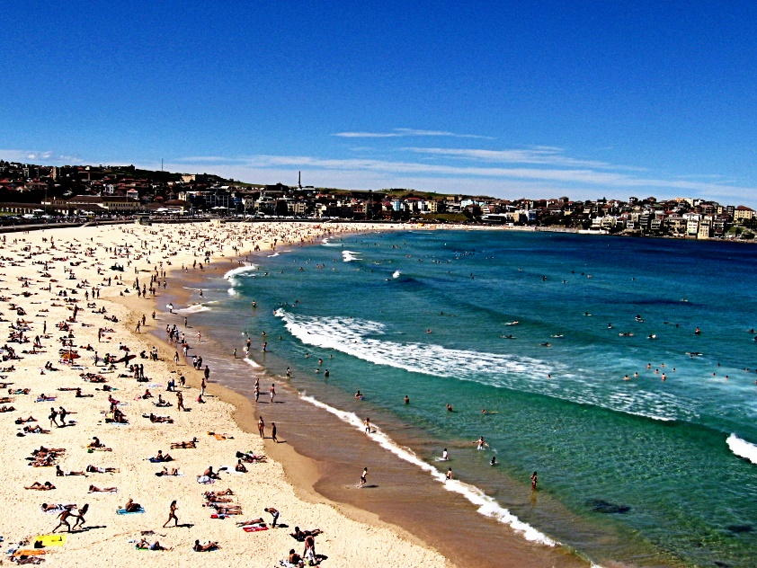
“The Friendly Beaches, Tasmania” by Steven Penton is licensed under CC BY 2.0
“Scarborough Beach” by Matthew Hamm is licensed under CC BY 2.0
“Bondi Beach” by Penreyes is licensed under CC BY 2.0

Slide 16
UK Beaches

Slide 17
