Slide 3
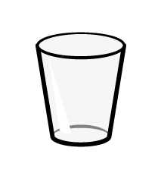
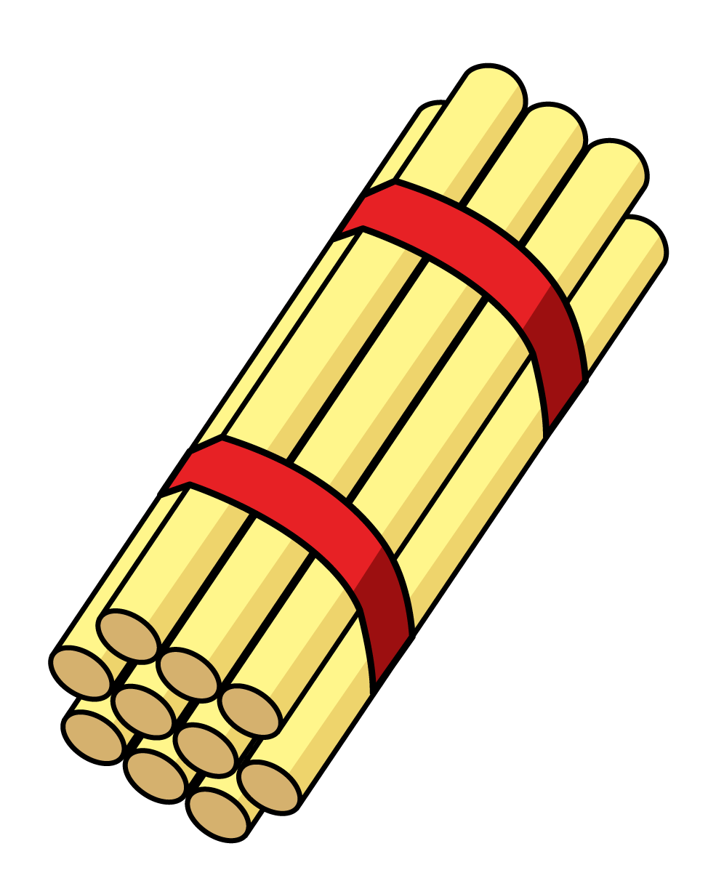
Can you fill in the proper symbol?
10 + 3 10 + 5
2) Is the glass full or empty?
3) How many straws?
4) True or false ?
I can measure the
length, mass and capacity of this mug!

Slide 4
Can you fill in the proper symbol?
10 + 3 10 + 5
2) Is the glass full or empty?
3) How many straws?
4) True or false ?
<
empty
32
I can measure the
length, mass and capacity of this mug!

Slide 6
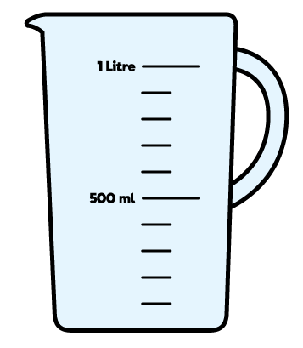
Compare capacity
These jugs are in order from
greatest to least capacity.

Slide 7
Compare capacity
Have a think
These jugs are in order from
_____________ capacity.
least to greatest

Slide 8
Have a go at question 1 on the worksheet

Slide 9
Have a think
12
20
7
A
B
C
Let’s compare using symbols!
<
Jug A Jug B

Slide 10
Have a think
12
20
7
A
B
C
Let’s compare using symbols!
<
Jug B Jug C

Slide 11
Have a think
12
20
7
A
B
C
Let’s compare using symbols!
>
Jug C Jug A

Slide 12
Have a go at question 2 on the worksheet

Slide 13
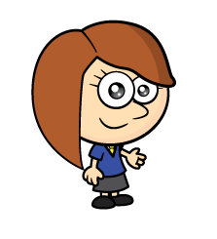
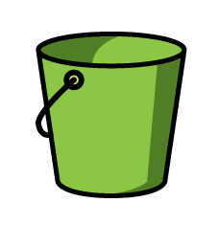
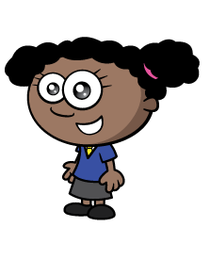
Measure capacity
2
8
4

Slide 14
Who has the greatest capacity?
Have a think
2
2
2
2
2
10
8
8
4
4
4
12

Slide 15
How could they have the same capacity?
Have a think
2
2
2
2
8
8
8
4
4
8

Slide 16
Have a go at question 3 on the worksheet

