Slide 3
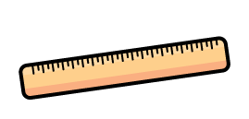
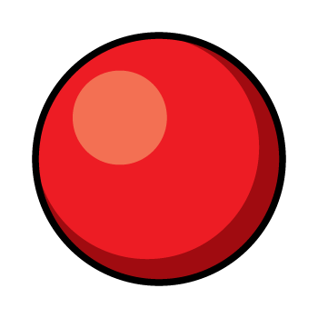
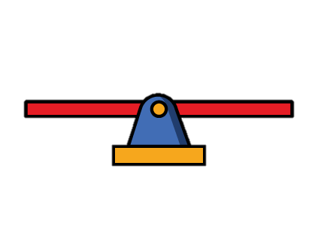
1) What do we measure with a ruler?
2) How do you spell 5?
3) What shape is this?
4) What do we measure with a balance scale?

Slide 4
1) What do we measure with a ruler?
2) How do you spell 5?
3) What shape is this?
4) What do we measure with a balance scale?
length
five
sphere
mass

Slide 6
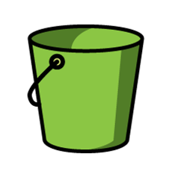
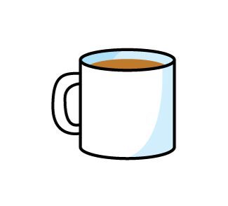
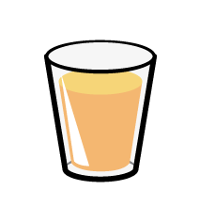
Capacity
Let’s compare!
Which has the greatest capacity?
Which has the smallest capacity?

Slide 7
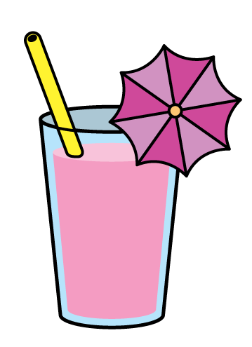
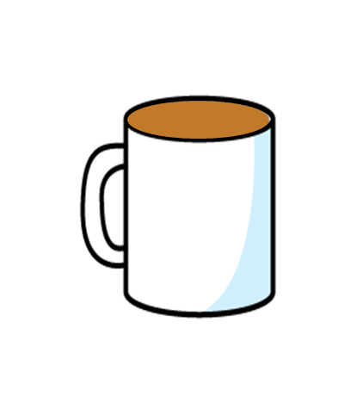
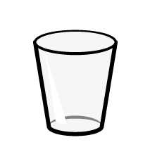
Volume
Have a think
almost
full
empty
almost
full
almost
full
full
How could you describe the volume in each?

Slide 8
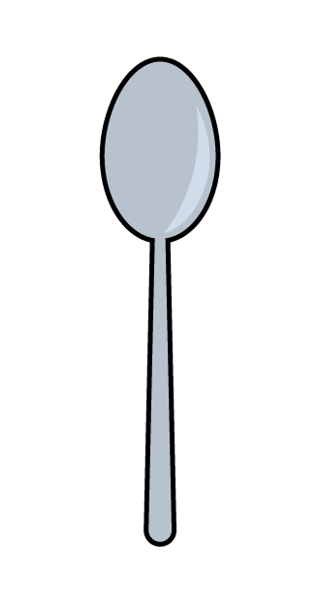
Have a think
If we put in a spoonful of water in the empty glass…
empty
The glass would be almost ______ .

Slide 9
Have a think
What is the volume of coffee in each mug?
full
almost
full
empty

Slide 10
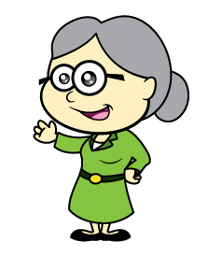
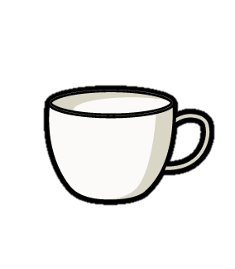
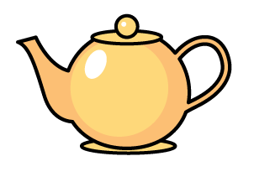
More or less?
Have a think
Tiny, why don’t you take the one with more tea?

Slide 11
Have a go at questions 1 and 2 on the worksheet

Slide 12
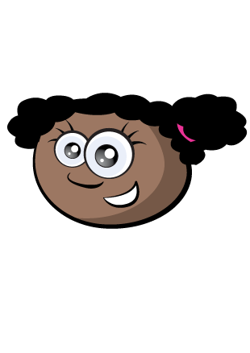
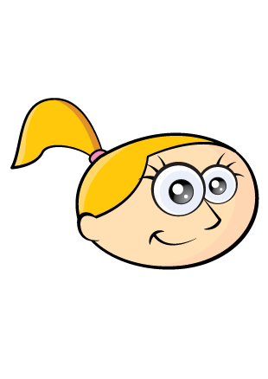
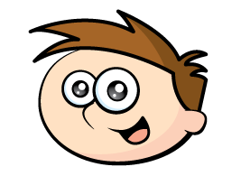
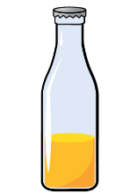
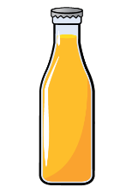
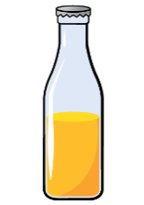
Volume and capacity
Have a think
Each bottle has a different volume of juice inside.
Each bottle has the same capacity.

Slide 13
More or less volume?
Have a think
more
Teddy has _______ than Whitney.
less
Whitney has _______ than Eva.
less
Teddy has _______ than Eva.

Slide 14
Have a go at question 3 on the worksheet

