Slide 3
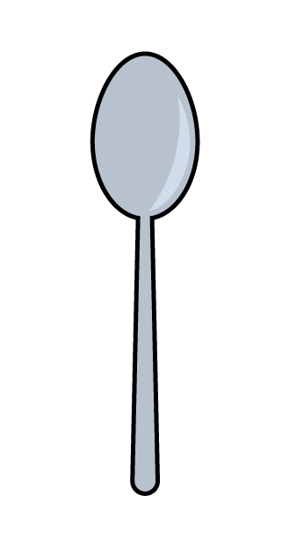
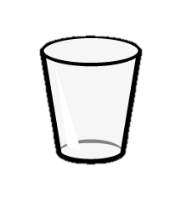
What is capacity?
How much liquid something can hold!
How can we talk about
capacity?
more
less
greatest
least

Slide 4
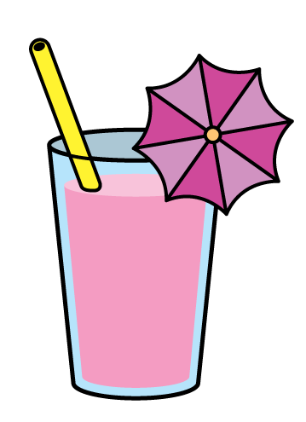
What is volume?
The amount of space the liquid takes up!
How can we talk about volume?
full
almost
empty
more
less
nearly
greatest
least

Slide 5
What are some different kinds of liquids?

Slide 6
Have a think
Would you rather…
Fill the bucket one spoon at a time or one cup at a time?

Slide 7
Find a cup and a spoon and a bowl. How can you fill the bowl?

Slide 8
Have a think
Different sizes
If you were thirsty…
If you had to take medicine…

Slide 9
Can you find different objects that have capacity?

