Slide 1
I wonder…
how trains work ?

Slide 2
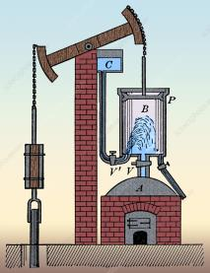
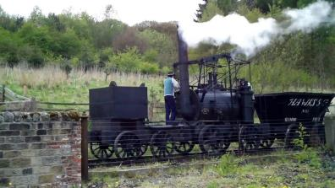
Steam trains
Have you ever watched a kettle boil? Do you remember seeing the steam?
When water boils, it turns into a gas which we call steam.
300 years ago, inventors found that if you push steam into a small space, it will move what is in its way. The first Steam Engine was made.
Soon, engineers and inventors found a way to use steam to make a wheel turn. The first ‘real’ trains were powered by steam.

Slide 3
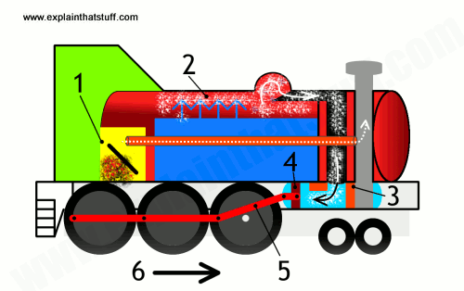
How do they work?
1. Coal is burnt in the firebox.
2. The water in the boiler is heated and turns to steam.
3. The steam goes to the cylinders (say sill-in-ders).
4. As the steam moves, it pushes the pistons. (This is is what makes the ‘chuff chuff’ noise).
5. The pistons push the rods that go to the wheels.
6. As the rods move, this makes the wheels turn.
7. The smoke from the fire goes out through the chimney.

Slide 4
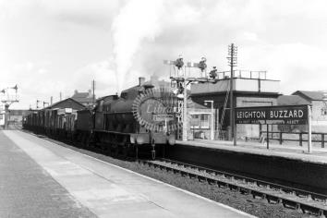
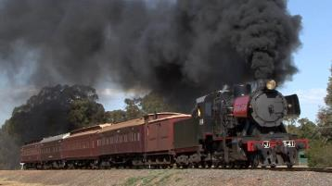
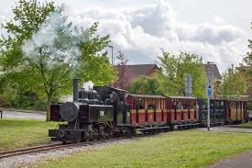
Steam trains
Most trains built for the next 100 years were steam trains. This old photo is of a train at Leighton Buzzard station.
Some people thought that steam trains were dirty and smelly and something different was better. Look at all the smoke!
Now a lot of people like to ride on steam trains on a day out. This is the steam railway at Leighton Buzzard. Have you seen it? Have you been on the steam train?

Slide 5
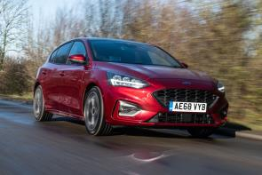
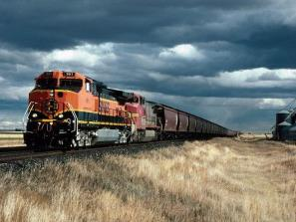
Diesel trains
Does your family have a car? If you do, it probably runs on petrol or diesel.
The first petrol and diesel engines were invented about 150 years ago. They were cleaner than steam engines because they didn’t use coal and safer because they didn’t get so hot.
The first diesel (say dee-zul) trains were made about 100 years ago. They were cheaper and could pull more than steam trains.

Slide 6
How do they work?
1. The fuel is kept in a big tank between the wheels.
2. A big pump takes the fuel from the tank to the engine.
3. When the fuel is heated, it makes a gas, which pushes pistons in the engine (just like a steam train).
5. These drive motors that make the wheels turn.
6. All the parts can get very hot, so the train has a big fan to let cool air in.

Slide 7
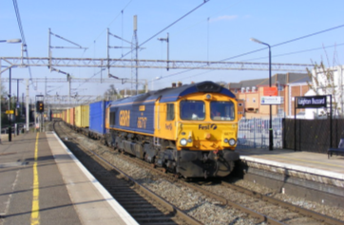
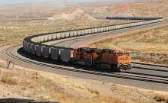
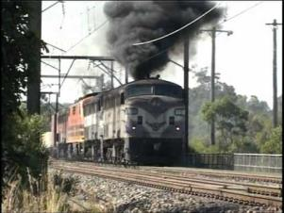
Diesel trains
Lots of diesel trains still run now. This one is pulling a heavy train through Leighton Buzzard.
Some diesel trains are very strong. Look at how long this train is.
Have you heard about fossil fuels? Burning lots of oil isn’t good for the environment.

Slide 8
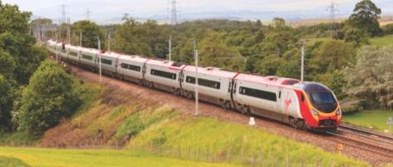
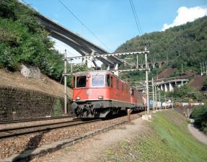
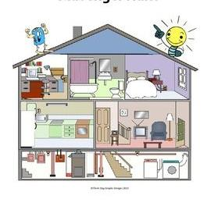
Electric trains
A lot of trains now run on electricity.
Electric trains don’t burn any fuel or give off any smoke. The are the most clean and most quiet sort of train.
What things can you think of at home or school that use electricity?

Slide 9
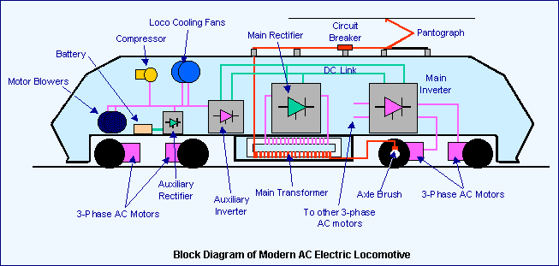
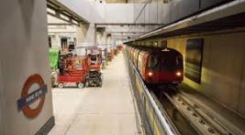
How do they work?
1. The electricity runs in wires above the train.
2. The electricity runs into the train using a pantograph (say pan-toe-graf).
3. The electricity makes motors turn.
4. The motors turn the wheels and the train moves.
Sometimes, the electricity comes from a rail on the ground, under the train. The London Underground uses this – never walk on train tracks.

Slide 10
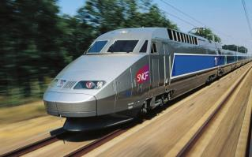
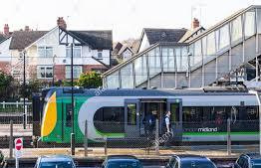
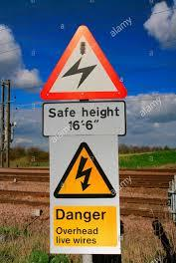
Electric trains
Electric trains are the fastest trains. This is a fast train in France.
Because electric motors are smaller, they use less space. This means that most electric trains have seats in them for people to sit on. This train takes people from Leighton Buzzard to London. Do you know anyone who takes the train to work?
The electricity in the wires is more than 100 times more powerful than the electricity at home.
It is very, very, dangerous and you must never go near the overhead wires.

Slide 11
Today’s task
Can you label a picture to show the parts of a train?
COOL | WARM | HOT

