Slide 2
Origin of Las Fallas
Las Fallas is a celebration that has been part of the history of Valencians since ancient times. People lit fires on the coasts for parties and celebrations. They also used them to communicate and to send messages to sailors.
The word ‘falla’ comes from a Mozarabic term meaning ‘torch’.
Mozarabic – This term was used to describe Christians that lived in Spain under Muslim rule when the country was called Al-Andalus.
Valencians – People who are born or live in Valencia.

Slide 3
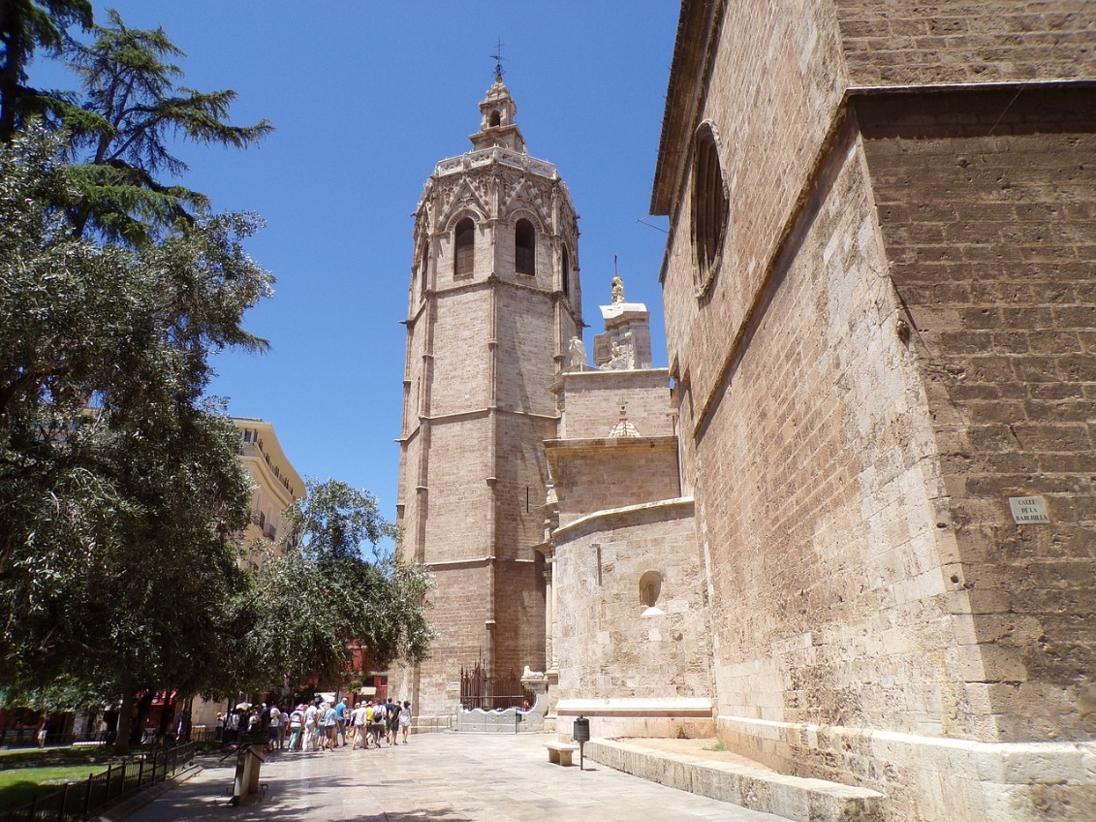
Origin of Las Fallas
One of the most popular fallas was in Valencia. It was lit above the Miguelete (in Valencian, ‘Micalet’); this is the tower at the top of the Cathedral of Valencia. This falla guided sailors during the night.
Another job that this falla had was to signal to workers who were outside the walls of the city that it was time to return home.

Slide 4
Pirates!
Valencian coasts were constantly threatened by pirates. One of the most famous of these was Barbarroja (Red Beard). The towers in Valencia lit fallas all along the coast to alert each other to the presence of pirates.
However, they didn’t light all of the fallas at once. The soldiers working on the towers had a special code that pirates didn’t know about! They used this code to communicate with each other.

Slide 5
Las Fallas Today
Today, fallas are models made of wire, paper and cardboard that form true works of art. They can reach 20 meters tall.
They usually have a central figure which is surrounded by smaller figures that are called ‘ninots’.
Las Fallas does not only happen in Valencia. The celebration also takes place in other towns and villages within the Valencian Community.
Las Fallas is so spectacular that it is an International Tourist Interest Festival. In 2016,UNESCO included it in the Lists of Intangible Cultural Heritage for Humanity.

Slide 6
The Sound of Las Fallas
Las Fallas is celebrated between the 1st and the 19th of March. The festival always starts with a ‘mascletá’, which is a set of firecrackers that are blown to produce the maximum possible noise.
Click on the triangle to hear a mascletá.

Slide 7
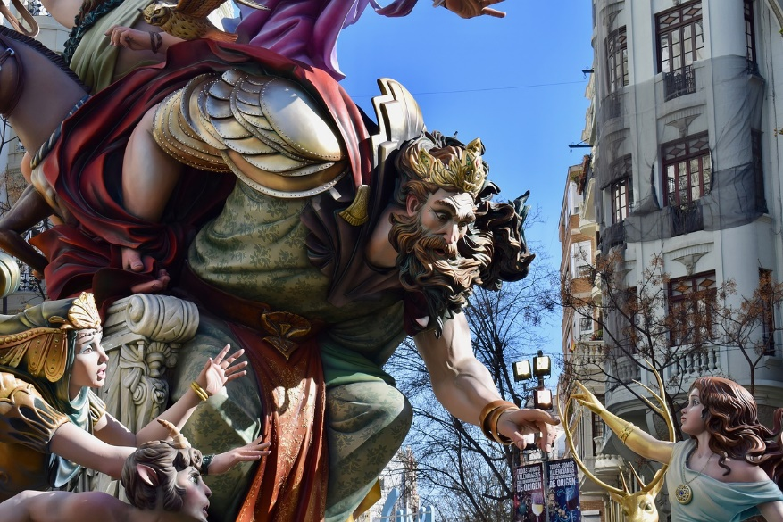
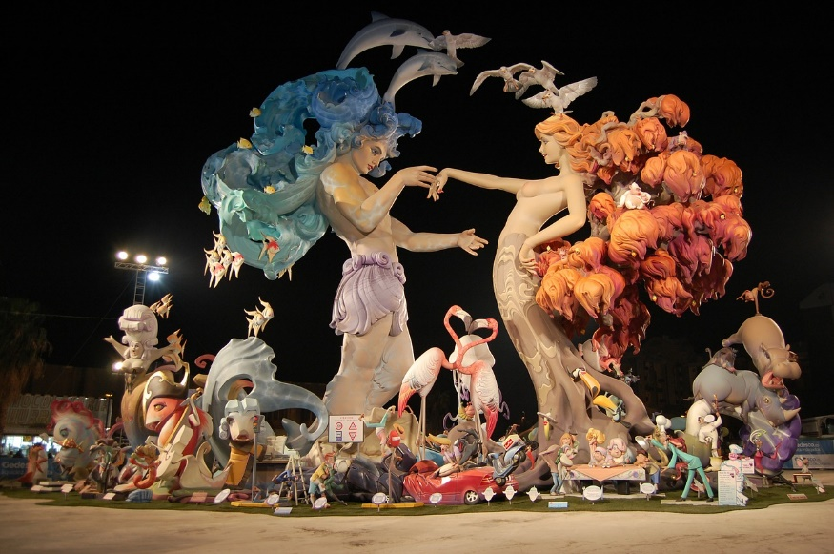
Ninots
Fallas are on display all over Valencia and people from all around the world travel to the city to see them.
Children also have their own fallas, which are smaller but just as spectacular.
Usually, ninots (the small figures on a falla) portray situations of daily life in a humorous or ironic tone. Sometimes, they represent fantastic worlds.

Slide 8
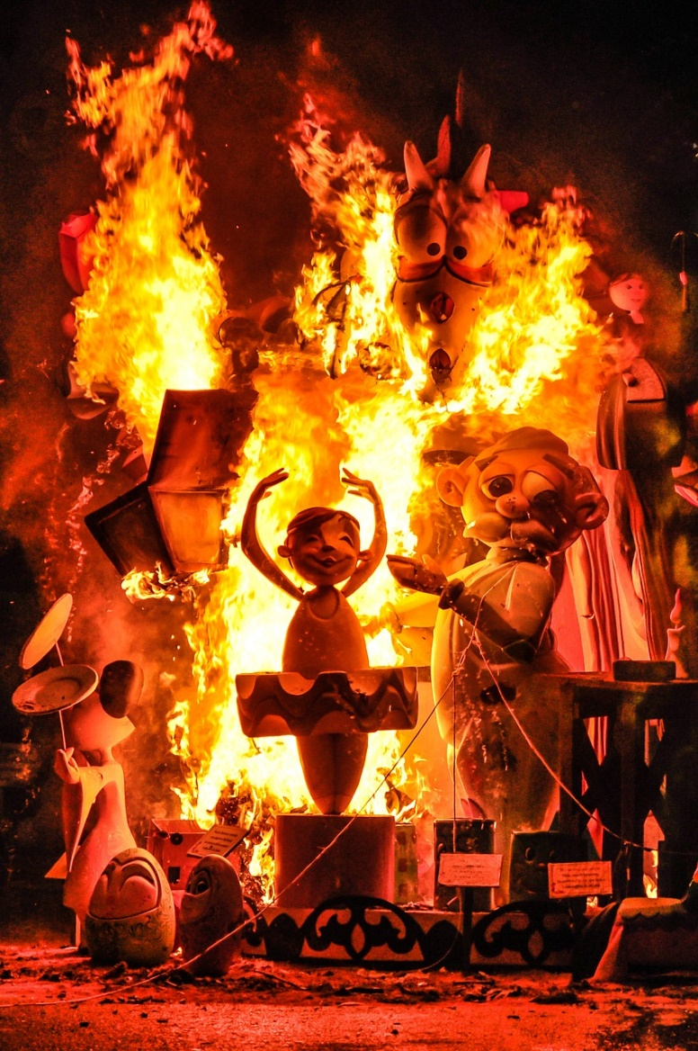
The Contest
All of the fallas enter a contest and those that do not win are burnt on the night of the 19th of March. This is what is called ‘cremá’. The fallas that win the prizes are pardoned and not burnt.

Slide 9
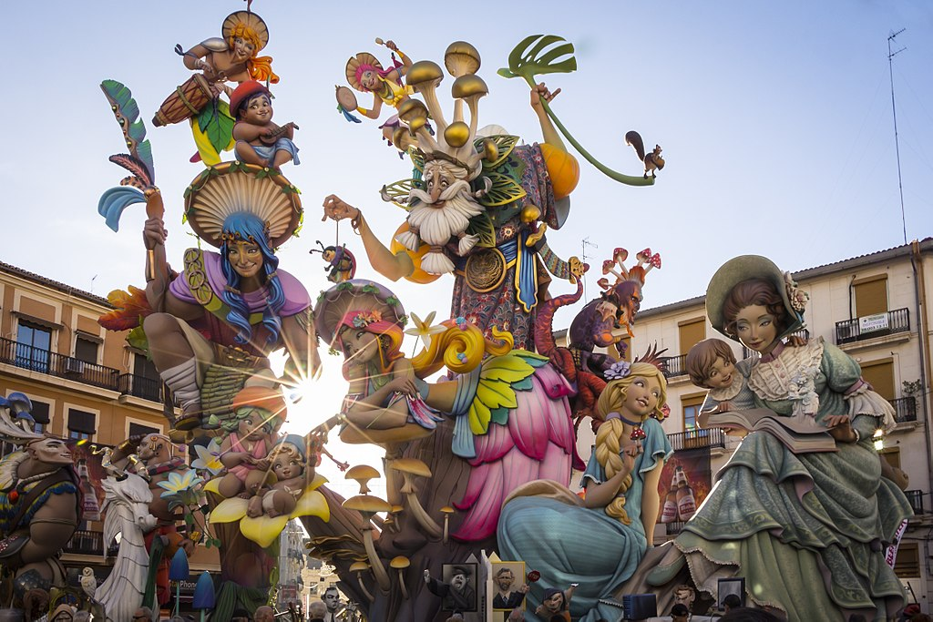
Time to Discuss
This was the falla that was pardoned in 2018. What do you think of it?

