Slide 1
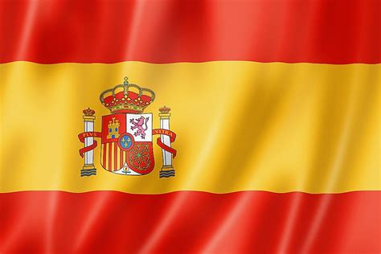
Todo sobre España
(All about Spain)

Slide 2

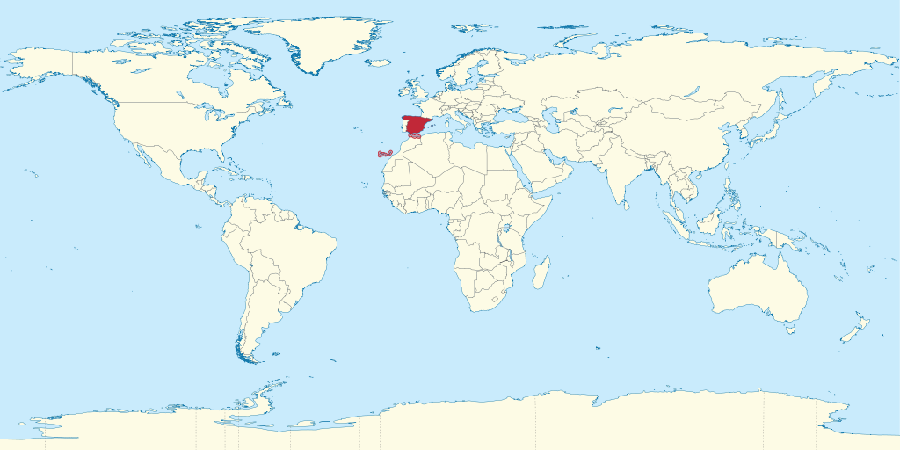
¿Donde esta España? (Where is Spain?)

Slide 3
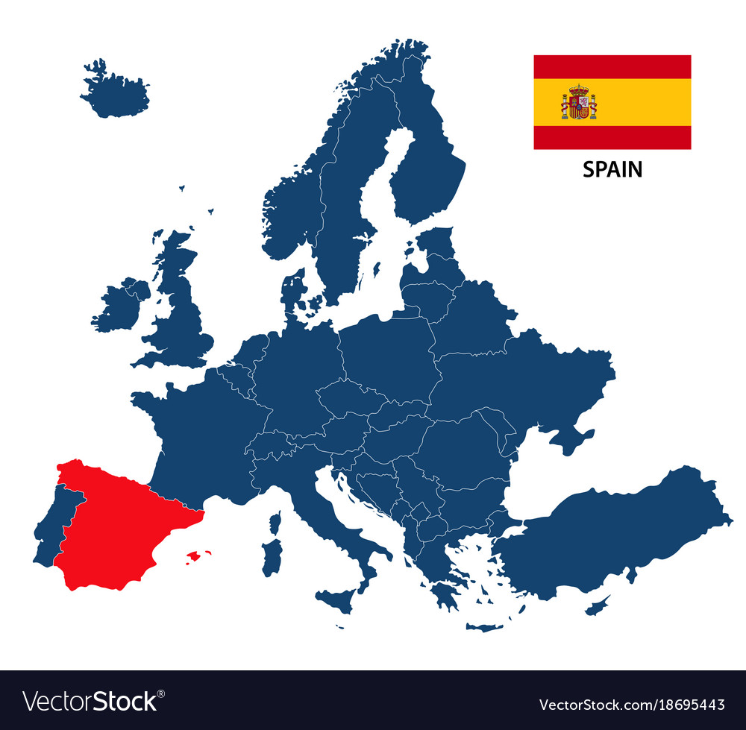
¿Donde esta España? (Where is Spain?)

Slide 4
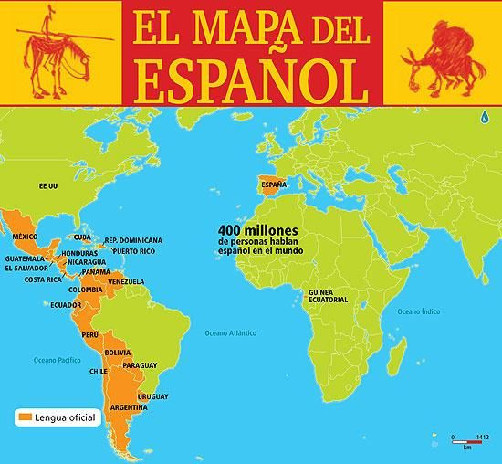
Many countries
speak Spanish:
In Europe - Spain
In America - Mexico, Cuba,
Peru, Argentina and many others
In Africa – Equatorial Guinea
In Asia – the Phillipines

Slide 5
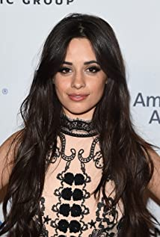
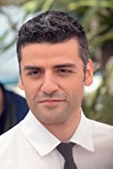
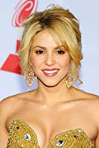
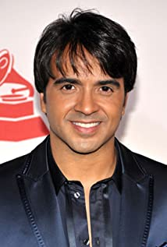
Famous Spanish speaking people:
Camila Cabello Oscar Isaac Shakira Luis Fonsi
(Cuba) (Guatemala) (Colombia) (Puerto Rico)

Slide 6
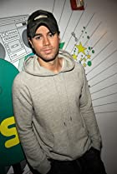
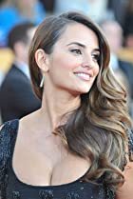
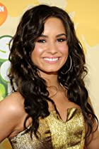
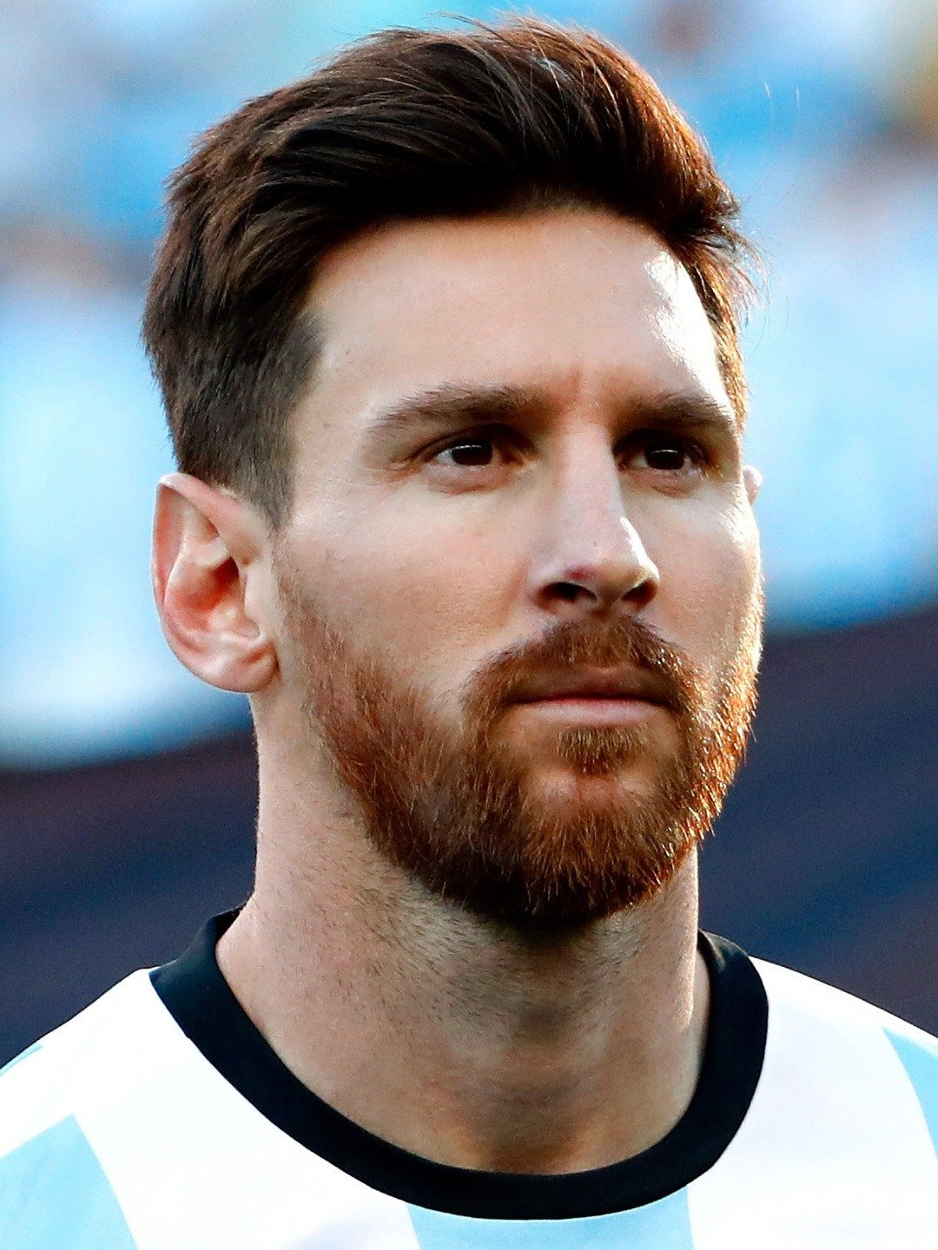
Famous Spanish speaking people:
Enrique Iglesias Penelope Cruz Demi Lovato Lionel Messi
(Spain) (Spain) (USA) (Argentina)

Slide 7
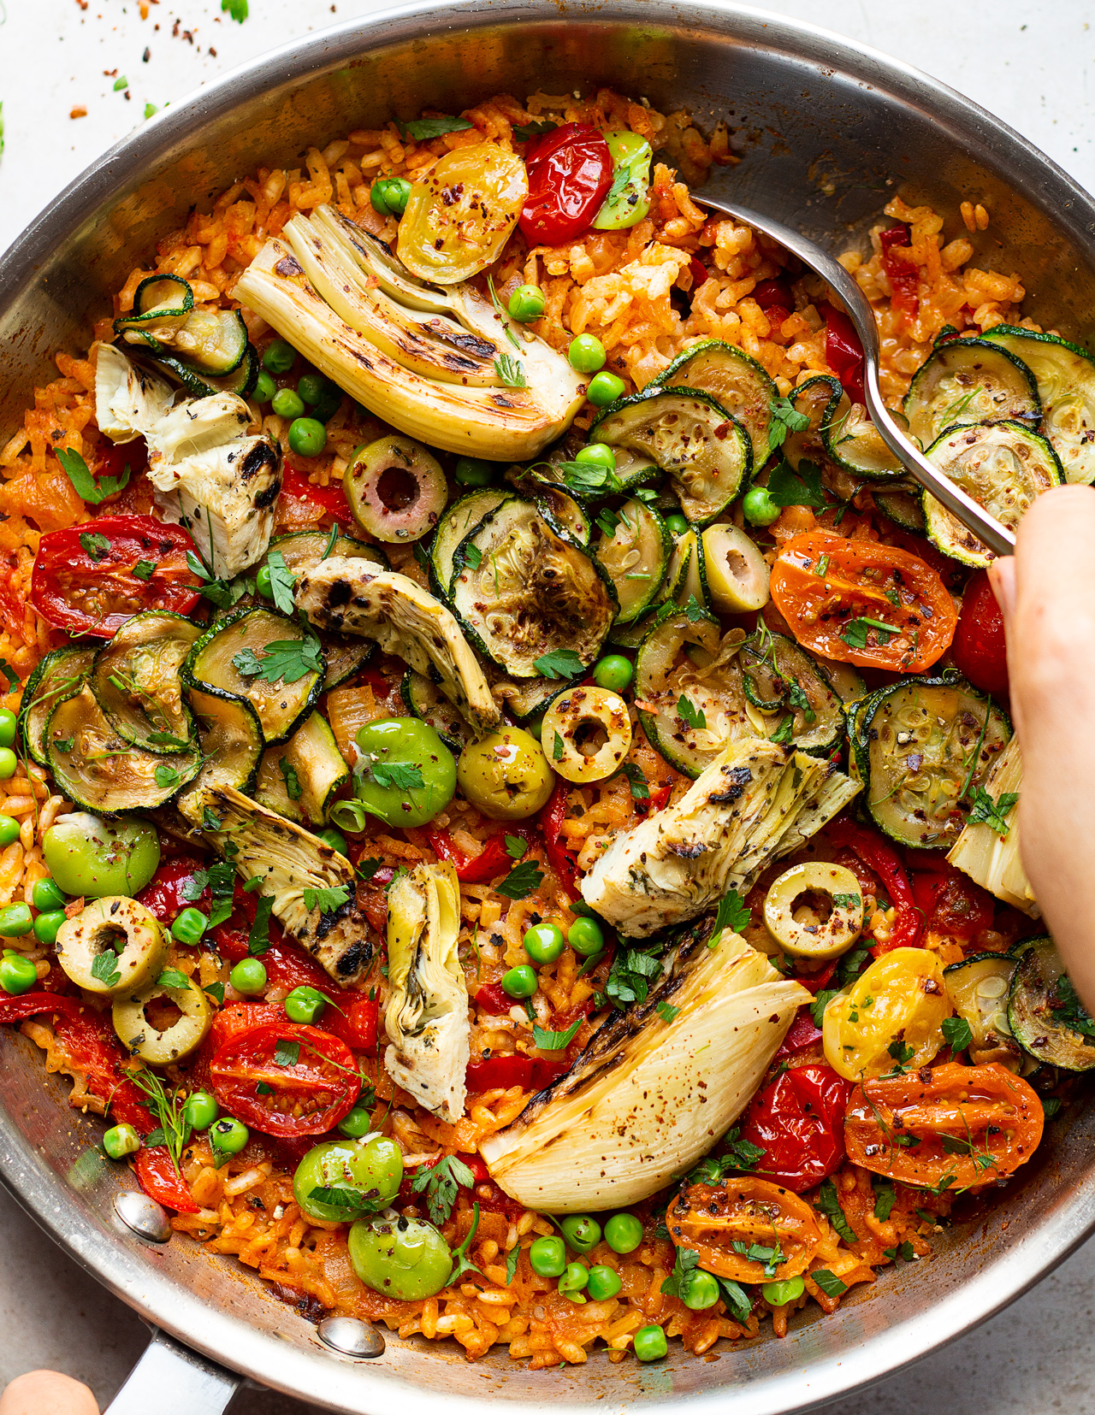
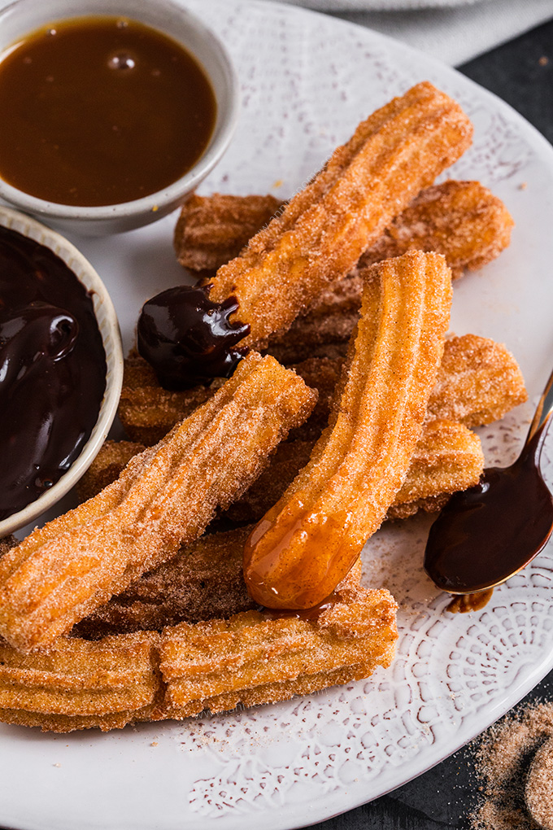
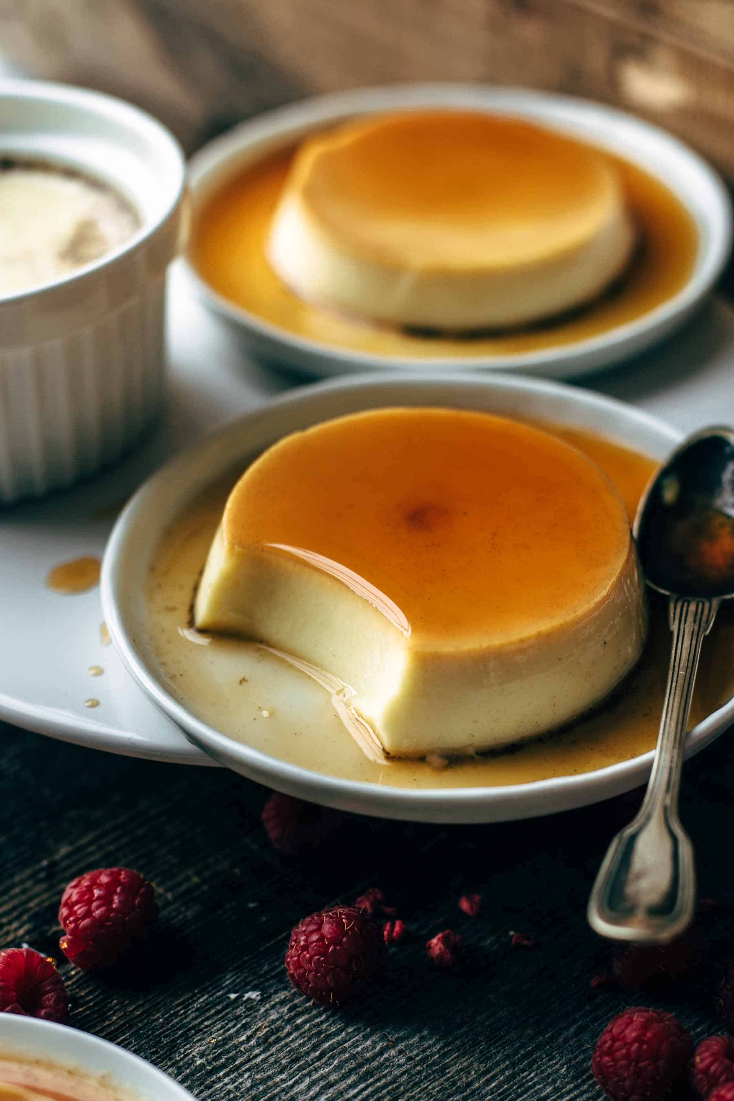
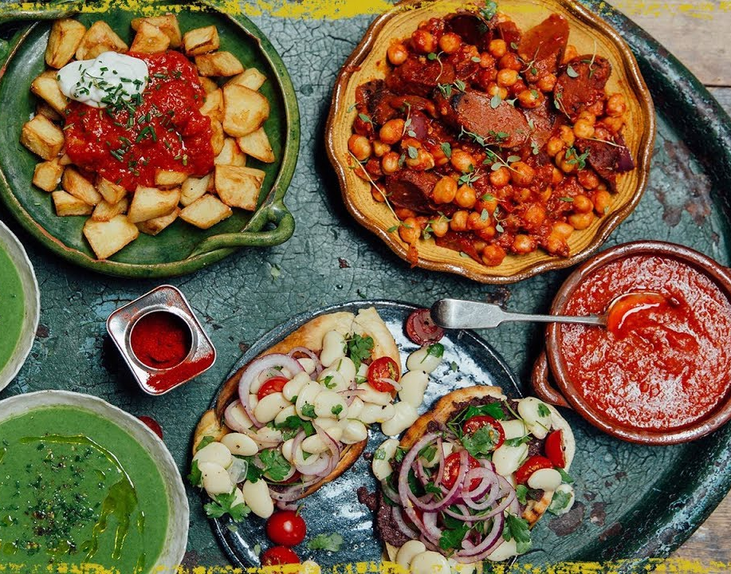
Spanish Food:
Spain: Paella Tapas Churros Flan

Slide 8
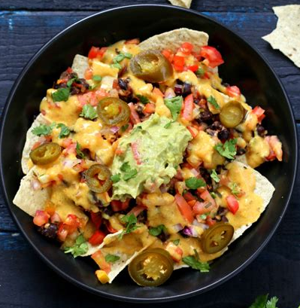
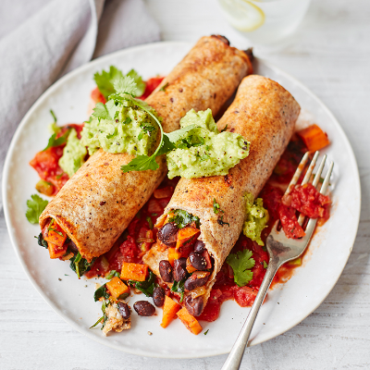
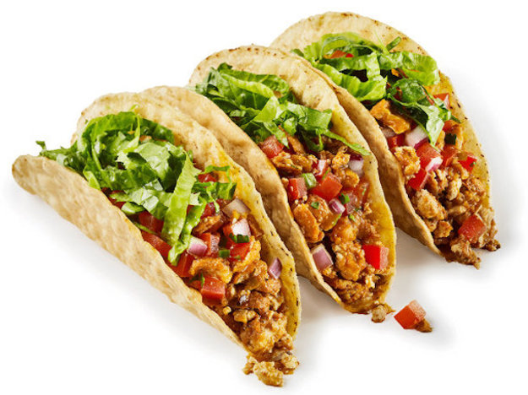
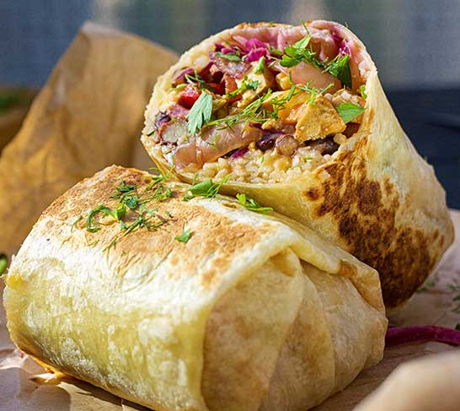
Spanish Food:
Mexico: Nachos Tacos Burritos Enchiladas

Slide 9
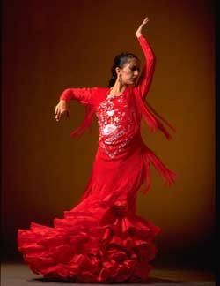
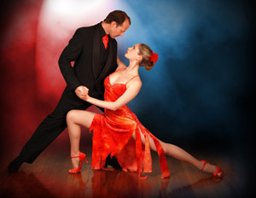
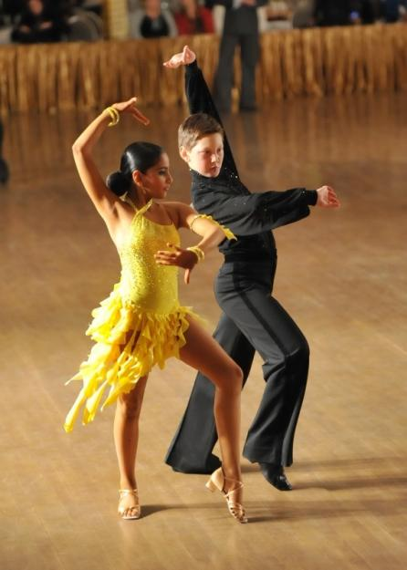
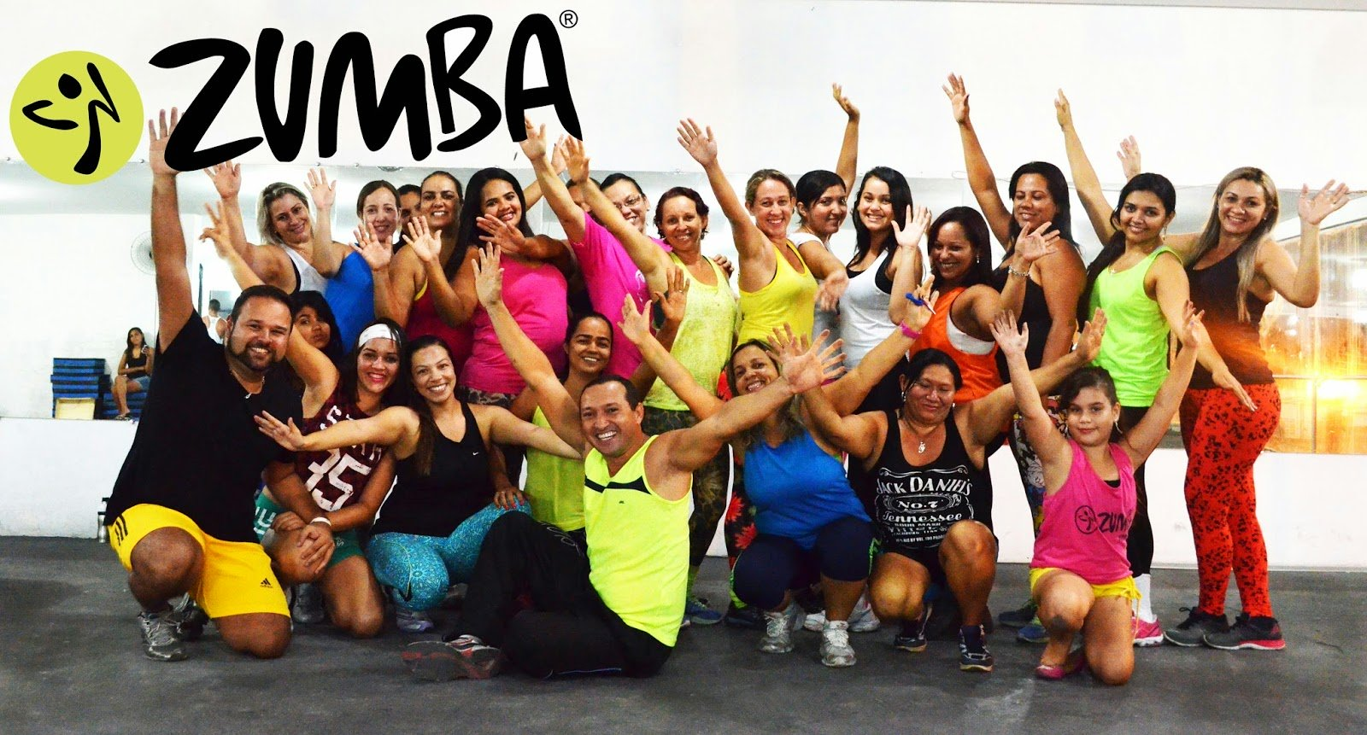
Spanish Dance
Flamenco
Salsa
Rumba
Cha-cha-cha
Zumba
Try some flamenco:
Gipsy Kings - Bamboleo - YouTube

Slide 10
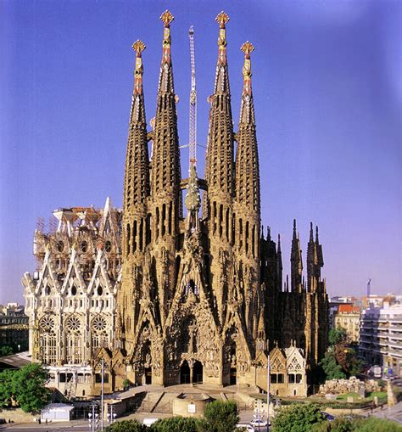
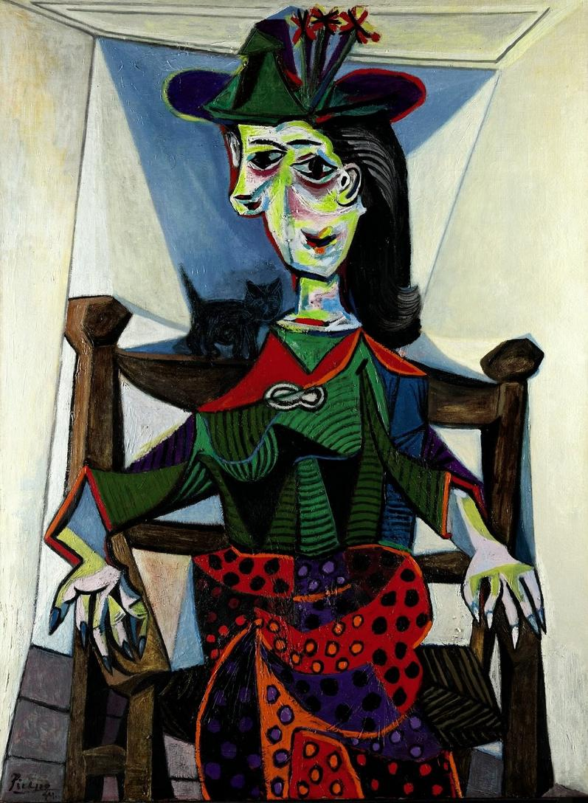
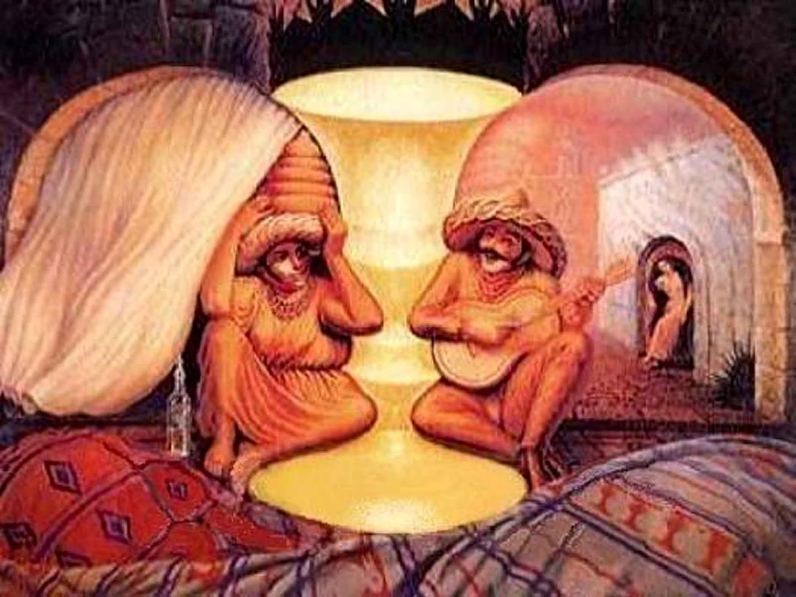
Spanish Art
Pablo Picasso Gaudi’s church Salvador Dali

Slide 11
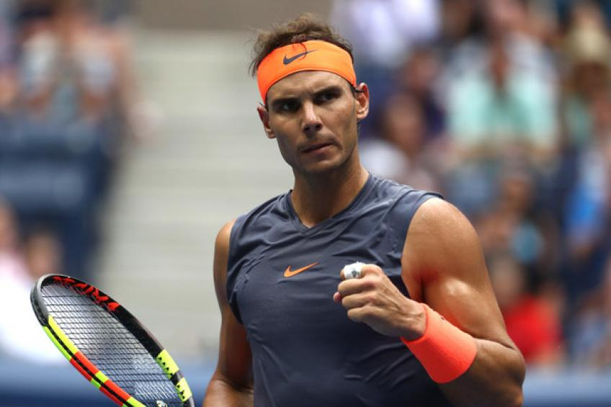
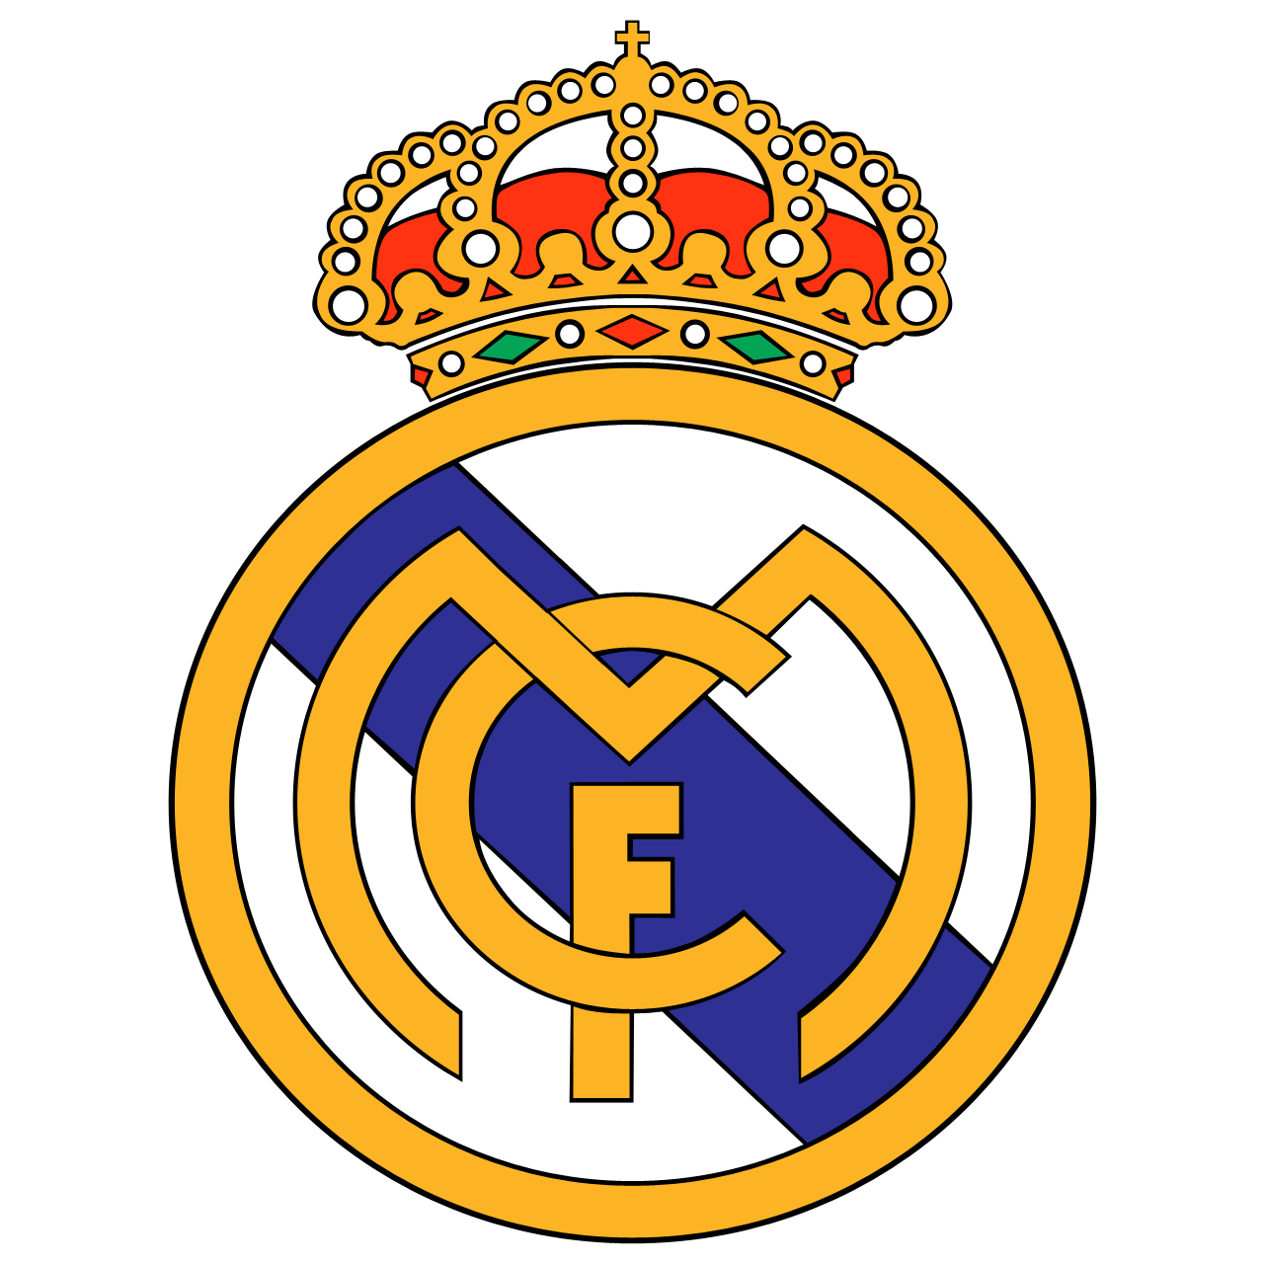
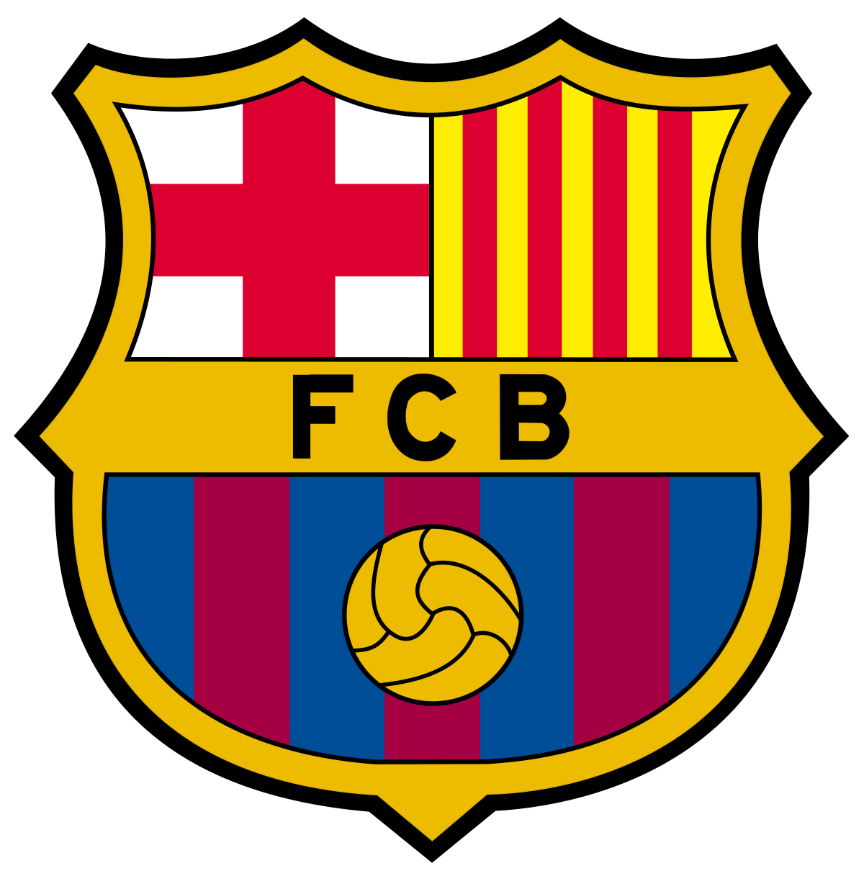
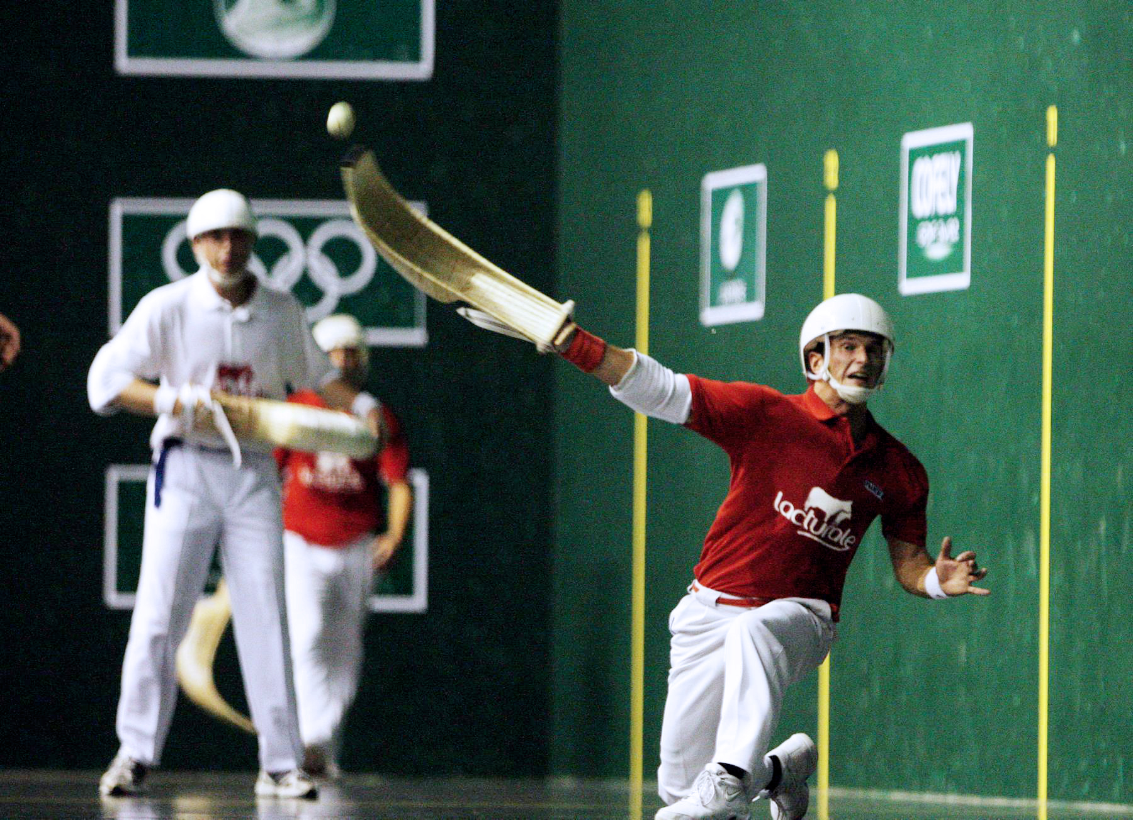
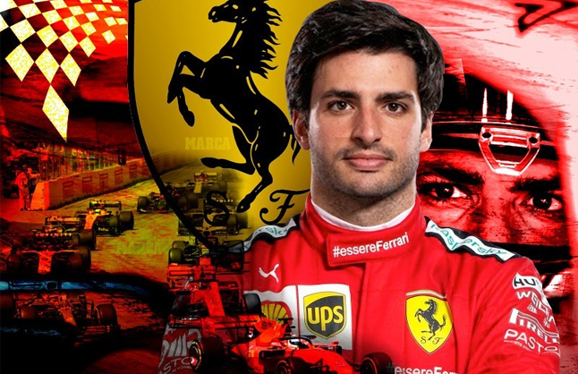
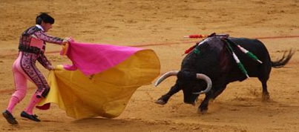
Spanish Sports
Football Tennis: Rafael Nadal
Pelota
Formula 1: Carlos Sainz
Bullfighting
(Very cruel)

Slide 12
Please write these Spanish Words:
Hola ……………….. Hello
Te amo ………. I love you
Gracias …......… Thank you
Adios ……….……. Goodbye
Olé …………………. Hurray
(Can you write any others?)

Slide 13
Spanish songs
La Bamba - Los Lobos - La Bamba – YouTube
La Macarena - 🌟 Macarena - The Girty Team | Just Dance 2015 🌟 – YouTube
Las Ketchup - https://www.youtube.com/watch?v=AMT698ArSfQ
La Cucaracha - LA CUCARACHA ya no puede caminar - Canciones Infantiles | Elite Kids – YouTube
Bailando: Enrique Iglesias - Bailando ft. Descemer Bueno, Gente De Zona (Español) – YouTube
Despacito: Learn how to dance to "Despacito" - Luis Fonsi ft. Daddy Yankee | Mini Pop Kids - Dance With Us – YouTube
Cielito lindo: Mariachi Nuevo Jalisco - Cielito Lindo - YouTube

Slide 14
