Slide 1
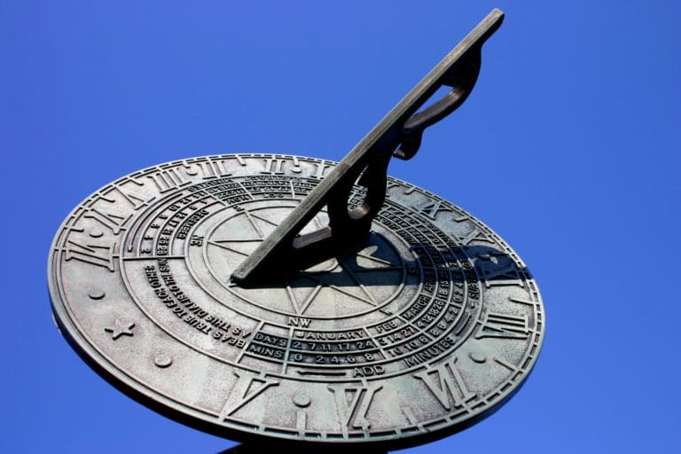
Making a sundial
Our science challenge today is to make your own working sundial.
A sundial measures time by the position of the sun and usually has markings for each hour of sunlight. Sundials have something in the centre which casts a shadow over the markings showing what the time is.
There are lots of ways to make a simple sundial, you can draw around your shadow from the same central point at different times throughout the day, use stones or even just a simple straw or stick like the one we will look at today.

Slide 2
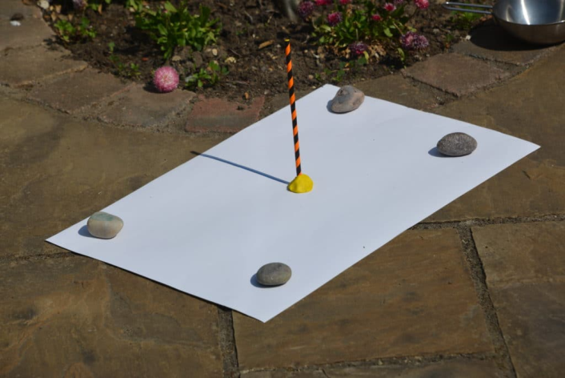
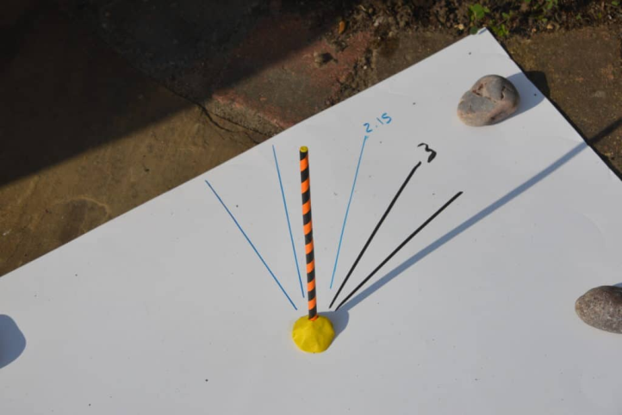
Making a sundial
WHAT YOU NEED:
A sunny spot
Pen or pencil
Straw or Stick
Plasticine
HOW TO MAKE A SIMPLE SUNDIAL
You’ll need a sunny spot that doesn’t get shady. Put some stones, or something heavy, on your paper to stop it moving or blowing away.
Use plasticine to make the straw stay upright in the middle of the paper.
Draw the line that the shadow makes every hour and write the time next to it. Perhaps begin at 12 o clock.
The next day, your sundial is ready to use.

