Slide 1
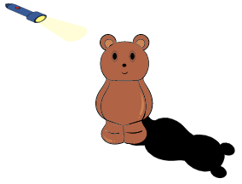
Science Lesson 6
Your challenge today is to make a
shadow bigger and smaller that its
original shape. You will need a light
source, an object to make a shadow
and paper and a pencil to draw around
the shadow made.
Draw a picture of your investigation and explain in sentences how you changed the shape of the shadow.
Cool – Draw around a shadow with a pencil.
Warm – To make shadows of different sizes with the same object.
Boiling – To make the shadow twice the size of the original. How will you know it is exactly twice the size?

