Slide 1
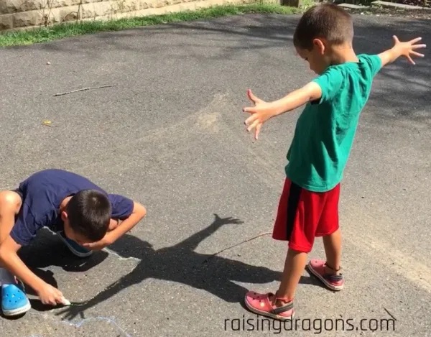
Lesson 5 - To be able to find patterns in the way that the size of shadows change.
We are going to carry out an experiment today to see if shadows are the same at different times in the day.
Go outside and draw around your shadow with chalk. Then go back in an hour and stand in exactly the same place. Draw around your shadow again. What has happened? What have you noticed? Repeat again. Explain what has happened and why in sentences.
Watch these videos to help with
your explanations.
https://www.bbc.co.uk/bitesize/clips/z6fnvcw
https://www.bbc.co.uk/bitesize/clips/z9fpyrd

