Slide 1
I took some up-close photos of items from my garden using my microscope. Can you guess what they are?
Let me know your answers by messaging me before 4.30 and the person with the most correct answers wins 10 blues!

Slide 2
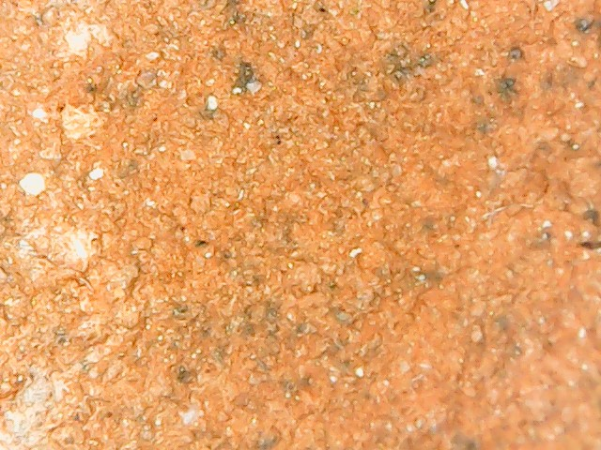
Question 1

Slide 3
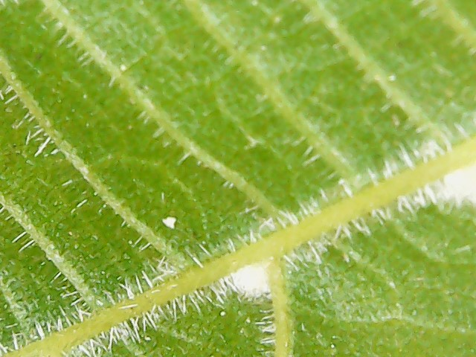
Question 2

Slide 4
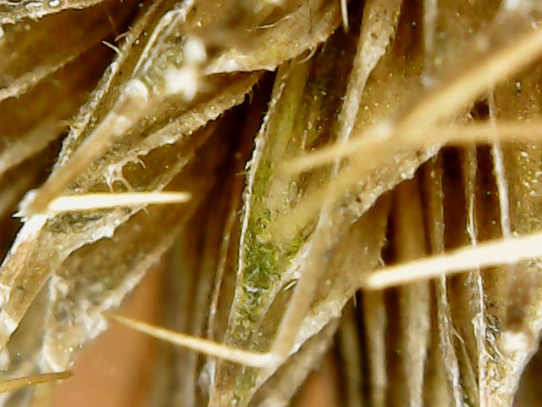
Question 3

Slide 5
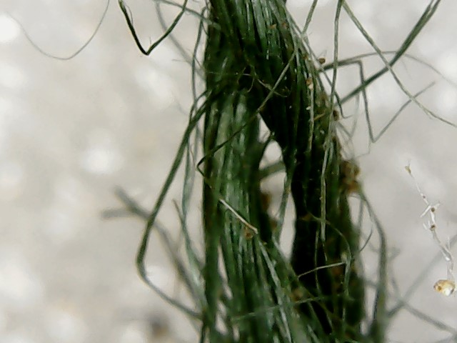
Question 4

Slide 6
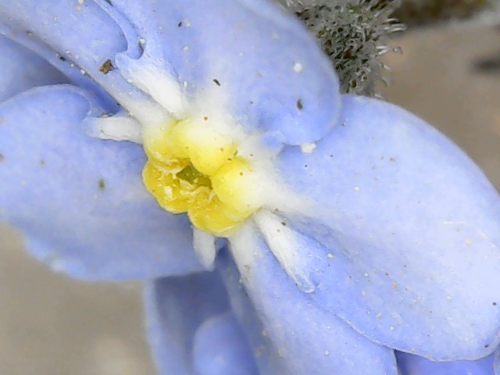
Question 5

Slide 7
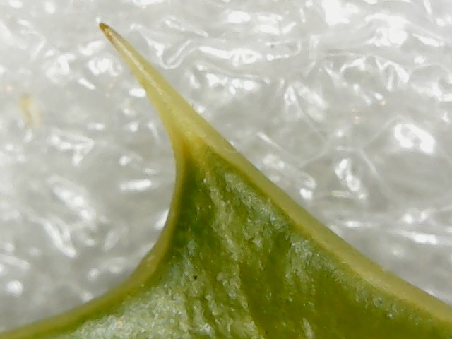
Question 6

Slide 8
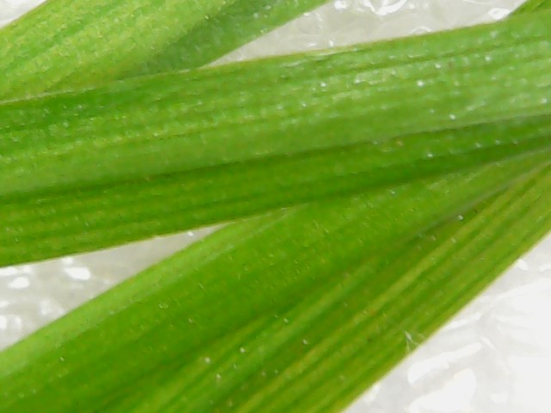
Question 7

Slide 9
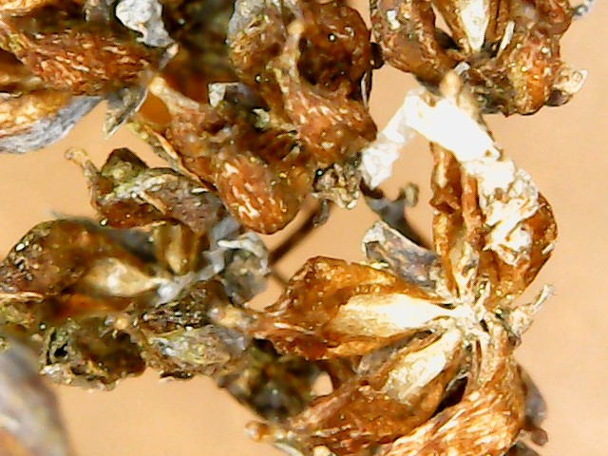
Question 8

Slide 10
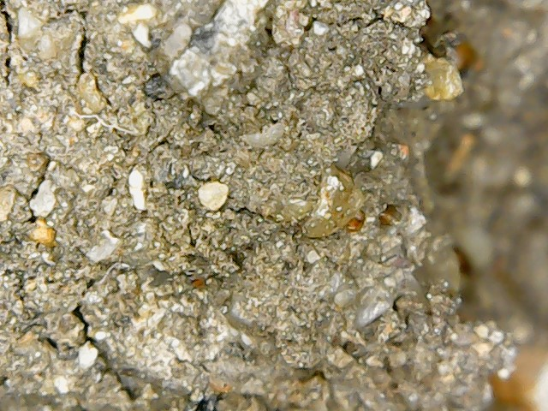
Question 9

Slide 11
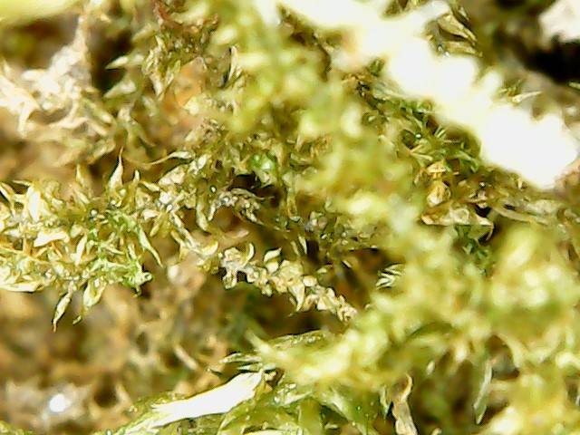
Question 10

Slide 12
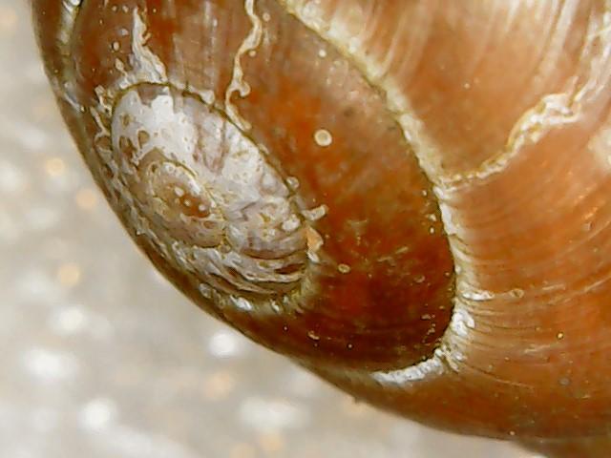
Question 11

Slide 13
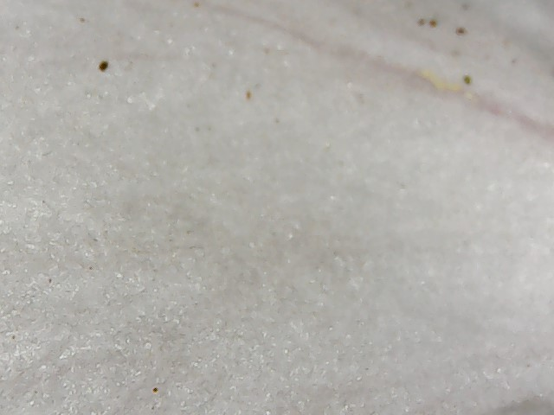
Question 12

Slide 14
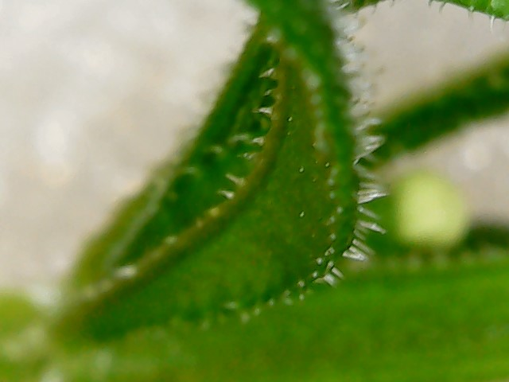
Question 13

Slide 15
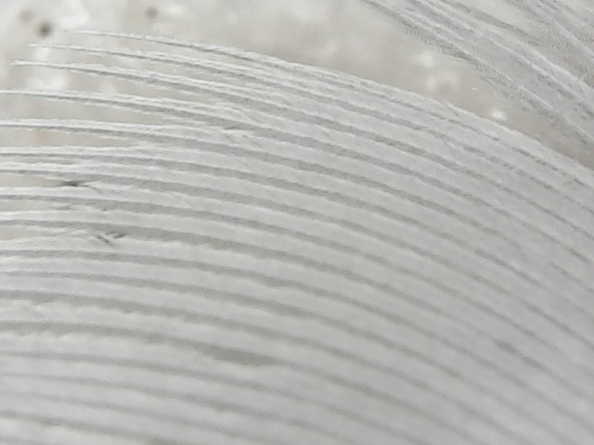
Question 14

Slide 16
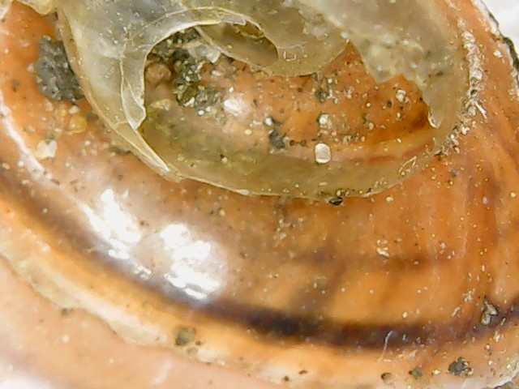
Question 15

Slide 17
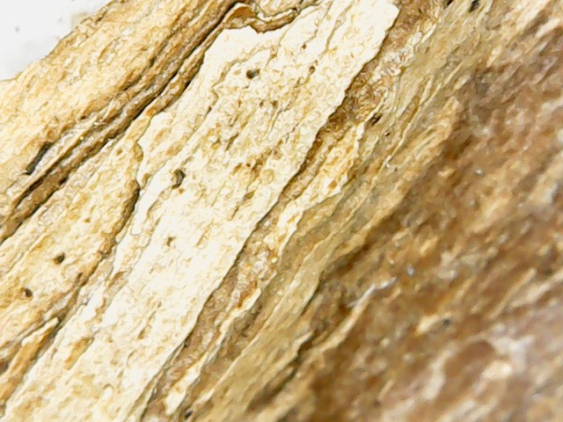
Question 16

Slide 18
Extra challenge; for extra points, can you think of any other words with the prefix ‘micro’ in them? (like the word microscope) What do you think ‘micro’ means?

