Slide 2
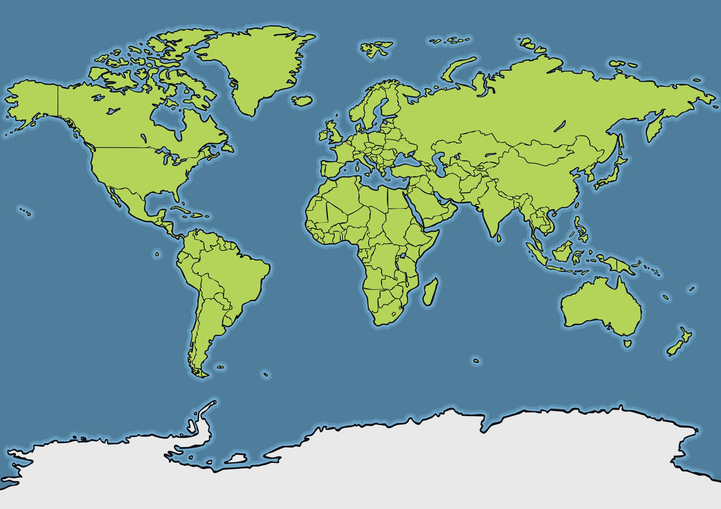
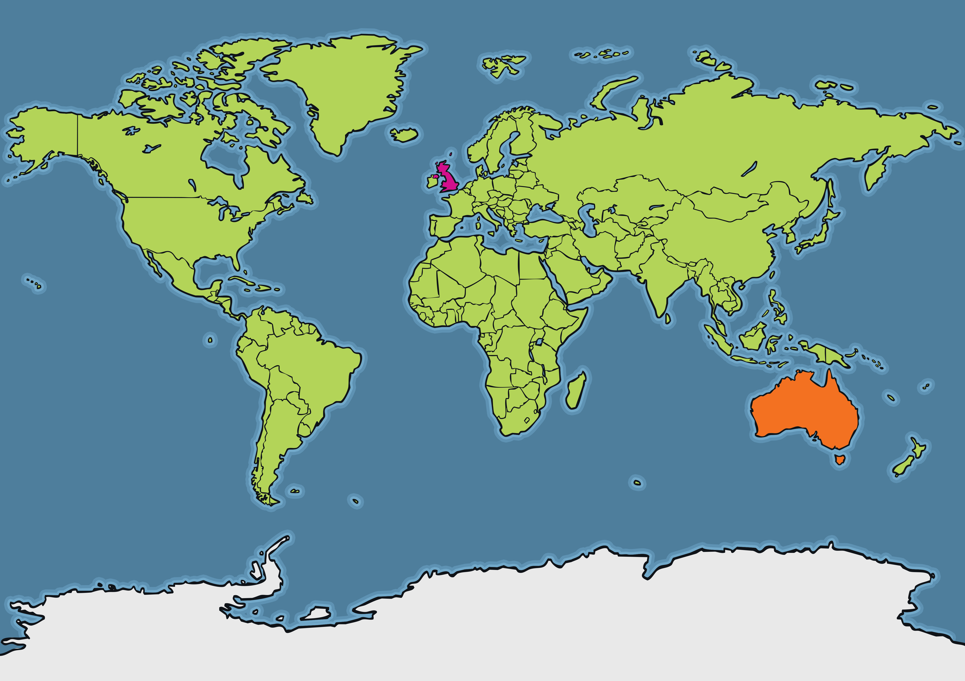
Where is Australia?
Where is the United Kingdom?

Slide 3
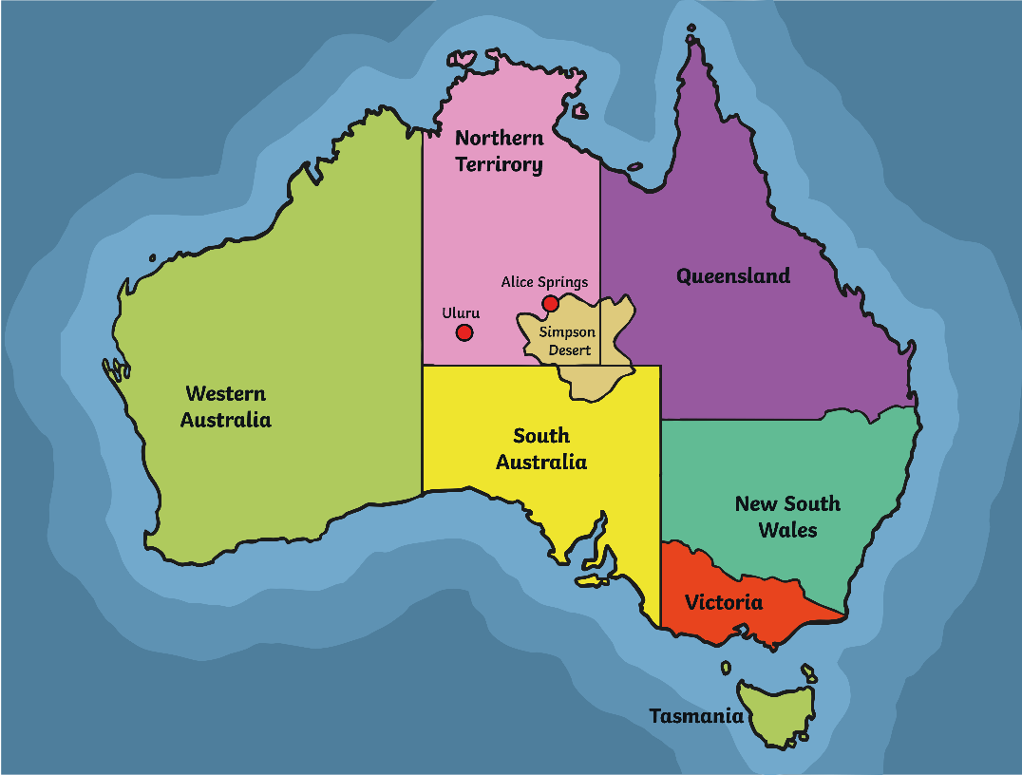
Australia
Australia is the world's sixth largest country.
Around 24 million people live in Australia, which is not that many considering how large it is! By comparison, 65 million people live in the United Kingdom.
However, you could fit the United Kingdom into Australia 22 times!

Slide 4
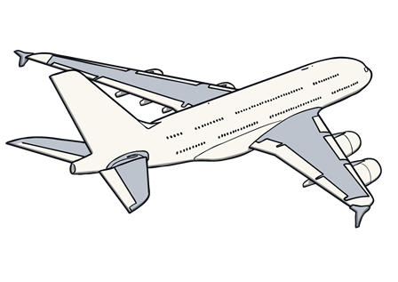
Australia
The name Australia means ‘south’. Australia is in the southern part (hemisphere) of the world.
London
8988 miles
It would take you almost a whole day to fly from the United Kingdom to Australia.
Perth

Slide 5
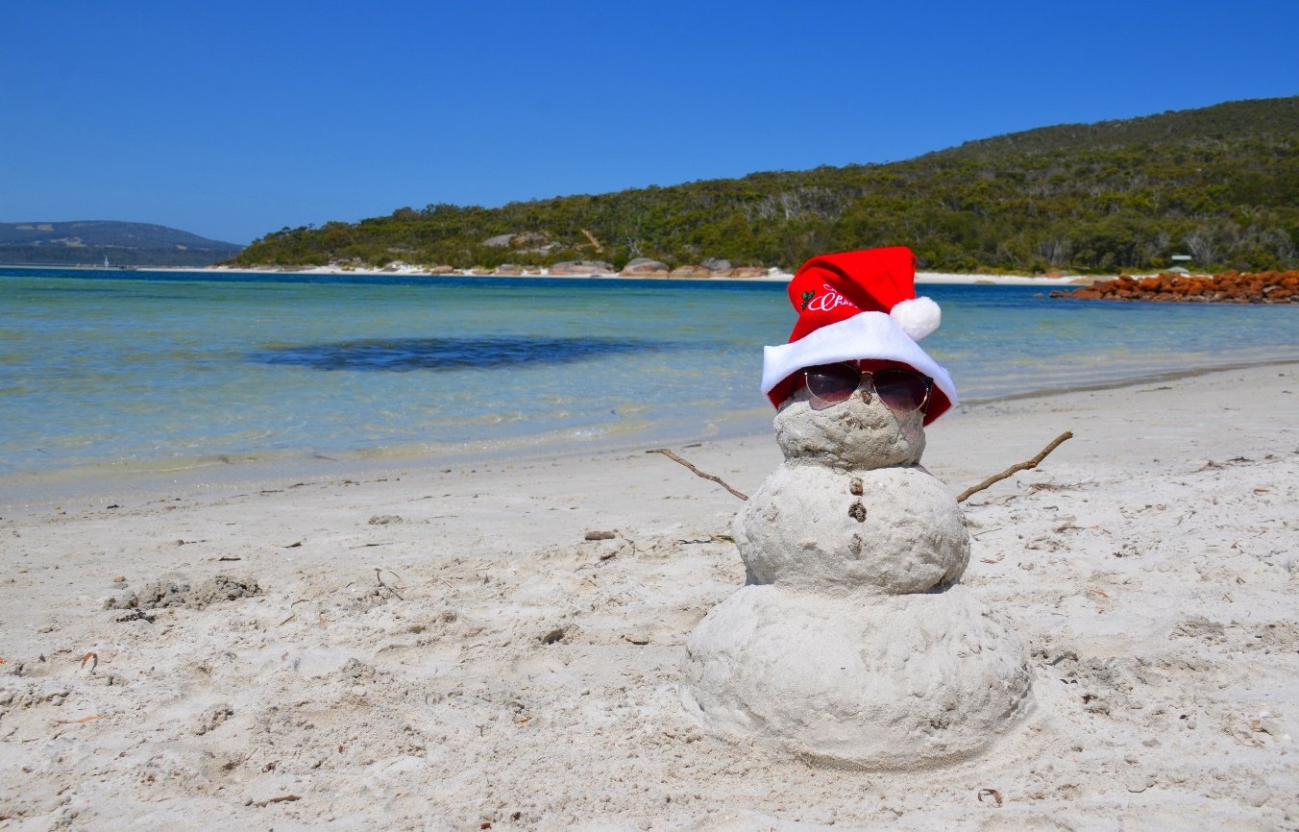
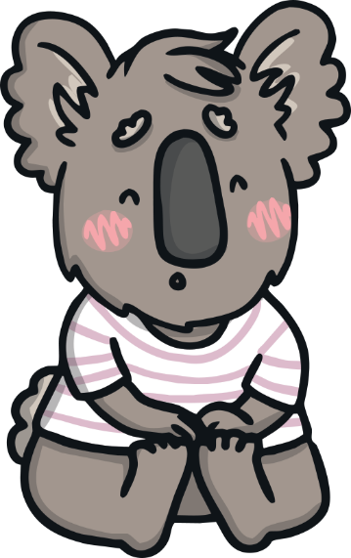
Climate
Australia’s seasons are the opposite to the seasons in the United Kingdom. When the UK is in winter, Australia is in their summer and when the UK is in summer, Australia is in their winter.
Mostly, summertime is very hot and dry.
Summer lasts from December to March.
People celebrate Christmas on the beach!

Slide 6
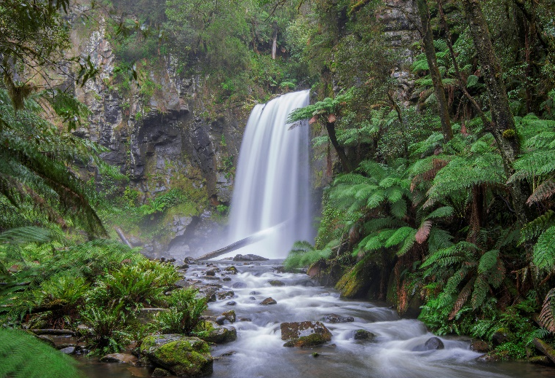
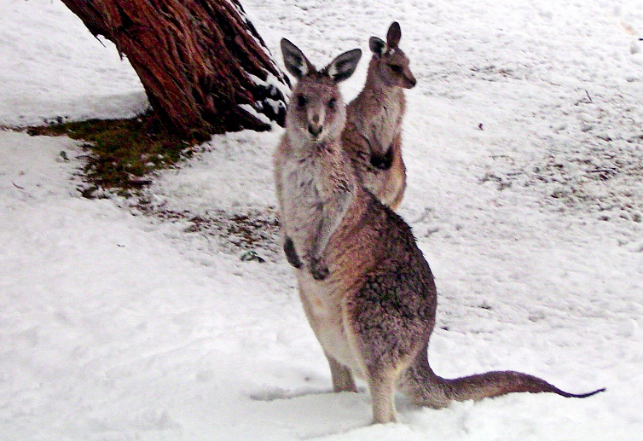
Climate
In the desert, it doesn’t rain very much but in the north of the country, it can rain lots. They have a wet season where heavy rains flood the land. This is called monsoon season.
Photo courtesy of Lenny K Photography (@flickr.com) - granted under creative commons licence – attribution
New South Wales, Victoria and Tasmania are the coldest areas in Australia and they usually get snow in the mountains during winter.
Photo courtesy of blairwang (@flickr.com) - granted under creative commons licence – attribution

Slide 7
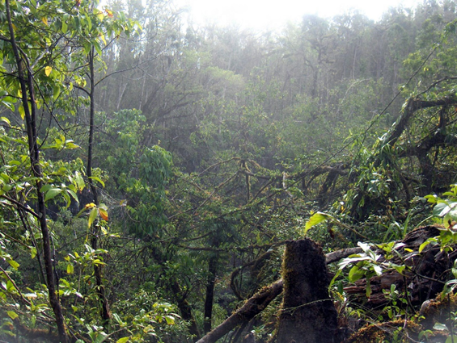
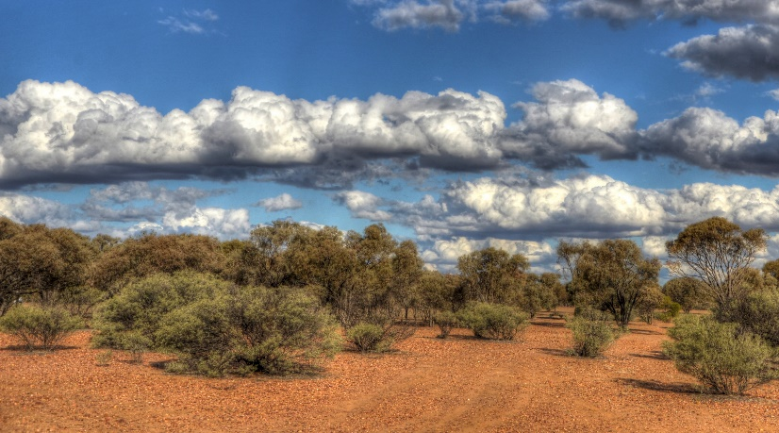
Physical Features
Most of Australia is made up of desert, called the Outback.
Temperatures in the Outback range from as high as 50°C on summer days, to -10°C during winter nights.
Photo courtesy of Rob and Stephanie Levy (@wikimedia.org) - granted under creative commons licence – attribution
Australia also has rainforests.
The Daintree Rainforest is the oldest rainforest in the world. You can find more than 1200 types of insects here!
Photo courtesy of Chris Fithall (@flickr.com) - granted under creative commons licence – attribution

Slide 8
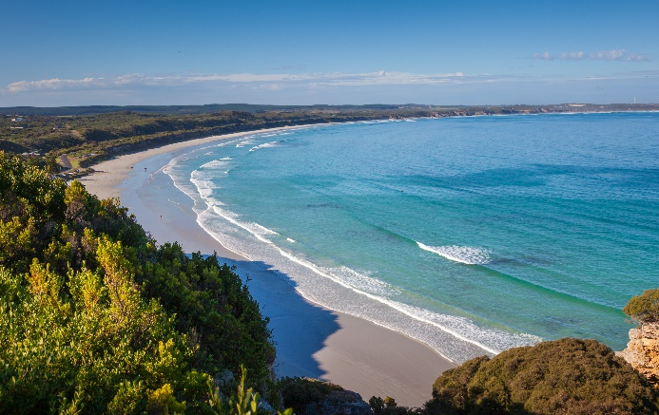
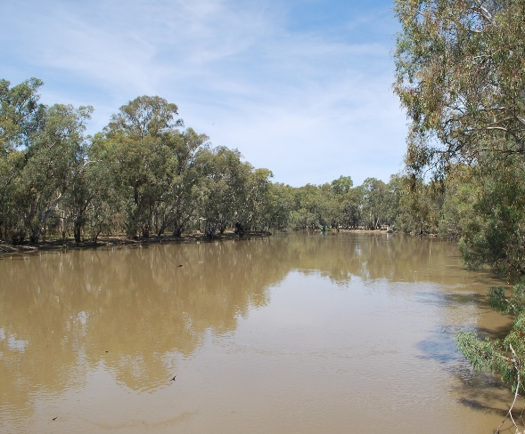
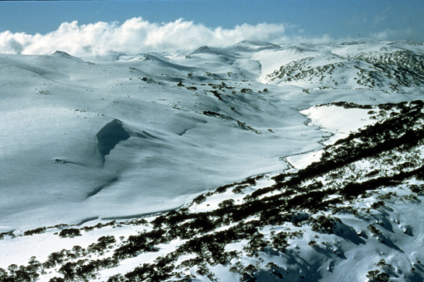
Physical Features
The Murray River is the longest river in Australia. It is 1558 miles long!
Photo courtesy of The 3B's (@flickr.com) - granted under creative commons licence – attribution
Photo courtesy of Mattinbgn (@wikimedia.org) - granted under creative commons licence – attribution
Australia is an island. It has coastline all around it and beautiful beaches.
The Australian Alps are Australia’s largest mountain range.
Photo courtesy of CSIRO (@wikimedia.org) - granted under creative commons licence – attribution

Slide 9
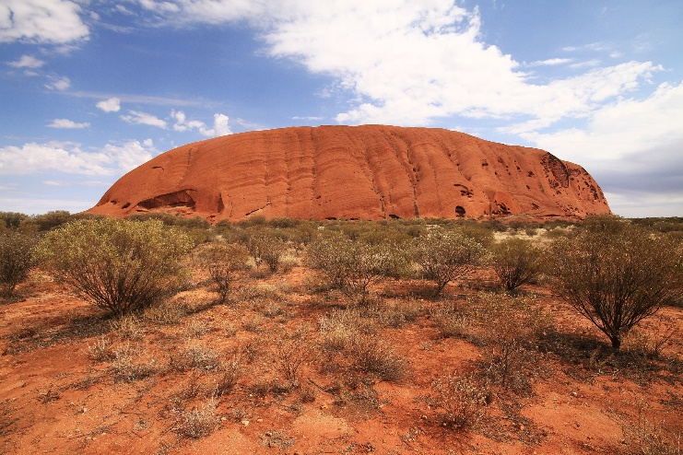
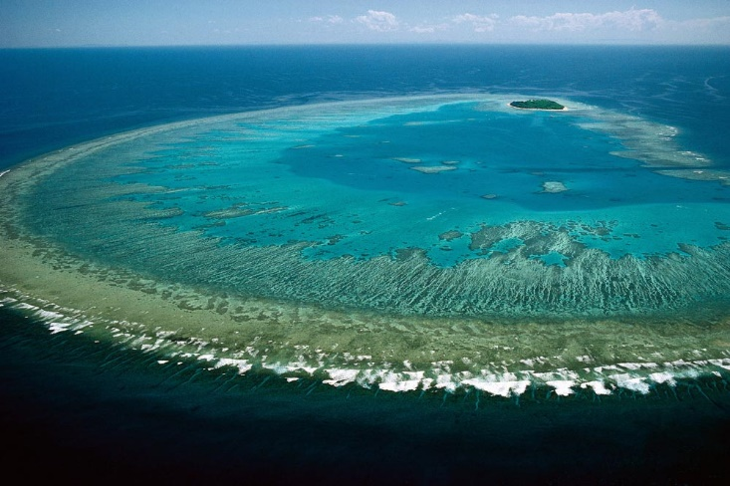
Physical Features
Uluru (also called Ayers Rock) is located in the centre of Australia.
Uluru is 348 metres high and over 600 million years old!
The Great Barrier Reef is the biggest coral reef in the world.
It is 1400 miles long and is home to more than 1500 species of fish!
Photo courtesy of Lock the Gate Alliance (@flickr.com) - granted under creative commons licence – attribution

Slide 10
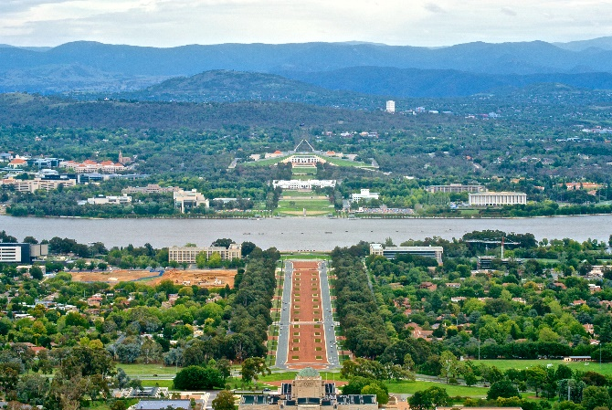
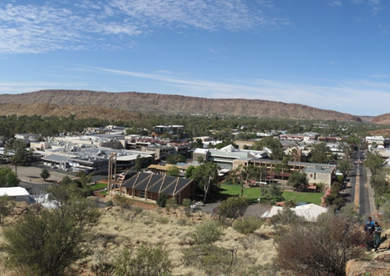
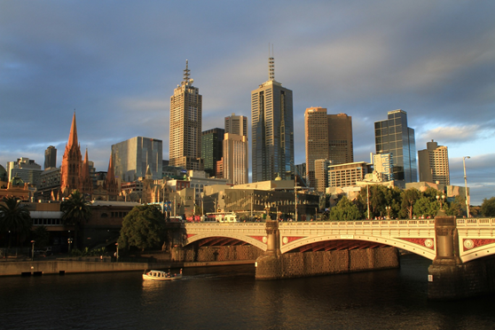
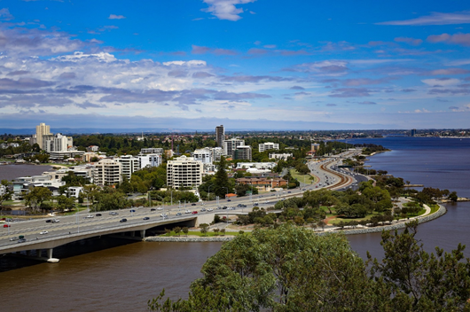
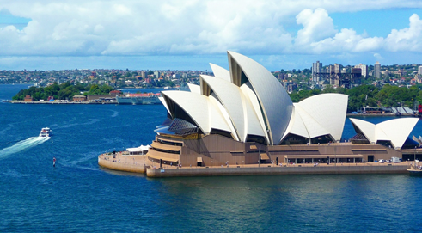
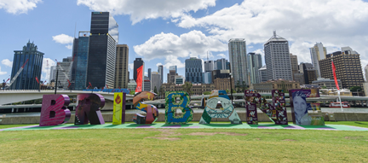
Human Features
Canberra is the capital city of Australia.
There are also lots of other big cities, such as Sydney, Melbourne, Perth and Brisbane. These cities are all near to the coast. Alice Springs is the main city in the Outback.
Canberra
Photo courtesy of Jason Tong (@wikimedia.org) - granted under creative commons licence – attribution
Alice Springs
Melbourne
Perth
Sydney
Brisbane
Photo courtesy of Lenny K Photography (@flickr.com) - granted under creative commons licence – attribution

Slide 11
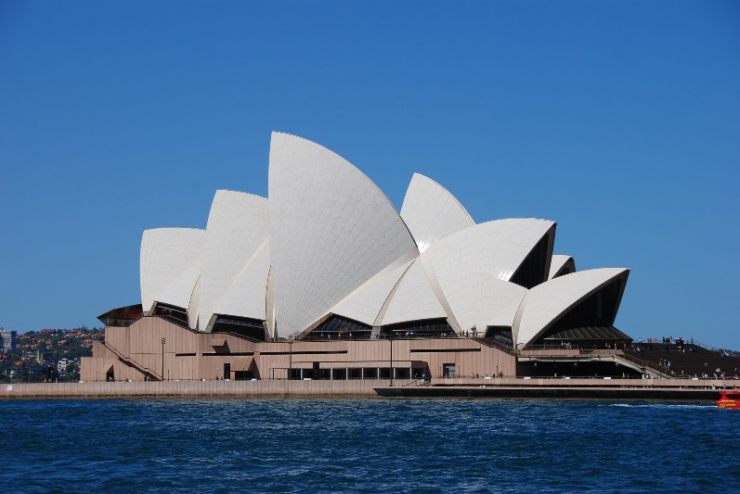
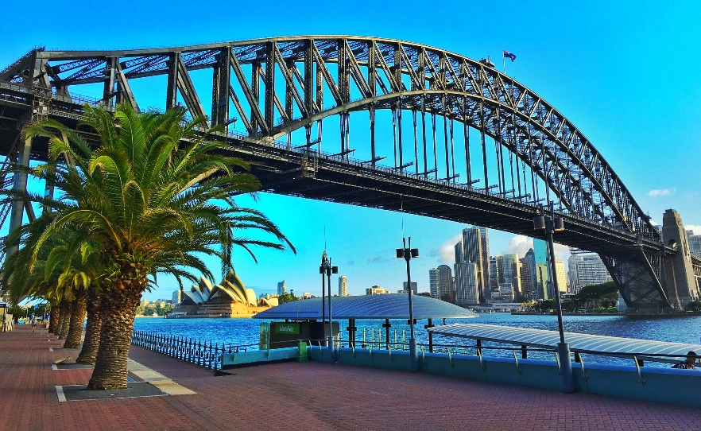
Human Features
Sydney is the oldest city in Australia.
It is famous for one of the most recognisable landmarks in the world; the Sydney Opera House.
The Sydney Harbour Bridge is also very famous.

Slide 12
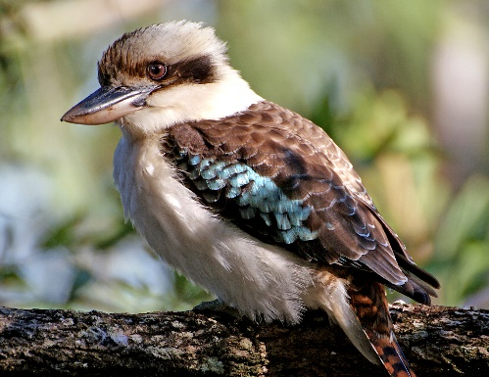
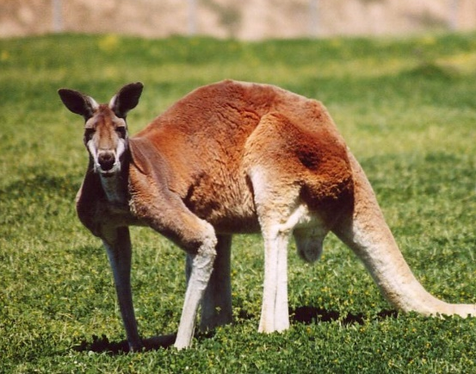
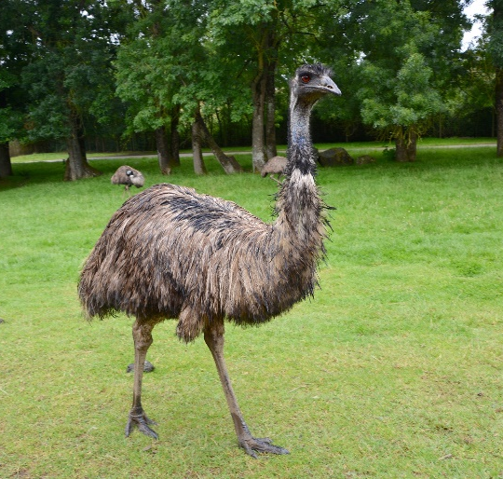
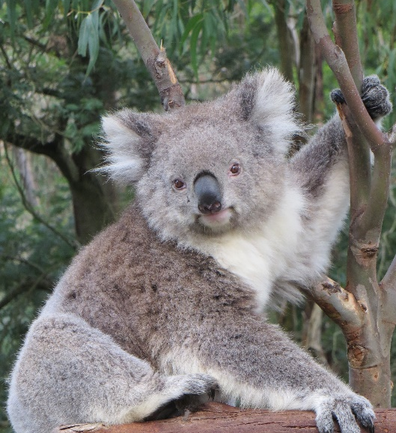
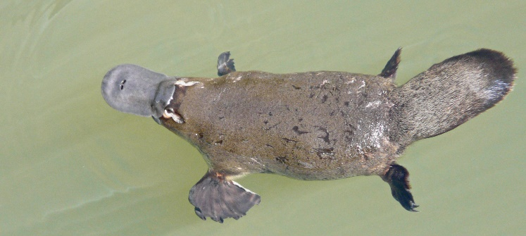
Australian Wildlife
Australia has lots of unique wildlife. Some cannot be found naturally anywhere else in the world!
These include koalas, kangaroos, kookaburras, emus and platypuses.

Slide 13
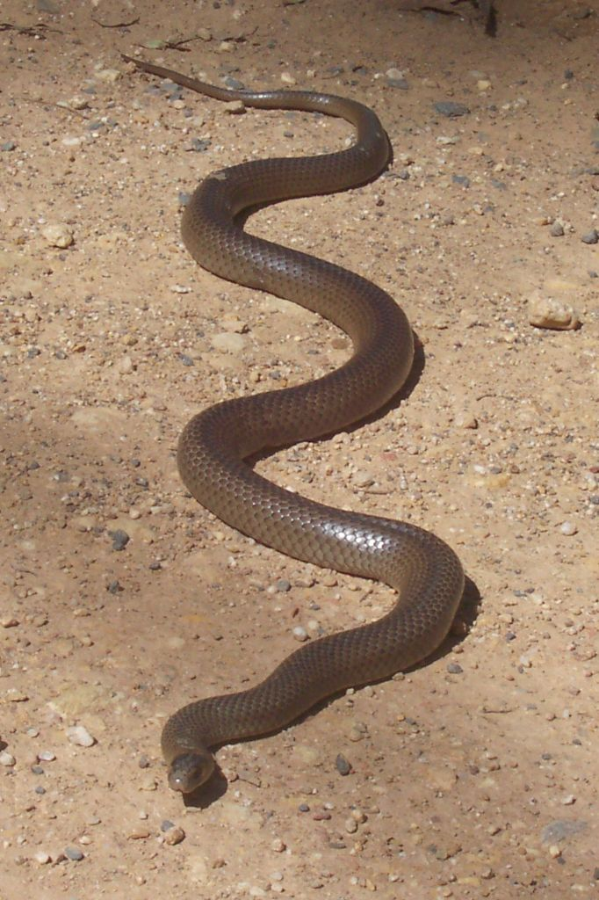
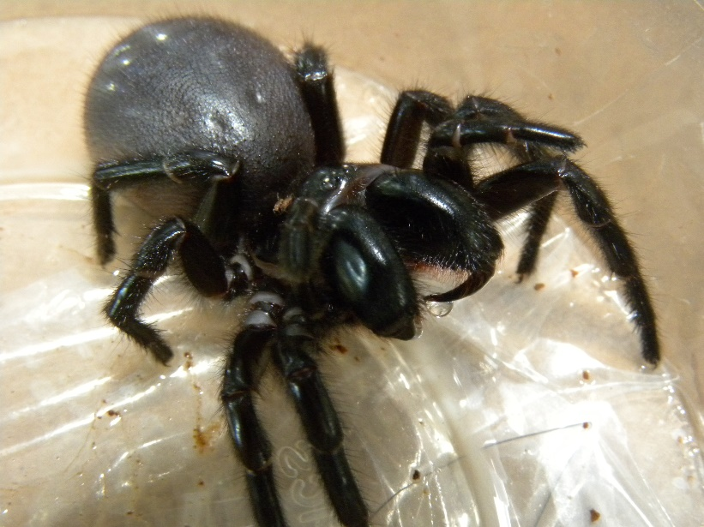
Australian Wildlife
Australia is also home to lots of dangerous creatures, such as venomous snakes and spiders!
Sydney funnel web spider
eastern brown snake
Photo courtesy of Alan Couch (@flickr.com) - granted under creative commons licence – attribution

Slide 14
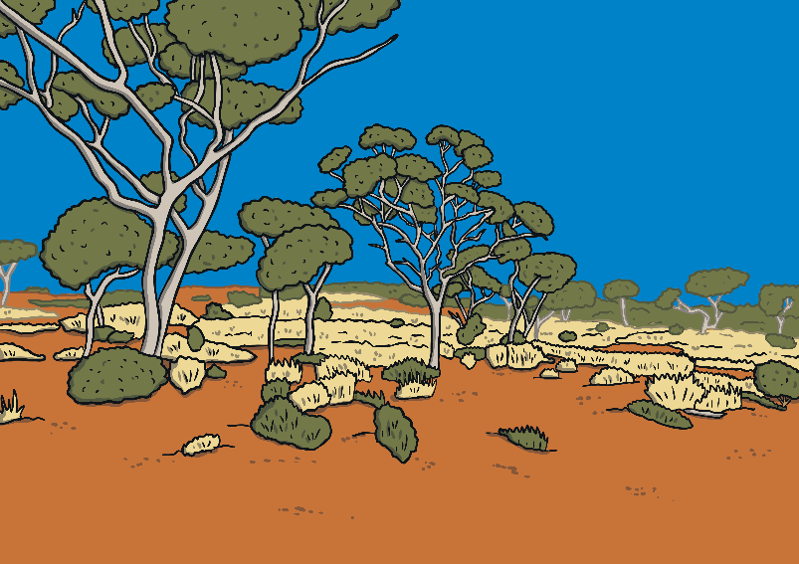
Quick Quiz!
Around 24 million people live in Australia.
How many people live in Australia?
Where do lots of people celebrate Christmas in Australia?
Lots of people celebrate Christmas on the beach.
What is the desert area in Australia called?
The desert area in Australia is called the Outback.

Slide 15
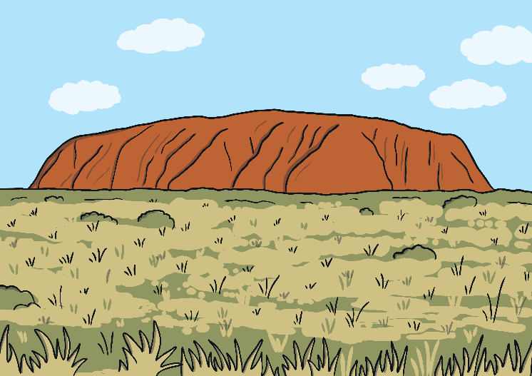
Quick Quiz!
How many types of insects can you find in the Daintree Rainforest?
You can find more than 1200 types of insects.
What is Uluru also known as?
Uluru is also known as Ayers Rock.
Name two venomous creatures that can be found in Australia.
Venomous snakes and spiders can be found in Australia.

