Slide 1
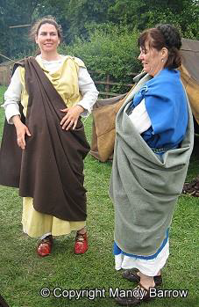
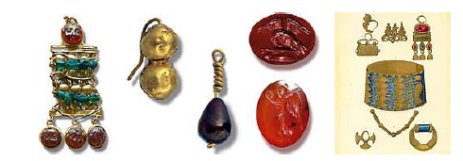
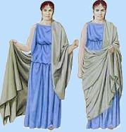
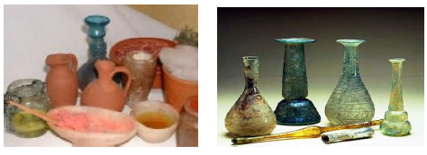
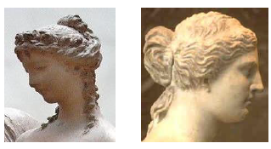
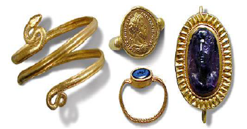
Roman clothing Women
Monday topic task
What clothes did women wear?
Women wore a longer tunic which was often ankle-length. Over this the women wore a stola which was a full length from neck to ankle, high- waisted and fastened at the shoulders with clasps.
Rich women wore long tunics made from expensive cotton or silk. They also wore lots of jewellery and make-up, strong scent and elaborate hairstyles.

Slide 2
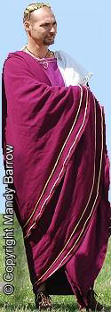
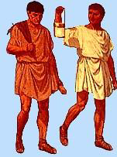
Roman clothing Men
What clothes did men wear in Roman times?
Men wore a knee-length tunic (chilton), either sleeveless or short-sleeved. Roman men wore a cloak over their tunic, which was like a wide shawl that was draped over the shoulder and carefully wrapped around the body.
Important Romans dressed in a long robe called a toga.

Slide 3
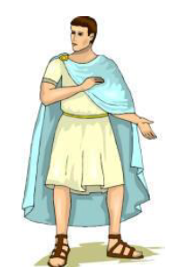
Roman clothing Boys
What clothes did boys wear in Roman times?
Boys wore a tunic down to their knees and a
cloak if it was cold.
Rich boys wore a toga.

Slide 4
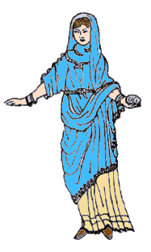
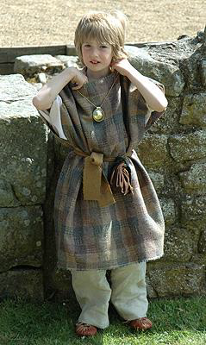
Roman clothing Girls
What clothes did girls wear in Roman times?
Roman girls wore a tunic and a stola, a dress belted at the waist.
Children wore a special charm around their neck called a bulla. It was given to them when they were a few days old.

Slide 5
Now choose a Roman man, woman or child and draw them in Roman clothes. Label the items of clothing.
As an extra challenge you could find out what their clothes might have been made from and how they were made.

