Slide 1
Year 4 Literacy
Storms and Shipwrecks
Tuesday 21st April

Slide 2
Today’s Spellings Activity
This should be a 10 minute activity. Choose from:
Spelling Frame
  Cool Warm Boiling
Spelling Mistakes Activity
Complete ten spellings in your planner

Slide 3
Today’s Reading Activity
You should read for enjoyment for 20 to 30 minutes each day.
You could:
Read to an adult (example comprehension questions are in planners – page 97-98)
Read to yourself (try to vary between both fiction and non-fiction)
Read online through ReadTheory or Bug Club

Slide 4
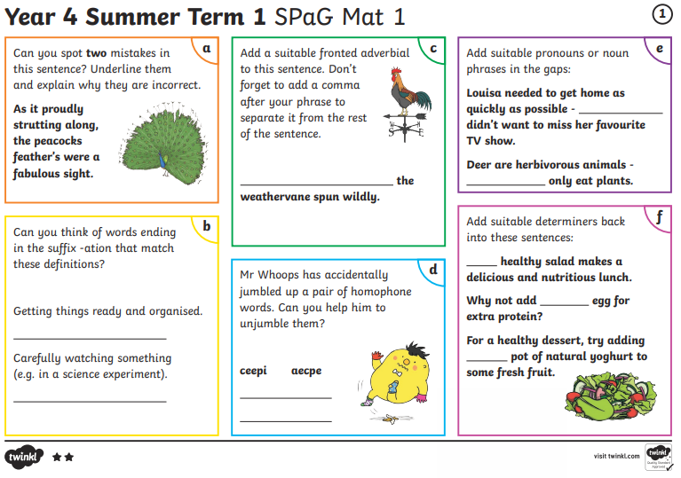
Today’s Literacy Activity
Complete the SPAG mat for Year 4, Summer Term, Week 1
Cool -  Warm -  Boiling - 
You can do this by printing off the sheet and filling it in, or by answering on a separate sheet of paper. Careful – the answers are included!

