Slide 2
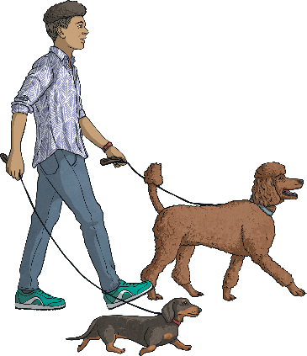
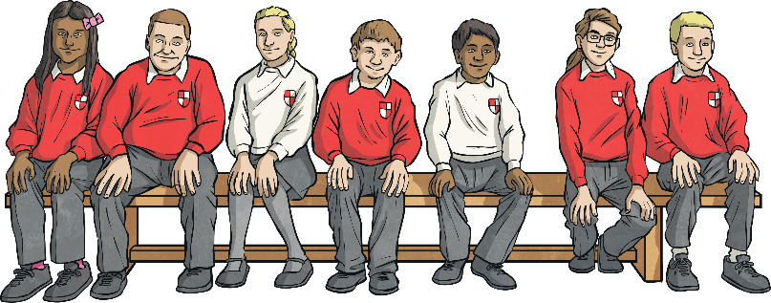
What Is Plural Possession?
Apostrophes can be used to show that something belongs to someone or something. This is called possession. When we are talking about more than one thing, we call this plural.
The dogs’ leads were too long.
The children’s lunch was delayed.
If the noun is plural and ends with an s, we just attach the apostrophe to it without an additional s.
If the noun is plural and does not end with s, we add ’s to the end.

Slide 3
Plural Possession
Now it is your turn. Read the singular form of the noun, make the noun plural and then show where the apostrophe would need to be to show plural possession.
Singular | Plural | Plural Possession
kitten
actress
baby
knife
child
volcano
kittens
kittens’
actresses
actresses’
babies
babies’
knives
knives’
children
children’s
volcanoes
volcanoes’

Slide 4
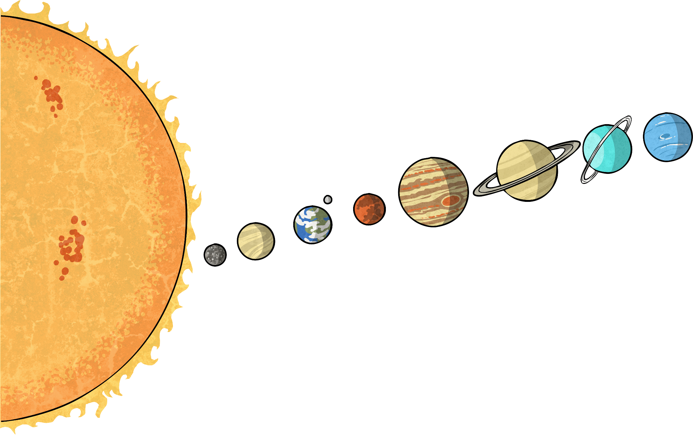
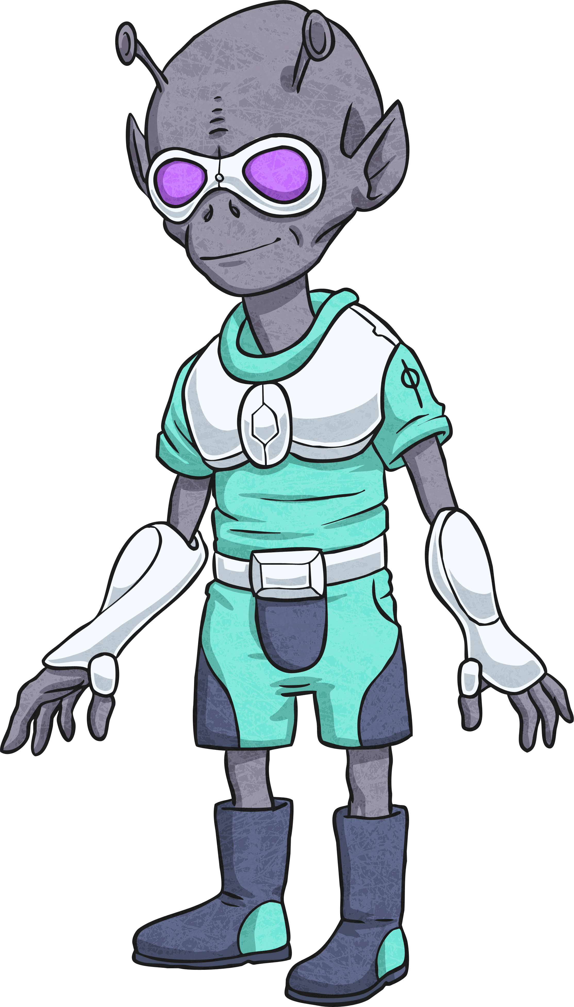
s or ’s ?
Read the words below and decide whether they would need just an apostrophe (’), or an apostrophe followed by an s (’s) to show plural possession.
’
’s
churches
next

Slide 5
s or ’s ?
Read the words below and decide whether they would need just an apostrophe (’), or an apostrophe followed by an s (’s) to show plural possession.
’
’s
back
men
next

Slide 6
s or ’s ?
Read the words below and decide whether they would need just an apostrophe (’), or an apostrophe followed by an s (’s) to show plural possession.
’
’s
back
mice
next

Slide 7
s or ’s ?
Read the words below and decide whether they would need just an apostrophe (’), or an apostrophe followed by an s (’s) to show plural possession.
’
’s
back
babies
next

Slide 8
s or ’s ?
Read the words below and decide whether they would need just an apostrophe (’), or an apostrophe followed by an s (’s) to show plural possession.
’
’s
back
potatoes
next

Slide 9
s or ’s ?
Read the words below and decide whether they would need just an apostrophe (’), or an apostrophe followed by an s (’s) to show plural possession.
’
’s
back
keys
next

Slide 10
s or ’s ?
Read the words below and decide whether they would need just an apostrophe (’), or an apostrophe followed by an s (’s) to show plural possession.
’
’s
back
people
next

Slide 11
s or ’s ?
Read the words below and decide whether they would need just an apostrophe (’), or an apostrophe followed by an s (’s) to show plural possession.
’
’s
back
donkeys
next

Slide 12
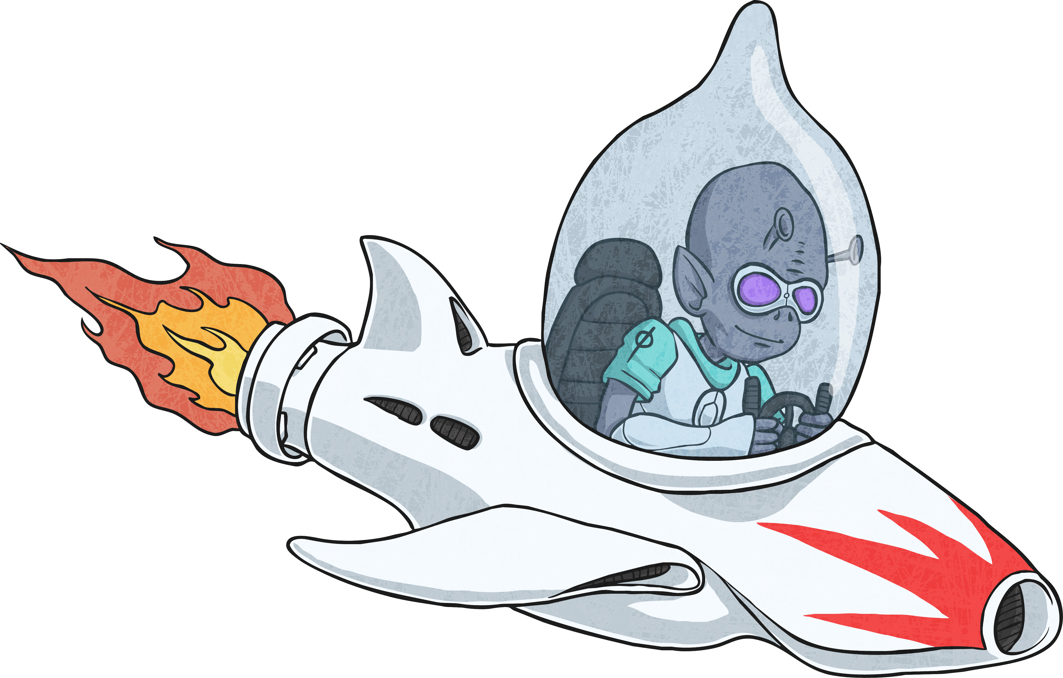
Correct!
’
’s

Slide 13
Correct!
’
’s

Slide 14
Incorrect!
’
’s
try again!

Slide 15
Which Word Is Correct?
Read the sentences below and decide which word should go in the gap. Which one accurately shows plural possession?
planets’
The orbits all centre around the star.
planets / planet’s / planets’ / planets’s
lice’s
Some eggs are difficult to remove.
lices / lice’s / lices’ / lices’s
teeth’s
All of the cavities must be filled.
teeths / teeth’s / teeths’ / teeths’s

Slide 16
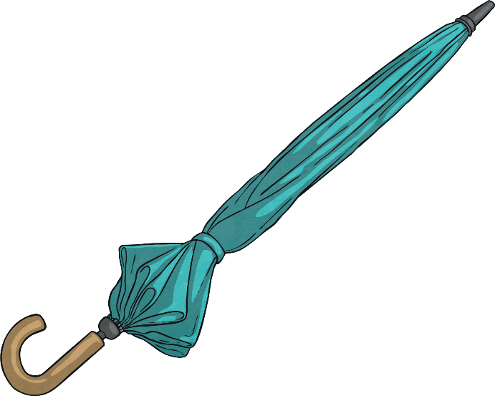
Plural Possession Quick Quiz
Take a quiz to see if you are an expert!
Which word should go in the gap to show plural possession?
handles are sometimes made from wood.
Umbrella’s
Umbrella’s
Umbrellas’
Umbrellas’
Umbrellas’s
Umbrellas’s
next
You’ve got it!
Try again!
Try again!

Slide 17
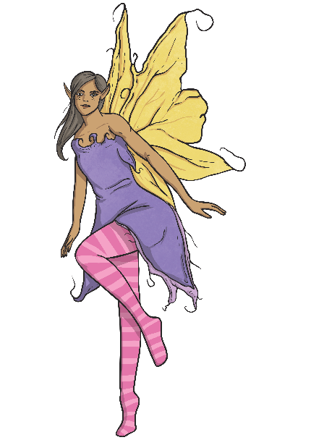
Plural Possession Quick Quiz
Take a quiz to see if you are an expert!
Which word should go in the gap to show plural possession?
The wings shimmered in the moonlight.
fairies
fairies
fairies’s
fairies’s
fairies’
fairies’
back
next
Try again!
Try again!
You’ve got it!

Slide 18
Plural Possession Quick Quiz
Take a quiz to see if you are an expert!
Which word should go in the gap to show plural possession?
beliefs shape their way of thinking.
People’s
People’s
Peoples’s
Peoples’s
Peoples’
Peoples’
back
next
Try again!
Try again!
You’ve got it!

Slide 19
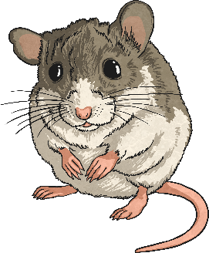
Plural Possession Quick Quiz
Take a quiz to see if you are an expert!
Which word should go in the gap to show plural possession?
The tiny feet tapped across the floorboards.
mices
mices
mice’s
mices’
mice’s
mices’
back
next
You’ve got it!
Try again!
Try again!

Slide 20
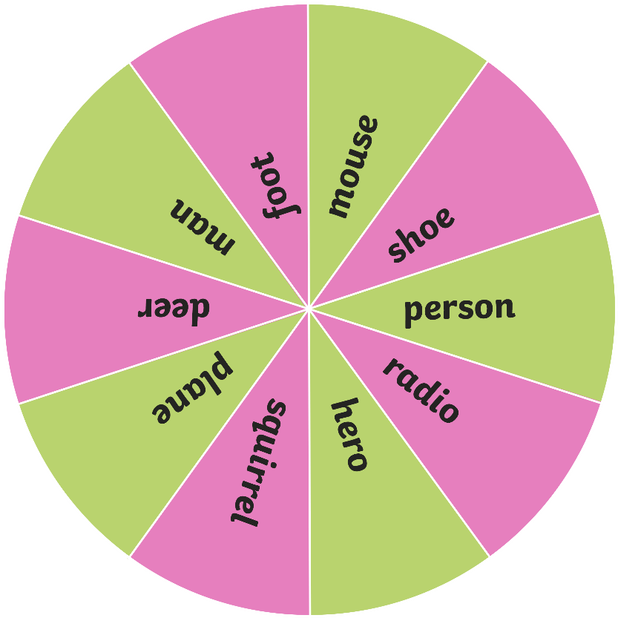
Lucky Dip
Spin the wheel to choose a singular noun. Then roll the die. If the number is even, you only need to write the noun in its plural form. If the number is odd, you must write a sentence which shows possession by the plural noun.
Spin
Roll

Slide 21

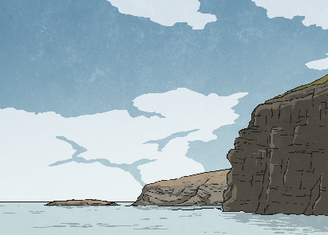

Which Word Is Correct?
Read the sentences below and decide on the plural which should go in the gap. Punctuate the word so that it accurately shows plural possession.
boxes’
Astonishingly, the contents did not weigh much.
singular noun: box
plural noun: boxes
cliffs’
Most of the faces were crumbling.
singular noun: cliff
plural noun: cliffs
animals’
The footprints all lead towards the hut.
singular noun: animal
plural noun: animals

Slide 22
Silly Sentences
Choose one word from each column to make the silliest sentences you can which still make sense and show plural possession.
Example: The witches’ money is made of frogspawn!
Determiner | Plural Possession | Random
the | bosses’ | smile
some | bushes’ | money
these | witches’ | days
many | people’s | clean
those | women’s | lantern

Slide 23

Show Me with Sentences
Look at the picture below. Use the picture to write two sentences which correctly use an apostrophe to show plural possession.

Slide 24
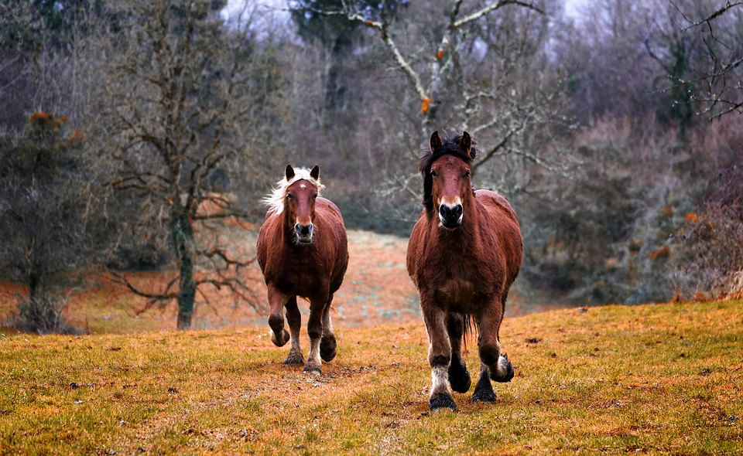
Show Me with Sentences
Look at the picture below. Use the picture to write two sentences which correctly use an apostrophe to show plural possession.

Slide 25

Show Me with Sentences
Look at the picture below. Use the picture to write two sentences which correctly use an apostrophe to show plural possession.

Slide 26
Plural Possession Quick Quiz
Take a quiz to see if you are an expert!
Is this sentence correctly punctuated to show plural possession?
The cacti’s spikes are sharp.
yes
yes
no
no
How did you know?

Slide 27
Plural Possession Quick Quiz
Take a quiz to see if you are an expert!
Is this sentence correctly punctuated to show plural possession?
Many of the childrens’ toys were left out.
yes
yes
no
no
Why is this incorrectly punctuated?

Slide 28
Plural Possession Quick Quiz
Take a quiz to see if you are an expert!
Is this sentence correctly punctuated to show plural possession?
Two witnesses’ testimonies stood out to the jury.
yes
yes
no
no
How did you know that this was correct?

Slide 29
Plural Possession Quick Quiz
Take a quiz to see if you are an expert!
Is this sentence correctly punctuated to show plural possession?
Witches’ hats are usually pointed.
yes
yes
no
no
How did you know that the apostrophe goes there?

Slide 30
Plural Possession Quick Quiz
Take a quiz to see if you are an expert!
Is this sentence correctly punctuated to show plural possession?
The table’s legs were all wobbly and needed to be fixed.
yes
yes
no
no
This shows singular possession. How could it show plural possession?

