Slide 1
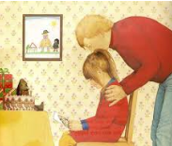

Plan a sequel to Gorilla. Can you think of 4 things that Hannah might do with her Dad on her birthday.
1___________________________________________________________________________________________________________ | 2___________________________________________________________________________________________________________
3___________________________________________________________________________________________________________ | 4___________________________________________________________________________________________________________

