Slide 2
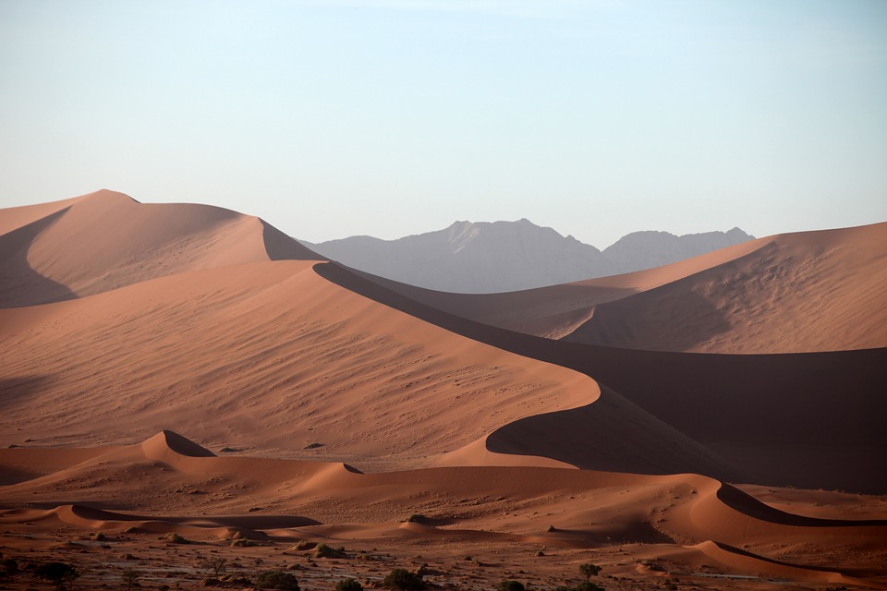
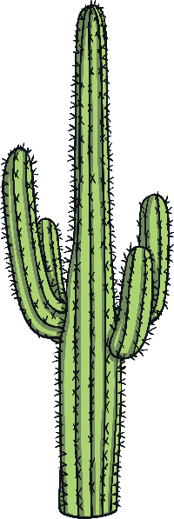
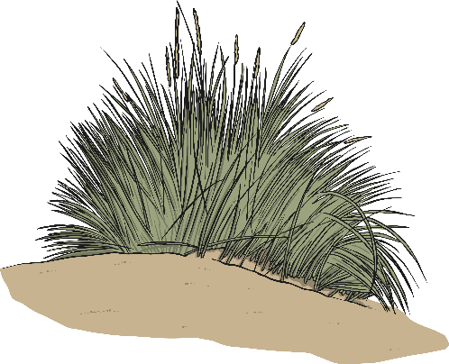
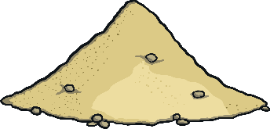
What are Deserts?
Deserts are very dry places. It hardly ever rains in a desert!
They are hot in the day but cold at night.
Do you think any animals live in the desert?

Slide 3
Desert Animals
Deserts are hot and dry but many animals do live there!
camel
tarantula
scorpion
iguana
What do animals eat and drink? Where do they shelter?

Slide 4
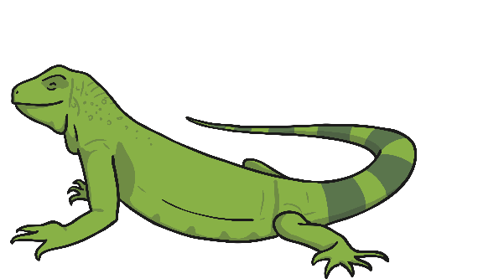
Desert Animals
All living things need to eat, drink and have shelter.
Camels can drink only once a week in summer and be fine!
Tarantulas live underground in burrows and come out at night to find food.
Scorpions burrow into the sand when it is really hot. They get water from eating their prey.
Iguanas, like all reptiles, are cold-blooded. They need the hot sun to keep warm.

Slide 5
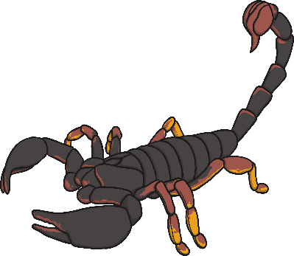
Desert Plants
Desert plants do not need much water.
They have thick leaves or spiky spines.
cactus plants
They have long roots to find water.
agave plants

Slide 6
Hot and Cold Deserts
Deserts are very dry places. Some deserts are hot but some are very cold!
The Antarctic and the Arctic are two cold deserts!
Did You Know…?
The hottest desert in the world is the Sahara Desert in Africa.

