Slide 2
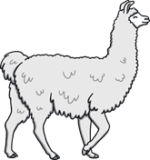
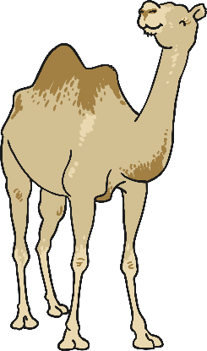
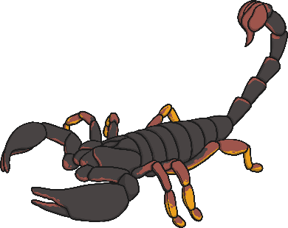
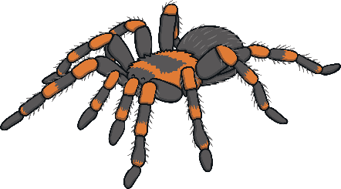
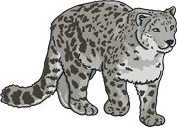
Different Desert Animal Habitats
Click on a desert habitat to find out a little bit more about it.
Hot desert habitat
Cold desert habitat

Slide 3
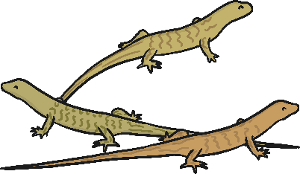
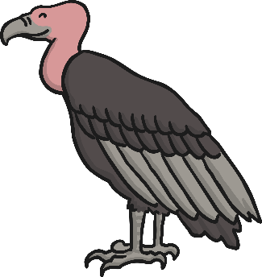
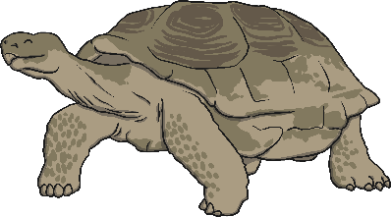
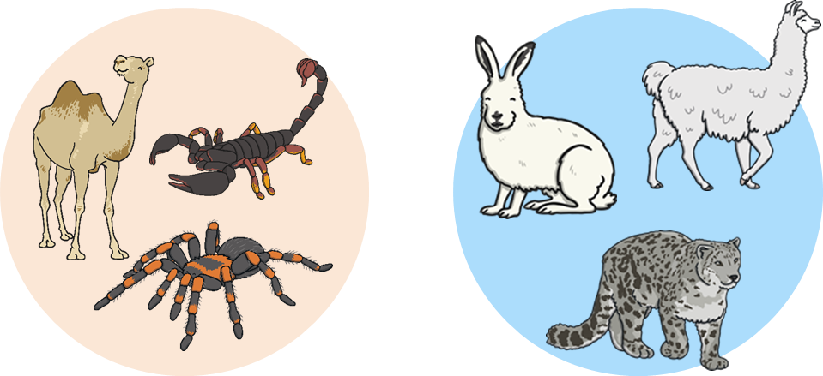
Hot Desert Animal Habitats
Click on a hot desert animal to find out a little bit more about it.
Main

Slide 4
Lizard
The desert horned lizard is adapted to very hot temperatures because it has horns behind its head and thick scales which keep the heat out.
They eat insects, which helps to control the insect population.
They have long tails, 4 legs and 5 toes on each foot.
They live for about 8 years.
Back

Slide 5
Tarantula
Tarantulas can be found in parts of America and African deserts.
They live underground to cope with the heat.
They do not spin webs but instead live in burrows. They use their silk to make ‘doors’ to their burrows.
They hunt at night when it is cooler.
They eat insects, beetles and grasshoppers.
Back

Slide 6
Scorpion
Scorpions have 2 eyes on the top of their heads and some have up to 5 pairs of eyes on each side of their heads.
They catch their prey with their pincers and crush it.
All scorpions are poisonous. 25 species of scorpion are deadly to humans.
They have an exoskeleton (a skeleton on the outside of their body) which helps them keep water in their bodies in order to survive in the harsh temperatures.
Back

Slide 7
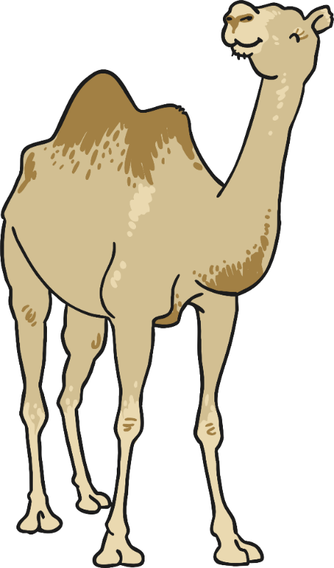
Camel
Camels eat grass, seeds, grains and some plants with thorns.
They can grow up to 7ft tall.
Their hair reflects the sun, which helps to keep them cool.
They are used to transport people and goods across the desert.
They do not store water in their humps.
Back

Slide 8
Vulture
There are 23 different species of vulture.
They save energy in the hot desert by soaring with their huge wings, rather than flapping.
Their wingspan is between 2m and 2.5m.
They are scavengers which means they do not kill their own food but eat the leftovers of other dead animals.
They have very good eyesight and a strong sense of smell.
Back

Slide 9
Tortoise
The desert tortoise can be found in California, Mexico, Nevada and Utah. They are protected from the sun by their scaly head and a hard, domed shell.
They have heavily scaled legs with sharp claws to dig underground and find shade.
They can survive temperatures up to 60°C.
They can survive without water for a year!
Back

Slide 10
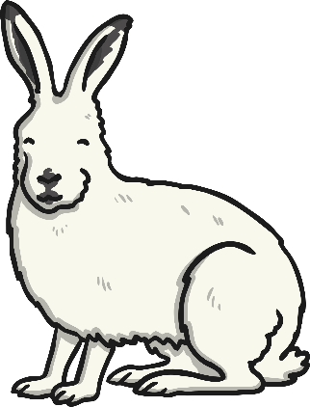
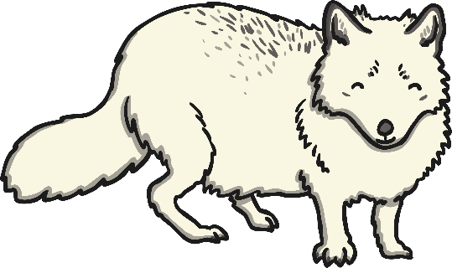
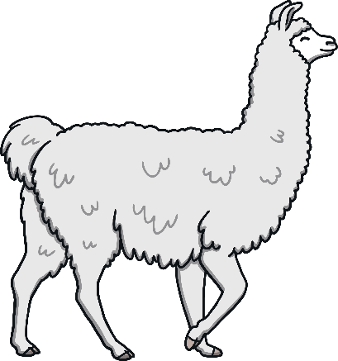
Cold Desert Animal Habitats
Click on a desert animal to find out a little bit more about it.
Main

Slide 11
Arctic Hare
Arctic hares live in the snows of the Arctic. They have thick white fur in the winter which keeps them warm in the cold temperatures. Their fur goes brown in the warmer months to help them stay camouflaged.
Arctic hares are herbivore and eat woody plants such as willow. They eat snow to get water.
They have an excellent sense of hearing and can run up to 40mph which helps them to escape predators.
Back

Slide 12
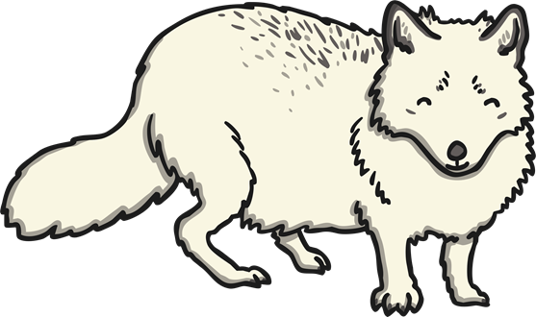
Arctic Fox
The arctic fox is a omnivore. It eats meat such as rodents, birds and fish as well as fruit and vegetables. They live in the coldest deserts in the world and burrow tunnels underground to live in.
Arctic foxes have beautiful white coats so that they blend in with the snow. Their coat changes colour as the season changes.
An arctic fox can live up to 6 years old.
Back

Slide 13
Snow Leopards
Snow Leopards live in some of the coldest parts of the world such as the rocky mountains of China, Russia and Nepal.
They grow to around 1 metre in length and are large and powerful. Their back legs are strong and they can leap long distances.
They have long tails which they wrap around their bodies to protect them from the cold.
They hunt wild sheep, pikas and hares.
Back

Slide 14
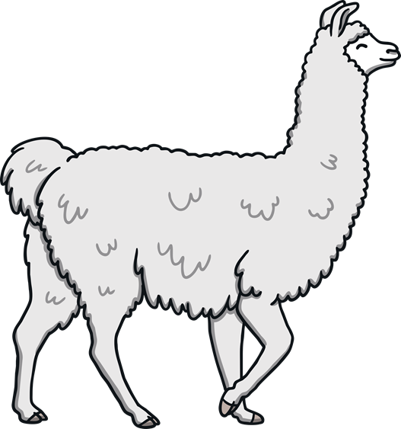
Llama
Llamas are mostly found in South America and they are related to the camel. However, they do not have humps!
They are long legs and necks, short tails and large, pointed ears.
They eat grass and other plants.
They are gentle animals but will hiss and spit when they are annoyed or scared.
They have a thick outer coat to keep them warm and this is used by humans to make jumpers and rugs.
Back

