Slide 2
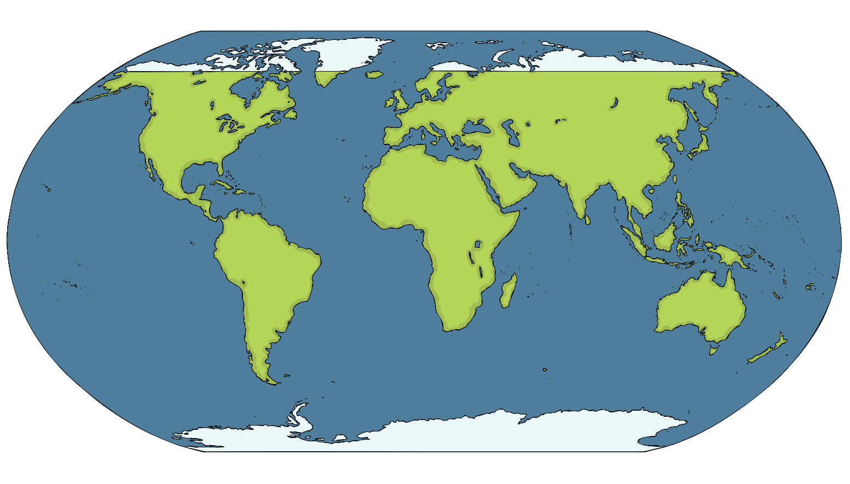
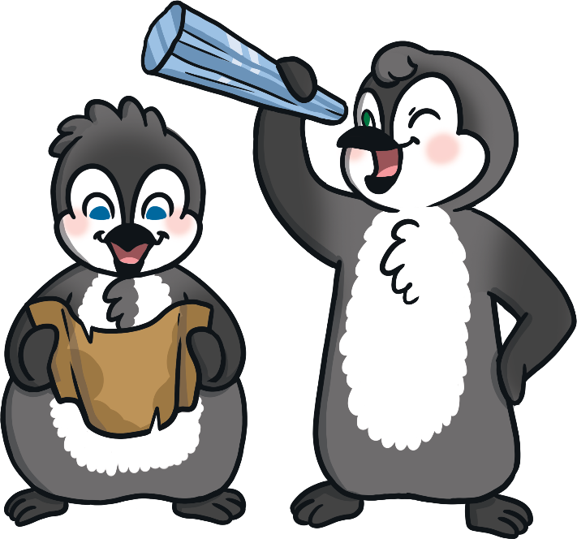
Where Are the Polar Regions?
The Arctic
Antarctica
Do you recognise any other places on the map?

Slide 3
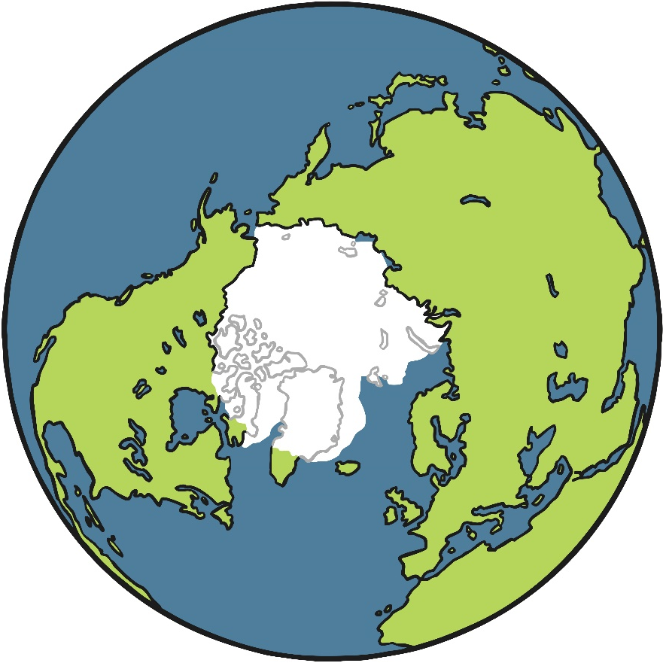
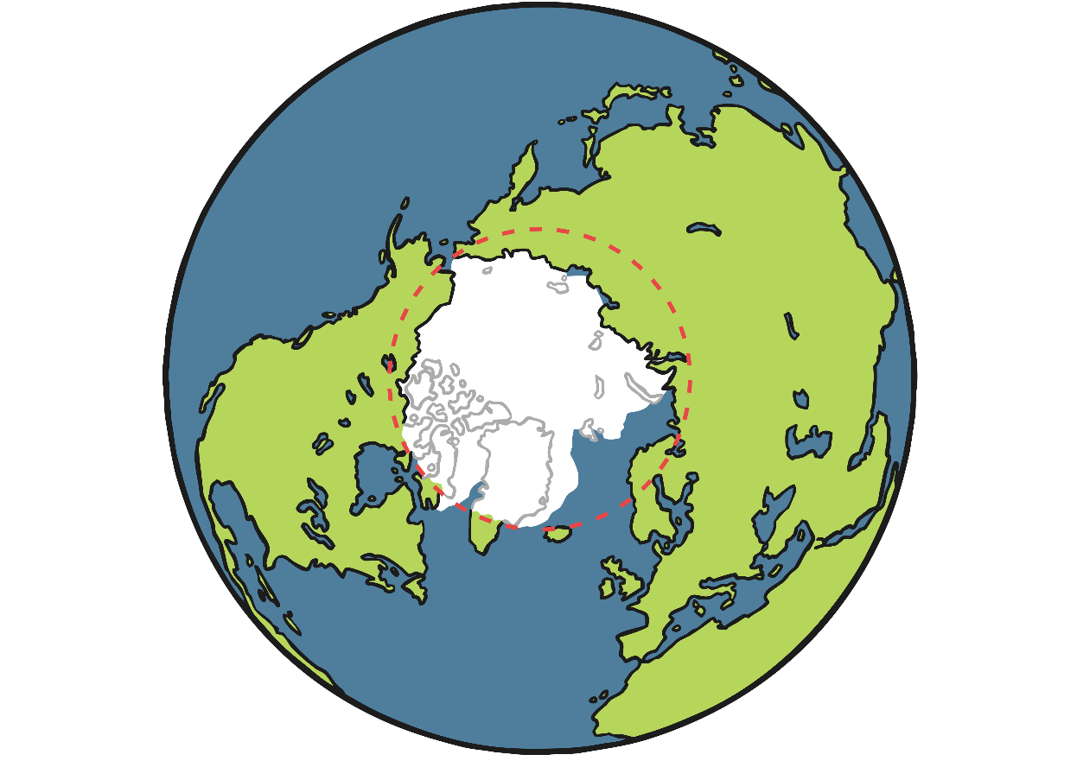
The Arctic
The Arctic is at the very top of the Earth. It includes the areas around the North Pole. The Arctic isn’t a country or a continent. It is actually mostly a frozen ocean.
The Arctic includes parts of lots of different countries. These include Norway, Finland, Sweden, Russia, the USA, Canada, Denmark and Iceland. It also includes the Arctic Ocean.
Arctic Ocean
ARCTIC CIRCLE
Canada
Russia
NORTH POLE
Finland
This whole area is known as the Arctic Circle.
Sweden
Norway
the USA
Iceland
Denmark

Slide 4
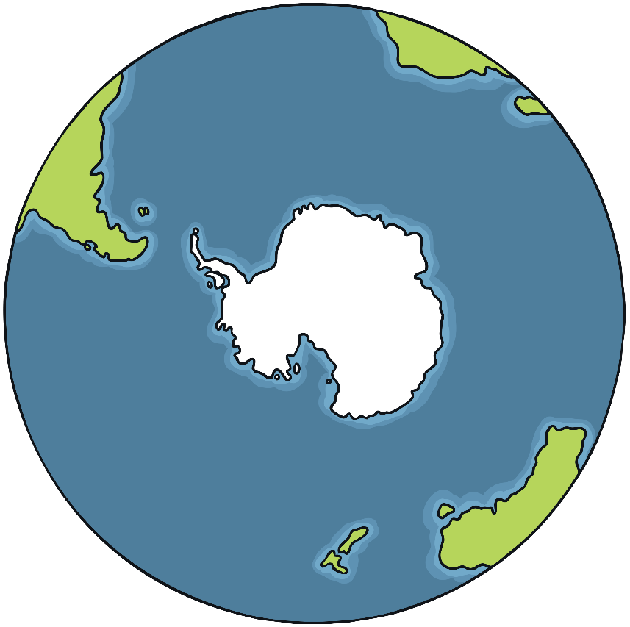
Antarctica
Antarctica is at the bottom of the Earth. It includes the areas around the South Pole. Unlike the Arctic, Antarctica is actually a continent. This is because Antarctica is an area of land, covered in ice.
Antarctica isn’t officially owned by anyone, so it is not called a country. It has no government and no towns or cities.
Madagascar
ANTARCTIC CIRCLE
Madagascar
Falkland
Islands
Falkland
Islands
It is looked after by a special agreement called The Antarctic Treaty. This means that the environment is protected and Antarctica can only be used for peaceful purposes. More than 50 countries have agreed to the treaty, including Russia, China, the UK and the USA.
Antarctica
Antarctica
SOUTH
POLE
Tasmania
Tasmania
Australia
New Zealand
Australia
New Zealand

Slide 5
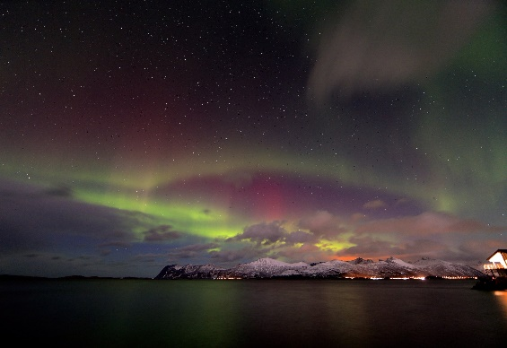
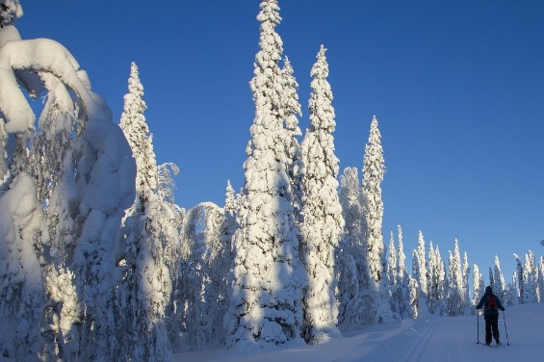
Climate in the Arctic
The Arctic only has two seasons. It has long, cold winters and short, cool summers. The winters last for about 8 months.
In the winter, the sun is so far away from the Arctic that it doesn’t rise at all. This means it can be cold and dark for months.
The average temperatures in the Arctic range from about 12ºC in the summer to about -34ºC in the winter.
What do you think it would be like if you didn’t see the sun for months?

Slide 6
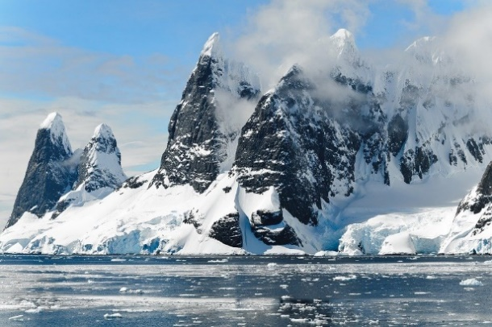
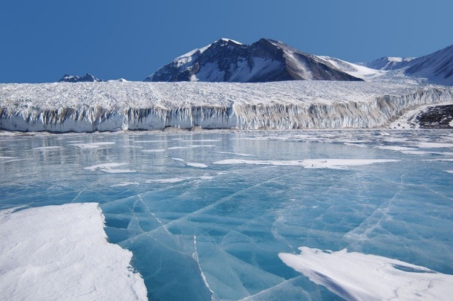
Climate in Antarctica
Antarctica is the coldest and windiest place on Earth. The lowest temperature ever recorded here was -89ºC! The average temperatures range from about 10ºC in the summer to -60ºC in the winter. Antarctica’s winter also lasts for 8 months.
Because it is so cold, over 98% of Antarctica is permanently covered in ice. The average thickness of this ice is about one mile! Antarctica is also home to the driest place on Earth. There are places in Antarctica which haven’t had rain or snow in over 2 million years!
What do you think -89ºC would feel like?

Slide 7
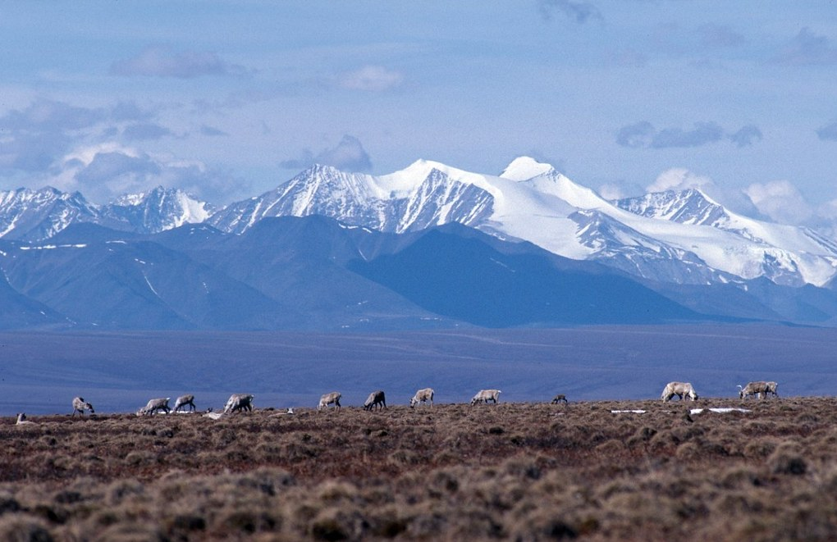
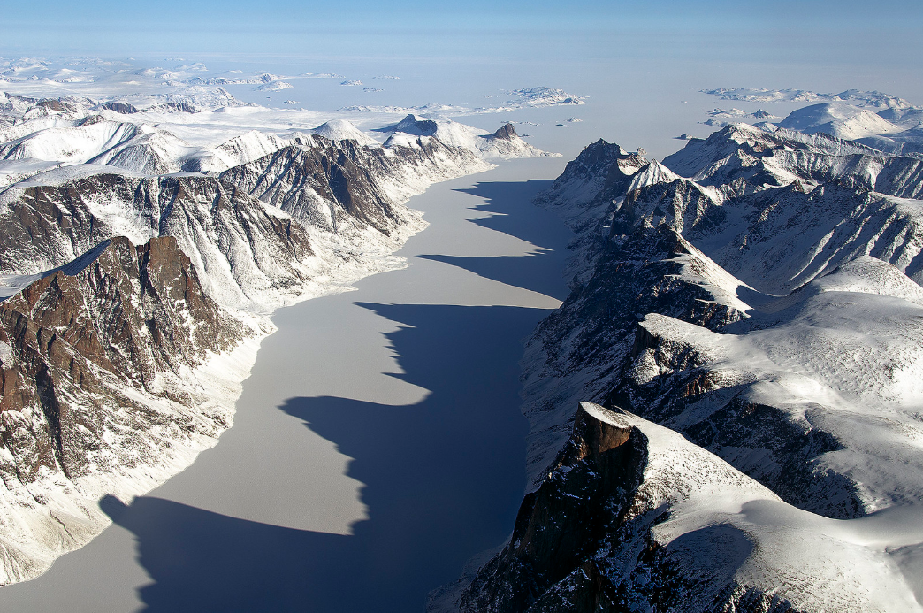
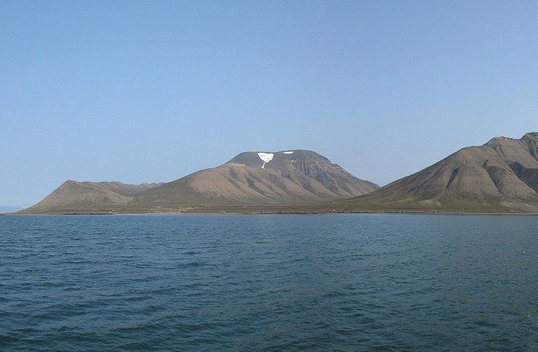
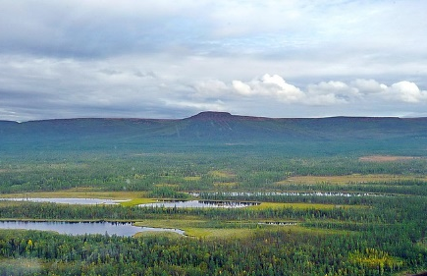
Physical Features in the Arctic
There are lots of different physical features in the Arctic. These include:
mountains
fjords
Most of the Arctic, however, is covered by water and most of that water is frozen. Some of these physical features, such as glaciers and icebergs, help to make up 20% of Earth’s freshwater.
islands
plateaus
“U.S. Fish and Wildlife Service Headquarters” by USFWS Headquarters is licensed under CC BY 2.0, “Baffin Island Davis Strait” by NASA ICE is licensed under CC BY 2.0, “Putorana Plateau” by jxandreani is licensed under CC BY 2.0

Slide 8
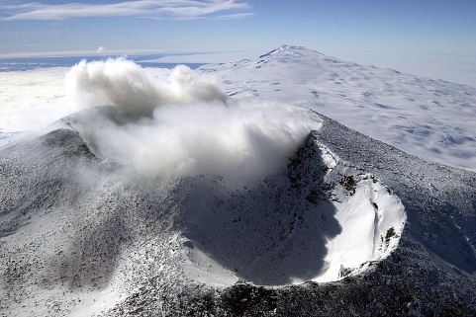
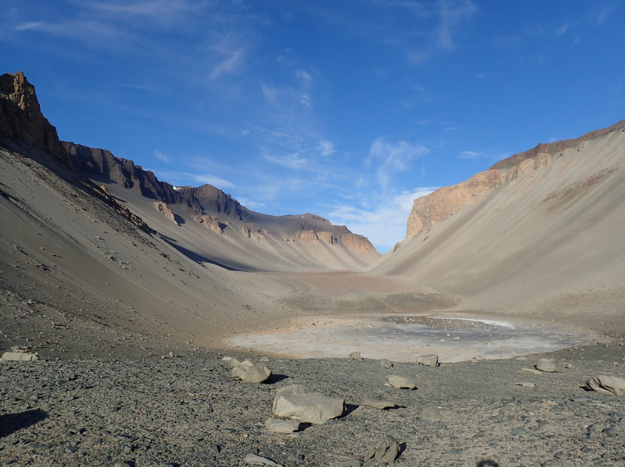
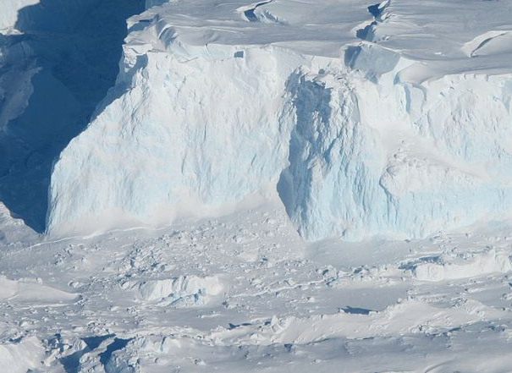
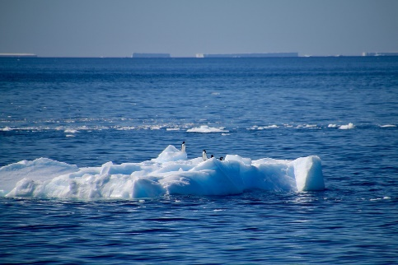
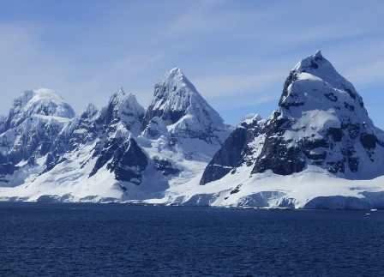
Physical Features in Antarctica
There are lots of different physical features in Antarctica. These include:
valleys
glaciers
seas
mountains
…and even volcanoes! There are 138 volcanoes in Antarctica. However, only two of them are currently active. The most active is called Mount Erebus and it has been active for about 1.3 million years.
“Don Juan Pond, South Fork, Upper Wright Valley, Antarctica” by Pierre Roudier is licensed under CC BY 2.0, “A close look at the shelf ” by NASA ICE is licensed under CC BY 2.0, “Mount Erebus craters, Ross Island, Antarctica” by NSF/Josh Landis is licensed under CC BY 2.0

Slide 9
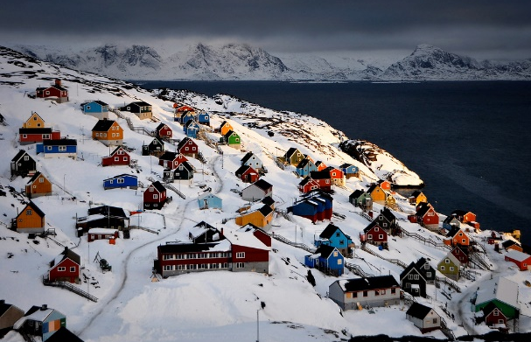
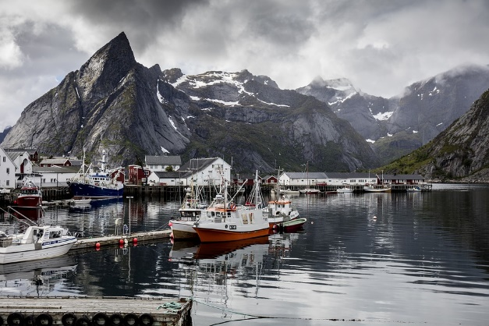
Humans in the Arctic
People have lived in the Arctic for thousands of years. Only about 4 million people live and work in the Arctic at the moment (for comparison, there are 66 million in the UK).
In the winter, it can get so cold that it’s too dangerous to go outside without special clothing and equipment. Strong storms and blizzards can make travel very difficult and heating a home can be expensive without trees for a fire.
“Sisimiut vinter houses” by Greenland Travel is licensed under CC BY 2.0
Mining for oil and gas, and fishing are important activities in the Arctic.
What do you think it would be like to live in the Arctic?

Slide 10
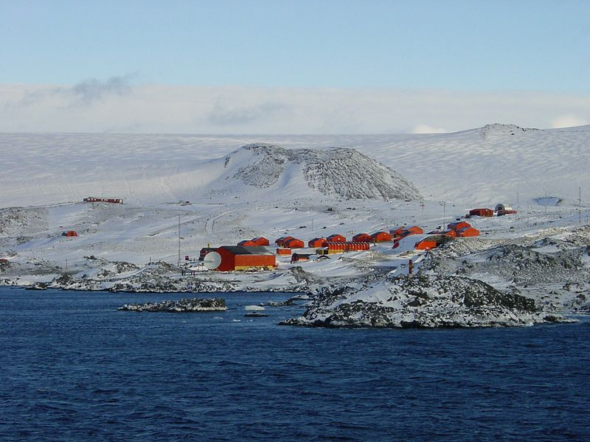
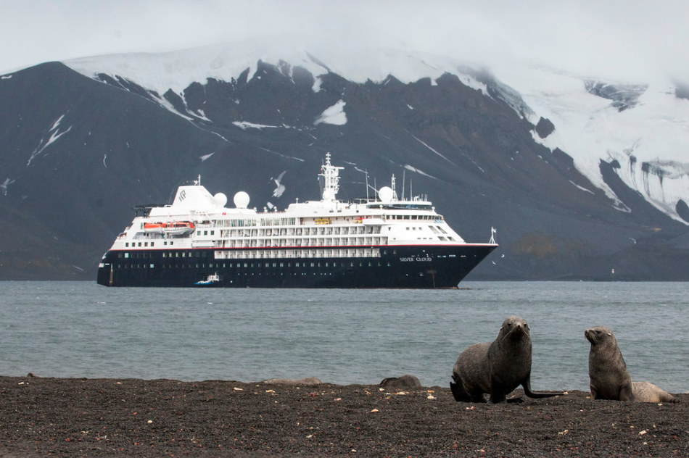
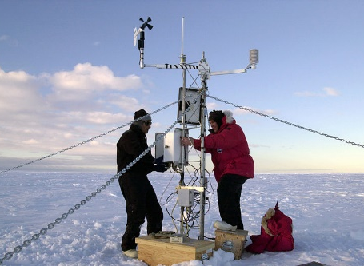
Humans in Antarctica
No people permanently live in Antarctica because it is too cold for them to live there for a long time. Scientists take turns living there for short periods of time to study the ice and the animals. Tourists also sometimes visit in the summer. There are no towns or cities in Antarctica.
research stations for scientists to work in
an Antarctic cruise ship
a weather experiment
“Esperanza Station anta0060” by NOAA Photo Library is licensed under CC BY 2.0
“Whalers Bay Deception Island Antarctica Fur Seal Silversea Silver Cloud 3 ” by Gary Bembridge is licensed under CC BY 2.0
“Iceberg B-15A weather instrument” by NSF/Josh Landis, employee 1999-2001 is licensed under CC BY 2.0
What do you think it would be like to live in Antarctica?

Slide 11
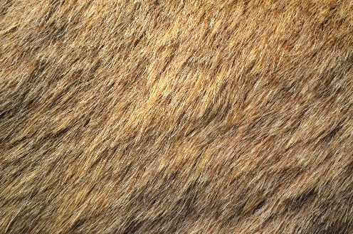
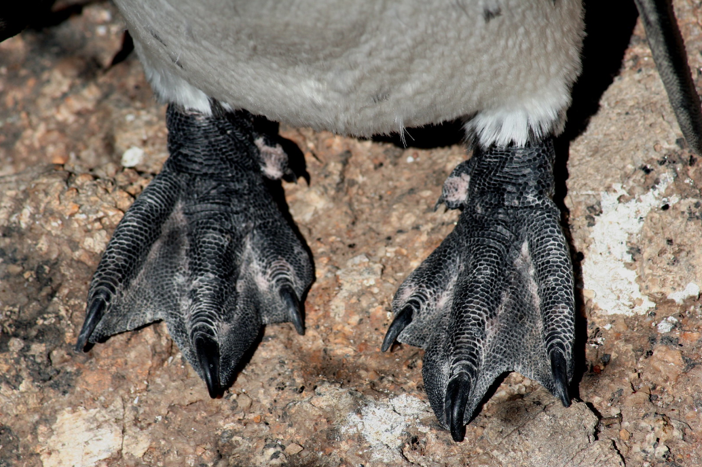
Polar Adaptations
There are lots of different animals that live in the polar regions. They all have special adaptations (skills or features they have developed) which allow them to live in such cold temperatures.
a reindeer’s thick coat
Many of these animals, such as seals and penguins, have a special layer of fat under their skin, called blubber. This helps to insulate their bodies and keep the heat in. They may also have thicker layers of fur.
a penguin’s sharp claws and webbed feet
Some of them have special adaptations on their feet, such as fur or sharp claws, to help them grip the slippery ice. They may also have wide or webbed feet to keep them from sinking in the snow.
“Penguin Feet” by Jon Rawlinson is licensed under CC BY 2.0

Slide 12
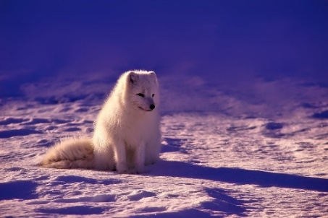
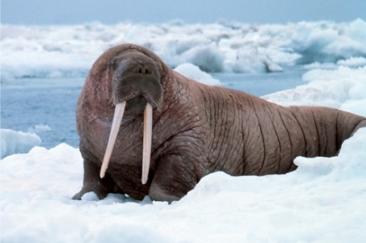
Arctic Animals
The Arctic covers area of Europe, North America and Asia. Because of this, there are lots of different types of animals here.
Arctic foxes have short ears and noses to limit how much of their body is exposed to the cold. They live in burrows underground to keep them warm. Their fur turns white in winter so they are camouflaged against the snow.
Polar bears have a thick coat and a layer of blubber to keep them insulated. They even have fur on their paws. This helps to protect them from cold surfaces and also lets them grip the ice.
Walruses have long tusks. They use them for pulling themselves out of the water and to break breathing holes in the ice when they are underwater. They also have a very thick layer of blubber.

Slide 13
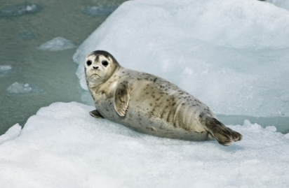
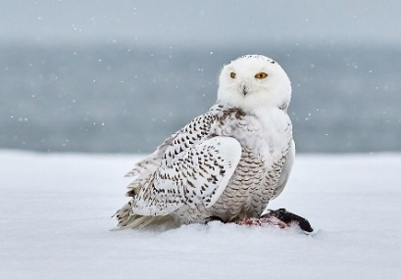
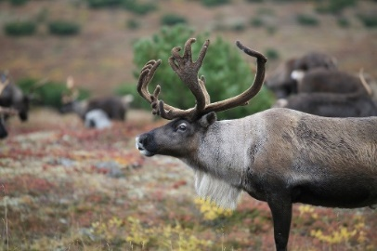
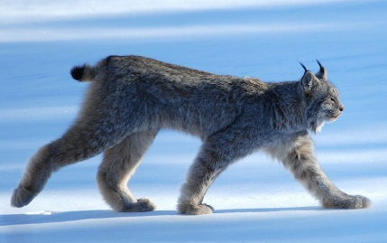
Arctic Animals
Harp seals spend very little time on land and most of their time in the water. They can stay underwater for up to 15 minutes! They eat mostly fish.
Snowy owls have very good eyesight and hearing. This helps them to spot their prey in the snow. They have mostly white feathers which help to camouflage them.
Reindeer have thick coats which keep them insulated. In fact, if a reindeer lies down, the snow underneath it won’t even melt! Their hooves also have fur on the bottom to keep them from slipping.
Lynxes have special paws. As they walk, their toes spread out, which stops them from sinking in deep snow. They have very good eyesight, which makes them excellent predators.
“Snowy Owl” by Jongsun Lee is licensed under CC BY 2.0
“Lynx Canadensis” by Keith Williams is licensed under CC BY 2.0

Slide 14
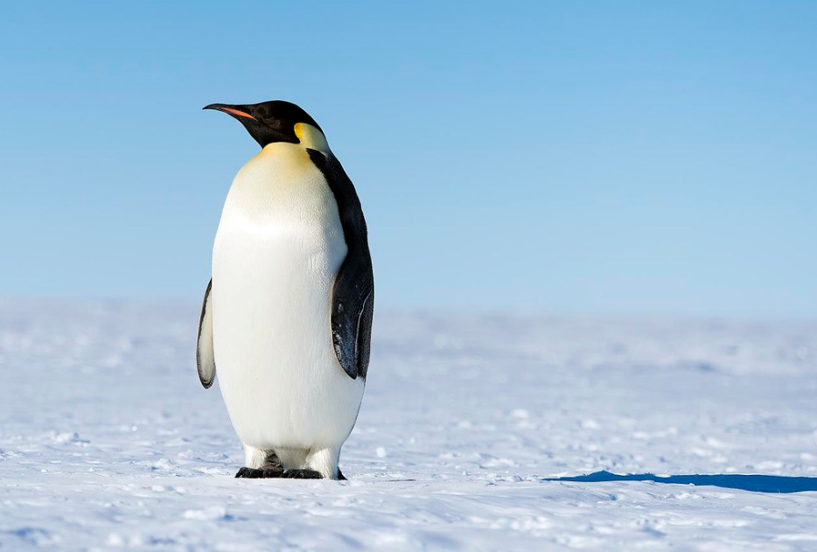
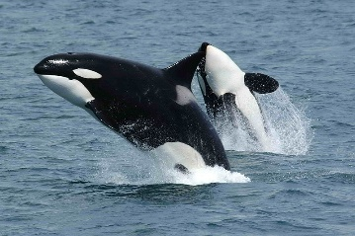
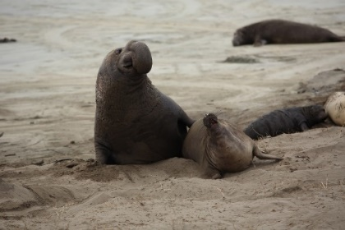
Antarctic Animals
There are lots of different animals that live in Antarctica.
Emperor penguins are the biggest penguins in the world. They have a special flap of skin above their feet where they keep their egg (and then their chicks) warm and off of the cold ground.
Orcas are one of the fiercest predators in the sea. They eat seals, sea lions, penguins, squid, sea turtles, whales and even sharks. They have a thick layer of blubber to protect them from the cold water.
Elephant seals are the largest of all the seals. They can dive over 4900 metres and can stay underwater for more than two hours.
“Emperor Penguins” by Christopher Michel is licensed under CC BY 2.0
“Killerwhales jumping” by Robert Pittman is licensed under CC BY 2.0

Slide 15
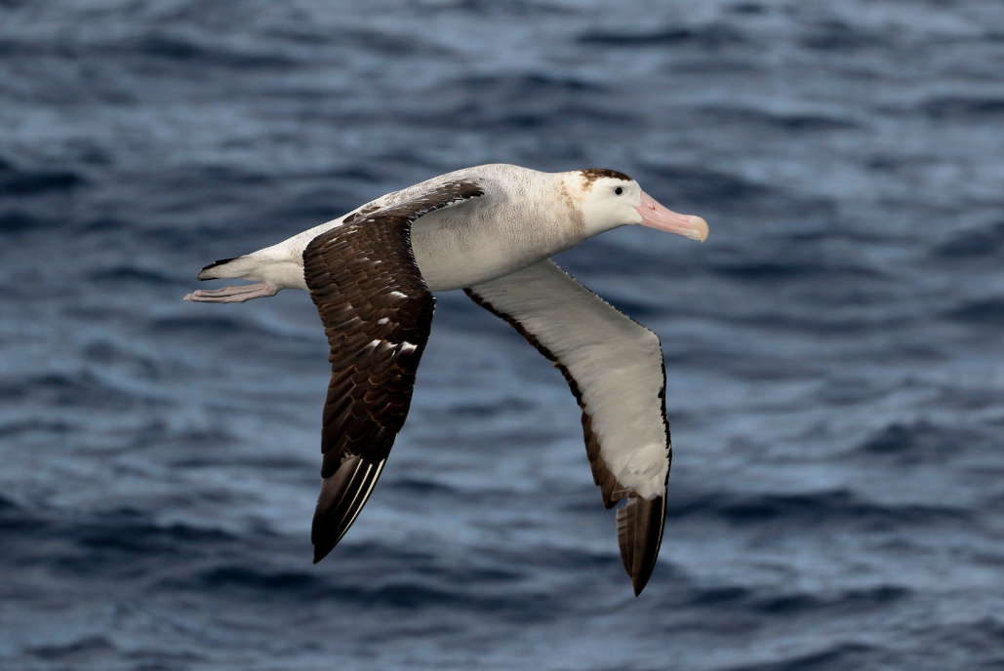
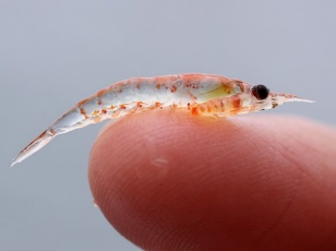
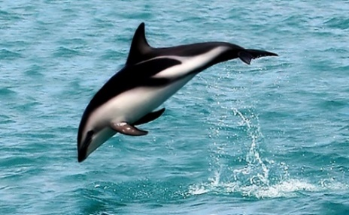
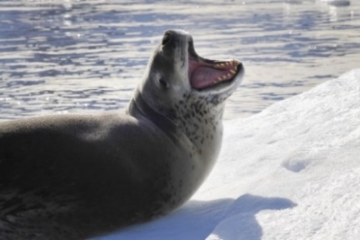
Antarctic Animals
Albatrosses have the largest wingspan of any bird in the world. Their wingspan can measure over three metres! They can soar through the air for several hours at a time without needing to flap their wings.
Krill are very small shrimp-like creatures. Krill are able to shrink their bodies and go for long periods of time without eating, which helps them survive the winter months.
Dusky dolphins are very social and playful. They have a curved dorsal fin (the fin on their back) which helps them to change direction quickly to swim away from predators.
Leopard seals have a thick layer of fat to keep them insulated in cold water. They can dive underwater for up to 15 minutes.
“Wandering Albatross” by Ed Dunens is licensed under CC BY 2.0
“Krill” by Sophie Webb/NOAA is licensed under CC BY 2.0
“A wild dusky dolphin named "Nox"” by AllenMcC is licensed under CC BY 2.0

Slide 16
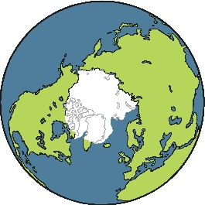
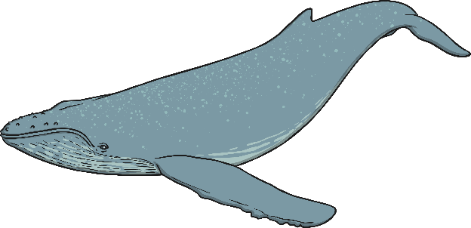
Quick Facts About the Arctic
Travel in the
Arctic relies on icebreakers. Icebreakers are giant powerful ships
which break up miles of sea ice, sometimes metres thick.
There are about 10 cities in the Arctic.
The Arctic Ocean is larger than the continent of Europe, but it is the smallest ocean in the world.
In 1958, a submarine called the USS Nautilus sailed under the frozen ice of the Arctic Ocean. This was proof that the Arctic ice sits on water and not on land.
Grey whales travel 12,500 miles every year from the Arctic to Mexico during the winter.
There are no penguins in the Arctic.

Slide 17
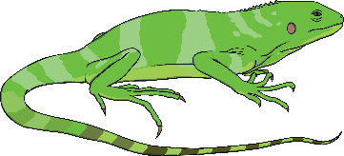
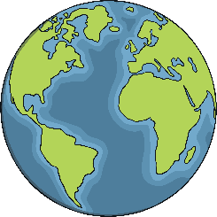
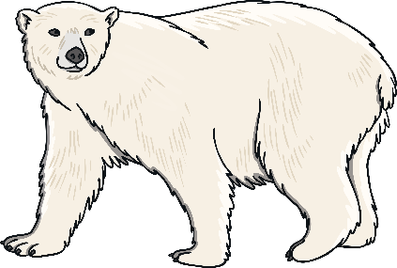
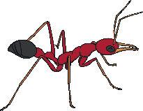
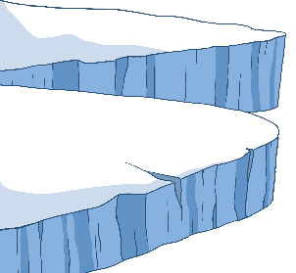
Quick Facts About Antarctica
Antarctica is the fifth-largest continent in the world and is about 50 times the size of the UK.
70% of Earth’s freshwater and 90% of its ice is in Antarctica.
Antarctica is the only continent without any reptiles.
There are no polar bears in Antarctica. They only live in the Arctic.
The largest recorded iceberg in Antarctica was bigger than the size of Jamaica!
Antarctica is one of the few places on Earth where you won’t find any ants.
Antarctica is called a desert. This is because it has very little rain.

