Slide 2
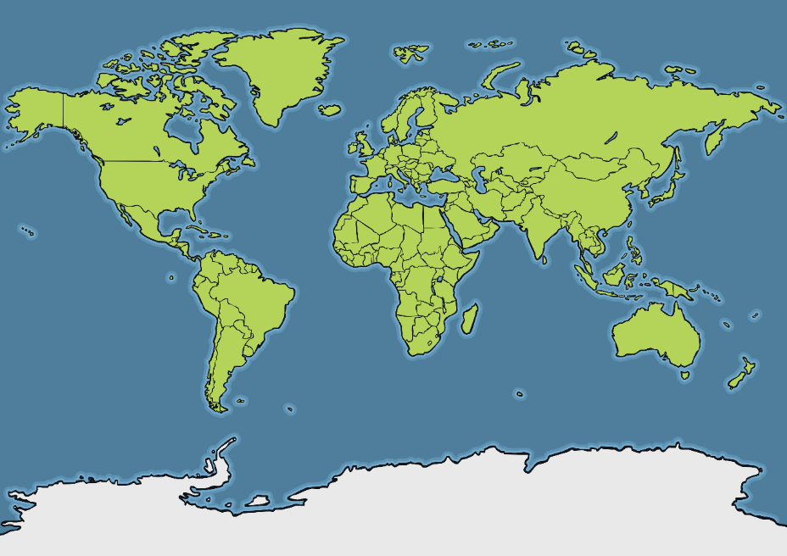

Where Is Antarctica?
Antarctica
Do you recognise any other places on the map?

Slide 3
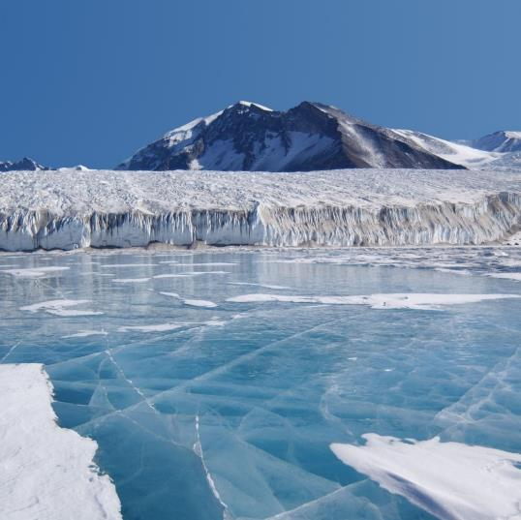
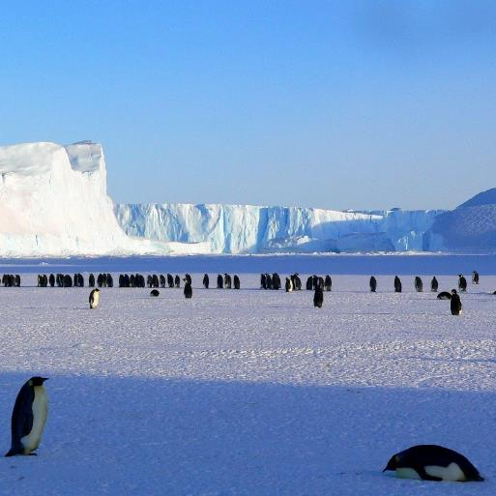
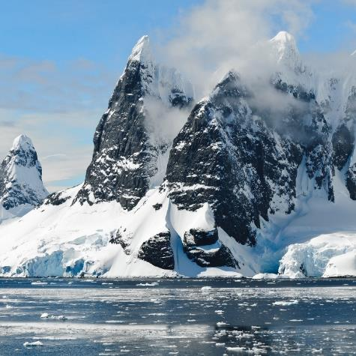
Antarctic Animals
There are lots of fascinating creatures that call the continent of Antarctica home.
What do you think it would be like to live in Antarctica?

Slide 4
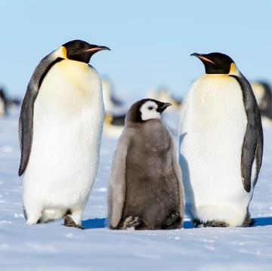
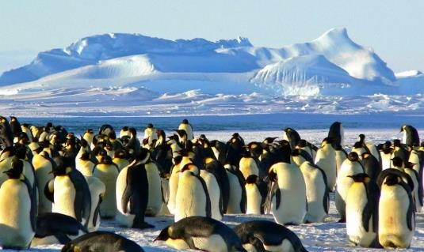

Emperor Penguin
There are 7 different types of penguin that live in Antarctica.
One type of penguin that lives in Antarctica is the emperor penguin. Emperor penguins are the biggest type of penguin in the world. They are only found in Antarctica.
Emperor penguins don’t build nests. The male penguin keeps their egg warm by balancing it on top of his feet under a loose fold of skin. He will do this for up to 75 days! All this time, he won’t eat anything until the egg has hatched and the female has returned with food.
Did you know? An adult emperor is about the same
size as a six-year-old person!
“Emperor Penguins” by [Christopher.Michel] is licensed under CC BY 2.0

Slide 5
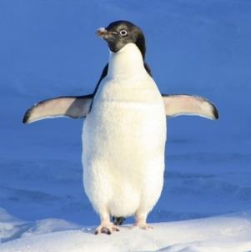
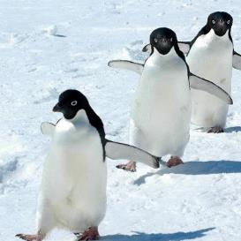

Adélie Penguin
Adélie penguins are another type of penguin that lives in Antarctica.
Adélies use rocks to build their nests and keep their eggs off the cold ground. However, Adélies can be sneaky. To save hunting for rocks, they’ll often steal them from other penguins’ nests!
Adélie penguins can only be found in Antarctica and its nearby islands.
Did you know? Adélies may travel a 185-mile round trip to find food!

Slide 6
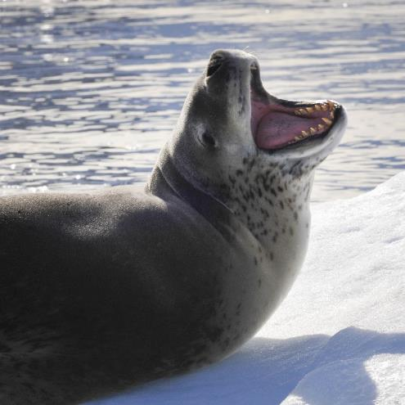
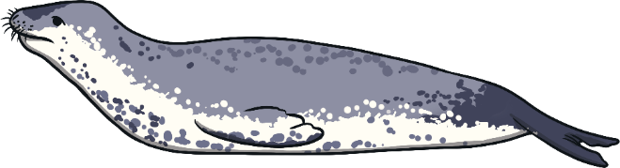
Leopard Seal
Leopard seals are named after their spotted coats which make them look a little like a leopard!
Leopard seals can also be found in South Africa, South America, Australia and New Zealand.
Leopard seals are fierce predators. This means they survive by eating other animals. They are diurnal, which means they are active during the day and sleep at night.
Leopard seals eat krill, squid, fish, birds, other seals and penguins.
Did you know? Leopard seals can dive underwater for up to 15 minutes!

Slide 7
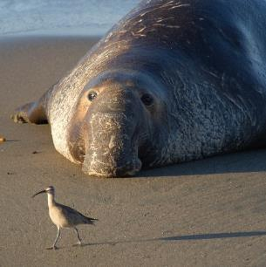
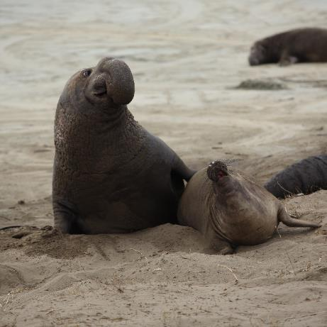

Elephant Seal
Male elephant seals are bigger than females and have a large trunk-like nose, which is where they get their name.
There are two types of elephant seals: the northern and the southern. The southern elephant seal is the type found in Antarctica.
Southern elephant seals are the largest of all the seals.
They can dive over 4900 metres and can stay underwater for more than two hours.
Did you know? Male elephant seals can weigh as much as 4000 kilograms. That’s twice as heavy as a car!

Slide 8
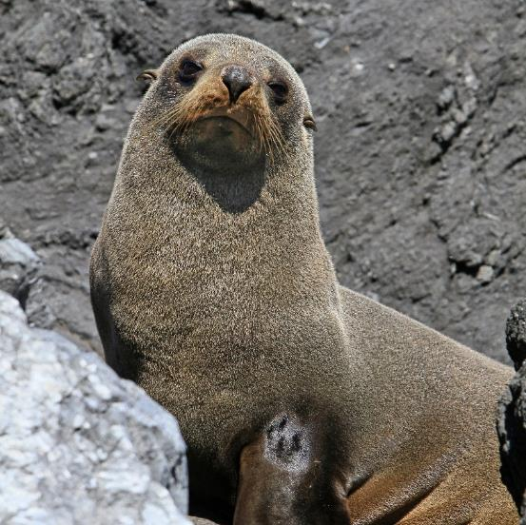
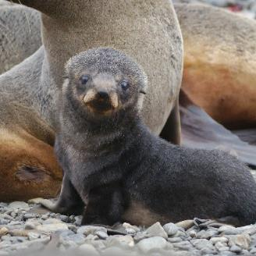
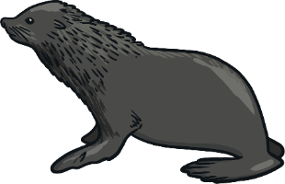
Fur Seal
Fur seals have excellent hearing and sight. They can also turn their back flippers forwards, meaning they can walk (in a clumsy way) on land.
They have thick fur and a thicker layer of blubber (fat) under their skin. This helps to keep them warm in Antarctic temperatures.
Mother fur seals can recognise their babies by the unique noise they make. They can even recognise this call after four years apart!
Did you know? Male fur seals are five times bigger than females!
“Baby Fur Seal” by [Rob Oo] is licensed under CC BY 2.0

Slide 9
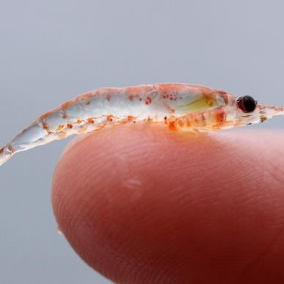
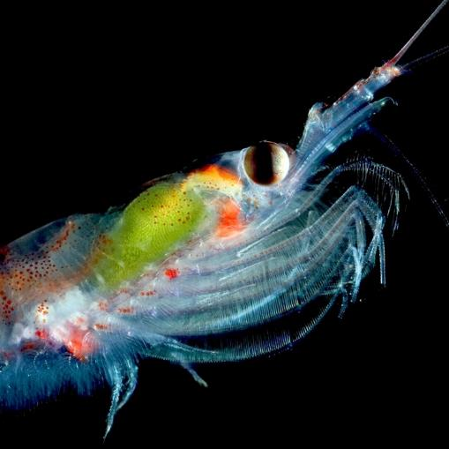
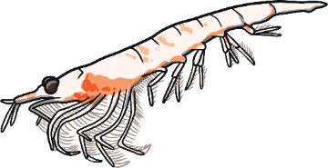
Krill
Krill are very small, shrimp-like creatures. They are slightly bigger than a paper clip when they are fully-grown.
Krill are found in all of the world’s oceans.
Krill are very important because hundreds of different animals depend on them as their main food source. These animals include birds, seals, whales and fish.
Did you know? Krill can live for up to 10 years.

Slide 10
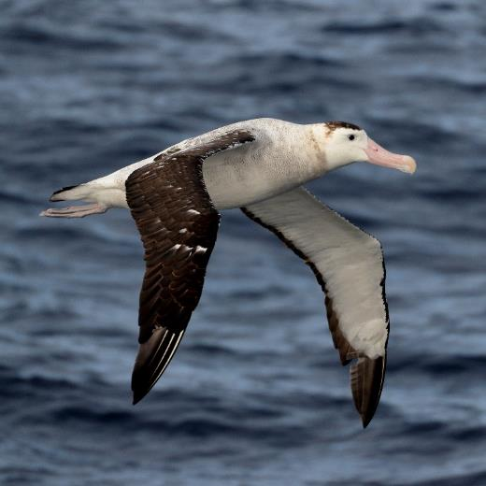
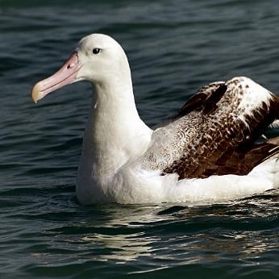
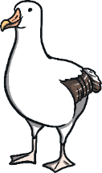
Wandering Albatross
Wandering albatrosses are one of the biggest birds in the world.
They have the largest wingspan (the length of their wings from tip to tip) of any bird in the world. Their wingspan can measure up to 3.5 metres!
Albatrosses are fantastic gliders. They can soar through the air for several hours without needing to flap their wings.
Did you know? Albatrosses can
fly up to 25 miles per hour!
“Wandering Albatross” by [blachswan] is licensed under CC BY 2.0

Slide 11
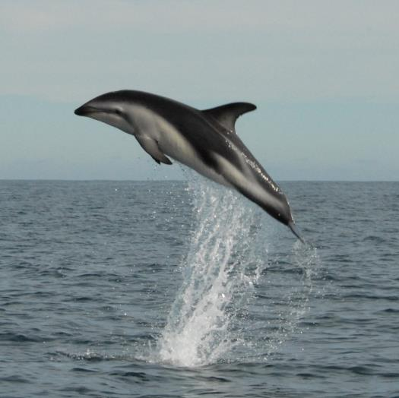
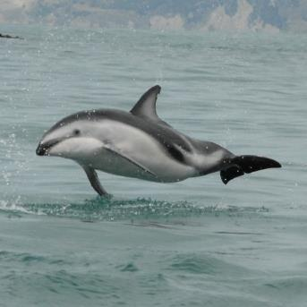
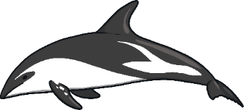
Dusky Dolphin
Dusky dolphins are very social and playful. They can often be seen leaping, flipping and gliding in the air after jumping high out of the sea.
They usually live in groups (called pods) of 20 to 30 other dolphins in the day, but will hunt with up to 1000 dolphins.
Dusky dolphins eat squid, fish, shrimp and anchovies.
Did you know? Dusky dolphins are the smallest species of dolphin.

Slide 12
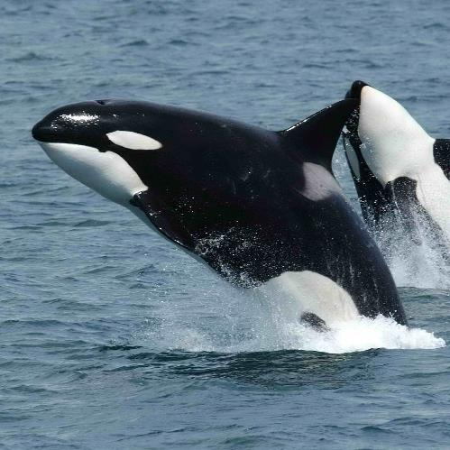
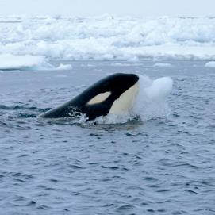
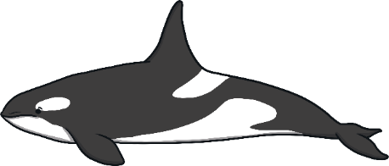
Orca
Orcas are very intelligent and very social. They live in pods (groups) of up to 30 orcas.
They are also known as ‘killer whales’. However, orcas aren’t actually whales but are a type of dolphin.
Orcas are one of the fiercest predators in the sea. They eat seals, sea lions, penguins, squid, sea turtles, whales
and even sharks.
Orcas work together in
groups to hunt their prey.
Did you know? Orcas live in every ocean in the world!

Slide 13
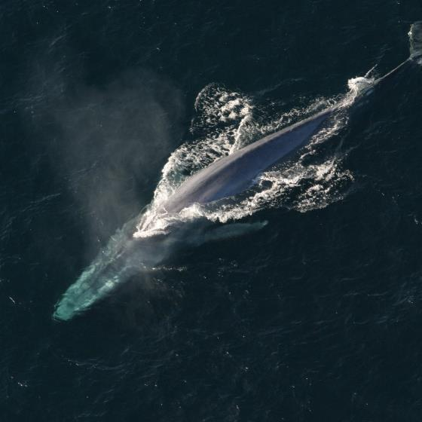

Blue Whale
Blue whales are the largest animal to have ever lived on Earth. They can weigh as much as 200 tonnes. For comparison, a double-decker bus only weighs 12 tonnes!
Blue whales mostly eat only krill. One adult can eat about 4 tonnes of krill per day!
Blue whales usually either live alone or in pairs.
They are one of the loudest animals on the planet. Their cries can be louder than a jet engine!
Did you know? A blue whale’s tongue can weigh as much as an elephant!
“Blue Whale” by [NOAA Photo Library] is licensed under CC BY 2.0

