Slide 2
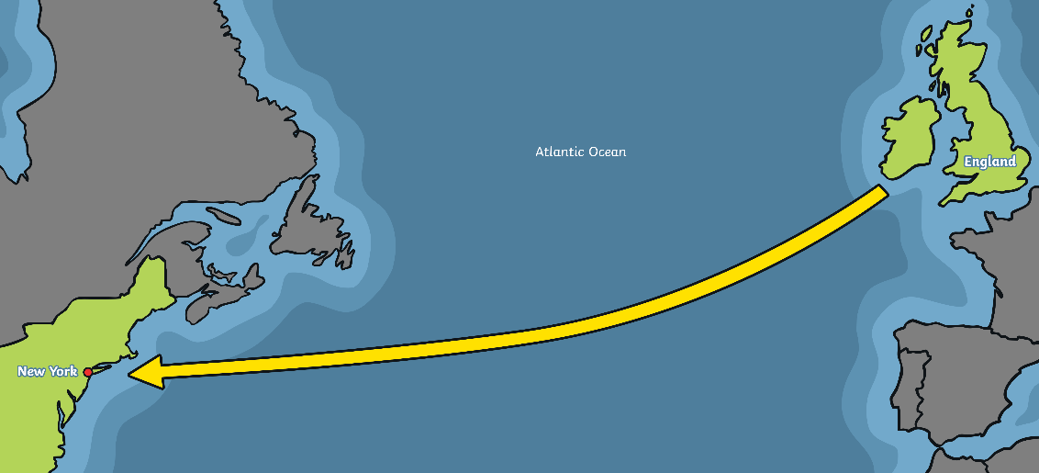
Travel in the Past
Today, if you want to travel from the United Kingdom to the USA, the easiest way to get there is on an aeroplane. It takes around eight hours.
In the days before aeroplanes, people had to travel from the UK to the USA on ships. It would have taken around seven days, so people had rooms they slept in called cabins.
Because the journey took so long, the ships had lots of things to do; there were restaurants, hairdressers, libraries and sometimes even a swimming pool!

Slide 3
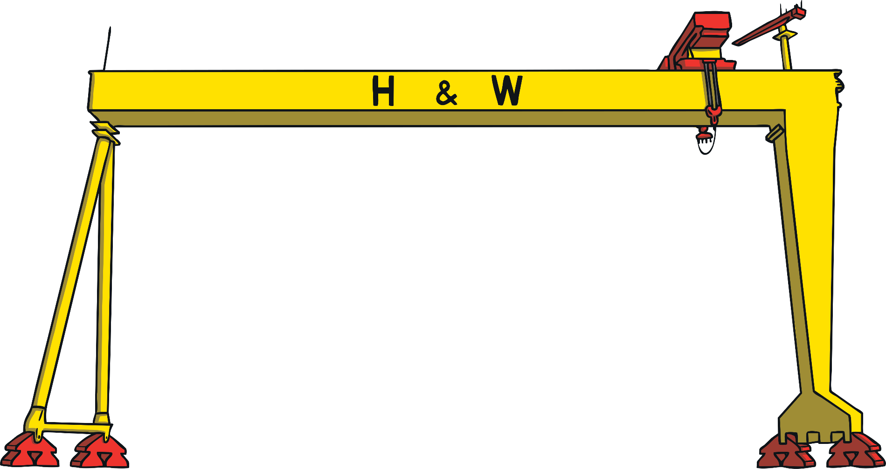
The Titanic
The Titanic was the largest ship ever built, and it took three years to make. It was built at the Harland and Wolff shipyard in Belfast in Northern Ireland.
The Titanic was as long as three football pitches and as high as a building with 17 storeys.
It cost hundreds of millions of pounds to build.
People said the Titanic was so amazing it would never sink.

Slide 4
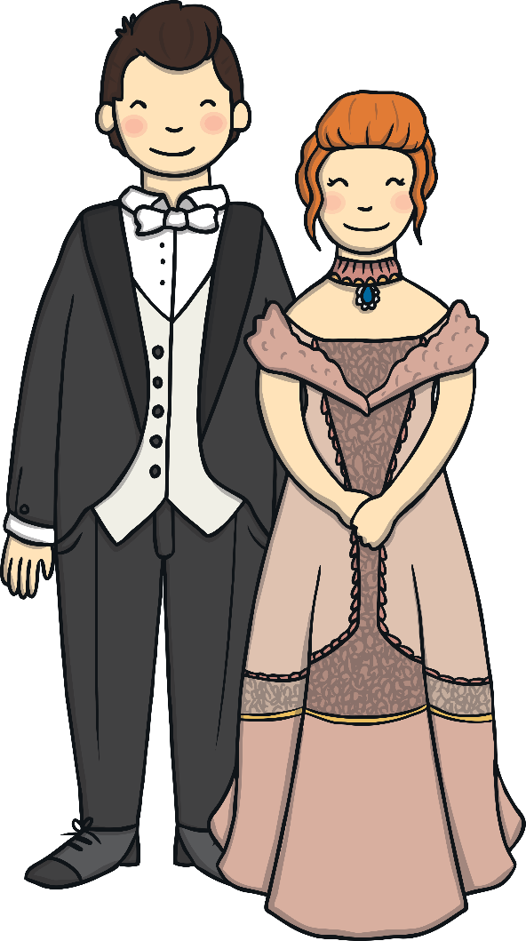
1st, 2nd or 3rd?
Not all cabins on the Titanic were the same. People with lots of money travelled first class. This meant their rooms were very posh. Sometimes, meals in the first class restaurants had ten different parts!
Second class passengers had a library and their own walking areas on the ship called promenades. The cabins were quite nice.
People who travelled in third class usually didn’t have much money. The cabins were near the ship’s engines so could be noisy. There were only two baths between 700 people! Third class passengers weren’t allowed to go in the first or second class areas.

Slide 5
Iceberg
An iceberg is a really big piece of ice floating in the sea. Icebergs can be bigger than houses. Most of an iceberg can’t be seen because it is under water.
On the Titanic’s first journey, the weather was really cold. There were icebergs in the sea.
One night, the ship hit an iceberg. It made a very big hole. The Titanic began to fill with water.

Slide 6
The Titanic Starts to Sink
As the Titanic started to sink, people began to get into lifeboats. Lifeboats are little boats put onboard a ship. If the ship gets into problems, passengers can get into lifeboats and sail away.
The problem was, there weren’t enough lifeboats for everyone on board the Titanic.

Slide 7
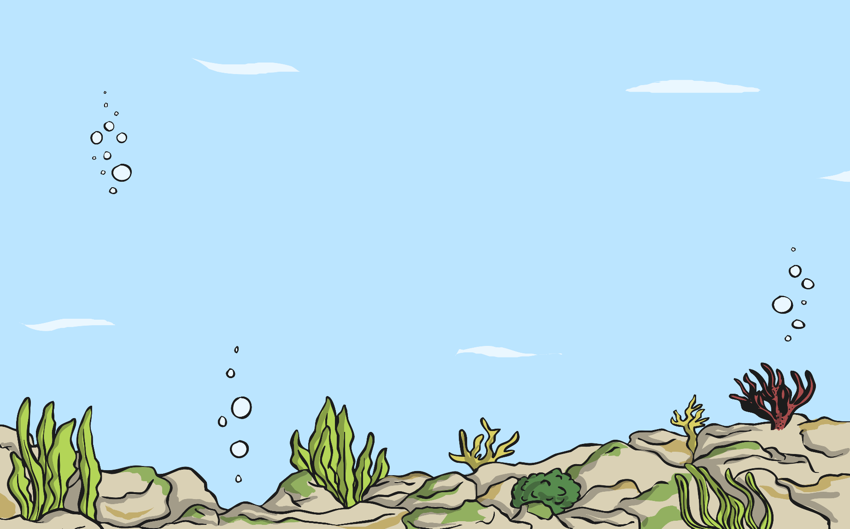
The Ship Goes Down
A few hours after the Titanic hit the iceberg, it sank to the bottom of the sea.
The people in the lifeboats waited in the freezing cold to be rescued.
The passengers were taken to New York in the USA. The crew (the people who worked on the ship) were taken to Plymouth in the UK.

Slide 8
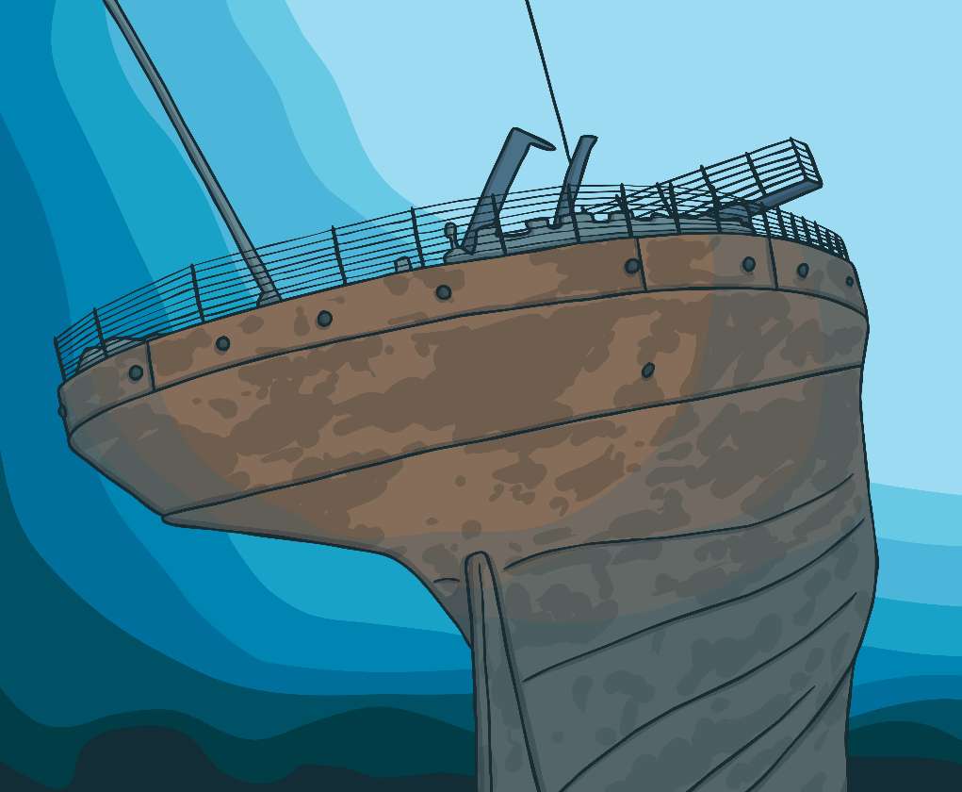
The Titanic is Found
For many years, people didn’t know where the Titanic had sunk. People went deep sea diving to try to find the ship.
Then a man called Robert Ballard found the Titanic. He discovered that the ship had broken into two pieces.
Today, people can go on special trips down to see the wreck of the Titanic.

