Slide 2
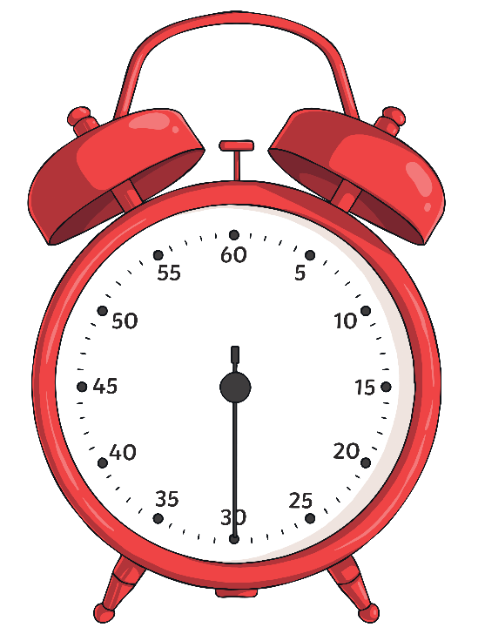
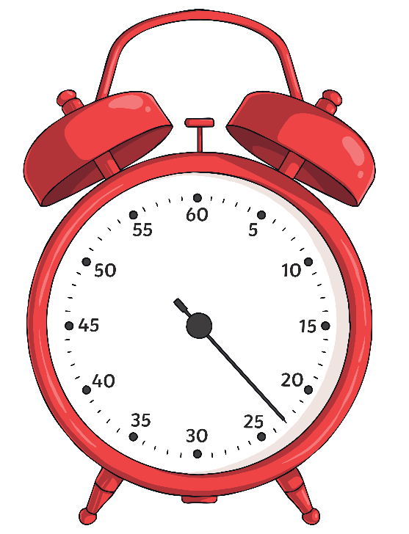
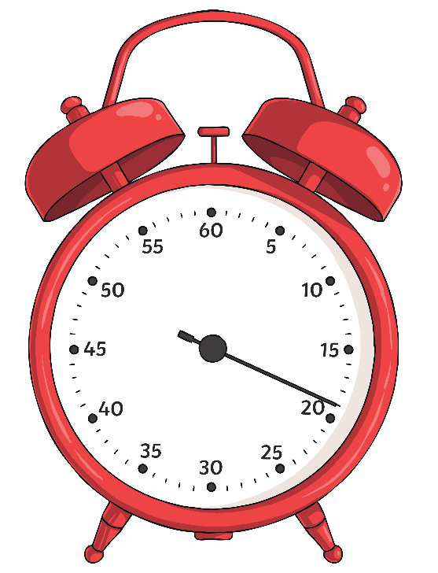
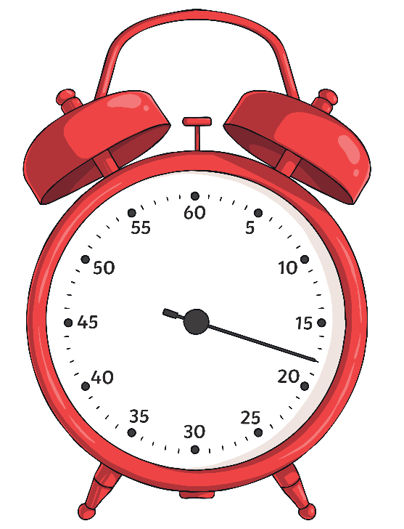
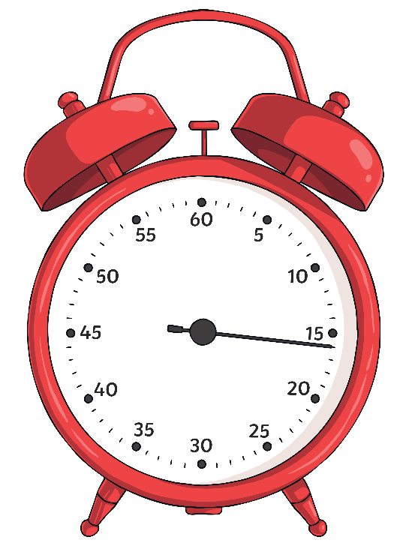
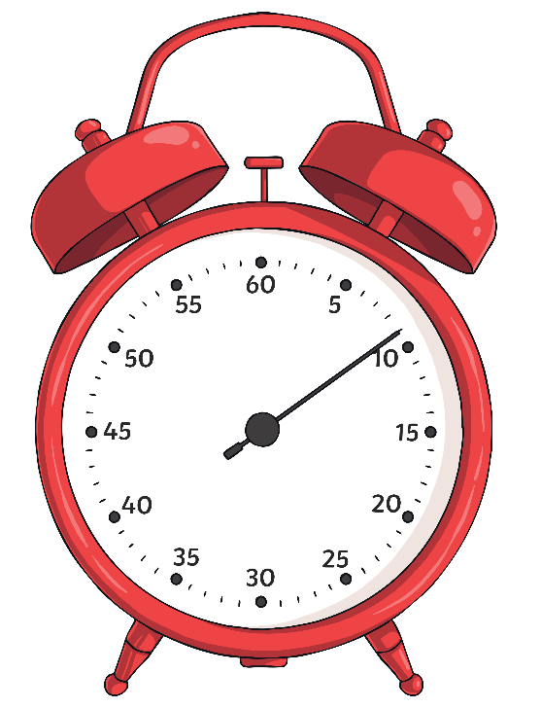
What Can You Remember?
You may have learnt about the Great Fire of London in Key Stage One. In 30 seconds, write as many things as you can remember about the Great Fire of London on a mini-whiteboard. Get ready to share your ideas with the class.
Start
Clock
Time’s Up!

Slide 3
When Did It Happen?
1642 – 1651
The English Civil War
1714 – 1830
The Georgian Era
1914 – 1918
First World War
Present
Day
1700
1900
1600
1800
2000
1666
The Great Fire of London
1837 – 1901
The Victorian Era
1939 – 1945
Second World War

Slide 4
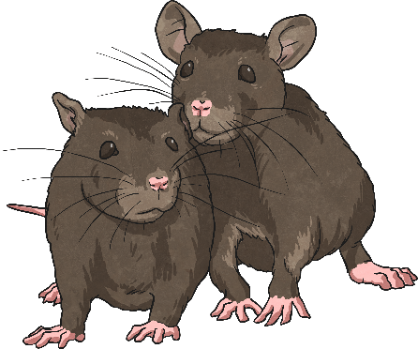
London Leading up to the Fire
Click on the pictures to discover more about London before the Great Fire.
Since 1644, a terrible disease called the Great Plague had spread throughout Europe. At the time, it wasn’t known how the disease was spread although we now know it was bacteria from fleas on rats that caused it. 1665 was the worst year of the plague in London and 15% of the city’s population died.
In 1666, England was at war with the Netherlands. This was called ‘The Second Anglo-Dutch War’ because it was the second time the two countries had been at war. England was also at war with France in one of the many wars called ‘The Anglo-French War’. Both wars were about controlling sea trade routes. Fighting two wars was dangerous and expensive for England.
In 1659, a man called Daniel Baker warned that London was at risk of a destructive fire. He reasoned that most houses were made of wood and roofs were often thatched. Houses were built extremely close together. If there was a hot summer, a fire could spread rapidly. The summer of 1666 had been long and hot and the water level of the River Thames was exceptionally low.
Charles II was the King of England at this time. He followed the Protestant version of Christianity, which angered Catholics in England and Catholic countries in Europe. The monarchy was still unstable at this point; Charles II’s father, Charles I, had been beheaded and the country was a Republic (a country with no monarch) for eleven years.

Slide 5
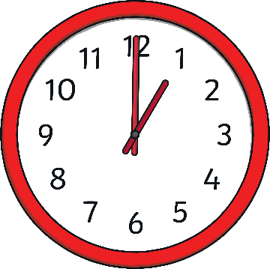
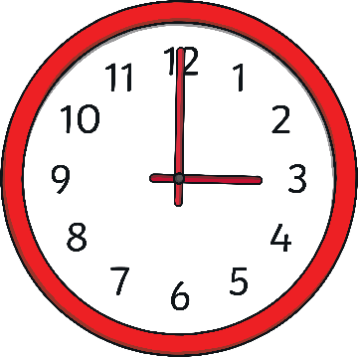
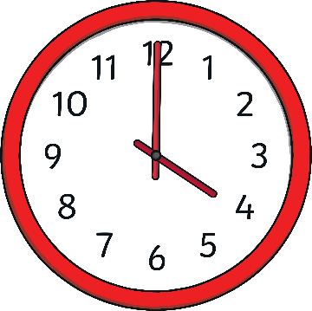
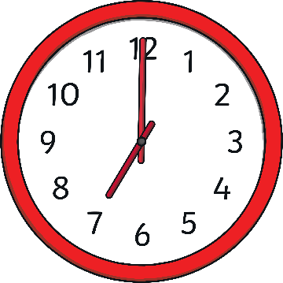
2nd September
Click on the clock to learn about the spread of the fire on the morning of the first day.
a.m.
a.m.
a..
a.m.
a.m.
a.m.
a.m.
The fire had spread for several miles. Samuel Pepys (more about him later!) was woken and told about the fire.
Thomas Farriner, the King’s baker, had a bakery on Pudding Lane. Although he always insisted that his ovens had been extinguished the previous evening, by 1 a.m. his house was ablaze. The Farriner family managed to escape, but their maid was killed.
Thomas Bloodworth, the Mayor of London, was woken and told of the spreading fire. He took no action.
By this point, 300 houses had been destroyed. People started to flee the city.

Slide 6
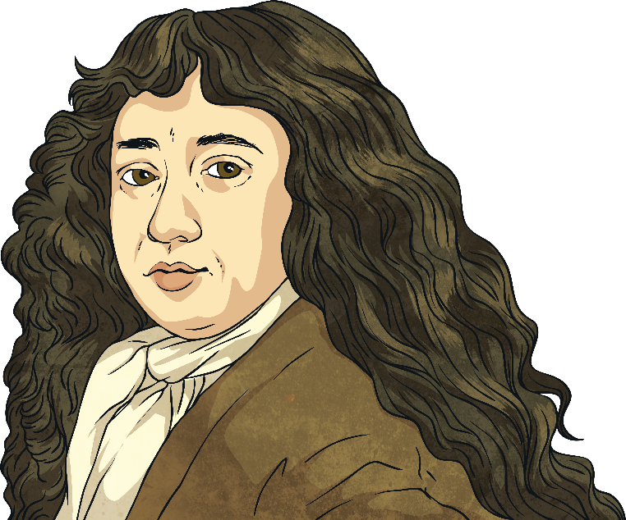
How Do We Know?
Samuel Pepys (1633 – 1703) was a famous diarist and essay writer. Much of what we know about the period comes from Pepys’ diary which he kept from 1660 to 1669. He recorded the spread of the fire, people’s reactions to it and his role in events. On the morning of 2nd September, Pepys went to Whitehall Palace where he met Charles II and his brother the Duke of York:
‘So I was called for, and did tell the King and Duke of Yorke what I saw, and that unless his Majesty did command houses to be pulled down nothing could stop the fire. They seemed much troubled, and the King commanded me to go to my Lord Mayor from him, and command him to spare no houses, but to pull down before the fire every way.’
Did You Know?
Pepys wrote his diary in a special code called shorthand. This is because at the time he didn’t want anyone to read the diary, not even his wife Elizabeth!
Did You Know?
Pepys is pronounced ‘Peeps’.

Slide 7
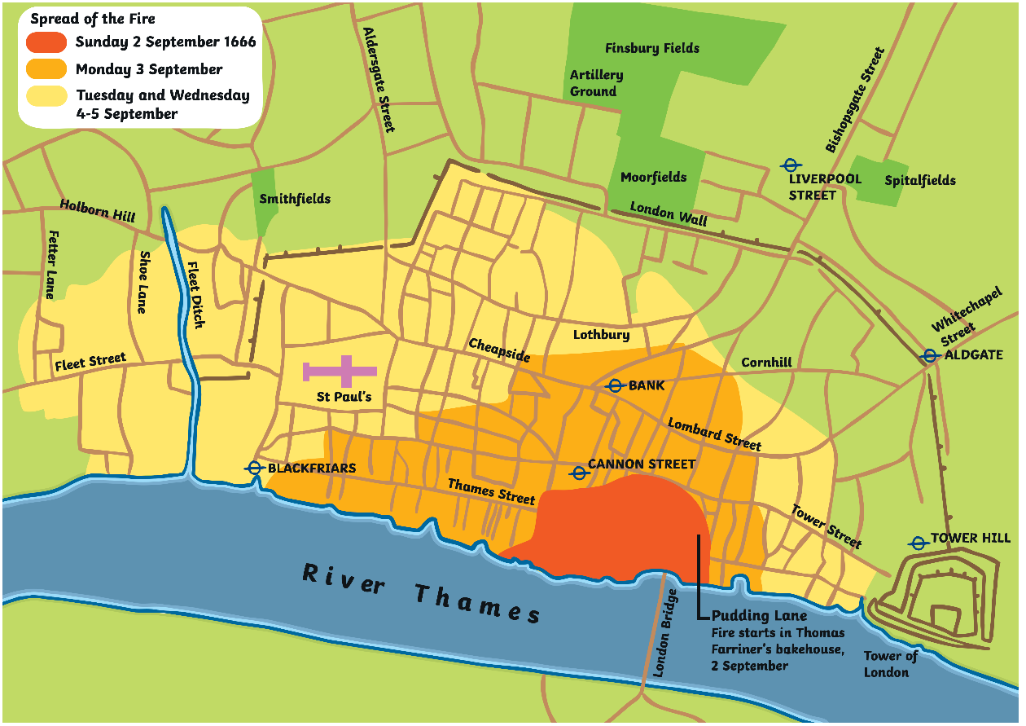
What Happened Next?
The fire continued to spread for another four days.

Slide 8
What Happened Next?
London had no dedicated fire brigade. On 3rd September, the Duke of York took control of organising the fire fight. Fire posts were set up and soldiers and civilians all joined in. Buildings were pulled down and water was thrown using leather buckets and water squirters. Despite their efforts, the fire continued to spread.
Those who could, fled the city, taking as many possessions with them as possible. Worried about looters, people hid possessions they could not take with them, sometimes digging holes and burying things. ‘I did dig another, and put our wine in it; and I my Parmesan cheese, as well as my wine and some other things.’ (Samuel Pepys’ diary, 4th September).
By 4th September, gunpowder was being used to blow up buildings, which made creating fire breaks quicker.
13,200 houses were lost, 87 churches were destroyed and several important buildings, including the Royal Exchange and St Paul’s Cathedral, were burned down.
Did You Know?
The Great Fire of London happened in 1666. Traditionally, Christians believed that 666 was the number of the devil.
The fire was officially declared over at 8 a.m. on 6th September.

Slide 9
The Death Toll
Initially, it was asserted that fewer than ten people died, including the maid in Thomas Farriner’s house. However, historians now believe that many of London’s poor could have died in the fire. At the time, records were only kept of the wealthy and important, and it isn’t known how many homeless people lived in London at the time.
Did You Know?
Because of the wars England was fighting at the time, rumours went around that the fire was started by a French or Dutch person. A French watchmaker named Robert Hubert confessed to starting the fire in Pudding Lane and was hanged. It later became clear Hubert hadn’t started the fire.
Did You Know?
It is believed that the fire ended the Great Plague by killing the rats which carried the disease.

Slide 10
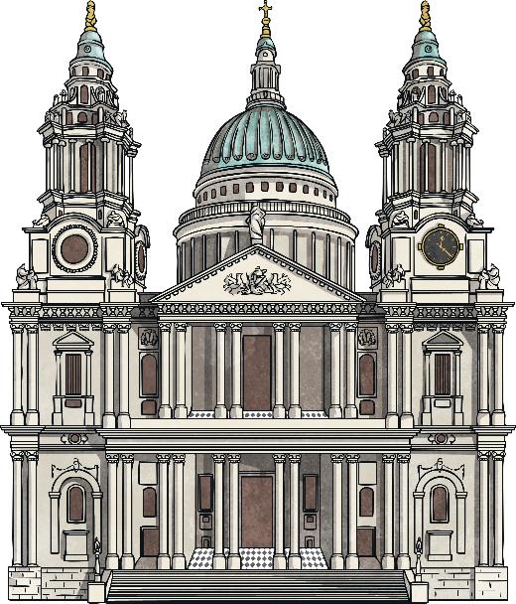
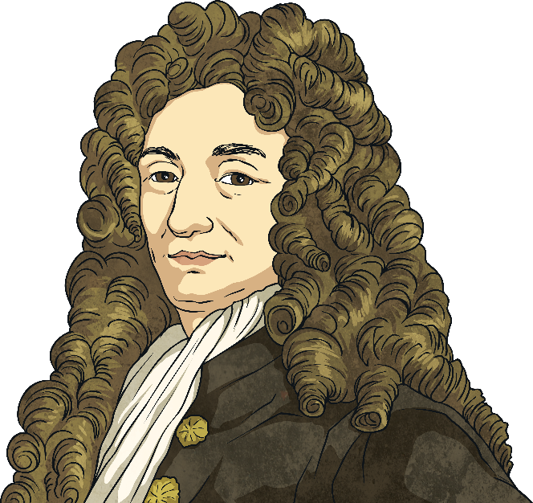
London Is Rebuilt
London was in ruins, with around 65 000 people now homeless. A huge rebuilding project was eventually started. To ensure the city couldn’t be destroyed by fire again, a law called the 1667 Rebuilding Act was passed.
This law stated that:
the upper floors of buildings could no long overhang the lower levels;
buildings had to be made of brick or stone;
water had to be easily accessed from lots of areas in case there was another fire.
The architect, Sir Christopher Wren, designed much of the city, including the new St Paul’s Cathedral.

Slide 11
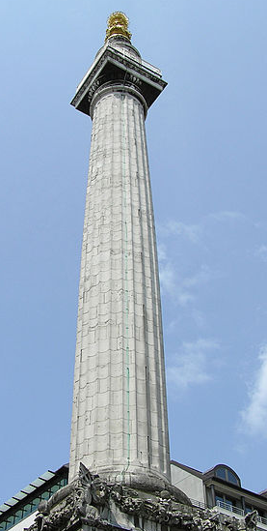
London Is Rebuilt
This is the Monument in London. It was built between 1671 and 1677 to celebrate the rebuilding of London.
The Monument is 61 metres high and is exactly 61 metres away from Pudding Lane.
Tourists can climb to the top of the Monument and enjoy views across London.

