Slide 1
Las fallas
De valencia

Slide 2
HISTORY
San José (Saint Joseph), the patron saint of carpenters, is the official focus for the festival. It all started back in the Middle Ages when carpenters used to hang up planks of wood called ‘parots’ in the winter to support their candles when they were working. At the onset of spring these pieces of wood would be burned as a way of celebrating the end of dark, winter working days.

Slide 3
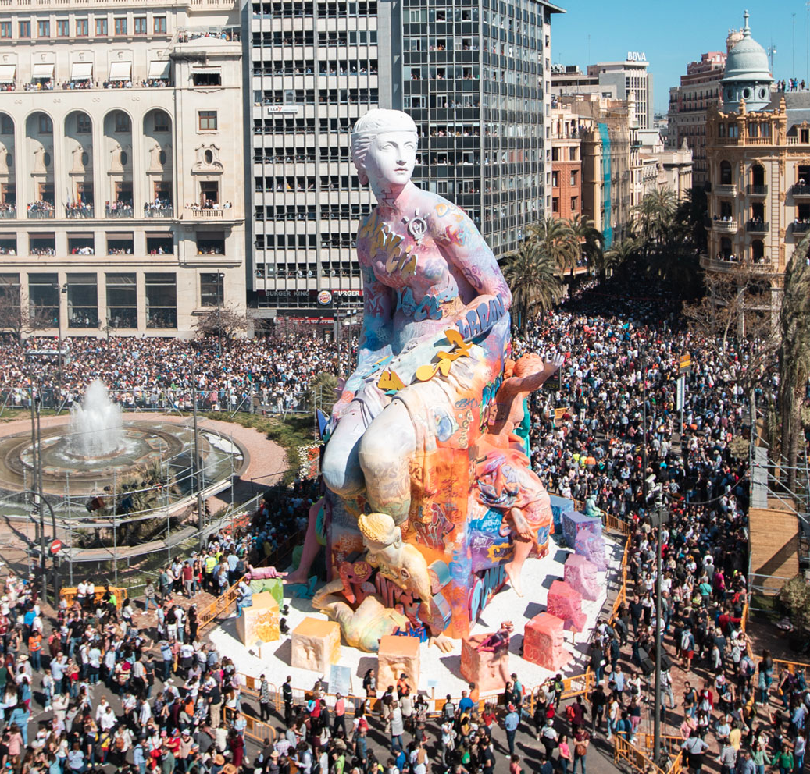
LAS FALLAS TODAY
Today, fallas are models made of wire, paper and cardboard that form true works of art. They can reach 20 meters tall.
They usually have a central figure which is surrounded by smaller figures that are called ‘ninots’.

Slide 4
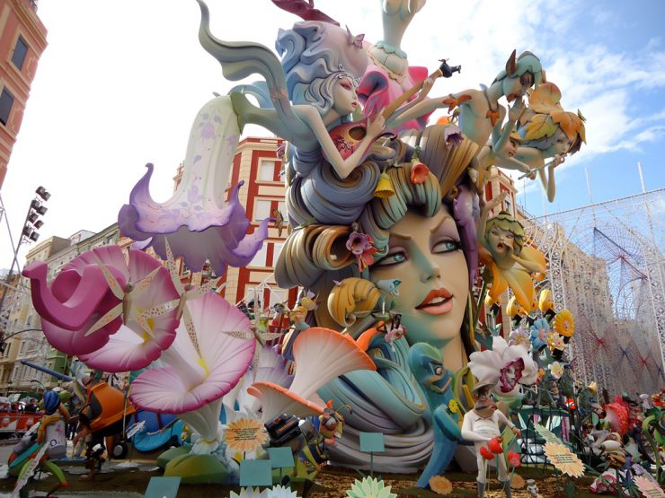
Falla is the name given to each one of the gigantic, sculpted structures of cardboard, wood and sometimes cork, which humorously portray events and personalities.

Slide 5
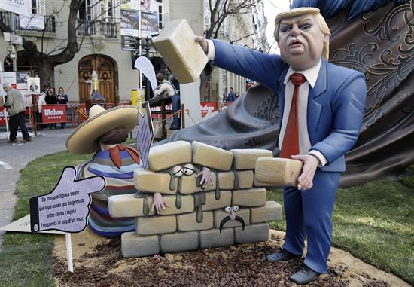
The ninots (nih-nots) are the individual figures that make up the scenes in the Fallas monuments.
The best one is saved and goes to a museum.

Slide 6
THE CONTEST
All of the fallas enter a contest and those that do not win are burnt on the
night of the 19th of March.
This is what is called
‘cremá’.
The fallas that win the
prizes are pardoned and
not burnt.
Watch up to minute 2:00

Slide 7
Symbolically, the “Falleros” throw everything that is considered to be superfluous, harmful or simply unusable onto the bonfire and, by doing so, aim to make a new start and regenerate the spirit. This objective has always been the basis of this kind of pagan rite, since ancient times.

Slide 8
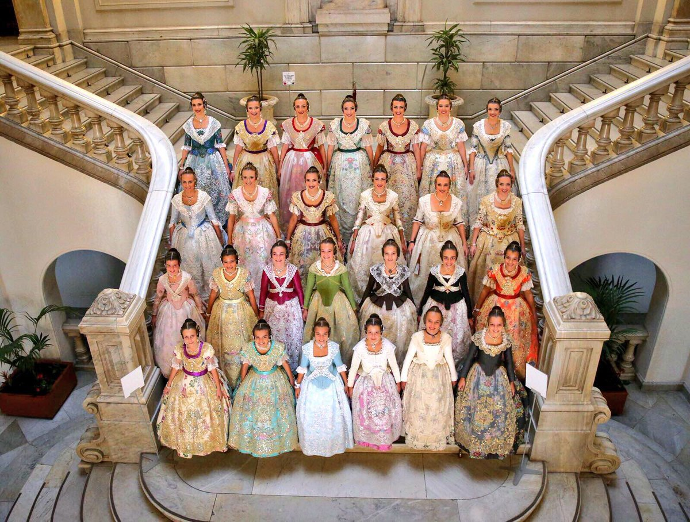
FALLERAS MAYORES DE VALENCIA
The two “Falleras Mayores de Valencia” (one adult and one child) are the queens of the fiesta, the official representatives of the entire Fallas organisation. The child selected bears the title of “Fallera Mayor Infantil de Valencia”.
These titles have reached a considerable
level of importance and they frequently
appear at the city’s most significant
events throughout the year.

Slide 9
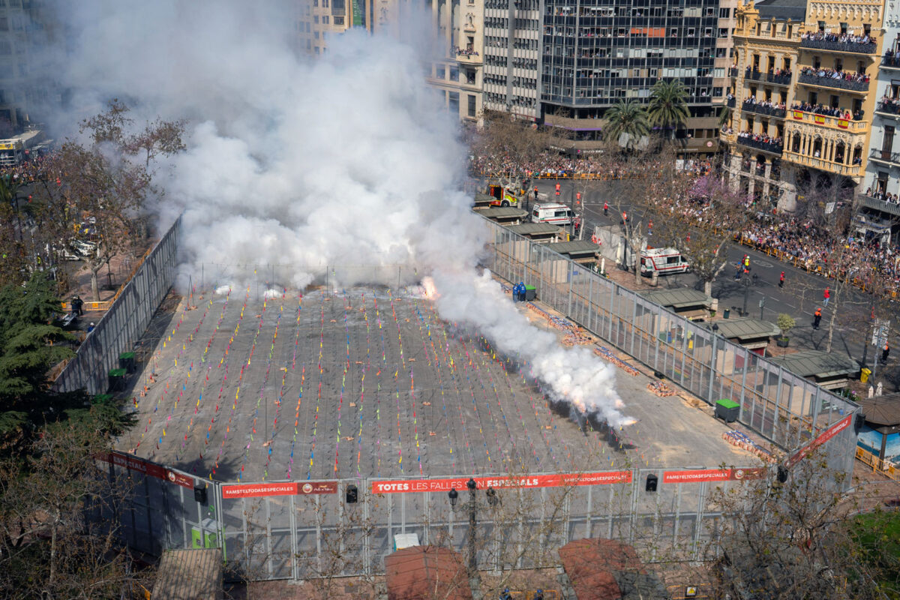
LA MASCLETA
The mascletà is the huge firecracker display which takes place at 2pm every day during the festival.
Press play and listen to the audio of one of the mascletàs.
PLAY
Video of one mascletà
(only for specific audience
Play from minute 2:00)
Link to video

Slide 10
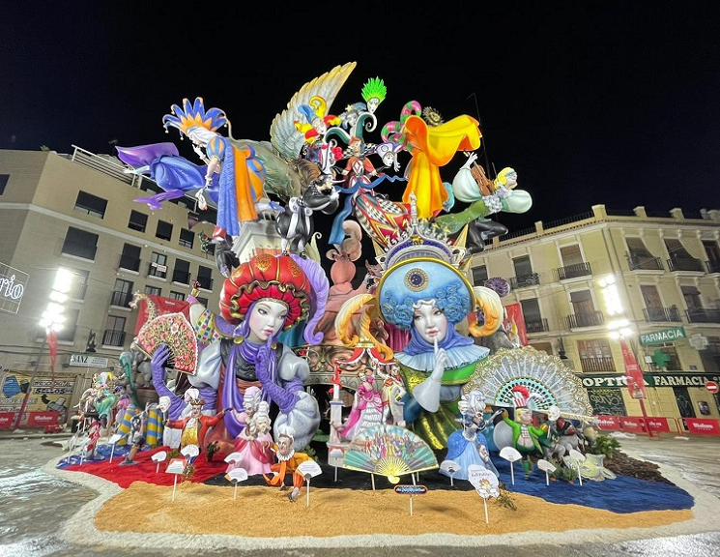
This is the falla that won in 2021.
What do you think?

Slide 11
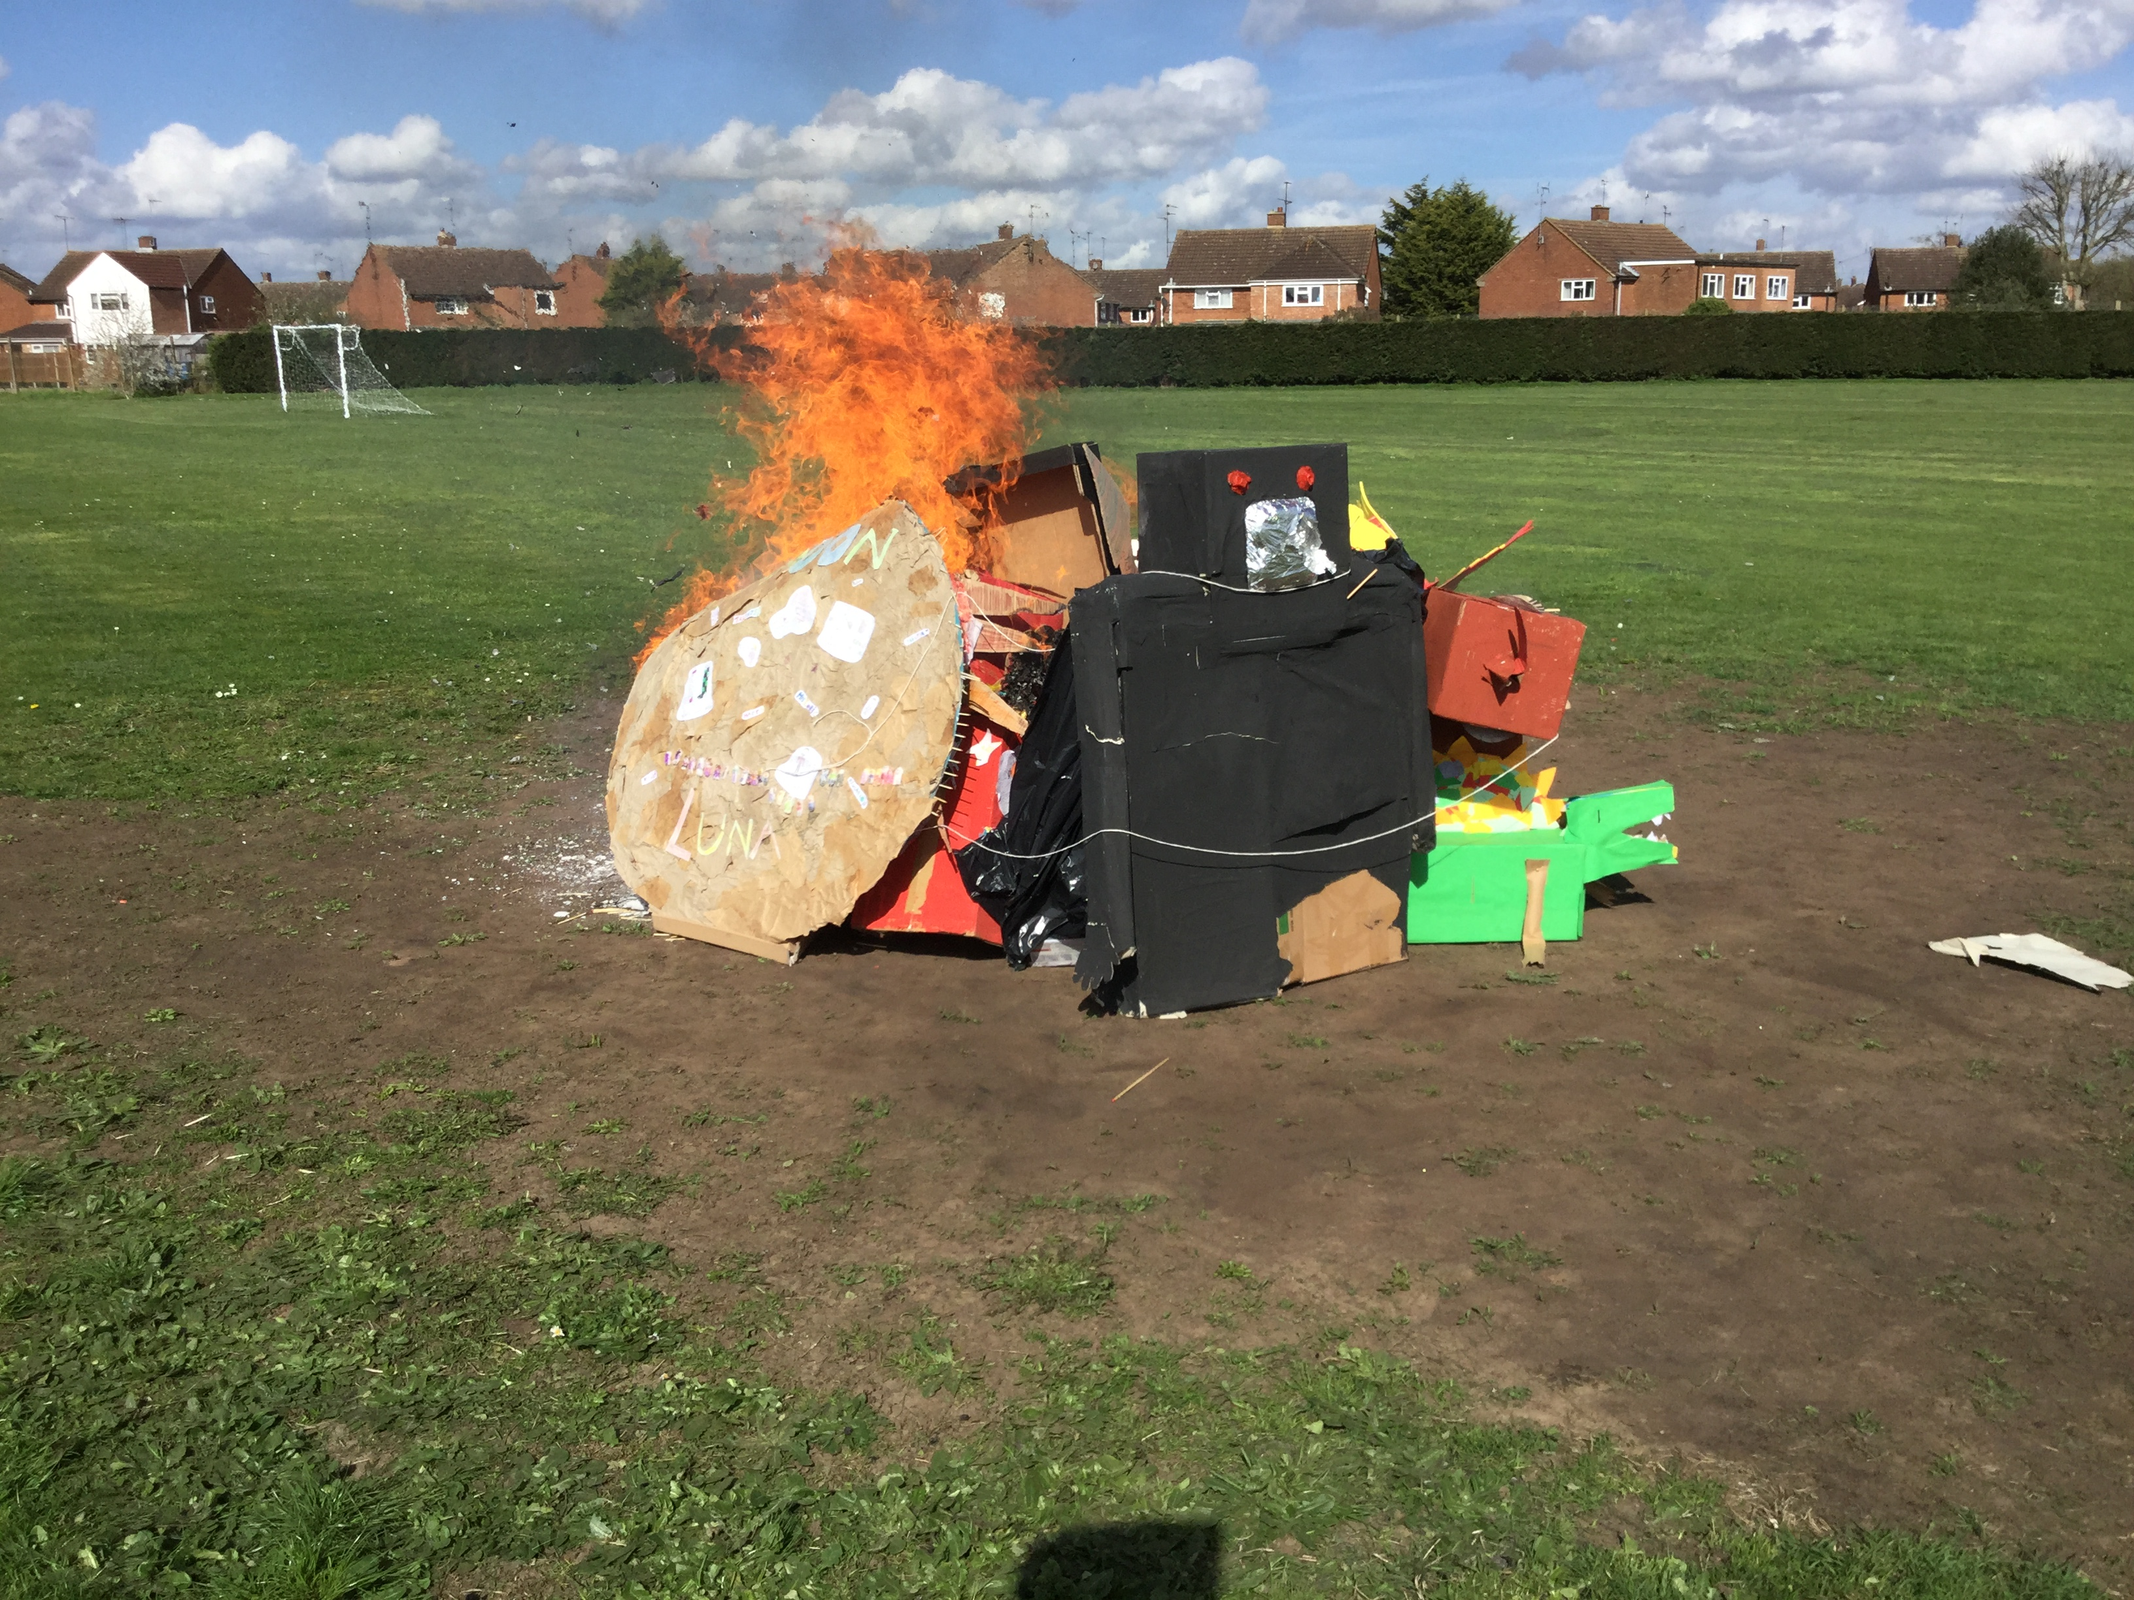
Enjoy Las fallas at Leedon!
March 2017

