Slide 1
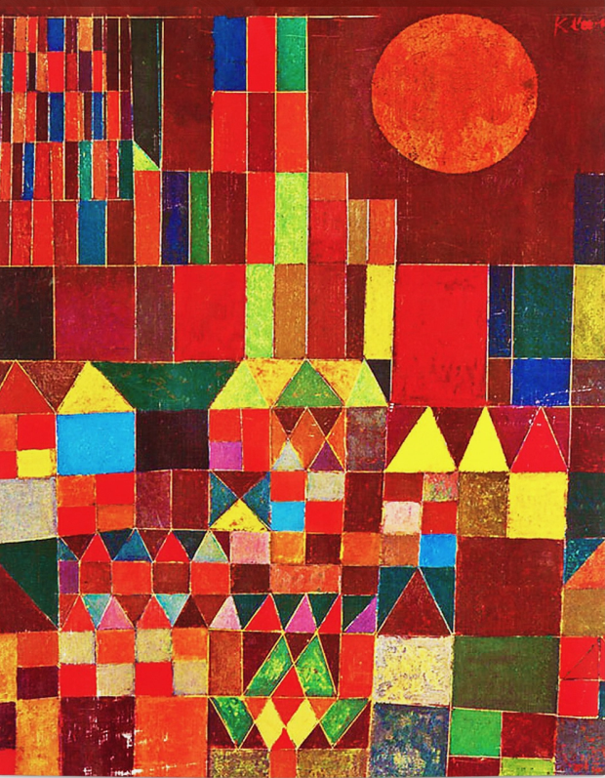
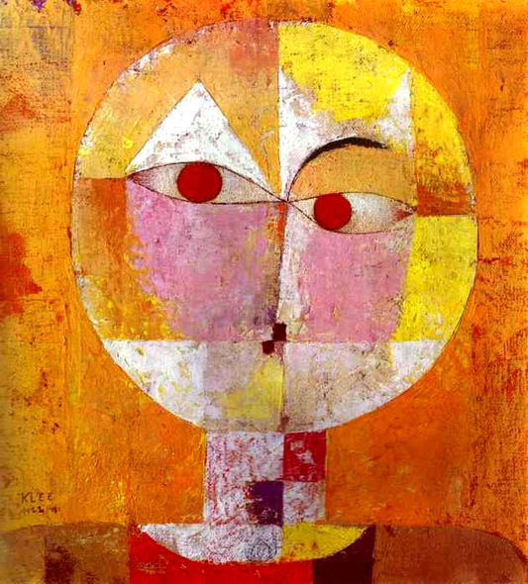
Paul Klee was a Swiss artist. His work is full of colour and shape. Have a look at some of his pictures with your child.
You can talk about shape, colour and texture.
What shapes can they see? How many sides and corners do these shapes have? Are the sides straight or curved? What objects has Paul Klee created using familiar shapes?
You could have a go at making a picture in this style in many different ways, for example:
Cutting up and collaging colourful used magazines or wrapping paper;
Using paints, crayons, felt tips or any media you like to completely cover a sheet of paper to cut into shapes and collage.
Enjoy talking about these art works – which ones do you like and why, and have fun creating your own work of art inspired by Paul Klee!

