Slide 1
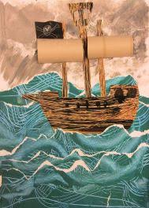
Your PIRATE challenge
Make a pirate ship picture with a variety of textures, using a range of materials of your choice.

Slide 2
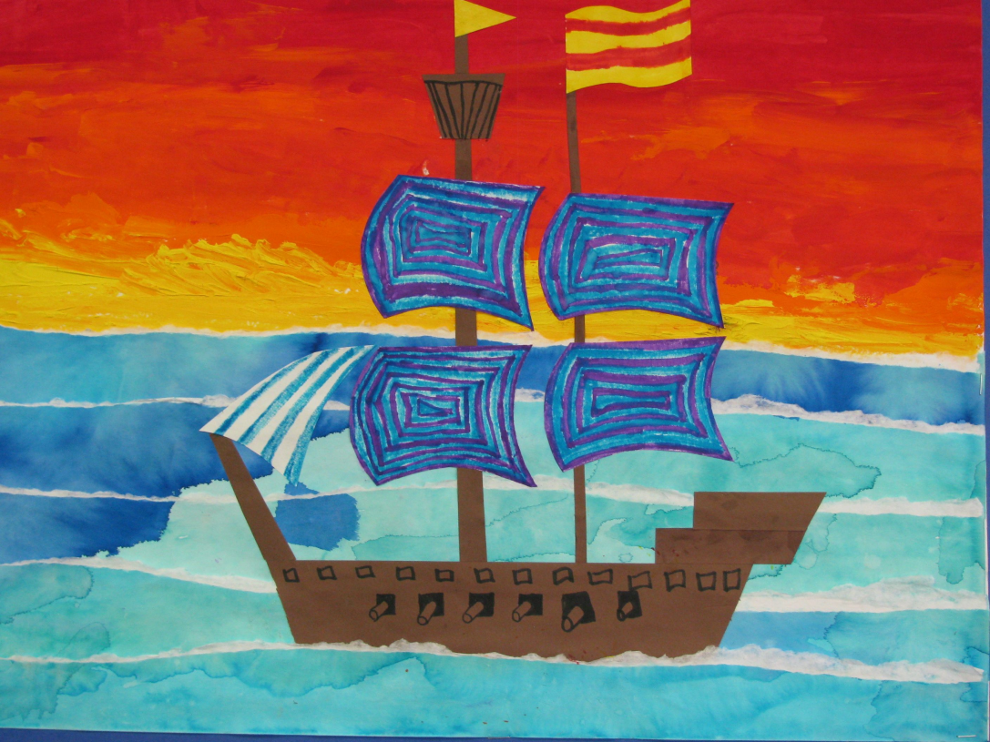
“Texture” is the feel of the materials you use.
You will be making a picture that is 3D, not flat.
That will make it lively and exciting!
Scraps of torn or cut-up paper, card, or magazines are all useful, and so are scraps of fabric.
Cutting and sticking to make art it called collage.

Slide 3
You will need to create your background first
Fill your sheet of paper with the sea and sky, like in these pictures.
If you are using paint, you can make waves by finding something like a skewer to create patterns while the paint is wet

Slide 4
Look at this stormy scene
How do you think the sky was made?
Perhaps it was printed using paint on a sponge
What about the sea?
Can you see the white, foamy tips of the waves? How could you get this effect?

Slide 5
While the background is drying…
Get your materials ready for making the galleon.
You can use whatever you like – just make sure that your picture has texture, instead of just being flat… it should be 3D not 2D!
Decorate scraps as you like – paint, crayon, felt-tips, or anything else you have.

Slide 6
Final tips
Arrange your ship on the background BEFORE sticking all the pieces in place.
Don’t forget to give your ship a flag!
Have fun, share your art on Seesaw, and make your messy deck ship-shape afterwards!

